Slide 1
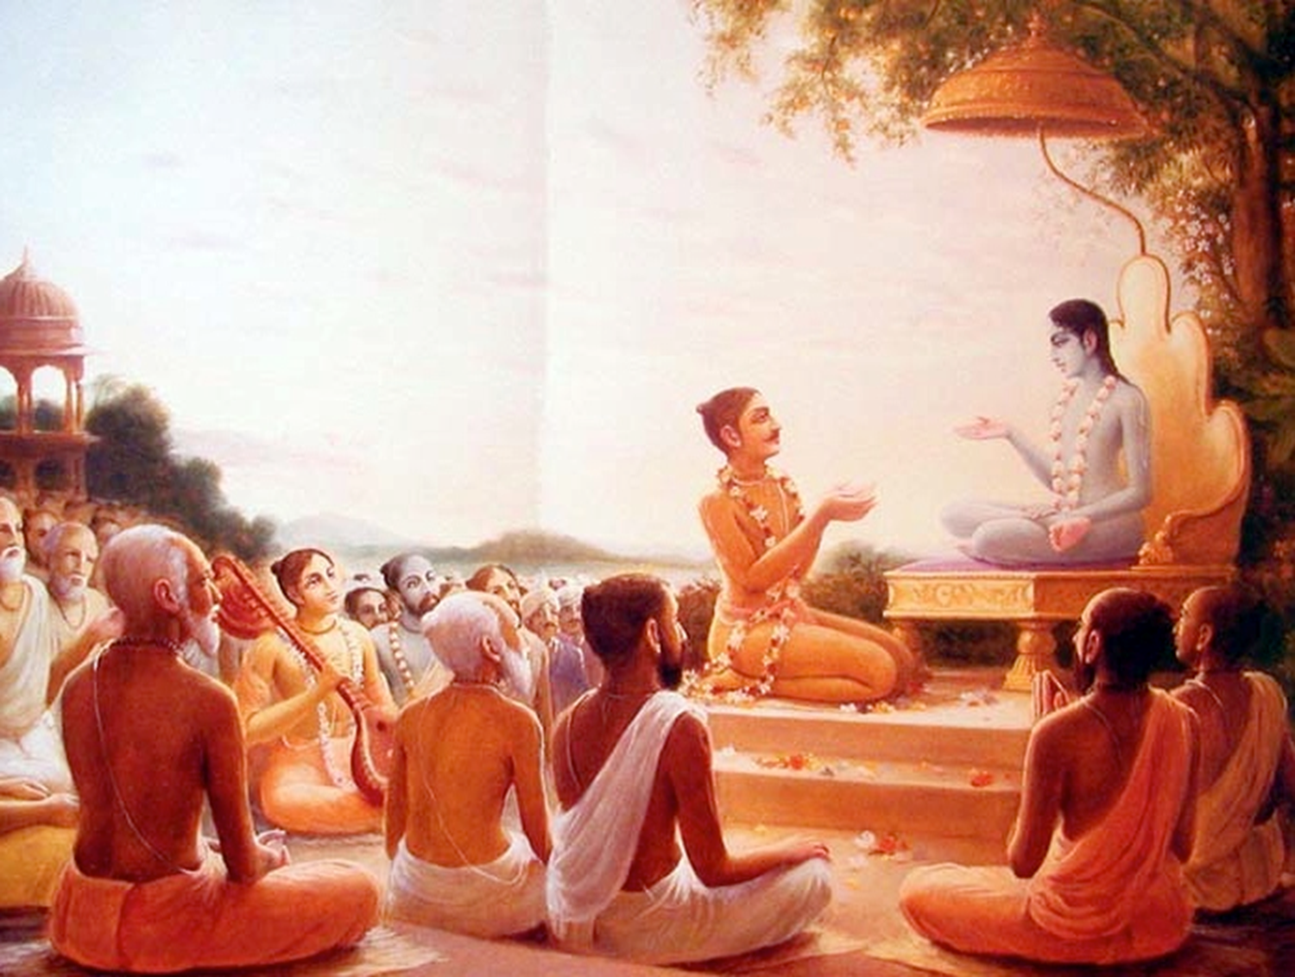

Srimad Bhagavatam: Canto 2
By Madan Sundar Das
Thanks to Bhakti Vedanta Vidyapitha – Wada for the PPT’s

Slide 2

Theme 1: Aim for Highest Bliss
SB 2.1.1 - 2.1.11

Slide 3

Parikshit’s question at the end of Canto 1
What is the ultimate duty of every person?
… especially one who is about to die?
What he should hear, chant & remember?
& what he should not do? (1.19.24, 38).

Slide 4

Wonderful Question !!!
[1] çré-çuka uväca
varéyän eña te praçnaù
kåto loka-hitaà nåpa
ätmavit-sammataù puàsäà
çrotavyädiñu yaù paraù

Slide 5

What should not be
chanted, heard & remembered?
[2] çrotavyädéni räjendra nåëäà santi sahasraçaù
apaçyatäm ätma-tattvaà gåheñu gåha-medhinäm
Grhamedhi has many things to chant, hear & remember.

Slide 6

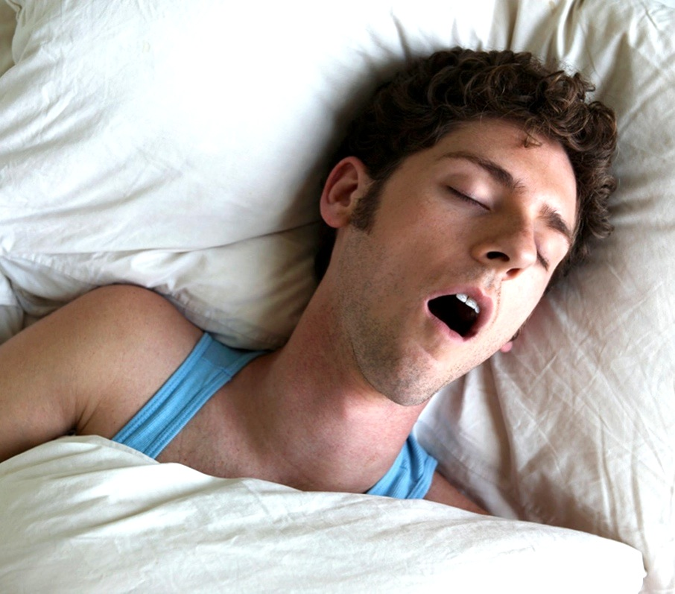
Grihamedhi’s life
[3] nidrayä hriyate naktaà vyaväyena ca vä vayaù
divä cärthehayä räjan kuöumba-bharaëena vä
Day – Wasted in working hard
Night – spent in sex & sleep

Slide 7


Grihamedhi’s life
[4] dehäpatya-kalaträdiñv ätma-sainyeñv asatsv api
teñäà pramatto nidhanaà paçyann api na paçyati
Great Faith in fallible soldiers
Doesn’t see his end coming
Notes:
Next -> So what should be done?

Slide 8
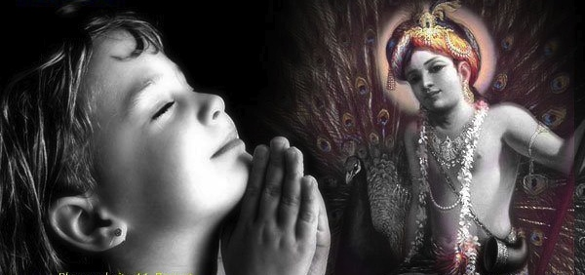
What should be chanted, heard & remembered?
Therefore...
[5] tasmäd bhärata sarvätmä bhagavän éçvaro hariù
çrotavyaù kértitavyaç ca smartavyaç cecchatäbhayam
Chant, Hear & Remember the Lord

Slide 9
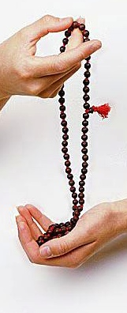
Bhakti is the BEST
[6] Even jnanis, karmis & yogis can achieve perfection
Any proof?
[7] Many self–realized sages have taken pleasure in Hari-Katha.
Any specific example?
[10] Phala-Sruti: Hearing Bhagavatam develops unflinching faith towards SPG.
[11] Harinama Kirtan is the topmost anga of the Bhakti.
[8-9] Myself
Although Brahman realized, Lord’s pastimes attracted my heart.
etan nirvidyamananam…
Harer namanukirtanam

Slide 10
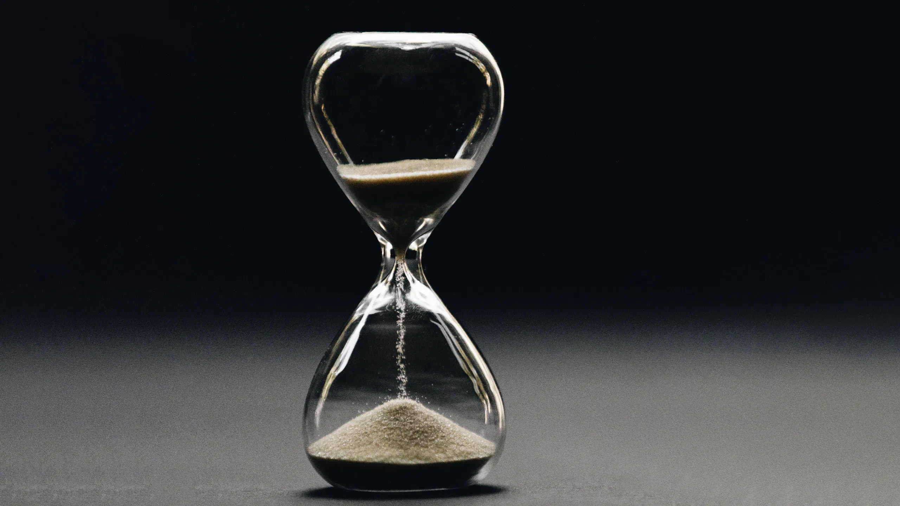

Theme 2: Quality of life matters
SB 2.1.12 - 2.1.15

Slide 11
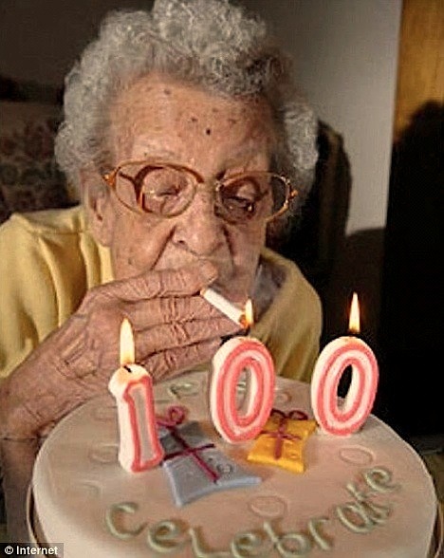
Quality of Life matters not quantity
[12] Why need a long life if not used properly?
[13] Khatvanga had just 1 muhurta, You have 7 days
So, Prepare for next life!
Notes:
How to prepare as there are different process?
Karma kanda, Asthanga yoga

Slide 12
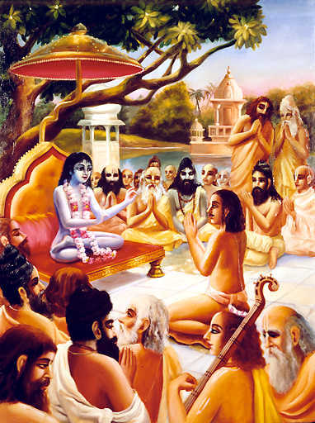

Another popular opinion : Bhakti Misra Jnana
Many sages in the assembly held this opinion of Bhakti misra Jnana. So Sukadeva Goswami described Astanga yoga process
Coming up ---> Summary of Astanga yoga process described in 2.1 & 2.2…
Notes:
Virat Rupa?

Slide 13

Theme 3: Freedom from material miseries
SB 2.1.16 – 39
Notes:
Next -> desc of universal form

Slide 14

Astanga Yoga Process Summarized…
Yama
Niyama
Asana
Pranayama
Pratyahara
AttachedYogi
Vaisvanara loka
Sisumara loka
Mahar loka
Brahma loka
Changes from Earth, Watery, Fiery, Airy, Ethery
Pierces False ego
Pierces Mahat tattva
Pierces Pradhan
Dharana
Dharanasraya is VIRAT RUPA
YES
Desire
Detached Yogi
NO
YES
Desire
NO
Dharanasraya is PARAMATMA
KRAMA MUKTI
Shat chakra yoga uplifts the prana from Muladhara to Ajna chakra
Dhyana
Samadhi
Brahman Realization
LIBERATION

Slide 15
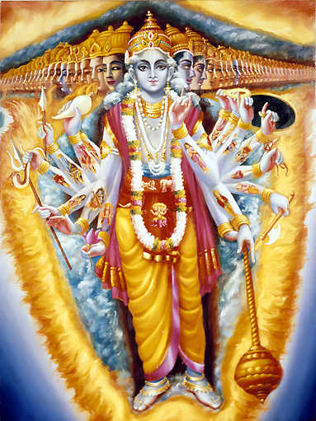
VIRAT RUPA: Dharanasraya of
Attached Yogi
Planetary systems as His limbs
Pätäla | Bottom of the feet
Rasätala | Heels and toes
Mahätala | Ankles
Talätala | Shanks
Sutala | Knees
Vitala | Lower part of thighs
Atala | Upper part of thighs
Mahétala (Earth) | Hips
Bhuvar (Outer space) | Navel
Svarga | Chest
Maharloka | Neck
Janaloka | Mouth/ Face
Tapoloka | Forehead
Satyaloka | Head
Notes:
Dharana – destroys contamination of mind from P & I

Slide 16
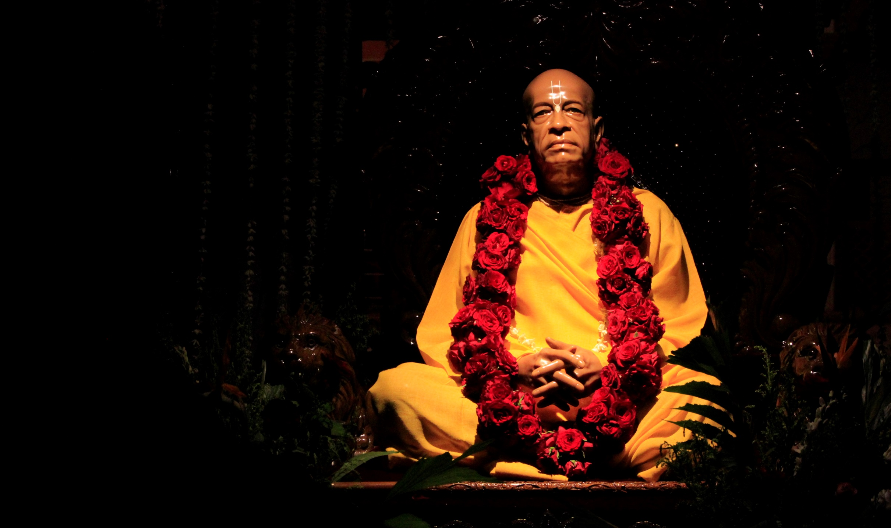


Thank you
Any Questions?
By Madan Sundar Das msdas@iskconpune.in
www.evolvepune.com

