Slide 1
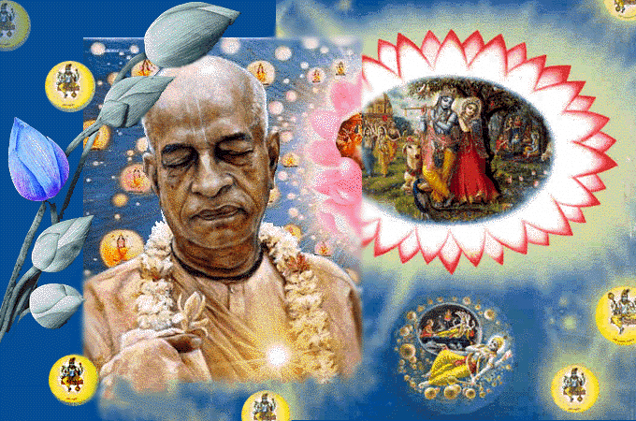
SRIMAD BHAGAVATAM, the Crest Jewel of All Puranas
By His Divine Grace A.C.Bhaktivedanta Swami Prabhupada, Founder Acarya of ISKCON
Bhagavata
Rasamaalayam
A 19-Session Presentation of First Canto of SB
by Radheshyam das, ISKCON, NVCC, Pune
www.live.radheshyamdas.com

Slide 2
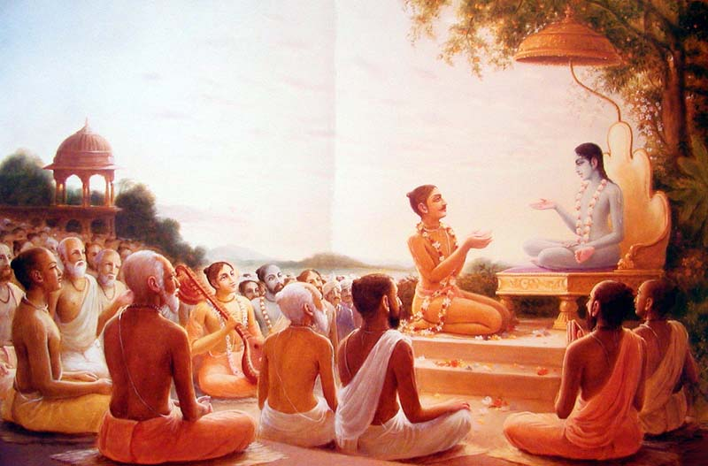
Bhagavata Rasamaalayam
A 19-Session Presentation of First Canto of SB
by Radheshyam das, ISKCON, NVCC, Pune
SB Canto 1 Chapter 6
Conversation between
Narada & Vyasadeva

Slide 3
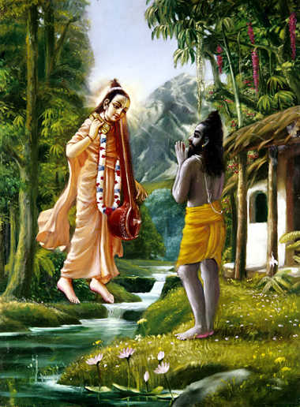
Canto 1, Chapter 5
Narada’s instructions
on SB to Vyasadeva

Slide 4

Revising Chapter 5 themes

Slide 5
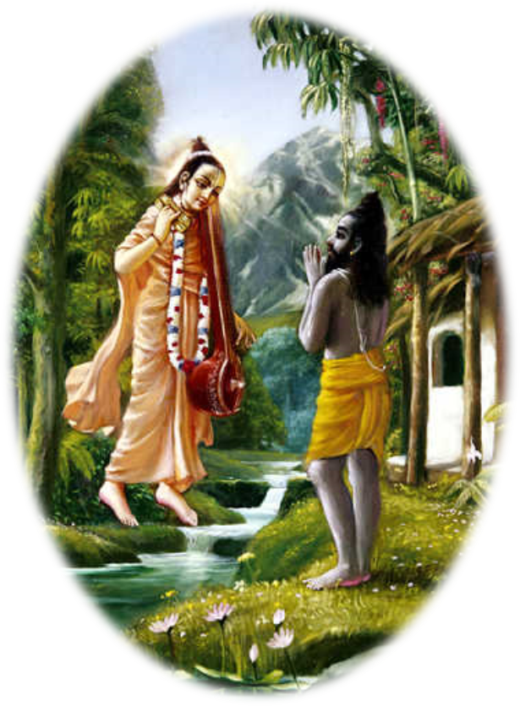
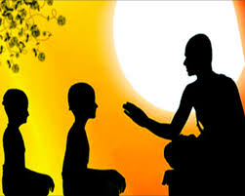
(1) Art of revealing heart & taking shelter
Guhyam akhyati prchchati – reveal mind & seek help
Lesson 1 :
All knowledge related with body or mind is the root cause of all despondencies (SB 1.5.5purport)
Lesson 2 : One cannot always detect the cause of his despondency, eventhough one may be the greatest
erudite scholar in materialistic knowledge.
(SB 1.5.5purport)

Slide 6
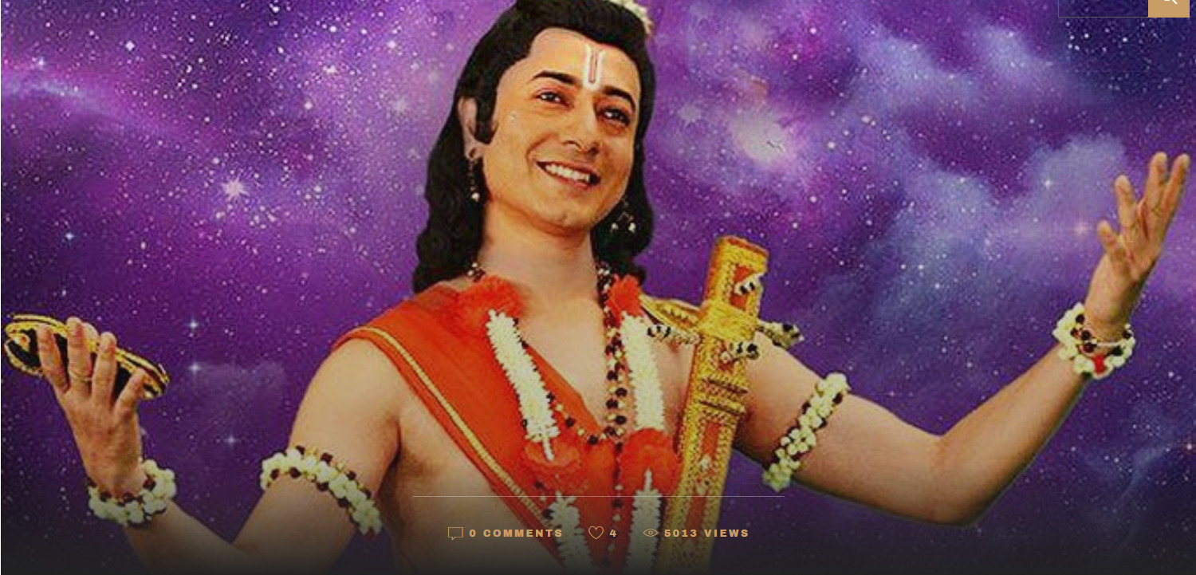
(2) Qualifications of Guru
Narada - `agaadha bodham’, `bhavan veda samasta guhyam’
Like SUN you travel everywhere;
Like AIR, you penetrate
internal region of everyone;
Like Supersoul,
you know about me.
Please find deficiency in me.

Slide 7
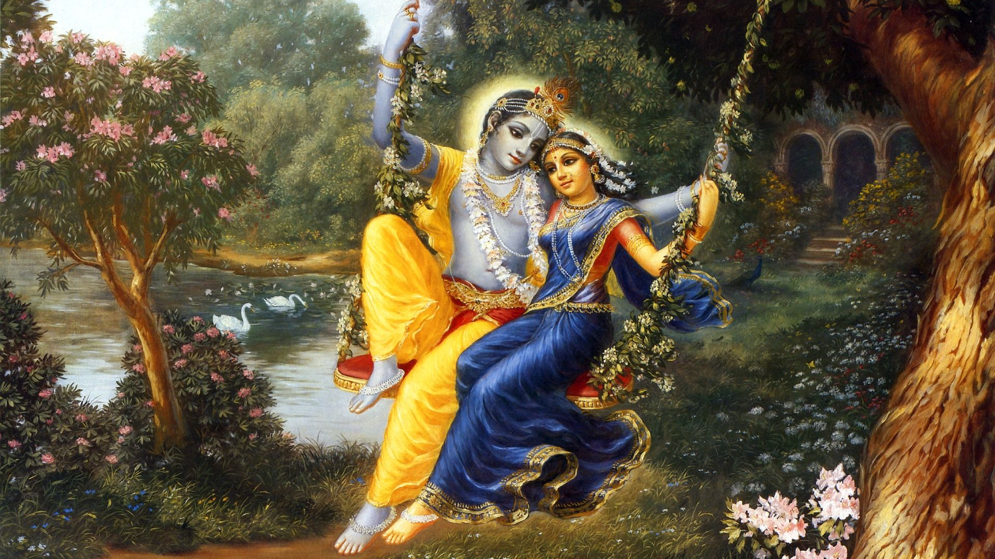
(3) Glorification of Supreme Lord –soul of spirituality
Not sufficiently described Lord’s spotless glories (SB 1.5.8)
to the extent you’ve described Purusharthas (SB 1.5.9)
Spotless glories of SPOG Vasudeva –Not repeatedly described (anuvarnitah), Not repeatedly glorified (anukirtitah)

Slide 8


(4) Dead and Live literature
(5) Liberal VS Conservative approach in preaching
(5) Liberal VS Conservative approach in preaching
1.5.15: Condemns the compromising spirit of Vyasadeva.
Intention - gradual elevation of conditioned souls.
Problem - People in general have strong attachment to sense gratification, and they consider these instructions as the complete religion.

Slide 9
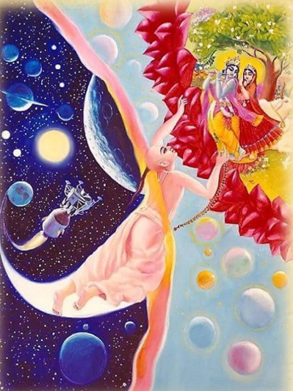

(6) Direct devotional service VS
step by step Vedic prescribed duties
BHAKTI
YOGA
JNANA
KARMA

Slide 10
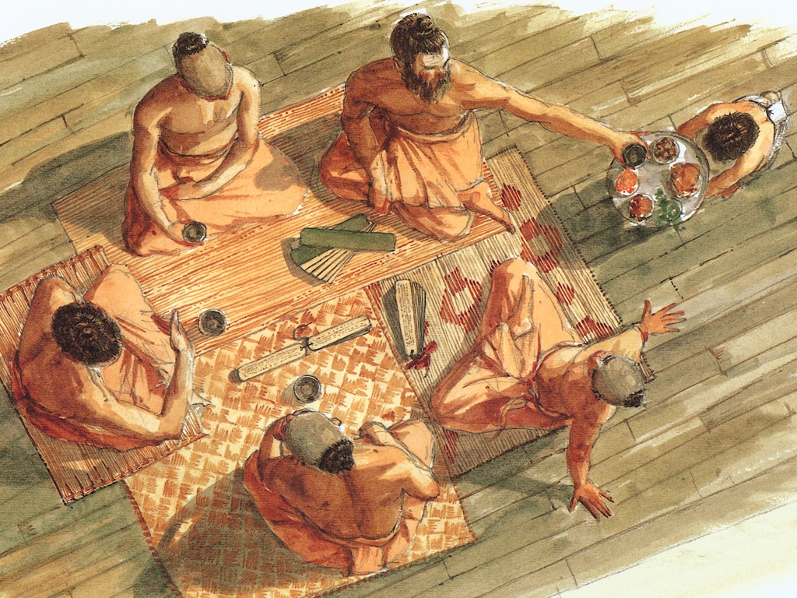
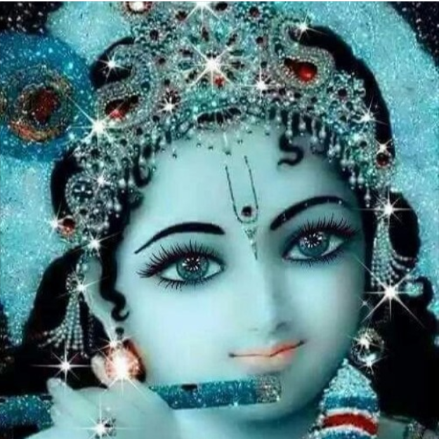
(7) Influence of a devotionally surcharged ambience
By hearing unadulterated glories of Lord Krishna……
1.One directly contacts the Lord
2.All his accumulated sins are cleared
3.Gradually become liberated from mundane association
4. Rajo, Tamo gunas are gone & one develops love of God
5.One can become one of the associate of the Lord

Slide 11
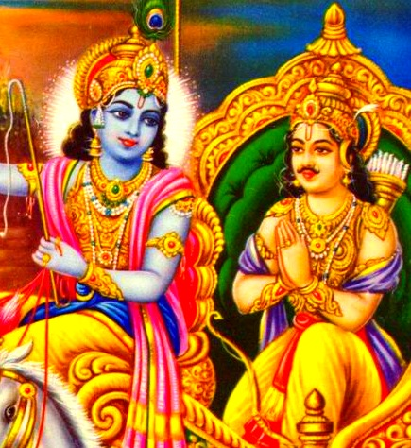
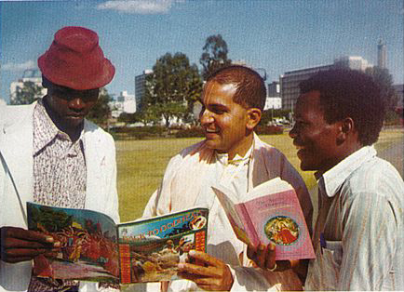
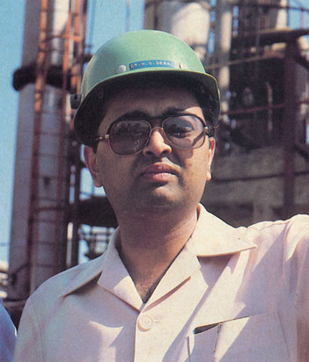
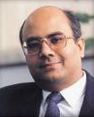
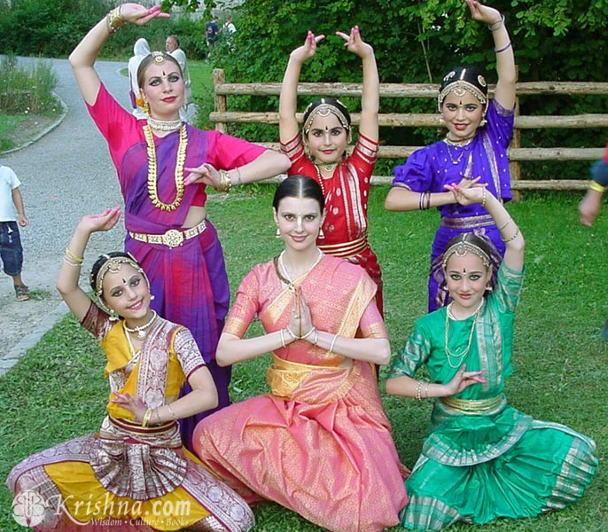
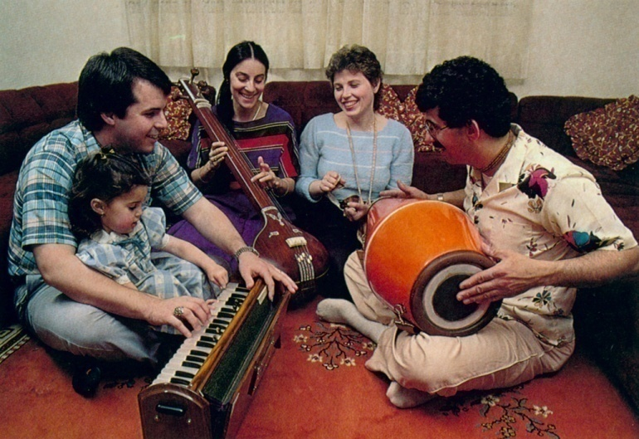
(8) Practicing Karma Yoga
Don’t lord over; Don’t reject material things; use everything for Lord’s service
Milk causes stomach disorder; but
curd cures stomach disorder. Similarly,
Iron rod put in fire → Fiery
Material activities → Spiritual Activities

Slide 12
Canto 1, Chapter 6
Conversation between
Narada and Vyasadeva

Slide 13
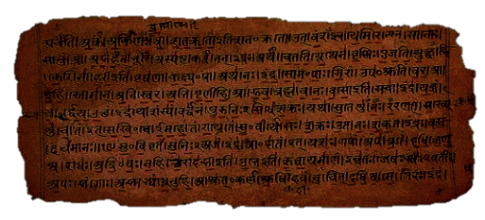
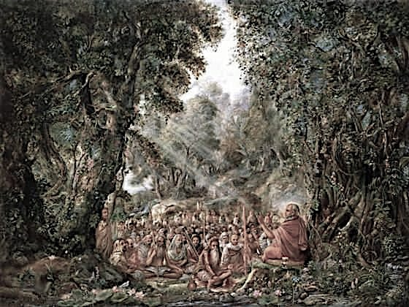
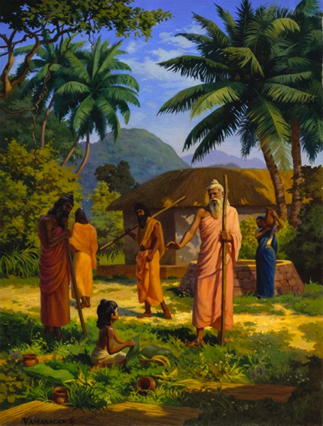
1.6. Conversation between Narada & Vyasa
Contents
Vyasadev inquires about Narada’s previous life
Lord’s appearance to Narada boy
Lord’s instructions to Narada boy
Narada boy attains perfection
Narada’s conclusion – Glorify Lord!

Slide 14
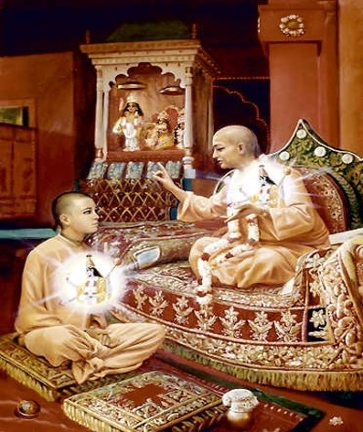
Themes covered in Chapter 6
(1) Sat-dharma prcchaa – Desire to Inquire from Guru
SB 1.6.2-5
Nectar of Devotion ||1.2.74||
atha aìgäni—
guru-pädäçrayas tasmät kåñëa-dékñädi-çikñaëam |
viçrambheëa guroù sevä sädhu-vartmänuvartanam ||74||
Nectar of Devotion ||1.2.75||
sad-dharma-påcchä bhogädi-tyägaù kåñëasya hetave |
niväso dvärakädau ca gaìgäder api sannidhau ||75||

Slide 15
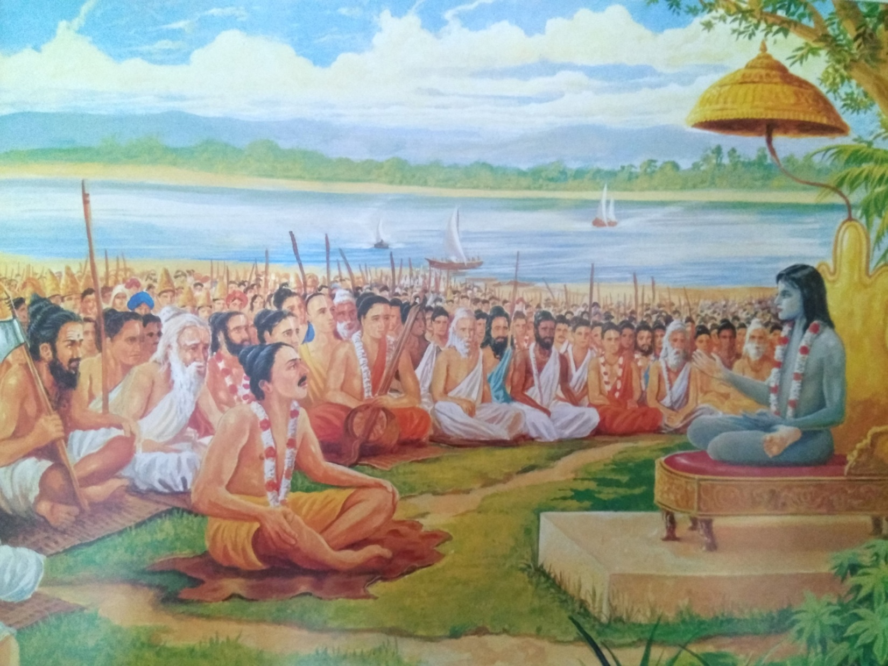
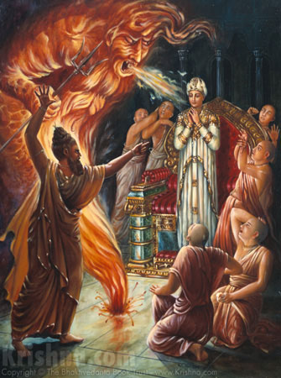
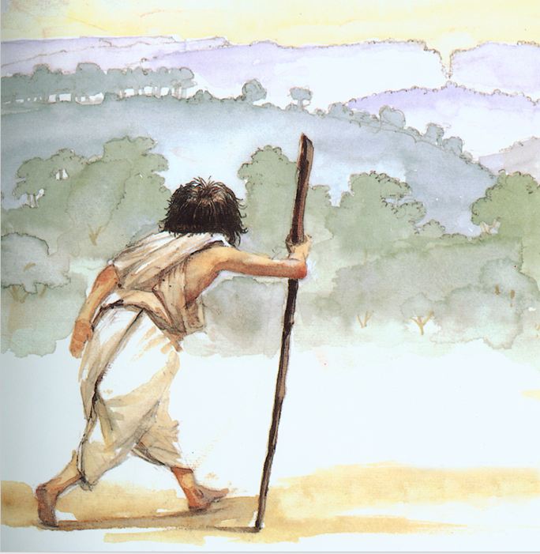
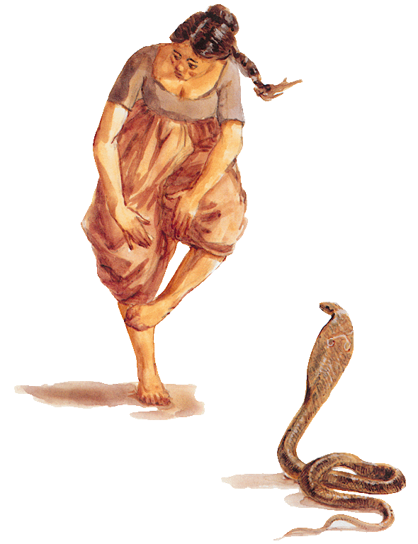
(2) Accepting Reverses in life as Lord’s special mercy
SB 1.6.6-10

Slide 16
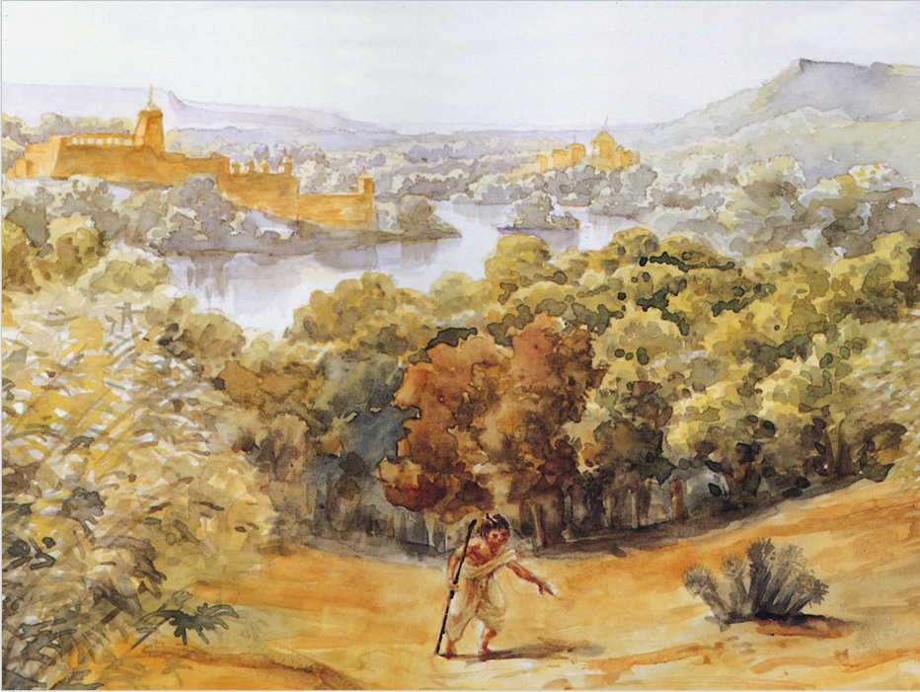
(3) Gaining Faith & Strength of Mind by travelling preaching
SB 1.6.11-14

Slide 17
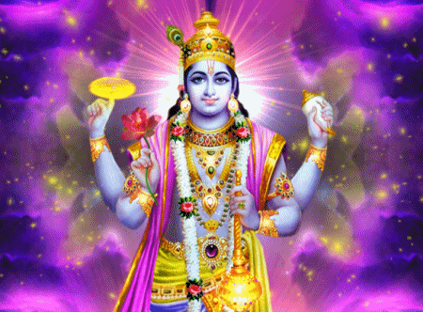
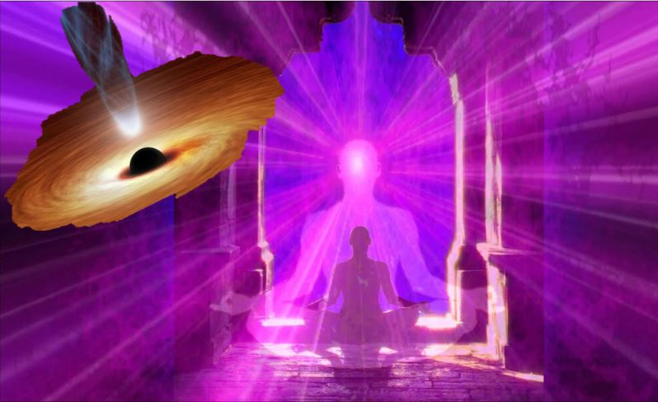
(4) Effects of seeing Lord’s beautiful form, SB 1.6.15-19

Slide 18
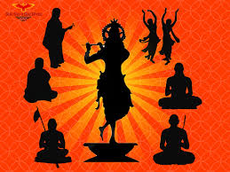
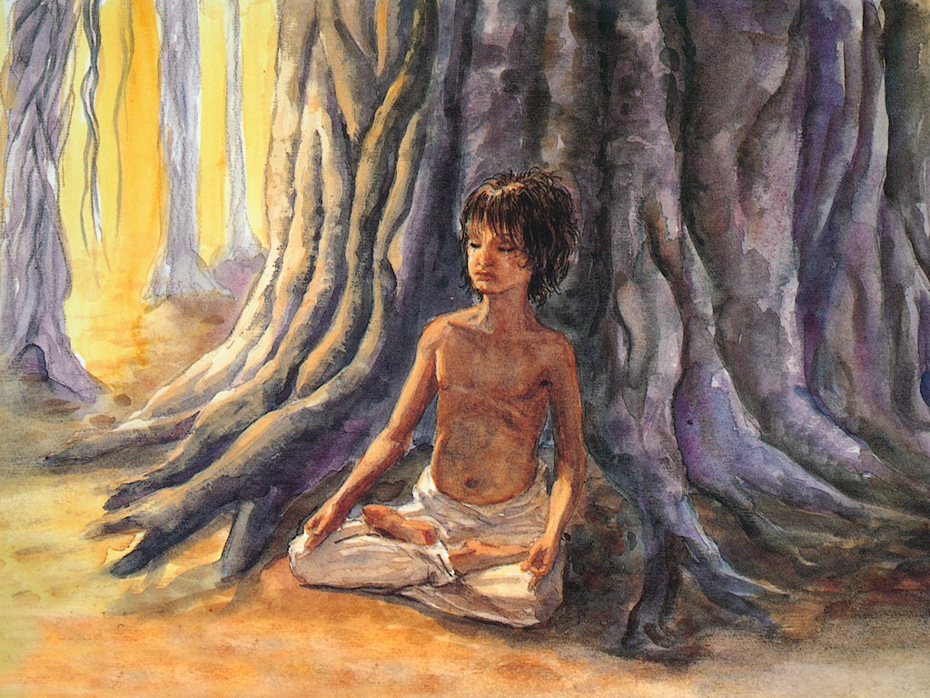
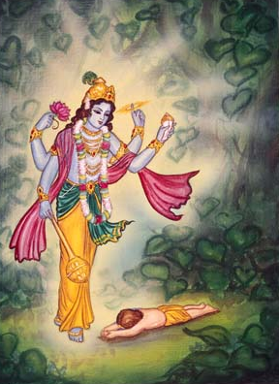
(5) Lovely speech in a lonely Jungle
SB 1.6.20-26

Slide 19
1-20: Lord’s appearance to Narada muni
1-4:Vyasa’s inquiries
  Life after initiation?
  Attaining current body?
  How do you remember?
5-20: Lord’s appearance to Narada
  Sages departed (5)
  Lord’s supreme control pervades – Only tie of affection & source of shelter (mother) bitten by snake (6-9)
    Special mercy of Lord (10)
  Narada travels thru varieties of Lord’s creation (11-13)
    Tired – relief – meditated on Supersoul (14-15)
    PoG appears on heart – ecstacy – every part of body enlivened (16-17)
  Lost the vision – perturbed – dissatisfied – aggrieved (18,19)
    Attempts to see Lord – Lord spoke (20)

Slide 20
21-25: Lord’s instruction to Narada
21-25: Lord’s instructions to Narada
  Narada’s material taint (21,22)
    You can’t see Me – incomplete service, material taint (21)
    My darshan is to increase your hankering (22)
  Lord glorifies Devotional service (23,24)
  sat-sevayädérghayäpi
  jätä mayi dåòhä matiù
  hitvävadyam imaà lokaà
  gantä maj-janatäm asi
    Even little service, one gets fixed int. & attains spiritual world (23)
    Time can’t interrupt DS (Your remembrance) (24)
  Grateful, Narada offers obeisances (25)

Slide 21
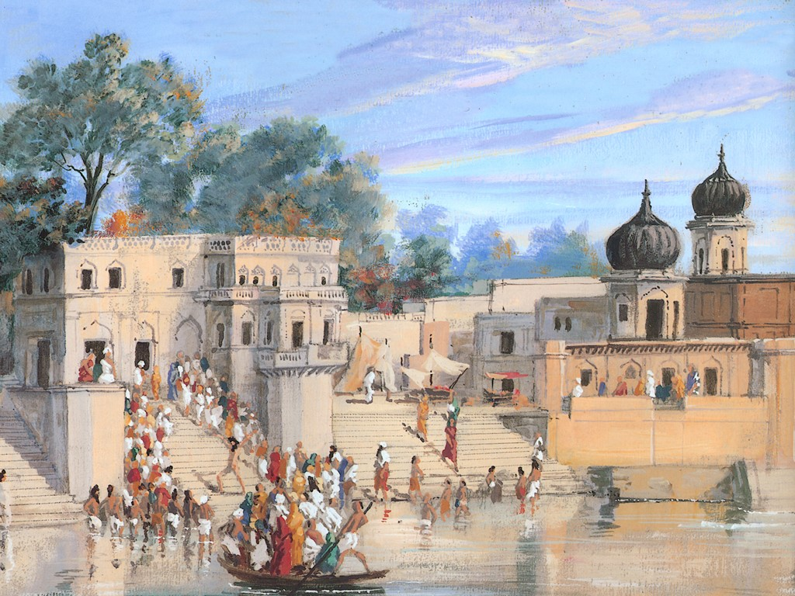
(6) Life of a sincere devotee &
Rewards he receives
SB 1.6.26-33

Slide 22
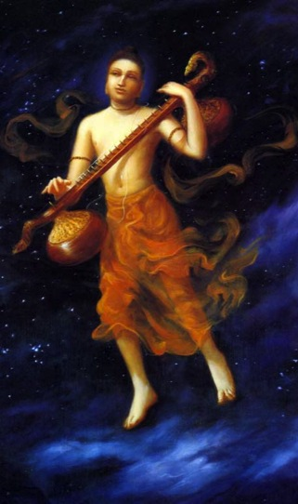
26-33: Narada’s perfection
26-33: Narada’s perfection
  Exhibits life of a sincere devotee (26)
    Chanting, travelling, Satisfied, humble, unenvious
    nämäny anantasya hata-trapaù paöhan
    guhyäni bhadräëi kåtäni ca smaran
    gäà paryaöaàs tuñöa-manä gata-spåhaù
    kälaà pratékñan vimado vimatsaraù
  Dies & gets spiritual body (27,28)
    Tr. disappearance & appearance in next creation (29,30)
  Unrestricted travelling in SW & MW, fixed in DS (31)
    Glorifying Lord on Vina (32)
    Lord appears in heart as he begins to chant (33)

Slide 23
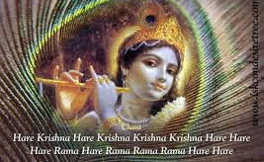
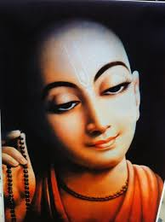
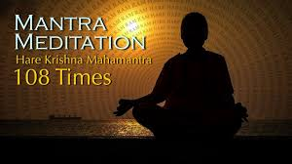
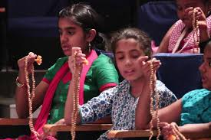
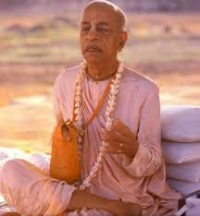
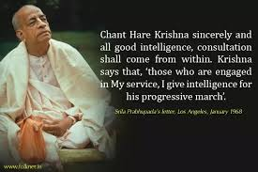
(7) Constant chanting of Lord’s glories
– best boat to cross bhava, SB 1.6.34-38

Slide 24

34-38: Narada concludes his instructions
Chanting: Most suitable boat to cross material ocean (34)
etad dhy ätura-cittänäà
mäträ-sparçecchayä muhuù
bhava-sindhu-plavo dåñöo
hari-caryänuvarëanam
Satisfaction is by DS, not by sense control (35)
My birth & acts are conducive for your personal realization (36)
  Narada departs (37)
Suta praises Narada (38)
  His chanting gives pleasure to him & enlivens others

Slide 25

Chapter 6 Overview
1.6. Conversation b/w Narada & Vyasa
1-4:Vyasa’s inquiries
5-20: Lord’s appearance to Narada
Sages departed (5)
Special mercy of Lord (10)
Life after initiation?
Attaining current body?
How do you remember?
Lord’s supreme control pervades – Only tie of affection & source of shelter (mother) bitten by snake (6-9)
Narada travels thru varieties of Lord’s creation (11-13)
Tired – relief – meditated on Supersoul (14-15)
PoG appears on heart – ecstacy – every part of body enlivened (16-17)
Lost the vision – perturbed – dissatisfied – aggrieved (18,19)
Attempts to see Lord – Lord spoke (20)
Narada’s material taint (21,22)
My darshan is to increase your hankering (22)
Lord glorifies DS (23,24)
Tr. disappearance & appearance in next creation (29,30)
You can’t see Me – incomplete service, material taint (21)
Even little service, one gets fixed int. & attains SW (23)
Time can’t interrupt DS (Your remembrance) (24)
Grateful, Narada offers obeisances (25)
Exhibits life of a sincere devotee (26)
Chanting, travelling
Satisfied, humble, unenvious
Dies & gets spiritual body (27,28)
Unrestricted travelling in SW & MW, fixed in DS (31)
21-25: Lord’s instructions to Narada
26-: Narada’s perfection
Glorifying Lord on Vina (32)
Lord appears in heart as he begins to chant (33)
34-38: Conclusion
Chanting: Most suitable boat to cross material ocean (34)
Satisfaction is by DS, not by sense control (35)
My birth & acts are conducive for your personal realization (36)
Narada departs (37)
Suta praises Narada (38)
His chanting gives pleasure to him & enlivens others

Slide 26
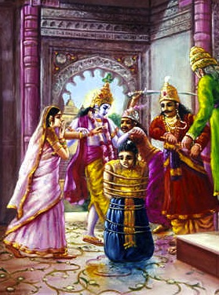
1.7. The Son of Droëa Punished
Contents
Vyasadeva’s meditation & vision
Glories of Bhagavatam
Suta answers questions about Parikshit
  Punishment of Asvatthama
Tomorrow…

Slide 27
SRIMAD BHAGAVATAM, the Crest Jewel of All Puranas
You are welcome Tomorrow for
First Canto Chapter 7
Son of Drona Punished
By His Divine Grace A.C.Bhaktivedanta Swami Prabhupada, Founder Acarya of ISKCON

