Slide 1
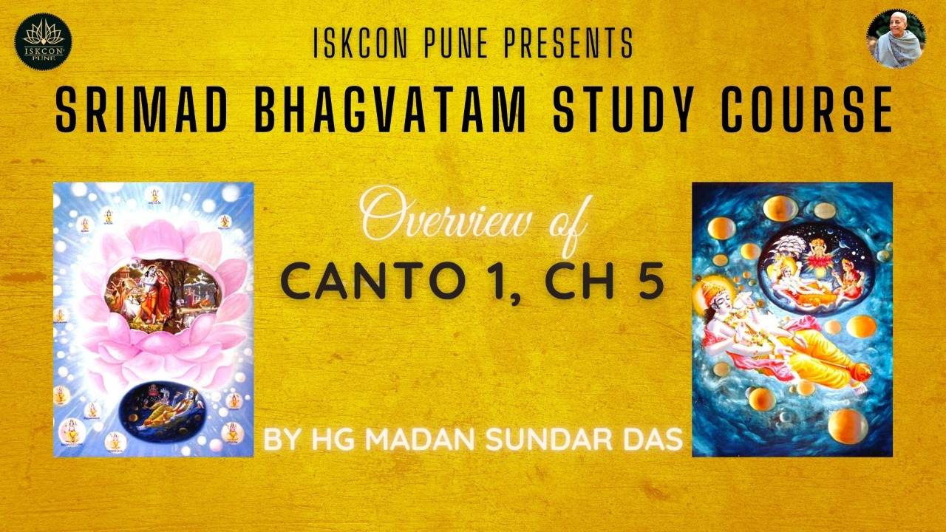

Slide 2
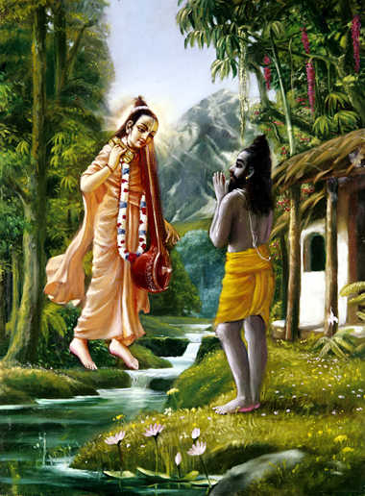
Chapter 4 Overview
SB 1.4 Appearance of Sri Narada

Slide 3
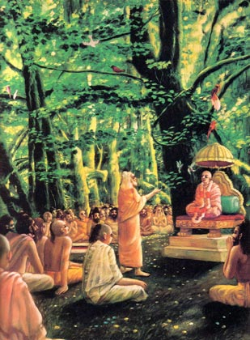
Questions asked
History of Srimad Bhagavatam: Where did Vyasadeva get inspiration to compile Bhagavatam?
Sukadeva Goswami: How did Hastinapur citizens recognize him?
Birth & activities of Parikshit maharaja
How did their meeting take place?

Slide 4
Chapter 4 Overview
SB 1.4 Appearance of Sri Narada
Answer to Q1
Vyasadeva divides the Vedas
Vyasadeva’s dissatisfaction
Narada muni’s appearance

Slide 5

Entering Chapter 5
Narada muni appears as Vyasadeva was regretting…
Vyasadeva receives him

Slide 6
Chapter 5 Overview
SB 1.5 Narada’s Instruction on Srimad Bhagavatam to Vyasadeva
Contents
NM inquires about Vyasa’s despondency
Narada muni’s diagnosis
Narada muni’s previous life
Narada muni’s advice to Vyasadev

Slide 7
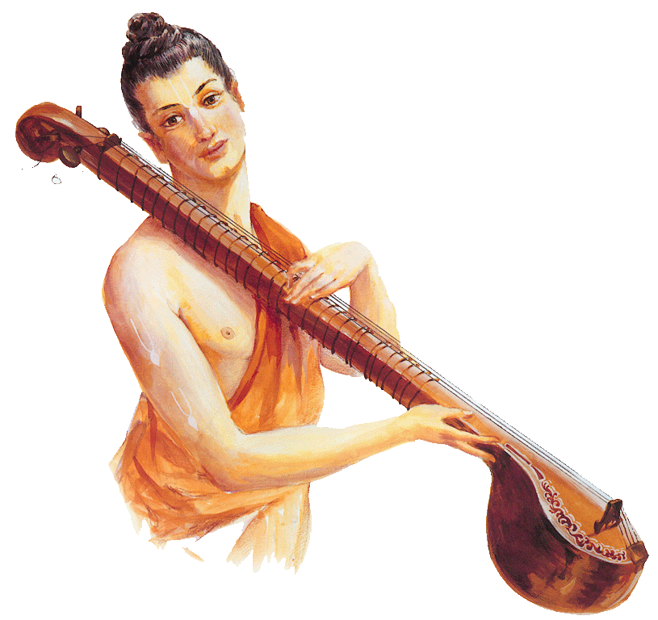
How Narada Muni
became a great KC devotee?

Slide 8
Narada Muni’s previous life

Slide 9
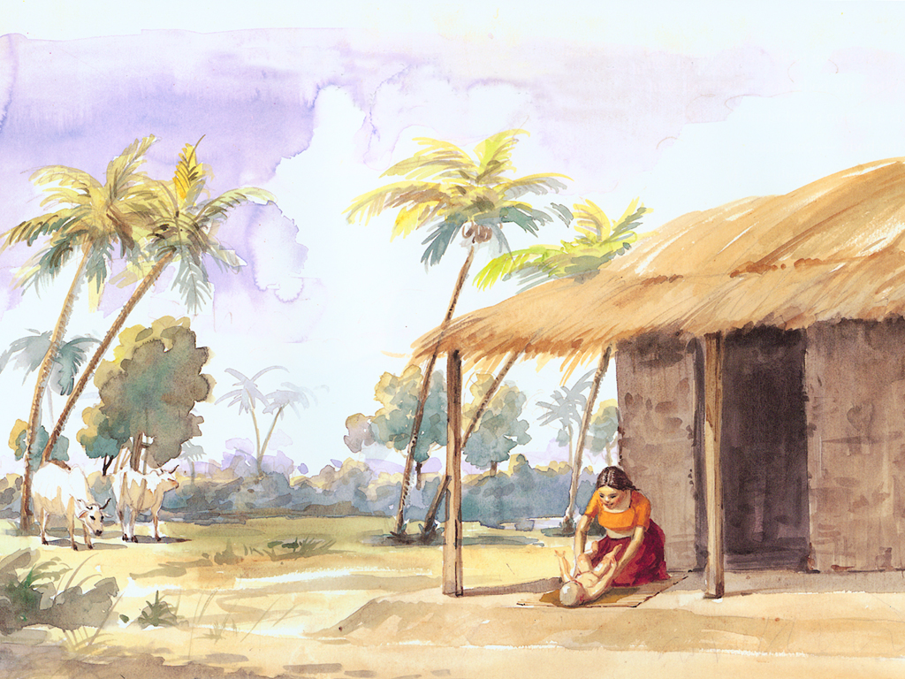
I was born as an insignificant son of a maidservant.

Slide 10
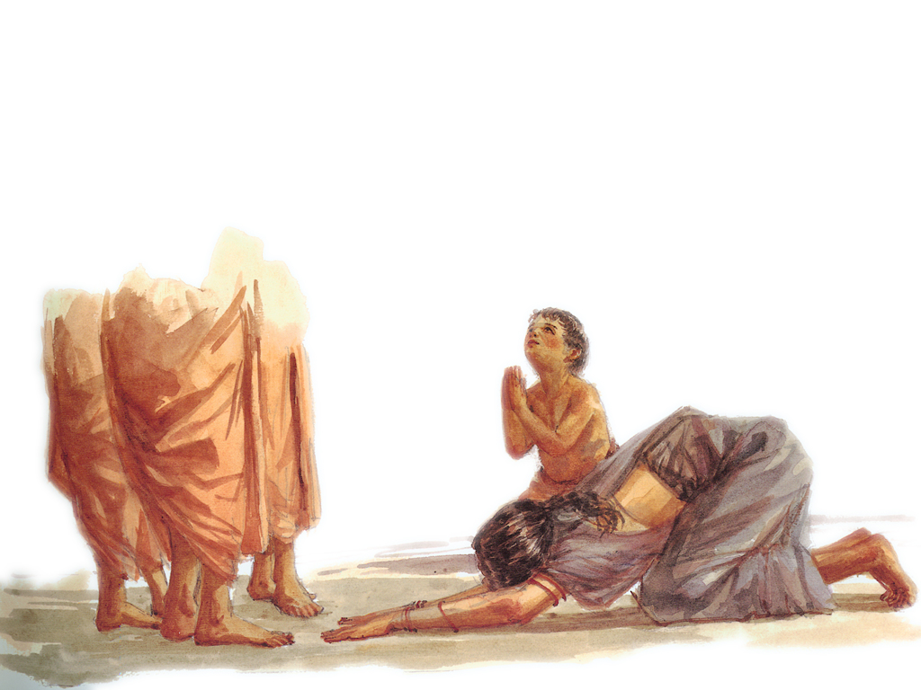
Once during Caturmaas time, the four months of the rainy season, some exalted vaishnavas came to the brahmana’s school where my mother was living;
Because she was attending to their needs, I also got the opportunity to render personal service unto them.
Although impartial by nature, they blessed me with their causeless mercy, because, eventhough I was only a small boy, I was Self-controlled, I did not speak more than required, I was not naughty, nor interested in childish play.

Slide 11
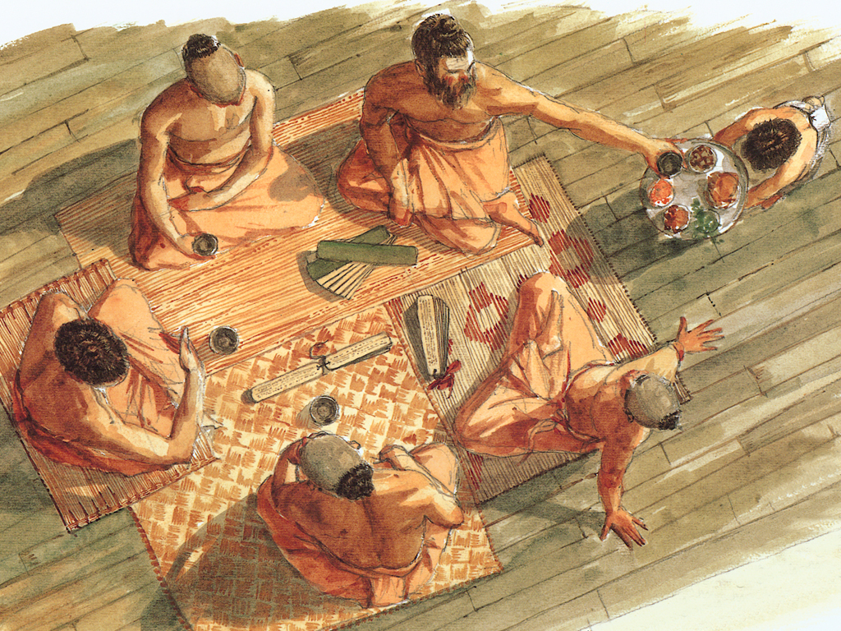
Once with their permission, I took the remnants of
their food and as a result, all of my sins were
eradicated. Because of this and due to serving
such great souls, the life of devotional service to
the Lord became very attractive to me.

Slide 12
In their association,
I heard narrations of Lord Krsna’s
transcendentally
attractive pastimes. By such regular and attentive hearing, my taste for such
topics increased
at every step.

Slide 13
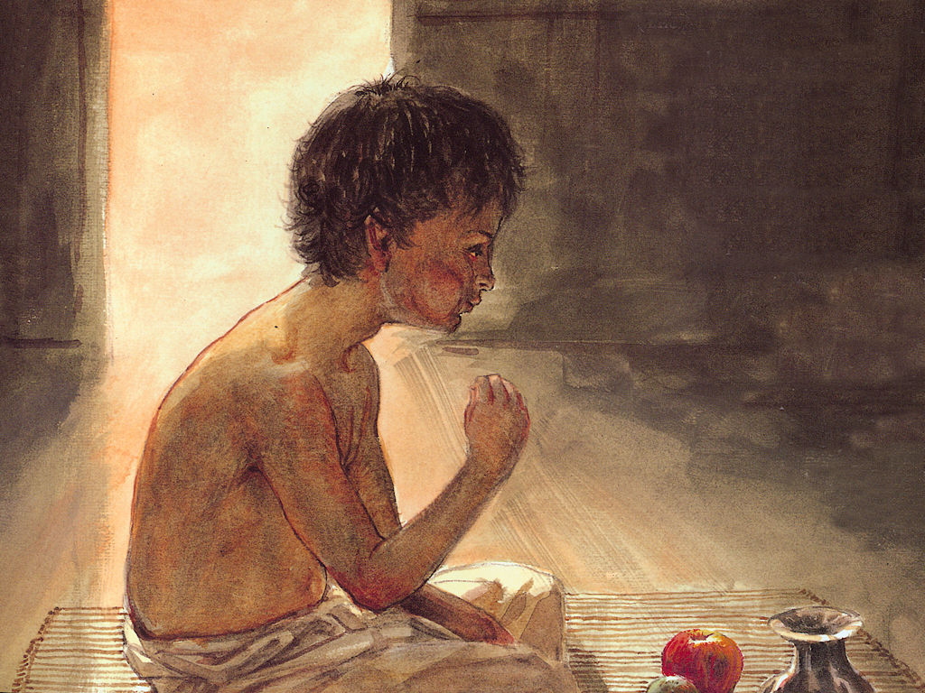
When this transcendental taste
Became very strong, my
Attention became fully fixed on
hearing about the SPOG. As a result, the mode of passion and ignorance vanished from my heart; I realized myself to be different from the gross & subtle bodies.
I loved those pure devotees
greatly, and with very
gentle behaviour, I strictly
followed their instructions.

Slide 14
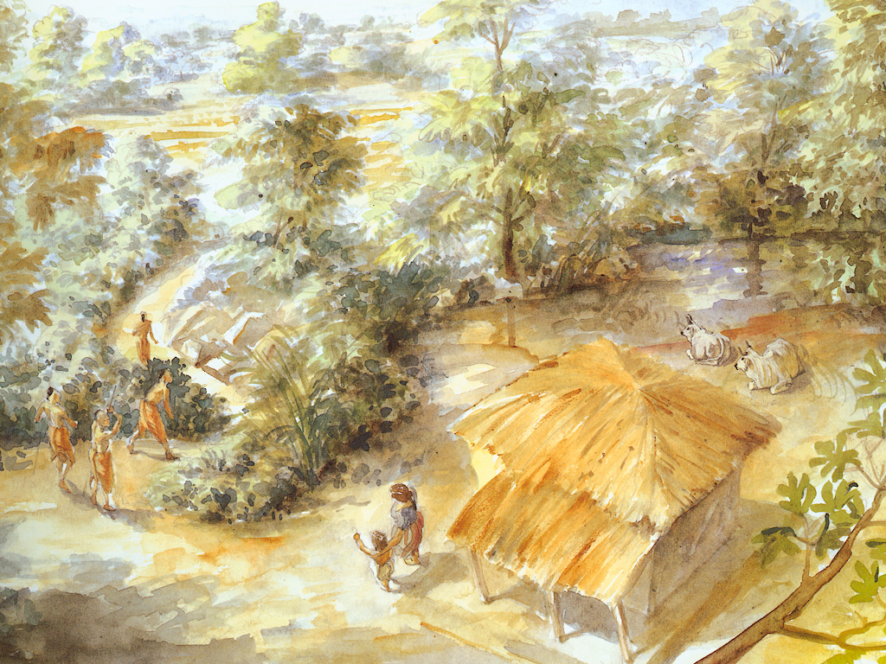
When they were about to depart, they instructed me in Bhakti yoga, the art of using everything in the service of the Lord to ultimately return back home back to Godhead.

Slide 15
Chapter 5 Overview
Narada’s inquires
1-7: Vyasa’s despondency
Vyasa’s reply
2 defects (8-9)
8-22: Narada’s diagnosis: Importance of describing Krsna’s pastimes
Categories of literature
(10-11)
1.5. Narada’s instructions on SB
DS is only asset (12-19)
Effect of Krsna-katha on Narada’s life (26-29)
23-31: Narada’s previous life
Sages instructed him most confidential knowledge
32-40: Narada’s conclusive advice to Vyasa
Describe Lord’s glories

Slide 16
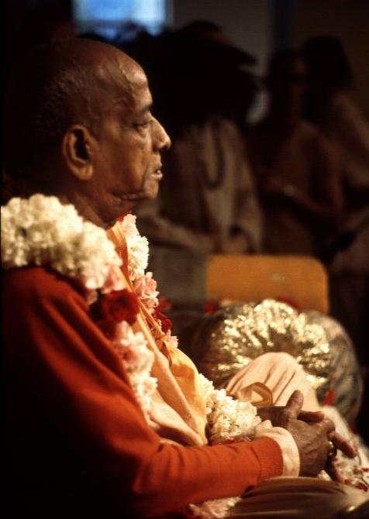
Concluding Quote
Närada Muni has just explained this by his personal experience. The whole idea is that simply by hearing about the Lord's pastimes one can become one of the associates of the Lord. Närada Muni has eternal life, unlimited knowledge and unfathomed bliss, and he can travel all over the material and spiritual worlds without restriction. One can attain to the highest perfection of life simply by attentive hearing of the transcendental pastimes of the Lord from the right sources, as Çré Närada heard them from the pure devotees (bhakti-vedäntas) in his previous life. This process of hearing in the association of the devotees is especially recommended in this age of quarrel (Kali).
- SB 1.5.26 (purport)
www.evolvepune.com

Slide 17
Entering Chapter 6
Vyasadev inquires: What did you do after the departure of the great sages?

Slide 18
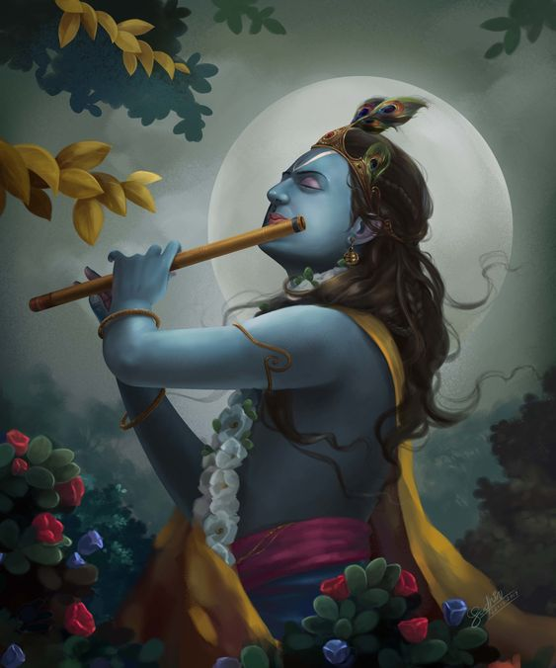


Thank you!
Any Questions?
By Madan Sundar Das msdas@iskconpune.in

