Slide 1
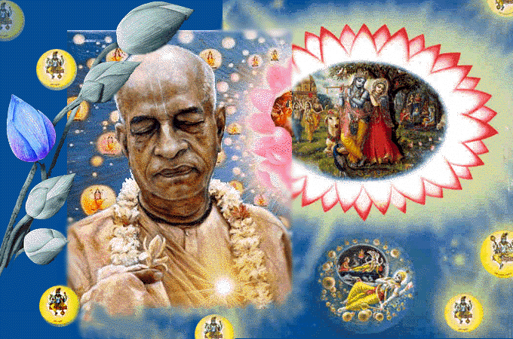
SRIMAD BHAGAVATAM, the Crest Jewel of All Puranas
By His Divine Grace A.C.Bhaktivedanta Swami Prabhupada, Founder Acarya of ISKCON
Bhagavata
Rasamaalayam
A 19-Session Presentation of First Canto of SB
by Radheshyam das, ISKCON, NVCC, Pune
www.live.radheshyamdas.com

Slide 2

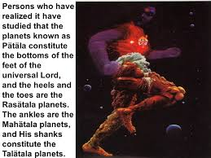
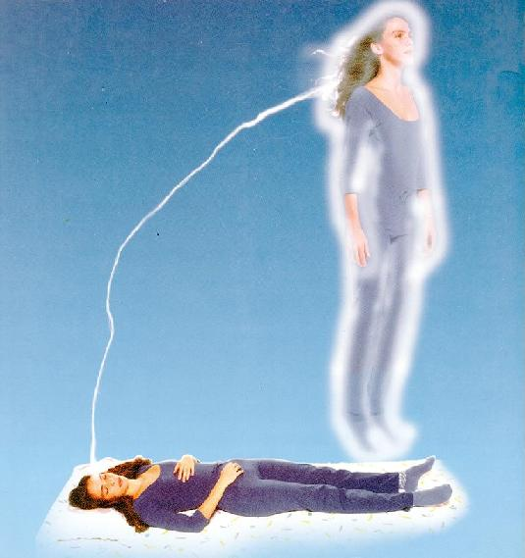
Krishna’s incarnations VS Virat Rupa , 1.3.30-39
1.3.30-39: The material forms (gross & subtle) of both
the Lord (viräö-rüpa) & jivas are actually imaginary (temporary)
There are those who can simply think of God as being great but do not know how great He is. If one thinks, "This mountain is the bone of Kåñëa," or if one thinks of the vast Pacific Ocean as Kåñëa's navel, one is in Kåñëa consciousness. Similarly, one may think of the trees and plants as the hairs on Kåñëa's body, one may think of Brahmaloka as the top of Kåñëa's skull, and one may think of the Pätälaloka planetary system as the soles of Kåñëa's feet. Thus one may think of Kåñëa as greater than the greatest (mahato mahéyän).

Slide 3
Virat rupa is material conception of the lord’s form (SB 1.3.30)
etad rüpaà bhagavato hy arüpasya cid-ätmanaù
mäyä-guëair viracitaà mahadädibhir ätmani
The form described below is a highly conceptualised form originally intended for impersonalists and is a different Virat-Rupa to the one shown to Arjuna on the battlefield. It is explained in the Srimad Bhagavatam that this Virat rupa is a material form while Krishna’s original spiritual form is made up of sac-cid-ananda, eternity, knowledge and bliss. That spiritual form has no veins or bones.
Hills/Mountains…..Stacks of His bones The air…………..His breath
Physical sound……His sense of hearing The ten directions………..His ears
Material aroma……His sense of smell The blazing fire…………..His mouth
Trees……………..The hairs of His body The sun & moon…………His eyes
Clouds…….………Hairs on His head Alluring material energy….His smile
Day and night……...His eye lids The passing ages………...His movements
Religion……………His breast The horse, mule, camel…..His nails
Irreligion…………..His back Varieties of birds………...His artistry
The Ocean…………His waist The brahmanas.…………His face
Rivers……………..Veins The ksatriyas…………….His arms
Twilight……………His dress The vaisyas………………His thighs
The sudras…………Under His feet

Slide 4
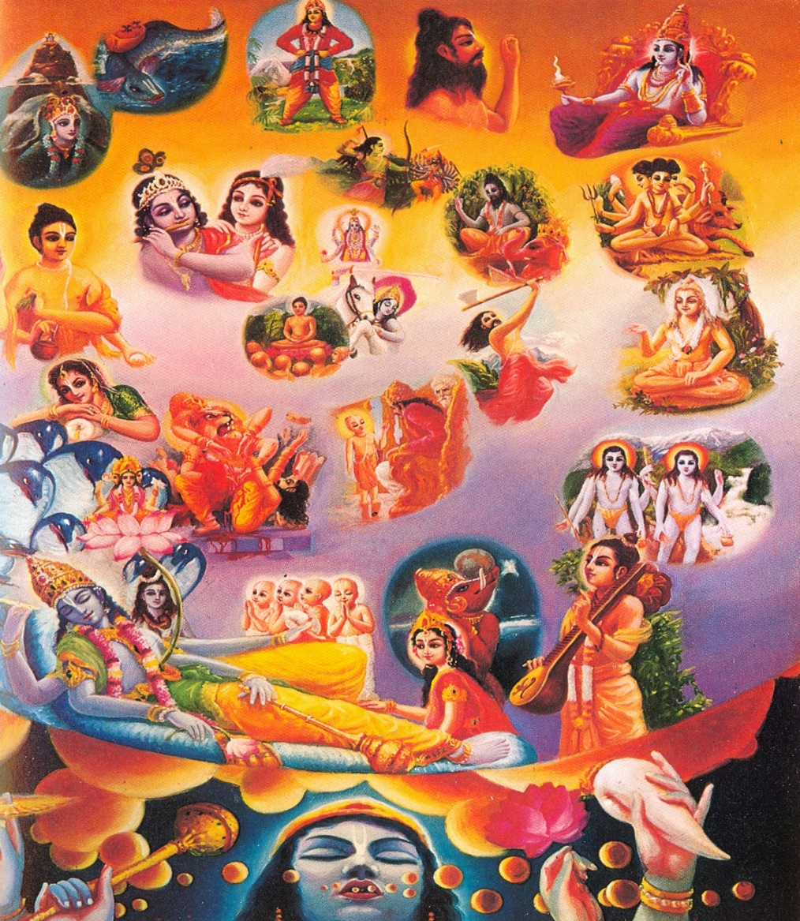
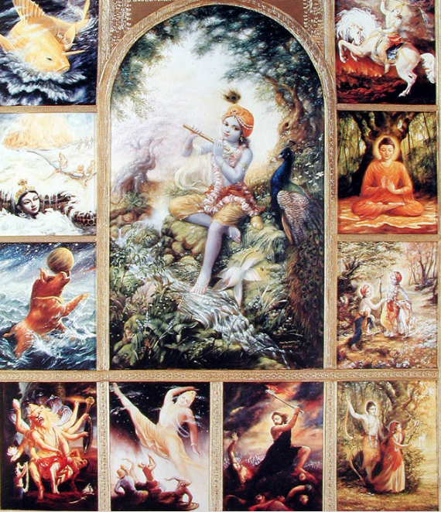
The foolish with a poor fund of knowledge cannot know the transcendental nature of the forms, names and activities of the Lord, who is playing like an actor in a drama.
[SB 1.3.37]
na cäsya kaçcin nipuëena dhätur
avaiti jantuù kumanéña ütéù
nämäni rüpäëi mano-vacobhiù
santanvato naöa-caryäm iväjïaù

Slide 5
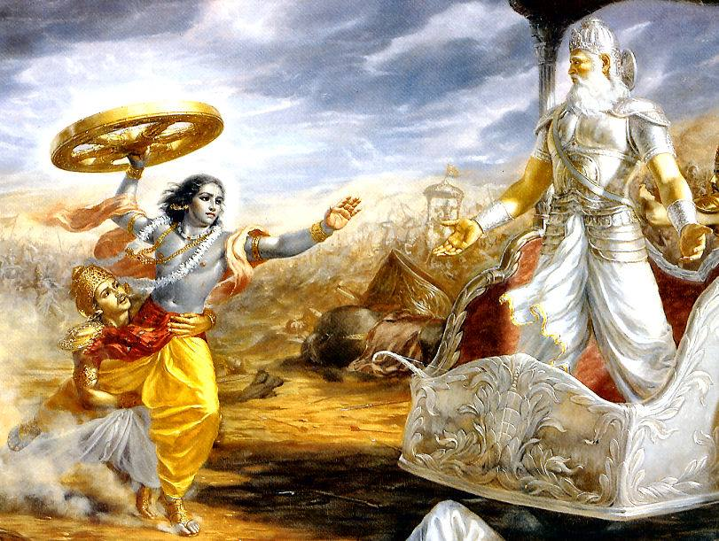
Only fools consider Lord’s spiritual pastimes ordinary. Understanding the Lord needs unreserved, uninterrupted, favorable Devotional service. [SB 1.3.38]
sa veda dhätuù padavéà parasya
duranta-véryasya rathäìga-päëeù
yo 'mäyayä santatayänuvåttyä
bhajeta tat-päda-saroja-gandham

Slide 6
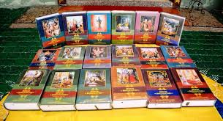
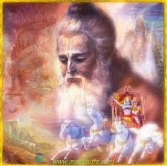
Glories of Bhagavatam, 1.3.40-44
idaà bhägavataà näma
puräëaà brahma-sammitam
uttama-çloka-caritaà
cakära bhagavän åñiù
niùçreyasäya lokasya
dhanyaà svasty-ayanaà mahat
This scripture named Çrémad-Bhägavatam is the literary incarnation of God, and it is compiled by Çréla Vyäsadeva, the incarnation of God. It is meant for the ultimate good of all people, and it is all-successful, all-blissful and all-perfect. [SB 1.3.40]

Slide 7
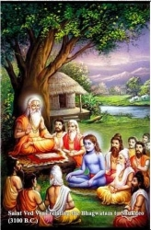
Glories of Bhagavatam, 1.3.40-44
tad idaà grähayäm äsa
sutam ätmavatäà varam
sarva-vedetihäsänäà
säraà säraà samuddhåtam
TRANSLATION
Çré Vyäsadeva delivered it to his son, who is the most respected among the self-realized, after extracting the cream of all Vedic literatures and histories of the universe. [SB 1.3.41]

Slide 8
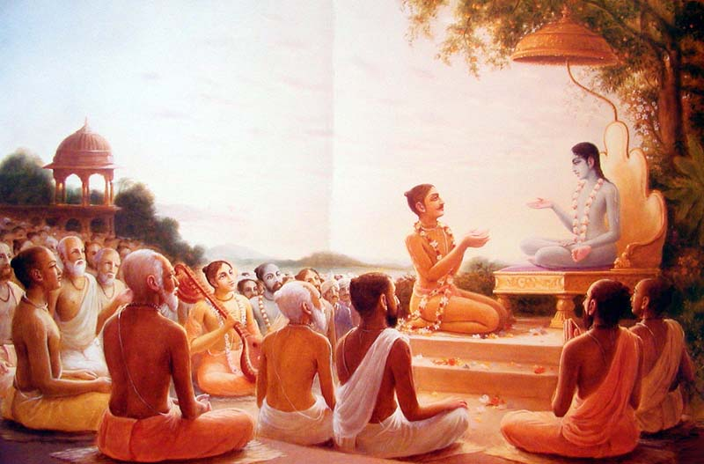
Glories of Bhagavatam, 1.3.40-44
sa tu saàçrävayäm äsa
mahäräjaà parékñitam
präyopaviñöaà gaìgäyäà
parétaà paramarñibhiù
TRANSLATION
Çukadeva Gosvämé, the son of Vyäsadeva, in his turn delivered the Bhägavatam to the great Emperor Parékñit, who sat surrounded by sages on the bank of the Ganges, awaiting death without taking food or drink. [SB 1.3.42]

Slide 9
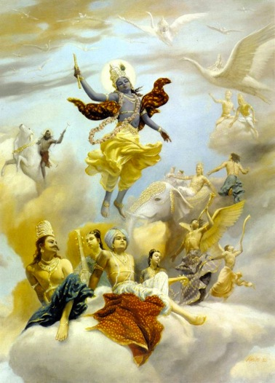
Glories of Bhagavatam, 1.3.40-44
kåñëe sva-dhämopagate
dharma-jïänädibhiù saha
kalau nañöa-dåçäm eña
puräëärko 'dhunoditaù
TRANSLATION
This Bhägavata Puräëa is as brilliant as the sun, and it has arisen just after the departure of Lord Kåñëa to His own abode, accompanied by religion, knowledge, etc. Persons who have lost their vision due to the dense darkness of ignorance in the Age of Kali shall get light from this Puräëa. [SB 1.3.43]

Slide 10
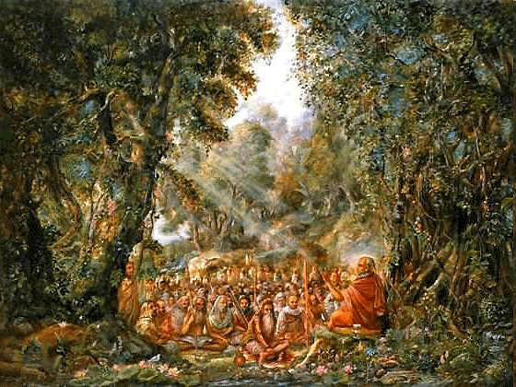
tatra kértayato viprä
viprarñer bhüri-tejasaù
ahaà cädhyagamaà tatra
niviñöas tad-anugrahät
so 'haà vaù çrävayiñyämi
yathädhétaà yathä-mati
TRANSLATION
O learned brähmaëas, when Çukadeva Gosvämé recited the Bhägavatam there [in the presence of Emperor Parékñit], I heard him with rapt attention, and thus, by his mercy, I learned the Bhägavatam from that great and powerful sage. Now I shall try to make you hear the very same thing as I learned it from him and as I have realized it. [SB 1.3.44]

Slide 11
Bhagavata Rasamaalayam
A 19-Session Presentation of First Canto of SB
by Radheshyam das, ISKCON, NVCC, Pune
SB Canto 1 Chapter 4
Appearance of Narada

Slide 12
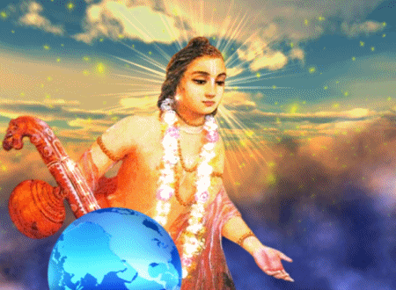

Slide 13
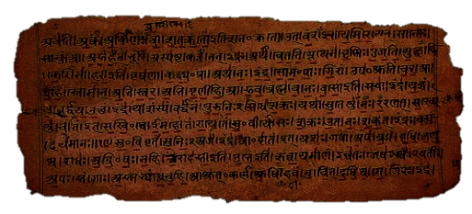
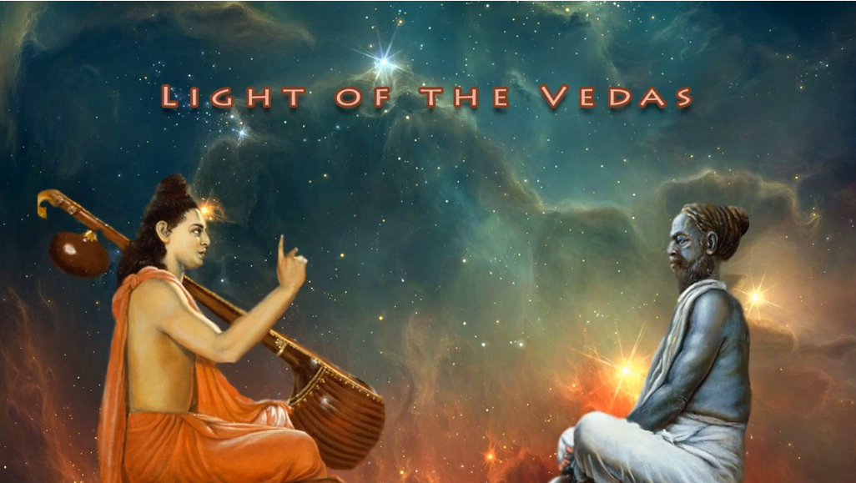
1.4. Appearance of Çré Närada
Contents
1.4.1-13 Saunaka rishi’s questions
1.4.14-25 Vyasadeva divides the Vedas
1.4.26-31 Vyasadeva’s dissatisfaction
1.4.32-33 Narada muni’s appearance

Slide 14
1-13: Saunaka rishis’s inquiries
About
  History of Srimad Bhagavatam: Where did Vyasadeva get inspiration to compile Bhagavatam?
  Sukadeva Goswami:
  How did Hastinapur citizens recognize him?
  Birth & activities of Parikshit maharaja
  How did their meeting of Sukadev & Parikshit take place?

Slide 15
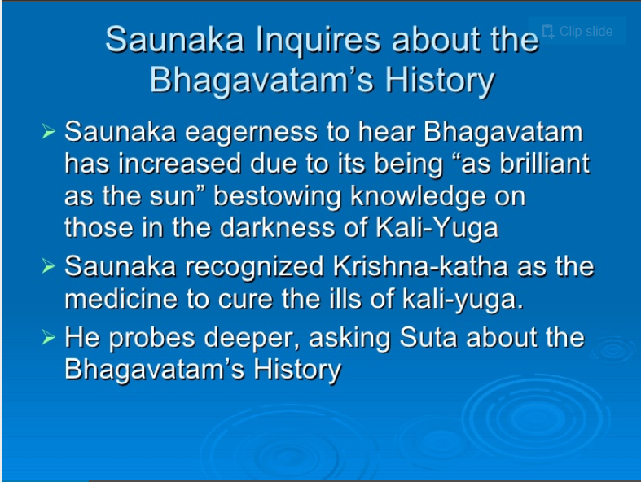

Slide 16
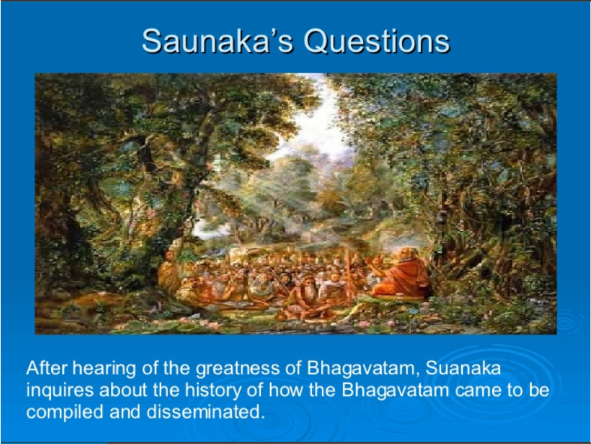
Verses 1.4.1-3

Slide 17
Theme – I Saunaka’s further questions to Suta (1-13)
|| 1.4.2 ||
çaunaka uväca
süta süta mahä-bhäga
vada no vadatäà vara
kathäà bhägavatéà puëyäà
yad äha bhagaväï chukaù
Çaunaka said: O Süta! O Süta! Fortunate soul (süta süta mahä-bhäga)! Best of speakers (vadatäà vara)! Please tell us (nah vada) the pure stories related to the Lord (kathäà bhägavatéà puëyäà) which the glorious Çuka spoke at the assembly of Parékñit (yad äha bhagaväï çukaù).
Verse Summary: Oh Suta! Pls narrate to us all that Suka spoke to Pariksit.
He addresses Süta twice out of joy.

Slide 18
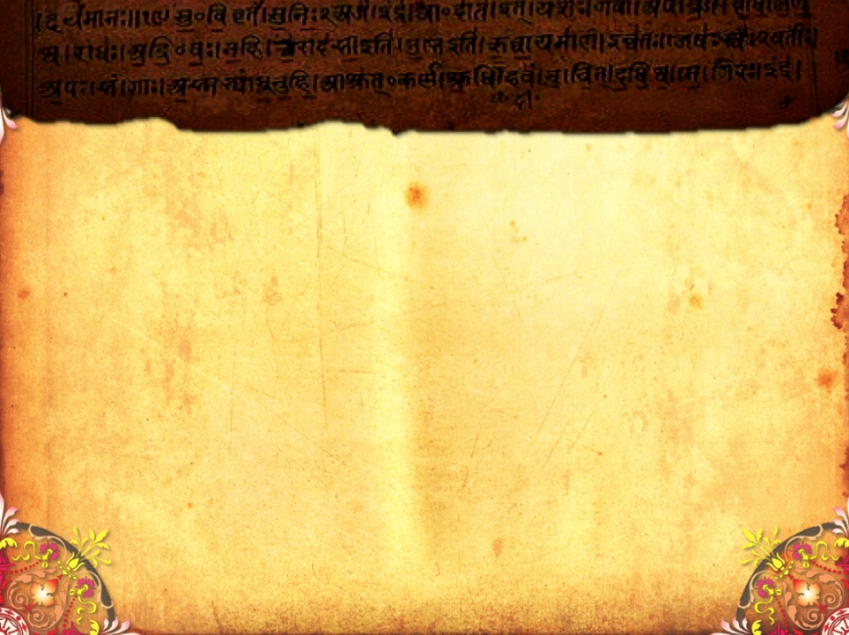
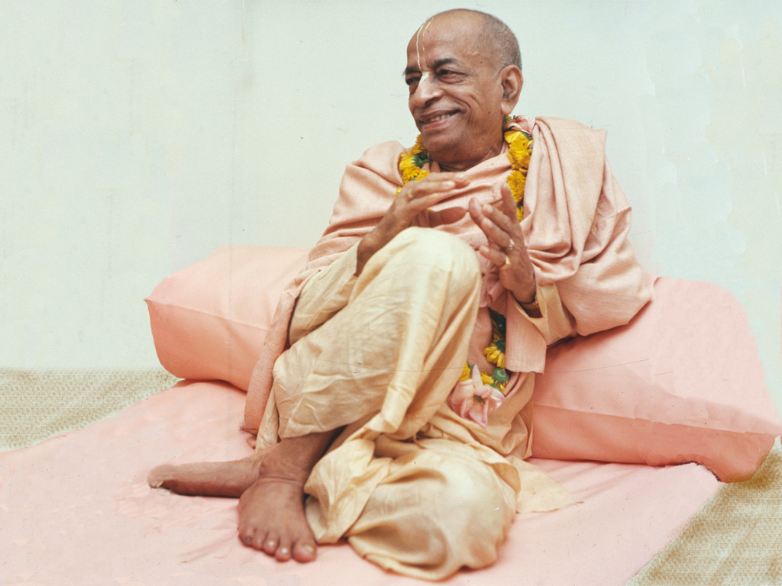
1.Realisation
- What it is?
- What it is not?
(SB.1.4.1)

Slide 19
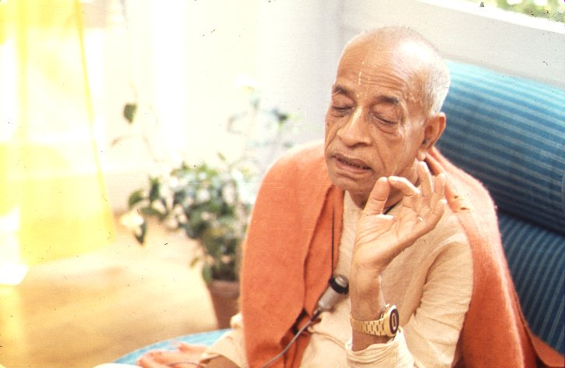
Personal realization does not mean that one should, out of vanity, attempt to show one's own learning by trying to surpass the previous äcärya. He must have full confidence in the previous äcärya, and at the same time he must realize the subject matter so nicely that he can present the matter for the particular circumstances in a suitable manner. The original purpose of the text must be maintained. No obscure meaning should be screwed out of it, yet it should be presented in an interesting manner for the understanding of the audience. This is called realization.
[Srimad Bhagavatam purport 1.4.1.]

Slide 20
Personal realization does not mean that
- one should, out of vanity, attempt to show one's own learning by trying to surpass the previous äcärya.
A Preacher…….
- should have full confidence in the previous äcärya,
- must realize the subject matter nicely
- can present the matter for the particular circumstances in a suitable manner.
While speaking on a subject……….
- The original purpose of the text must be maintained.
- No obscure meaning should be screwed out of it,
- yet it should be presented in an interesting manner for the understanding of the audience.

Slide 21
Personal Realisation
Who is a Preacher?
A Preacher
- gives Krishna to others & transform their hearts.
- helps others to come closer to Krishna.
- makes others feel closer to Krishna.
- attracts people to KC understanding through his deep Conviction rather than Pushiness or dishonest preaching techniques.
(eg) SP didn’t see degradation in hippies as much as he saw soul’s natural relationship with Krishna.

Slide 22
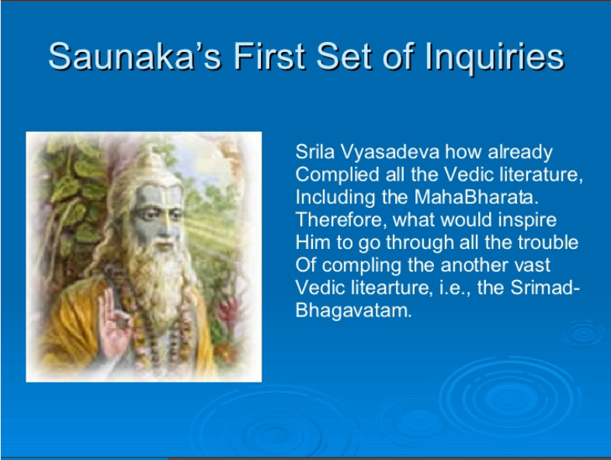
Verse 1.4.4

Slide 23
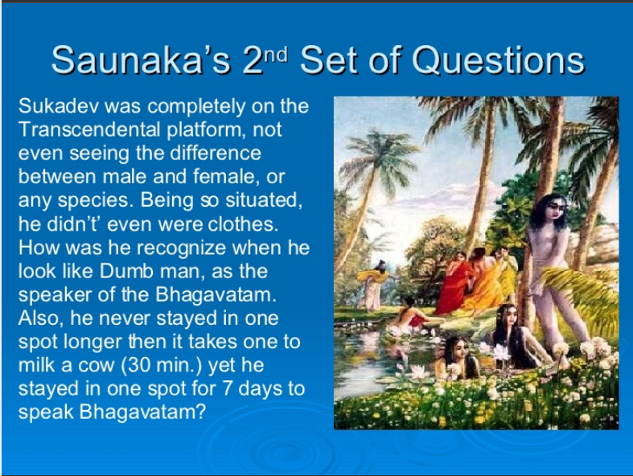
Verses 1.4.4-8

Slide 24
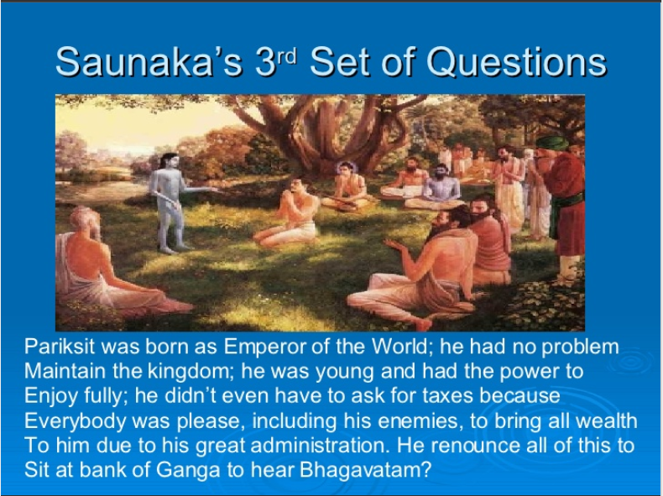
Verses 1.4.9-12

Slide 25
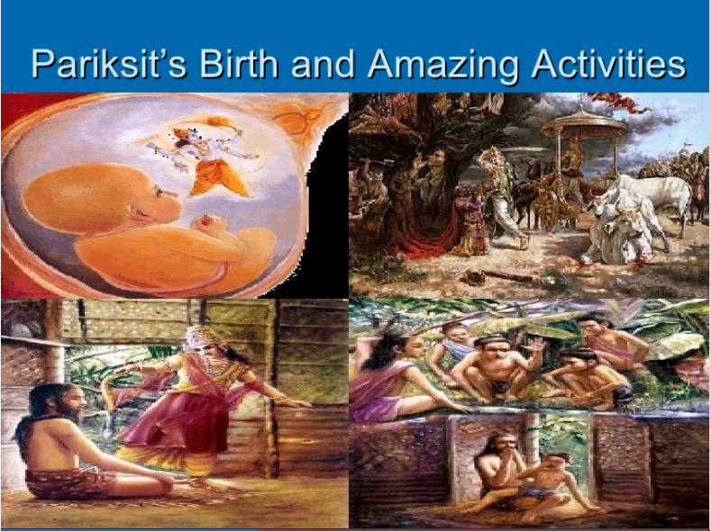

Slide 26
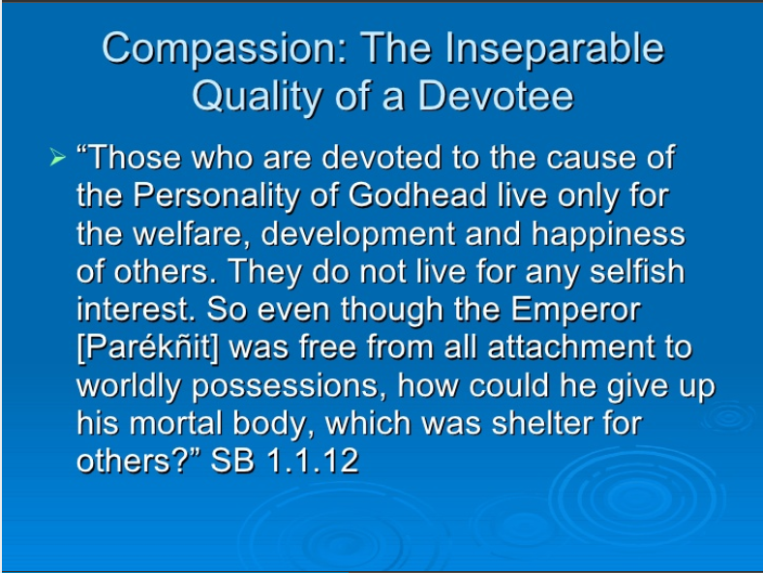

Slide 27
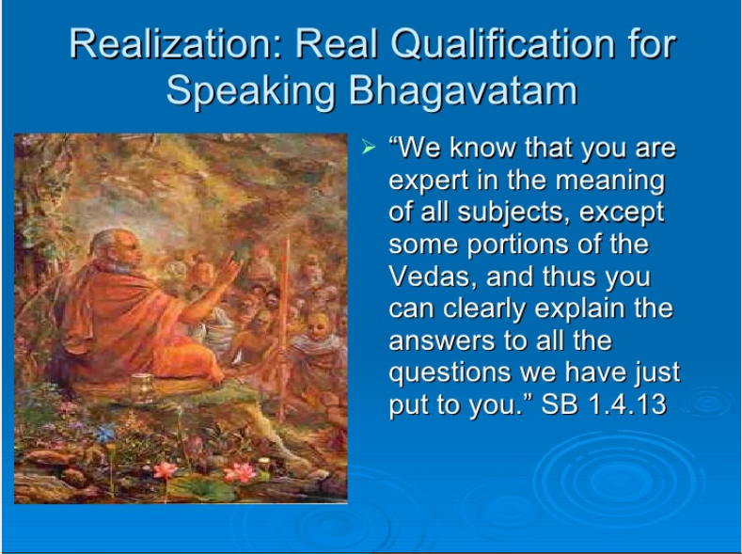

Slide 28
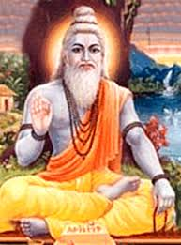
1.4.14-25: Vyasadeva divides the Veda
Vyasadeva, in his meditation saw the anomalies of Kali yuga &
contemplated for the welfare of people
bhautikänäà ca bhävänäà
çakti-hräsaà ca tat-kåtam
açraddadhänän niùsattvän
durmedhän hrasitäyuñaù
durbhagäàç ca janän vékñya
munir divyena cakñuñä
sarva-varëäçramäëäà yad
dadhyau hitam amogha-dåk
The great sage, who was fully equipped with knowledge, could see with his transcendental vision the deterioration of everything material due to the influence of the age. He could also see that the faithless people in general would be reduced in duration of life and would be impatient due to lack of goodness. Thus he contemplated for the welfare of men in all statuses and orders of life. [SB 1.4.17-18]

Slide 29
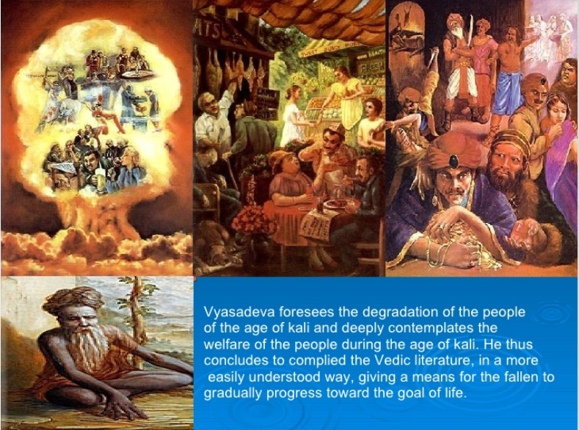

Slide 30
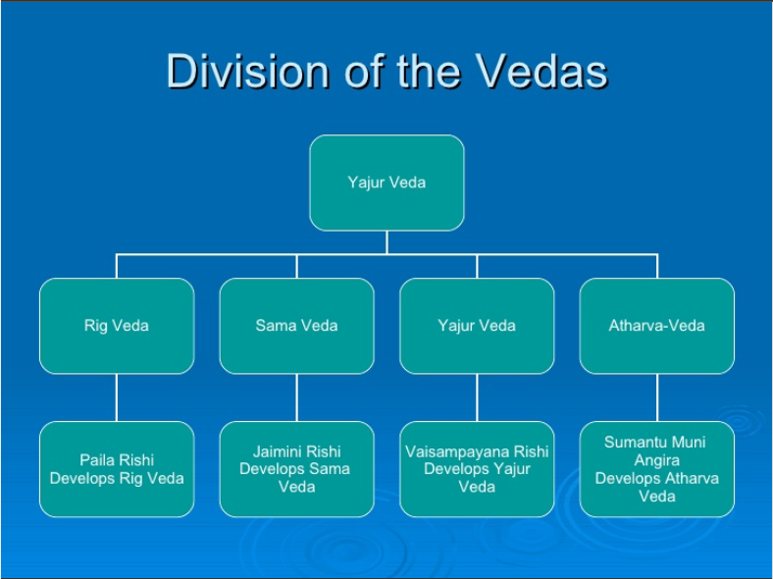

Slide 31
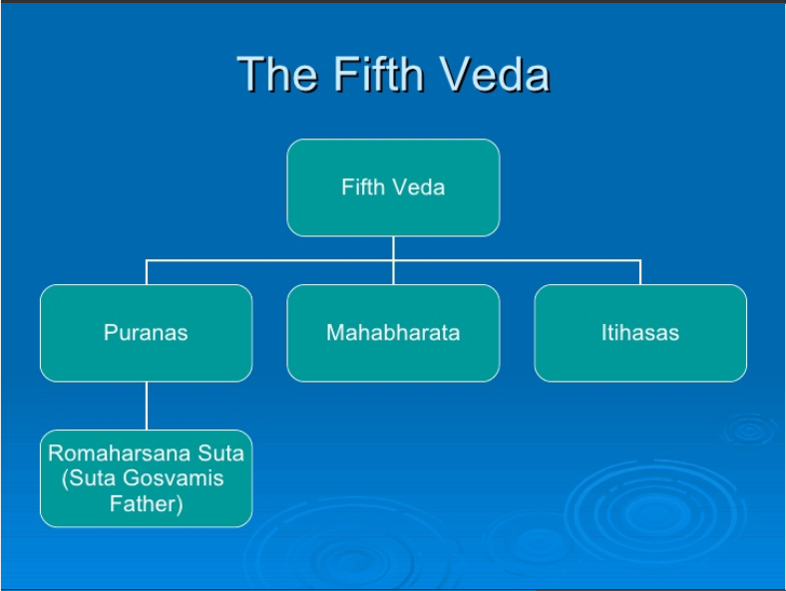

Slide 32

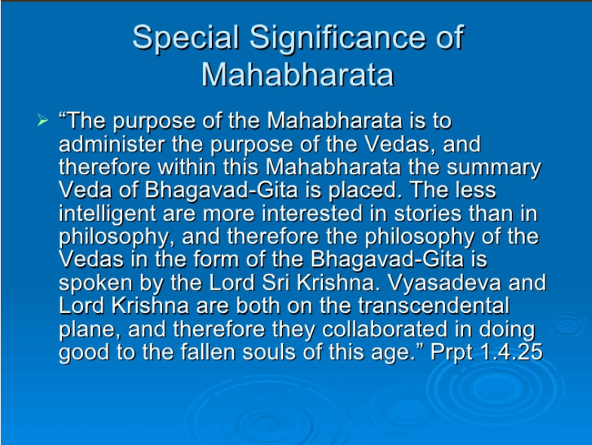

Slide 33
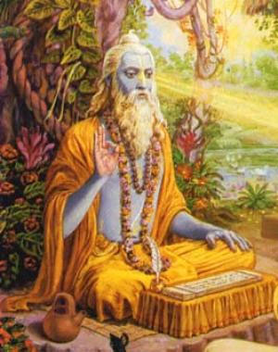
26-31: Vyasadeva’s dissatisfaction
He reflected on the cause of dissatisfaction
His efforts:
(i) underwent strict disciplinary vows,
(ii) unpretentiously worshiped the Vedas,
the spiritual master and the altar of sacrifice.
(iii) Abided by the rulings
(iv) shown the import of
disciplic succession through the
explanation of the Mahäbhärata.
    Still a feeling of incompleteness
Catches the possible clue: may be because
I have not pointed out DS which is dear to both
- perfect beings and the infallible Lord.

Slide 34
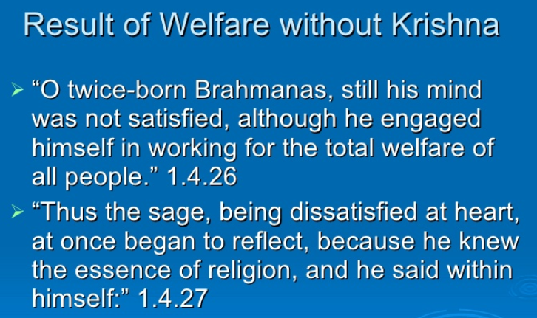
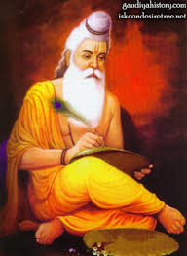

Slide 35
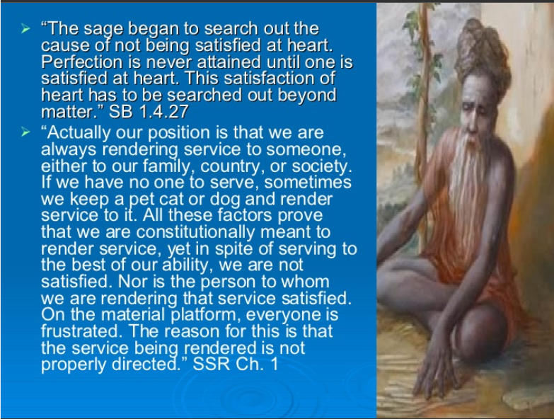

Slide 36
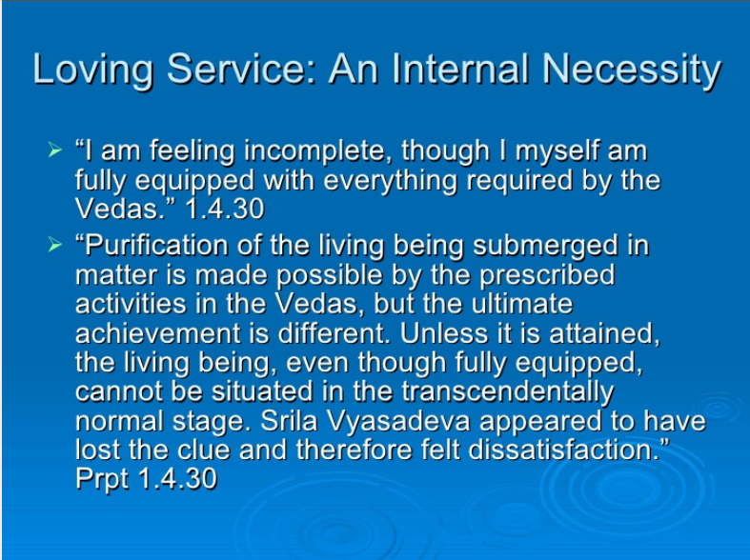

Slide 37
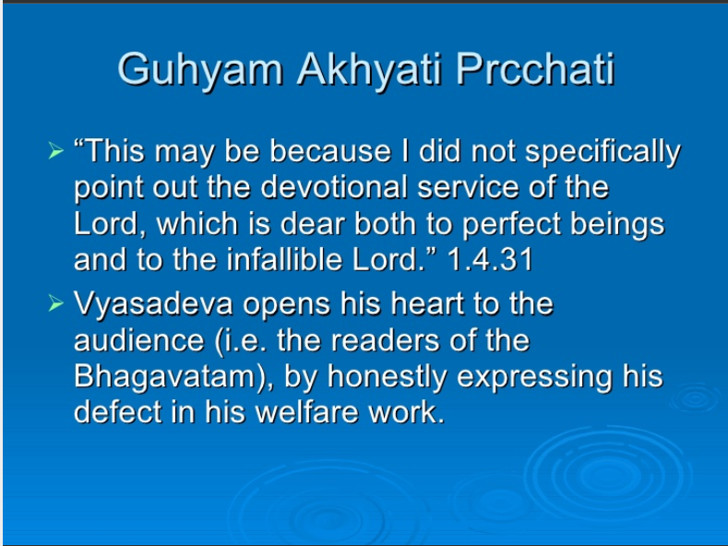

Slide 38
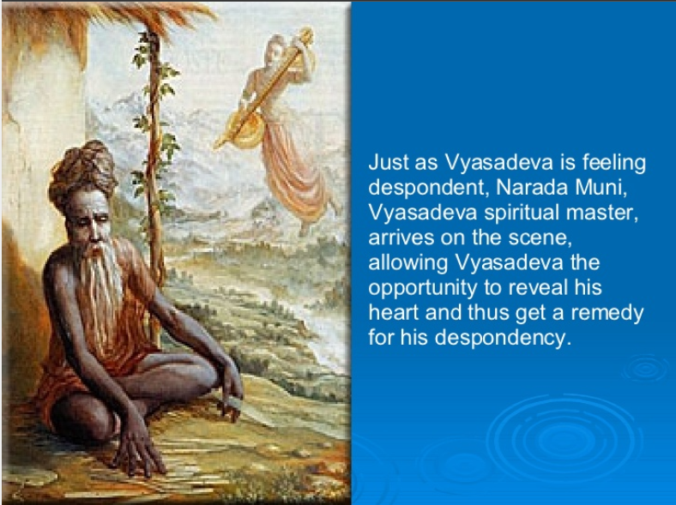
kià vä bhägavatä dharmä
na präyeëa nirüpitäù
priyäù paramahaàsänäà
ta eva hy acyuta-priyäù

Slide 39
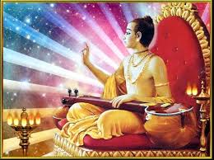
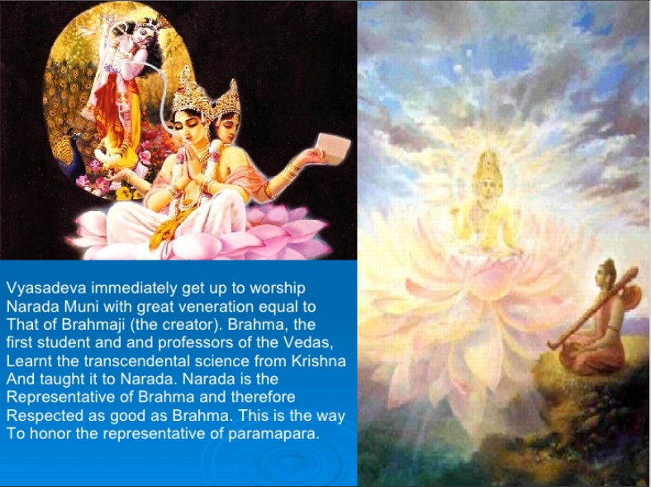

Slide 40
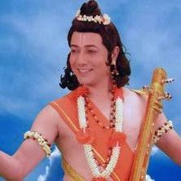
Chapter 4 Overview
1.4. Appearance of Narada
1-13: Saunaka appreciates Suta & asks 4 questions
Suta is most fortunate & respected of all speakers (2) & expert, can answer all questions (13)
Pious message of SB (2)
A: History – what period, place, why?
B: Where did Vyasa get inspiration? (3)
About Suka (4-6)
Transcendental, appeared ignorant (4)
Made no distinctions b/w male & female (5)
Reception at Hastinapura? (6)
About Suka’s meeting with Parikshit (7,8)
Stay at a house for milking time (8)
About Parikshit’s birth & acts (9-12)
Exalted emperor, why gave up everything? (10)
Enemies surrender to him for own benefit (11)
How did he give up mortal body, shelter for others? (12)
Suta’s reply
History of Vyasa’s birth, place (A) (14,15)
Vyasadeva’s vision (16-18)
Future anamolies of Kaliyuga
Deterioration of everything material
Faithless people – life duration reduced, impatient due to lack of goodness
Contemplation for welfare & Division of Veda (19-23)
Vedic sacrifices for purification
Simplified Vedic process by dividing 1 Veda into 4
5th Veda – Histories & Puranas
Entrusted Vedas to scholars – further entrusting to granddisciples.
Reason for division (24-25)
Kindness to the ignorant
For assimilation by the less intelligent
To enable man to achieve ultimate goal of life
Compassion: Mahabharata for stri, sudra, dvijabandhu
Vyasa’s dissatisfaction & reflection (26-31)
Efforts: Strict disciplinary vows & parampara, Worshiped Vedas, SM & sacrificial fire, Compiled MB
Cause: not specifically pointing out DS
Narada’s arrival & reception (32-33)

Slide 41
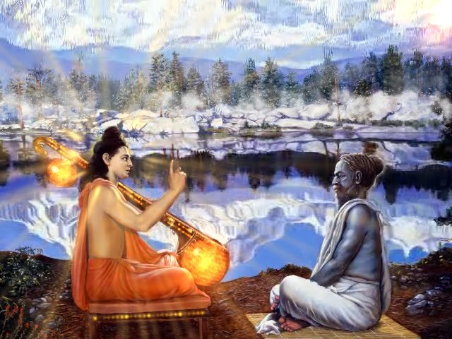
Entering Chapter 5
Narada muni appears as Vyasadeva was regretting Vyasadeva receives him

Slide 42
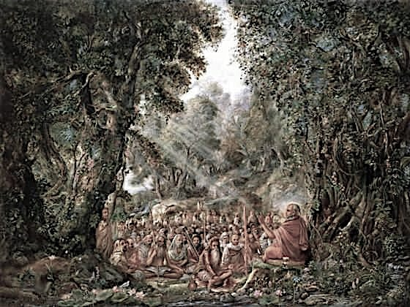
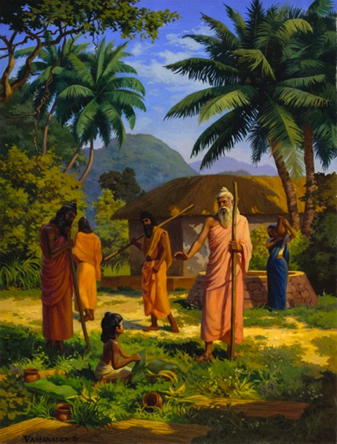
1.5. Narada’s Instruction on Srimad Bhagavatam to Vyasadeva
Contents
Vyasadeva’s despondency
Narada muni’s diagnosis
Narada muni’s previous life
Narada muni’s advice to Vyasadev – describe Lord’s glories

Slide 43
SRIMAD BHAGAVATAM, the Crest Jewel of All Puranas
You are welcome Tomorrow for
First Canto Chapter 5
Narada’s Instruction on SB to Vyasa
By His Divine Grace A.C.Bhaktivedanta Swami Prabhupada, Founder Acarya of ISKCON

