Slide 1
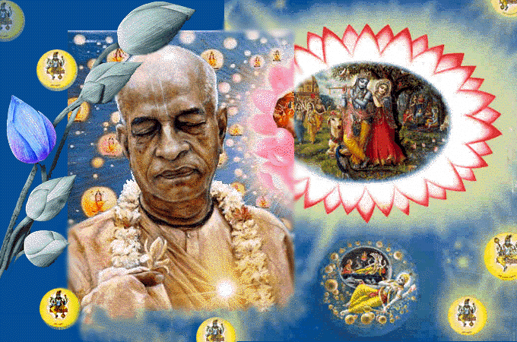
SRIMAD BHAGAVATAM, the Crest Jewel of All Puranas
By His Divine Grace A.C.Bhaktivedanta Swami Prabhupada, Founder Acarya of ISKCON
Bhagavata
Rasamaalayam
A 19-Session Presentation of First Canto of SB
by Radheshyam das, ISKCON, NVCC, Pune
www.live.radheshyamdas.com

Slide 2
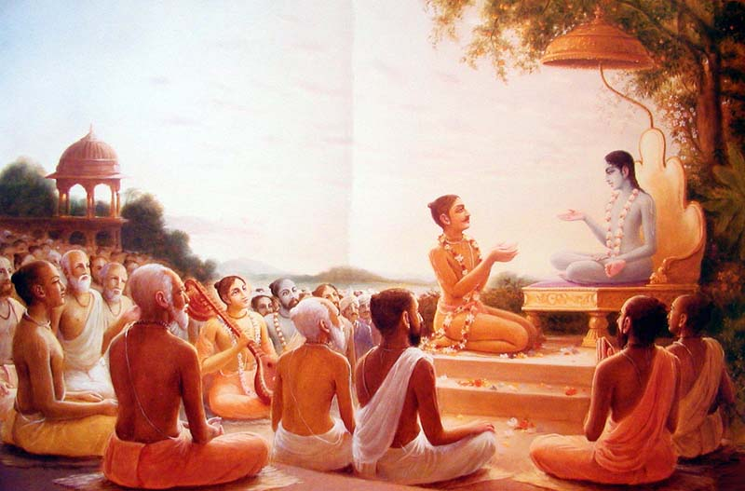
Bhagavata Rasamaalayam
A 19-Session Presentation of First Canto of SB
by Radheshyam das, ISKCON, NVCC, Pune
SB Canto 1 Chapter 2
Divinity and Divine Service

Slide 3

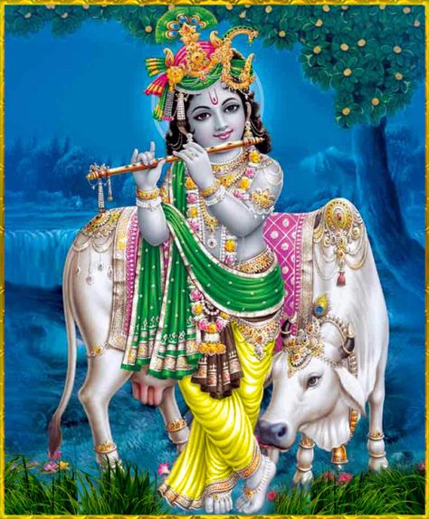
Chapter 1
Overview
1-3: Prelude
Definition of Absolute Truth
Glories of SB, Actual religion
Invitation to relish SB
4-8: Sages glorify Suta Goswami
Sages assemble for sacrifice to satisfy SPG & devotees
Offer seat to Suta Goswami & glorify him
9-23: Sages describe condemned state of affairs of Kaliyuga people & ask 6 questions, expressing their eagerness to hear
Kali yuga people
Eagerness to hear
6 questions
1.1. Questions by Sages

Slide 4
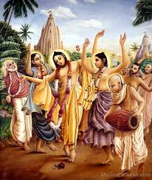
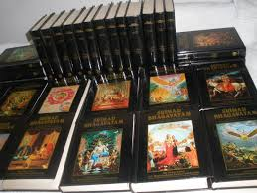
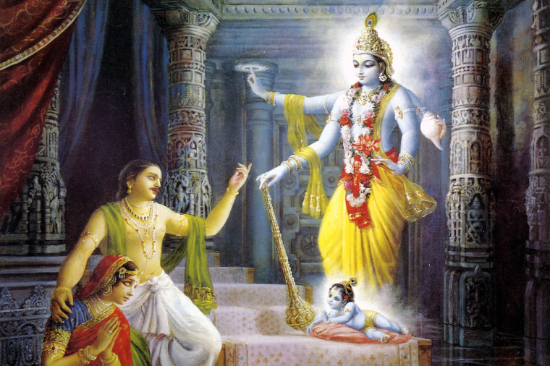
The 6 Questions by Sages
What is the absolute & ultimate good for people in general?
What is the essence of all scriptures?
Why Çré Kåñëa, the Supreme Personality of Godhead appeared?

Slide 5
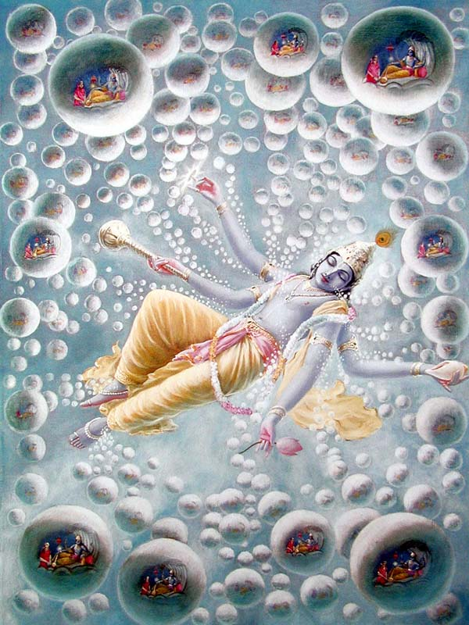
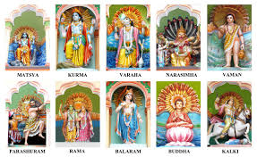
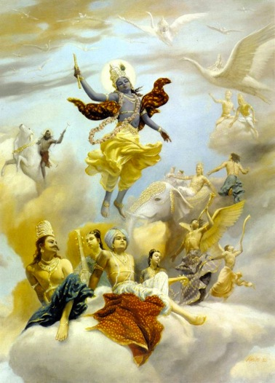
The 6 Questions by Sages
What acts did the Lord perform in relationship to creating the material world.
What are activities of the incarnations of the Lord?
Where have religious principles gone after Lord Çré Kåñëa's disappearance from this planet?

Slide 6
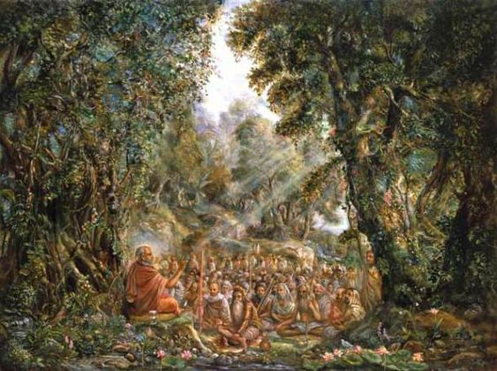
Entering Chapter 2
Çréla Süta Gosvämé perfectly satisfied by the questions, thanked and attempted to reply

Slide 7
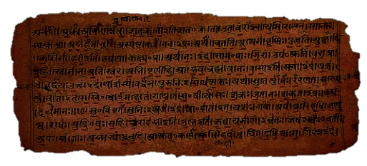
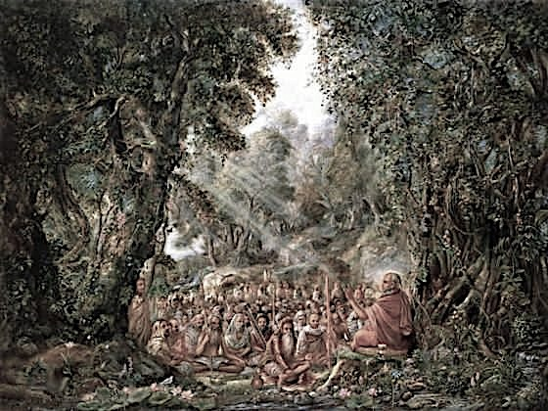
1.2. Divinity & Divine Services
Contents
Suta’s reply begins with obeisances
Answers to sages’ questions 1, 2, 3 & 4
Glories of Bhakti
Superiority of Krsna’s worship

Slide 8
Chapter 2 Overview
2nd, 3rd and 4th Verses → Obeisances to Guru
4th Verse → Obeisances to Vyasadeva
5th Verse → Appreciating Hearers
6th & 7th Verses → Answer to Q1 & Q2
8th to 11th Verses → Spiritual duty & Occupational duty
12th to 22nd Verses → Hearing : process of perfection in KC
23rd to 29th Verses → Krishna is Supreme Goal &
only Object of Worship
30th to 34th Verses → Answer to Q3 & Q4
Lord, though transcendental to
material world creates & maintains it.

Slide 9
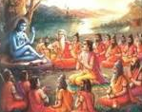
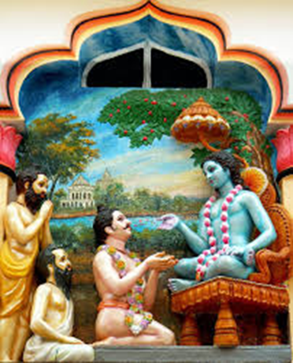
Suta’s reply – begins with obeisances & appreciates the questions
Obeisances to Sukadeva Goswami
yaù svänubhävam akhila-çruti-säram ekam
adhyätma-dépam atititérñatäà tamo 'ndham
saàsäriëäà karuëayäha puräëa-guhyaà
taà vyäsa-sünum upayämi guruà munénäm
narayanam namaskrtya…

Slide 10
Suta’s reply – begins with obeisances & appreciates the questions
Only questions related to Lord Krishna are capable of benefitting all & completely satisfying the self.
munayaù sädhu påñöo 'haà
bhavadbhir loka-maìgalam
yat kåtaù kåñëa-sampraçno
yenätmä suprasédati

Slide 11
The 6 Questions by Sages
What is the Absolute & ultimate good for
people in general?
What is the essence of all scriptures?

Slide 12
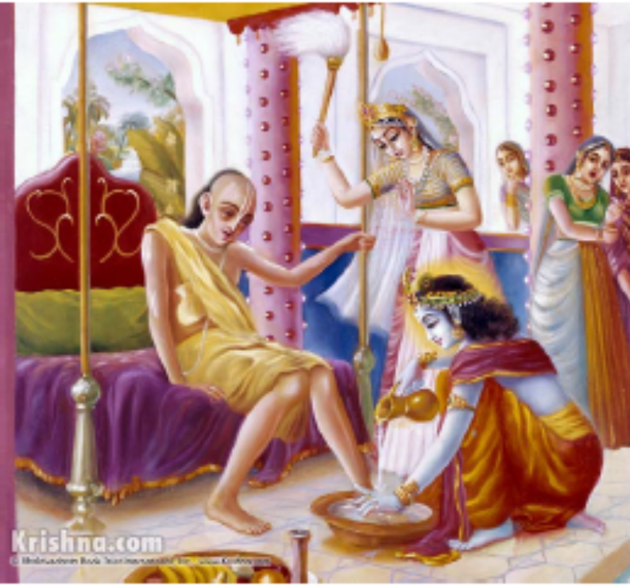
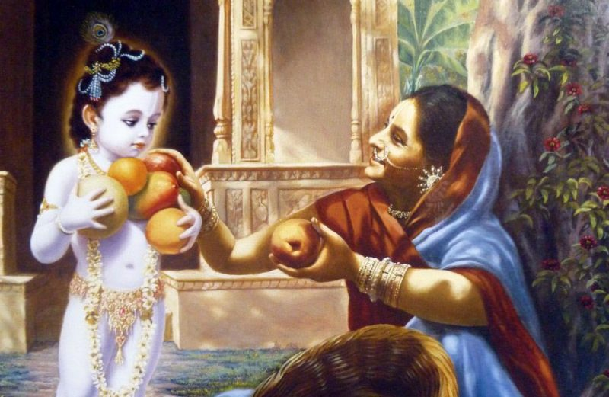
Answer to Questions 1 & 2
1.2.6 & 7: Supreme dharma is Bhakti;
it produces
knowledge & detachment.
sa vai puàsäà paro dharmo
yato bhaktir adhokñaje
ahaituky apratihatä
yayätmä suprasédati
väsudeve bhagavati
bhakti-yogaù prayojitaù
janayaty äçu vairägyaà
jïänaà ca yad ahaitukam

Slide 13
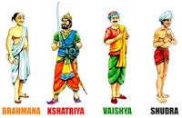
1.2.8-11: Occupational duties &
Kåñëa consciousness
Varnasrama Dharma is useless labor if
it doesn’t provoke attraction for Krishna katha (8)
dharmaù svanuñöhitaù puàsäà viñvaksena-kathäsu yaù
notpädayed yadi ratià çrama eva hi kevalam
Material gain or sense gratification are
never the goal of all occupational engagements. (9)
Maintaining healthy life, inquire only about Absolute Truth who is perceived as Brahman, Paramätmä and Bhagavän (10-11)

Slide 14
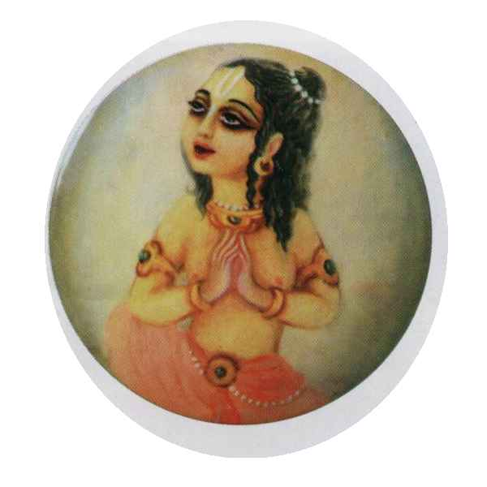
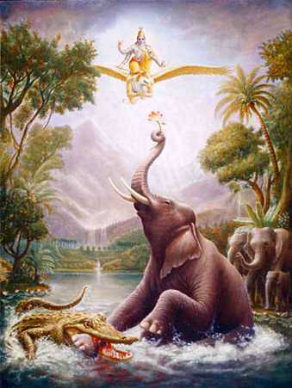
12-22: Hearing Bhagavatam is
the process of perfection
Process of realising Absolute Truth is
Devotional service, which is the
only purpose of Varnasrama dharma (12-13)
So, by any means focus on
devotional service (14)
tasmäd ekena manasä
bhagavän sätvatäà patiù
çrotavyaù kértitavyaç ca
dhyeyaù püjyaç ca nityadä
Remembrance of Lord
cuts the knot of karma (15)

Slide 15
16-21: Stages of Bhakti
1.2. Divinity & Divine Services
1 – 7: Suta goswami’s reply
16–21: Bhakti progresses
8–15: Only Bhakti is to be gained
22–29: Only Krsna is to be served
30–34: Purushavataras – Krsna in MW
Service to devotees (16)
Affinity to hear (16)
Paramatma cleans heart of material desires (17)
Effect of lower modes disappear (19)
Loving service establishes as irrevocable fact (18)
Established in goodness, happy (19)
Mind enlivened by DS (20)
Gains +ve scientific knowledge of PoG (in liberated stage) (20)
Knot of heart pierced, misgivings cut, chain of fruitive action terminated, self as master
Sraddha (16)
Sadhu sanga (16)
Bhajana kriya (16)
Anartha nivritti (17)
Nishta (18)
Ruci (19)
Asakti (19)
Bhava (20)
Prema (20)

Slide 16
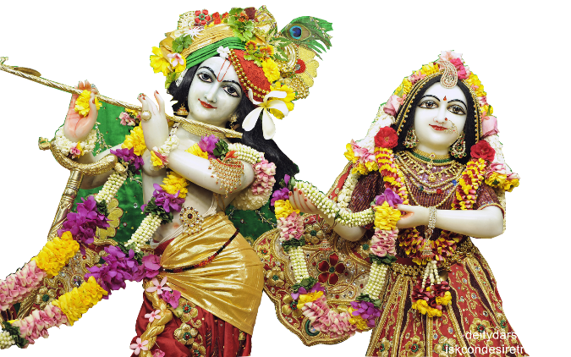
Nine Stages from Sraddha to Prema Bhakti
ädau çraddhä tataù sädhu-saìgo ‘tha bhajana-kriyä
tato ‘nartha-nivåttiù syät tato niñöhä rucis tataù
athäsaktis tato bhävas tataù premäbhyudaïcati
sädhakänäm ayaà premëaù prädurbhäve bhavet kramaù
Sraddha
Sadhu Sanga
Bhajana Kriya
Anartha Nivrtti
Nistha
Asakti
Bhava
Prema
Ruci

Slide 17
What is the cause of Bhakti?
Bhakti?
Lord’s mercy
Devotees causeless mercy
Shubha-Karma

Slide 18


A Practical Analogy
7
6
5
8
4
9
3
2
1

Slide 19

1) Ädau çraddhä: (faith)
What does çraddhä mean?
  Faith?
    Respect
    Interest
But why does one have çraddhä and other not?
  Sukrti
    Good Deeds (Service to the Supreme leads to respect for the Supreme)
    Service & Respect are naturally linked
How causes one to unknowingly perform divine service?
  Devotion in the heart of devotees

Slide 20
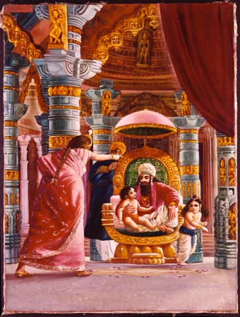
1) Ädau çraddhä: (faith)
Two types of çraddhä
  Svabhaviki (ex. Narada boy)
  Bala utpadita (ex. Dhrtarashtra)
When faith matures sufficiently
it leads him to take
association of a devotee

Slide 21
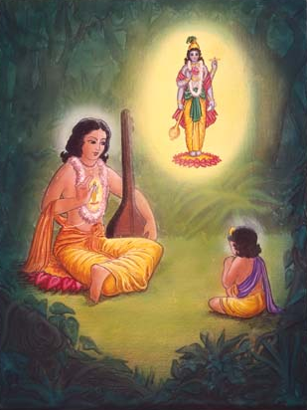
2) Sädhu-saìga: (association of devotee)
Often results in exchange of views initially
Seeing genuineness (of understanding & practice) one asks some questions
Faith grows with association.
  They strengthen & push each other
Respect arises &
a sense of service develops
The devotee engages us in
some practical devotional service

Slide 22
2) Sädhu-saìga: (association of devotee)
çuçrüñoù çraddadhänasya väsudeva-kathä-ruciù
syän mahat-sevayä vipräù puëya-tértha-niñevaëät
O twice-born sages, by serving those devotees who are completely freed from all vice, great service is done. By such service, one gains affinity for hearing the messages of Väsudeva. (SB 1.2.16)
This verse depicts the stage of çraddhä & Sädhu-saìga

Slide 23
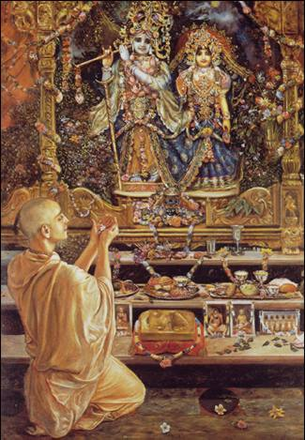
3) Bhajana-kriyä: (practicing devo. activities)
Depending on one’s sincerity & simplicity one progress
Engages in more service
  Chanting
  Following regulative principles
By Bhajana-kriyä one attains
freedom from materialistic life
Yet he is unsteady in his practice

Slide 24
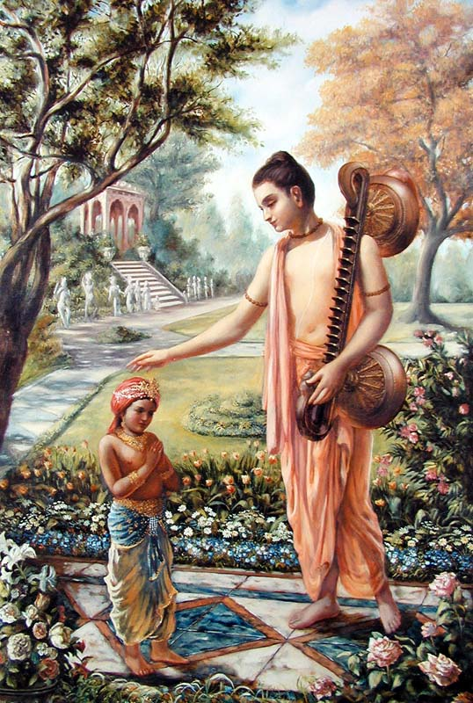
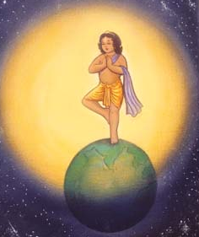
3) Bhajana-kriyä: (practicing devo. activities)
çåëvatäà sva-kathäù kåñëaù puëya-çravaëa-kértanaù
hådy antaù-stho hy abhadräëi vidhunoti suhåt satäm
Çré Kåñëa, the Personality of Godhead, who is the Paramatma [Supersoul] in everyone's heart and the benefactor of the truthful devotee, cleanses desire for material enjoyment from the heart of the devotee who has developed the urge to hear His messages, which are in themselves virtuous when properly heard and chanted. (SB 1.2.17)
This verse depicts the
stage of Bhajana-kriyä

Slide 25

4) Anartha-nivåtti: (nullification of misgivings)
Clearing of unwanted obstacles on the path of Bhakti
Categorized as
  Duskrtottha: Arising from Past Sins
  Sukrtottha: Desire for enjoyments
  from pious acts
  Aparadhotta: Arising from offences
  Bhaktyutta: Arising from Bhakti as
  wealth, position, fame
  overwhelm the heart

Slide 26
4) Anartha-nivåtti: (nullification of misgivings)
Gramo-dagdhah Pato Bhagnah nyaya
Each of the four types of anarthas have five grades of anartha nivrtti (nullification) :
  Limited/partial (eka-desha-vartini),
  Substantially (bahu-desha-vartini),
  Almost complete (praayiki),
  Complete (purna) and
  Absolute (atyantiki).

Slide 27
4) Anartha-nivåtti: (nullification of misgivings)
Repeatedly hearing & chanting can give Krsna prema
Serving sacred tirthas can bestow all perfections
Lord’s prasadam can destroy all desire for sense-enjoyment
THEN WHY DOES IT NOT HAPPEN??
OFFENCES

Slide 28
5) Niñöhä : (steady determination)
There are five persistent obstacles
  laya (sleep) during kirtana, sravana and smarana (japa) in increasing order,
  viksepa (distraction) towards mundane, like gossiping in japa
  apratipatti (disinterest in spiritual topics) even in the absence of laya & vikshepa,
  kasaya (tendency towards bad habits) such as anger, greed and pride
  Rasäsväda (inability to absorb mind in kirtana/ seva due to sense allurements).

Slide 29
5) Niñöhä : (steady determination)
nañöa-präyeñv abhadreñu nityaà bhägavata-sevayä
bhagavaty uttama-çloke bhaktir bhavati naiñöhiké
By regular attendance in classes on the Bhägavatam and by rendering of service to the pure devotee, all that is troublesome to the heart is almost completely destroyed, and loving service unto the Personality of Godhead, who is praised with transcendental songs, is established as an irrevocable fact. (SB 1.2.18)
This verse depicts the stage of Niñöhä

Slide 30
5) Niñöhä : (steady determination)
tadä rajas-tamo-bhäväù käma-lobhädayaç ca ye
ceta etair anäviddhaà sthitaà sattve prasédati
As soon as irrevocable loving service is established in the heat the effects of nature's modes of passion and ignorance, such as lust, desire and hankering, disappear from the heart. Then the devotee is established in goodness, and he becomes completely happy. (SB 1.2.19)
This verse depicts the effects of Niñöhä

Slide 31

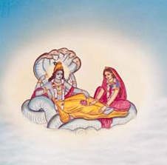
6) Ruci: (attainment of taste)
One develops constant taste for hearing & chanting
Constant performance does not cause fatigue
Jaundice of Avidya is cured
His heart repents for his former thoughts, speech & deeds & habits
He laments when he is not able to perform devotional service due to material circumstances

Slide 32

7) äsakti: (attachment to the lord)
Taste for doing bhajana reaches extreme depth and Krishna becomes the very object of one’s devotional service,
‘Ruci’ mainly has bhajana, devotional practice, as its subject, while ‘Asakti’ mainly has the Lord, the object of bhajana, as its subject.
Ruci is the immature stage of attachment, while Asakti is the mature stage.
No deliberate effort needed to engage the mind in Lord

Slide 33
7) äsakti: (attachment to the lord)
evaà prasanna-manaso bhagavad-bhakti-yogataù
bhagavat-tattva-vijïänaà mukta-saìgasya jäyate
Thus established in the mode of unalloyed goodness, the man whose mind has been enlivened by contact with devotional service to the Lord gains positive scientific knowledge of the Personality of Godhead in the stage of liberation from all material association. (SB 1.2.20)
This verse depicts the stage of Asakti

Slide 34
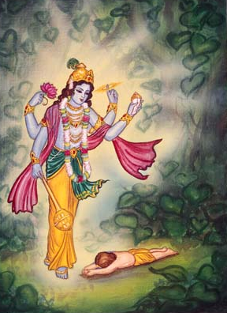
8) Bhäva: (ecstatic love)
When ‘asakti’ achieves its utmost maturity it is called ‘rati’ or ‘bhava’
The devotees relish with the lord in following rasas
  santa (neutral);
  dasya (servitude);
  sakhya (friendship);
  vatsalya (parental); and
  mädhurya (conjugal).

Slide 35
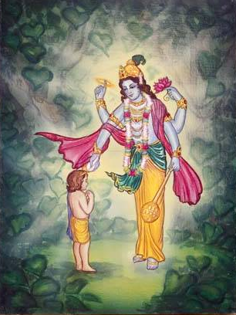
9) Prema: (pure love for Krishna)
Shining brilliantly, the fully blossoming flower of bhava matures and brings forth the fruit of prema.
Though previously the countless emotions of the devotees were tightly bound by the ropes of attachment to body, family, relatives, home and wealth, ‘prema’ now effortlessly cuts those bonds.

Slide 36
9) Prema: (pure love for Krishna)
bhidyate hådaya-granthiç chidyante sarva-saàçayäù
kñéyante cäsya karmäëi dåñöa evätmanéçvare
Thus the knot in the heart is pierced, and all misgivings are cut to pieces. The chain of fruitive actions is terminated when one sees the self as master. (SB 1.2.21)
This verse gives a glimpse of Prema

Slide 37
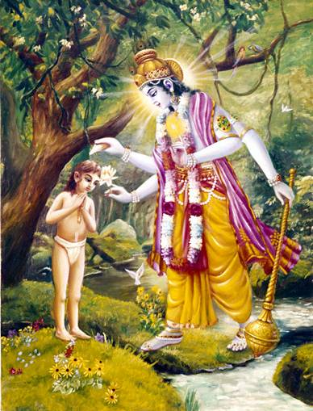
V.Chakravarti Thakura :
The fourteen steps are as follows:
  mercy of devotees,
  service to devotees,
  faith,
  surrender to guru,
  desire for worship (or hearing),
  bhakti,
  clearance of anarthas,
  niñöhä,
  ruci,
  äsakti, rati, prema, seeing the Lord, and
  experiencing the Lord’s sweetness.

Slide 38
How we make progress in
Krishna Consciousness….?
yugayitam & aslisya va
Prema
nayananam
Bhava
ayi nanda
Asakti
na dhanam
Ruchi
trnad api
Nishta
namnamakari
Anartha Nivritti
Bhajankriya
ceto darpana…
Sadhusanga
Sraddha

Slide 39
16-21: Stages of Bhakti
16–21: Bhakti progresses
Service to devotees (16)
Affinity to hear (16)
Paramatma cleans heart of material desires (17)
Effect of lower modes disappear (19)
Loving service establishes as irrevocable fact (18)
Established in goodness, happy (19)
Mind enlivened by DS (20)
Gains +ve scientific knowledge of PoG (in liberated stage) (20)
Knot of heart pierced, misgivings cut, chain of fruitive action terminated, self as master
Sraddha (16)
Sadhu sanga (16)
Bhajana kriya (16)
Anartha nivritti (17)
Nishta (18)
Ruci (19)
Asakti (19)
Bhava (20)
Prema (20)

Slide 40
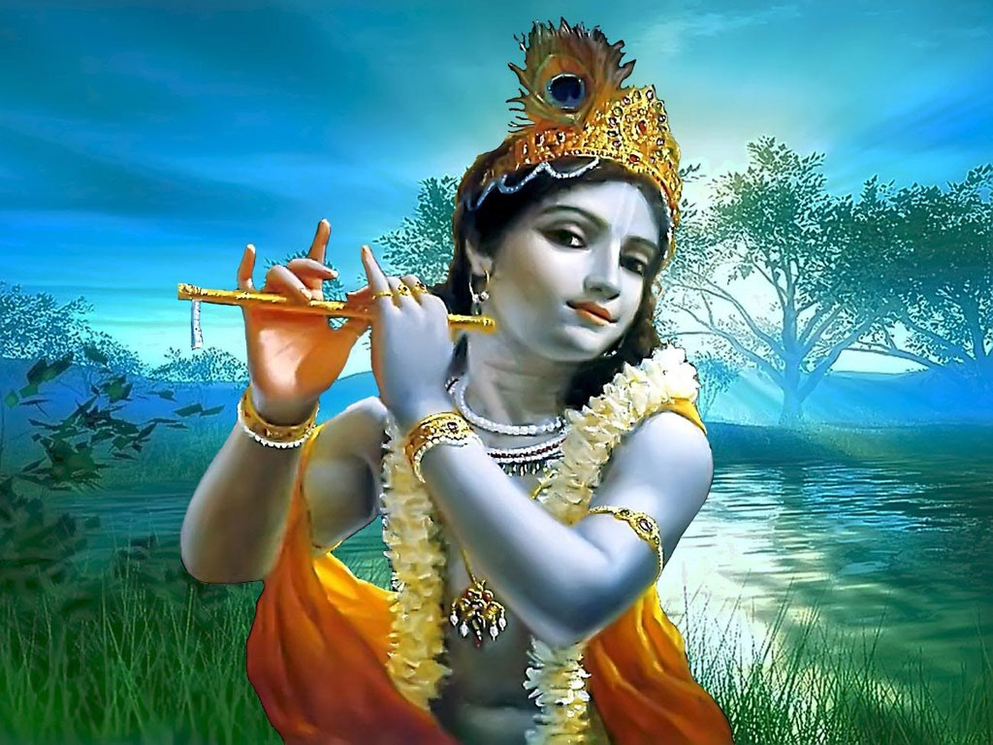

Slide 41
23-29: Kåñëa in relation to His various expansions (Glory of Bhagavan as topmost object of worship)
Vasudeva is Ultimate goal of
Gati
Dharma
Tapa
Jnana
Kriya
Yoga
Makha
Veda
Visnu worship is superior to worship of
Brahma & Siva
[Goodness >
Passion & Ignorance]
or other demigods
Lord Vasudeva is the essence of all processes

Slide 42
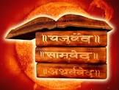
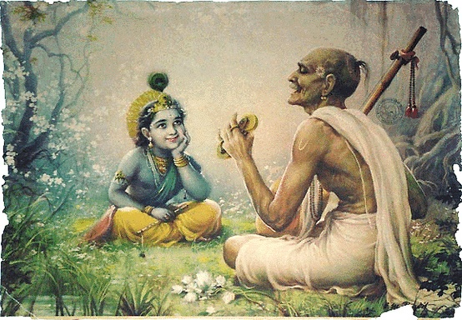
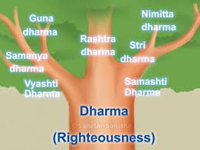
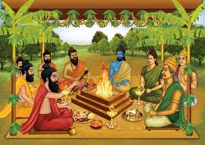
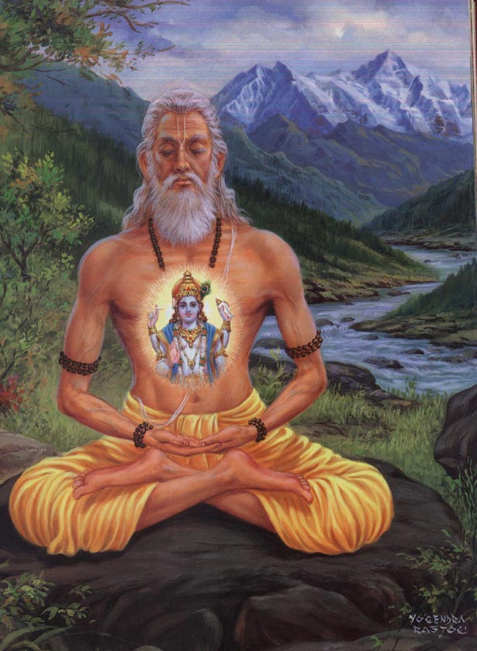
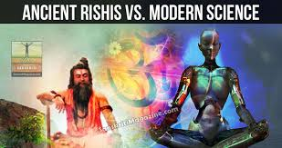
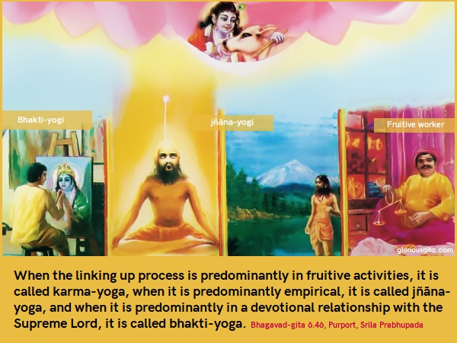
Vasudeva is Ultimate goal of
Gati
Dharma
Tapa
Jnana
Kriya
Yoga
Makha
Veda

Slide 43
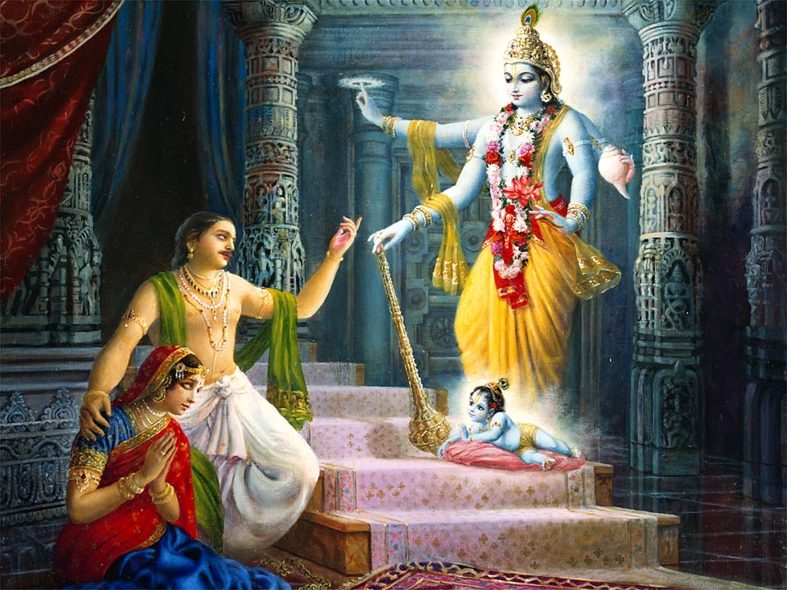
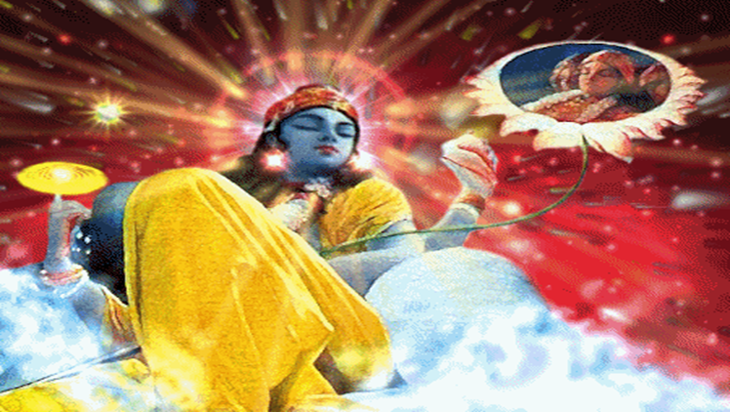
The 6 Questions by Sages
3. Why Çré Kåñëa, the Supreme Personality of Godhead appeared?
What acts did the Lord perform in relationship to creating the material world.

Slide 44
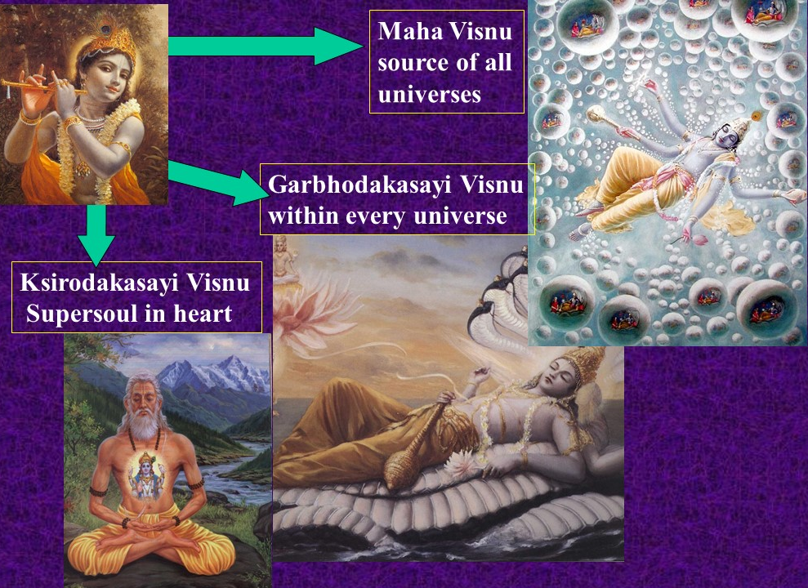
30-33: Answer to Questions 4
Answer to Question 4:
Krishna manifests the material world
by expanding Himself into the 3 purushavataras (30-33)

Slide 45
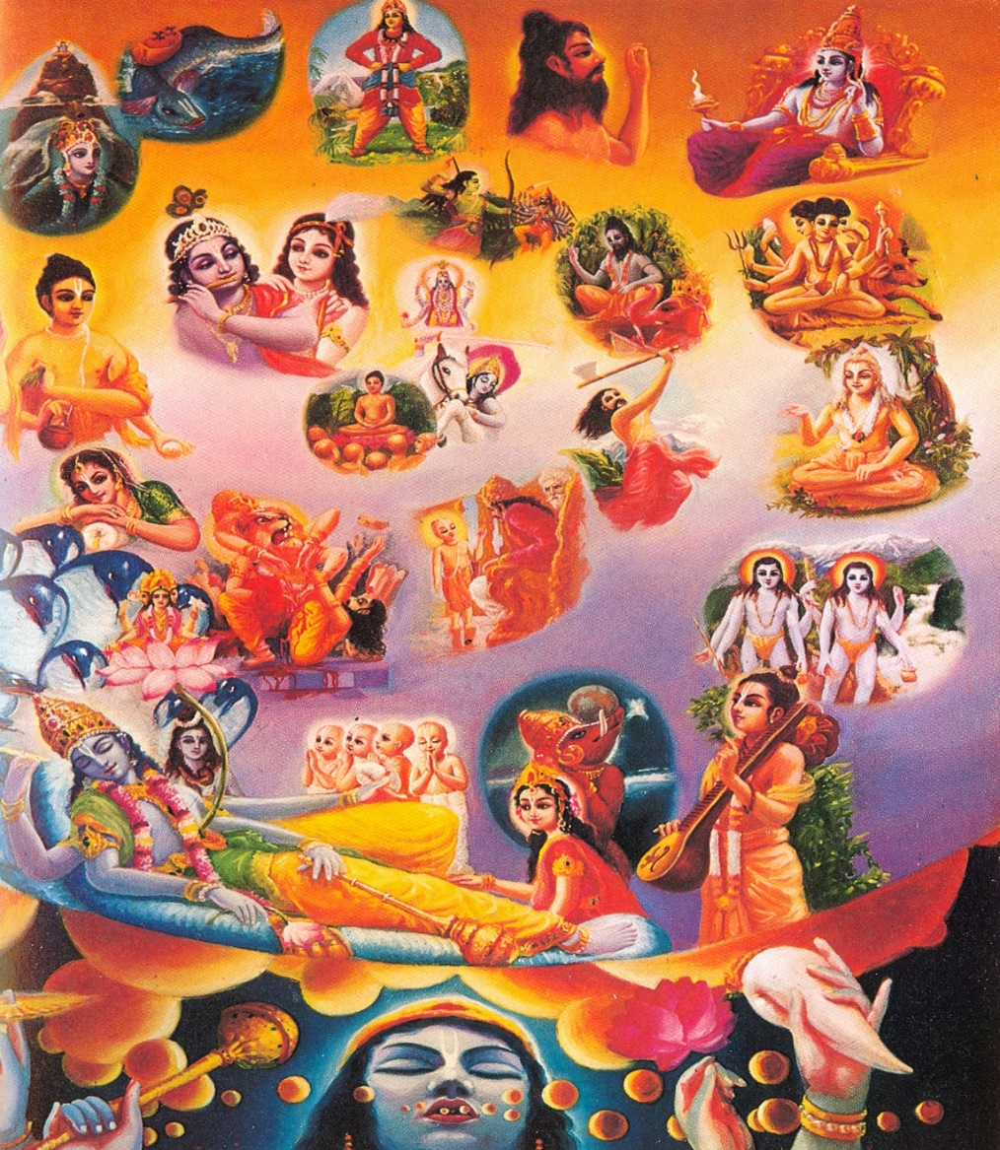
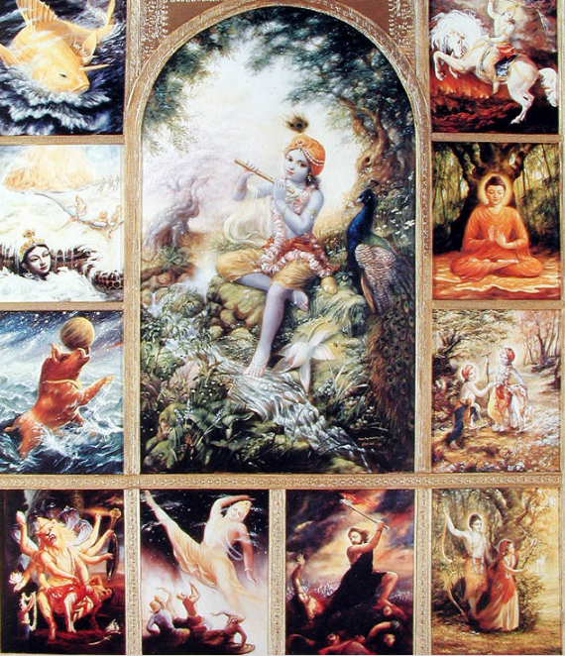
30-33: Answer to Questions 3
Answer to Question 3:
Assuming the roles of incarnations, the Lord performs pastimes (Lilavataras) to reclaim those in the mode of pure goodness.
{Lilavataras are described in Chapter 3}

Slide 46
Chapter 2 Overview
1.2. Divinity & Divine Services
1 – 7: Suta goswami’s reply
16–21: Bhakti progresses
Answers Q1 & Q2
8–15: Only Bhakti is to be gained
22–29: Only Krsna is to be served
30–34: Purushavataras – Krsna in MW
Glorifies sages’ questions
Offers obeisances
Occupational duty (8,9)
Desires of human being (10)
3 features of AT (11)
Realize AT by DS (12)
DS is only purpose of Varnasrama (13)
So, Hear, Glorify, Remember & Worship PoG (14)
Remembrance cuts karma knots. Who wont hear? (15)
Sraddha to Prema
Conclusion: All transcendentalists do DS (22)
Visnu to be worshiped among gunavataras (23-25)
Reject demigod worship (26)
Answer to Q3 (34)
Answers to Q4 (30-33)
Incarnations to reclaim pure souls

Slide 47
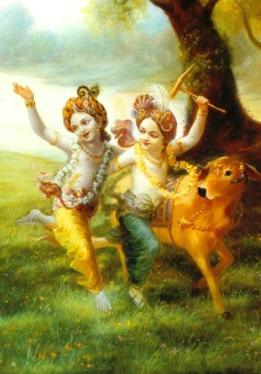
1.3. Krsna is the source of all Incarnations
Contents
Roles of Purushavataras
Description of 22 incarnations
Krsna is the source of innumerable incarnations
Material forms of Lord & Jiva are imaginary
Glories of Srimad Bhagavatam

Slide 48
SRIMAD BHAGAVATAM, the Crest Jewel of All Puranas
You are welcome Tomorrow for
First Canto Chapter 3
Krsna is the source of all Incarnations
By His Divine Grace A.C.Bhaktivedanta Swami Prabhupada, Founder Acarya of ISKCON

