Slide 1
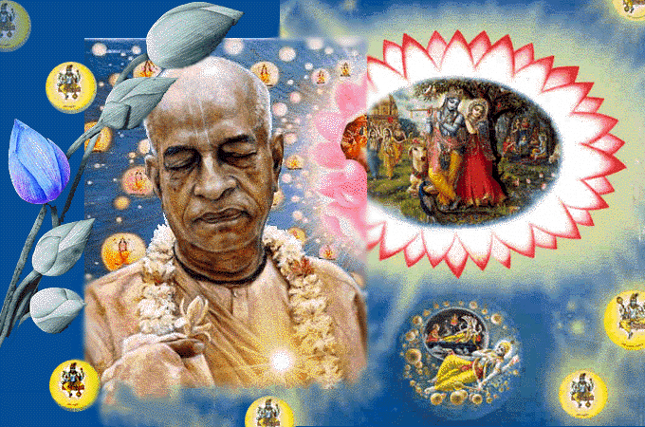
SRIMAD BHAGAVATAM, the Crest Jewel of All Puranas
By His Divine Grace A.C.Bhaktivedanta Swami Prabhupada, Founder Acarya of ISKCON
Bhagavata
Rasamaalayam
A 19-Session Presentation of First Canto of SB
by Radheshyam das, ISKCON, NVCC, Pune
www.live.radheshyamdas.com

Slide 2
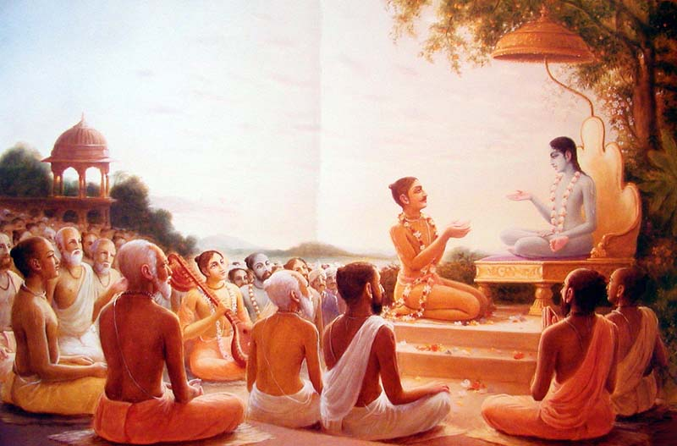
Bhagavata Rasamaalayam
A 19-Session Presentation of First Canto of SB
by Radheshyam das, ISKCON, NVCC, Pune
SB Canto 1 Chapter 7
Son of Drona Punished

Slide 3
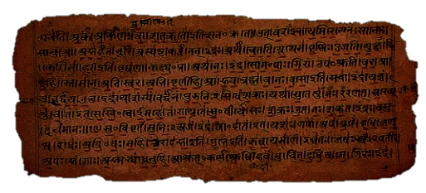
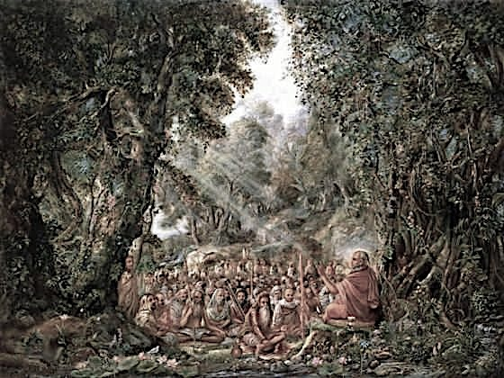
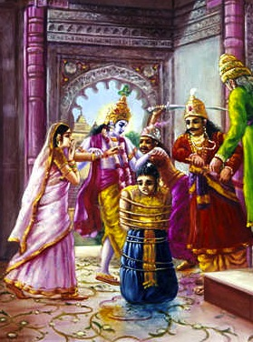
1.7. The Son of Droëa Punished
Contents
Vyasadeva’s meditation & vision
Glories of Bhagavatam
Suta answers questions about Parikshit
  Punishment of Asvatthama

Slide 4

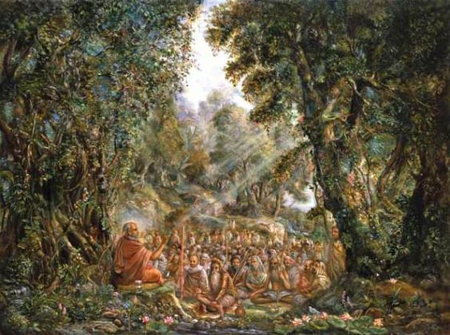
In SB 1.4.9, Saunaka Rishi inquired from Suta Goswami about Maharaja Parikshit’s birth and life because that story would lead to the retelling of how the Bhagavatam came to be spoken.
Suta Goswami’s words are always “vaksye krsna-kathodayam” -- words that give rise to speaking Krishna katha (SB 1.7.12). Suta begins narrating from the point of disaster, just after the Battle of Kurukshetra.

Slide 5
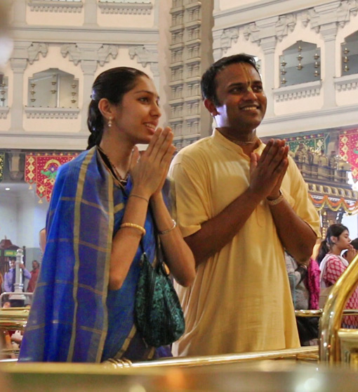
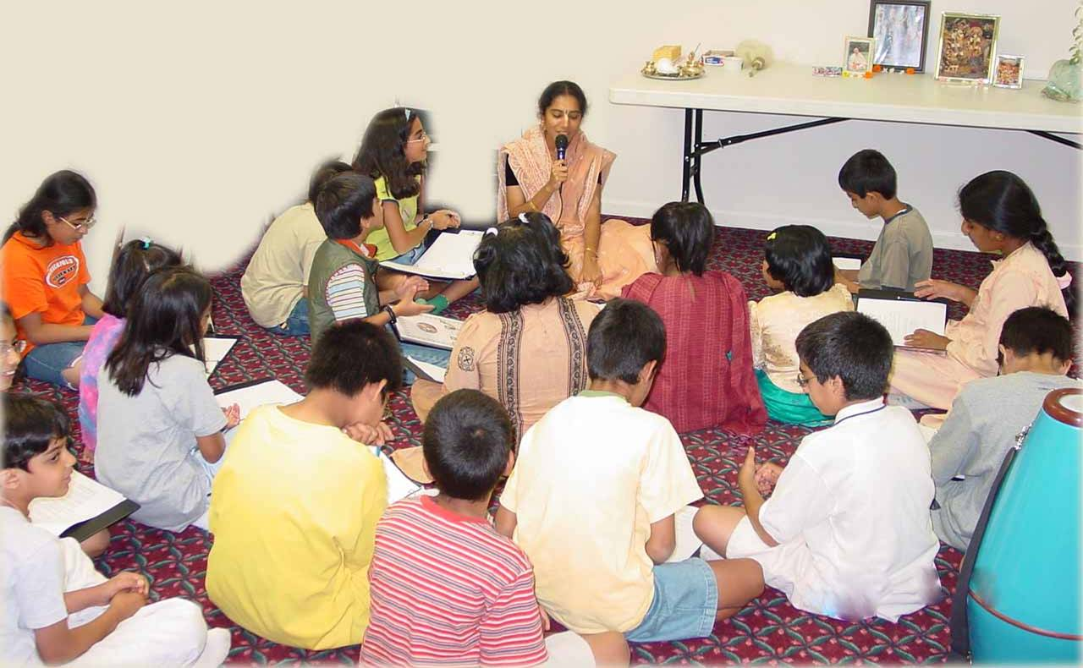
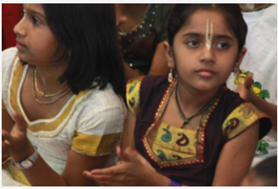
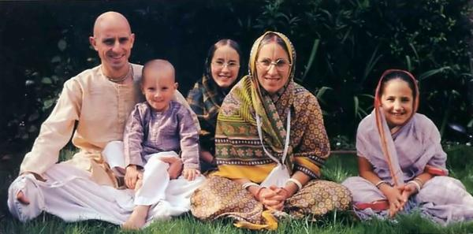
(1) Importance of staying in Ashram, SB 1.7.2

Slide 6
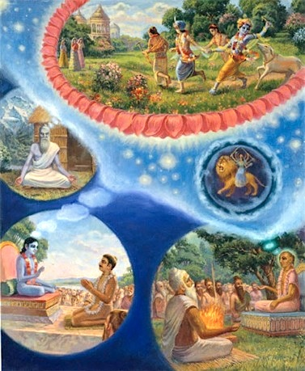
(2) Srila Vyasadeva’s meditation & vision, SB 1.7.4-5
What Meditation technique did Vyasa use?
bhakti-yogena manasi
samyak praëihite 'male
apaçyat puruñaà pürëaà
mäyäà ca tad-apäçrayam
Vyasadeva saw
Supreme Lord along with His external energy, which was under full control. [SB1.7.4]

Slide 7
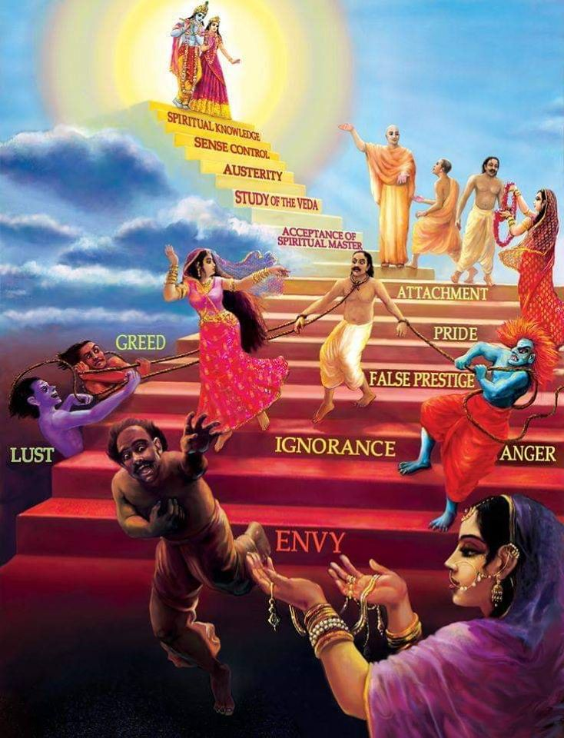
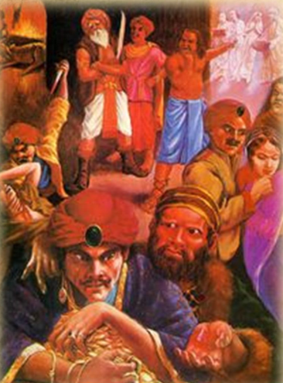
Living entity’s misidentification & suffering SB 1.7.5

Slide 8
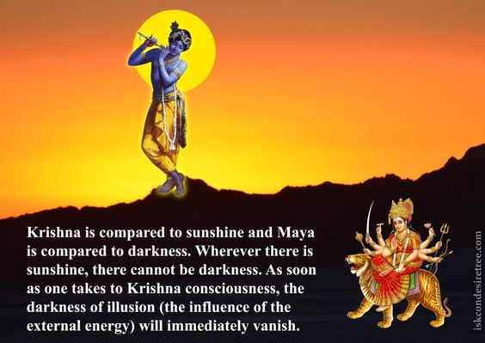
Living entity’s misidentification & suffering SB 1.7.5
yayä sammohito jéva
ätmänaà tri-guëätmakam
paro 'pi manute 'narthaà
tat-kåtaà cäbhipadyate [SB 1.7.5]

Slide 9
(3) Remedial measures for material sufferings, SB 1.7.6-7
Suffering can be mitigated by Bhakti yoga & Vyasadeva compiled Bhagavatam, hearing which loving devotional service sprouts in the jiva & extinguishes the soka, moha & bhaya
anarthopaçamaà säkñäd
bhakti-yogam adhokñaje
lokasyäjänato vidväàç
cakre sätvata-saàhitäm
yasyäà vai çrüyamäëäyäà
kåñëe parama-püruñe
bhaktir utpadyate puàsaù
çoka-moha-bhayäpahä

Slide 10
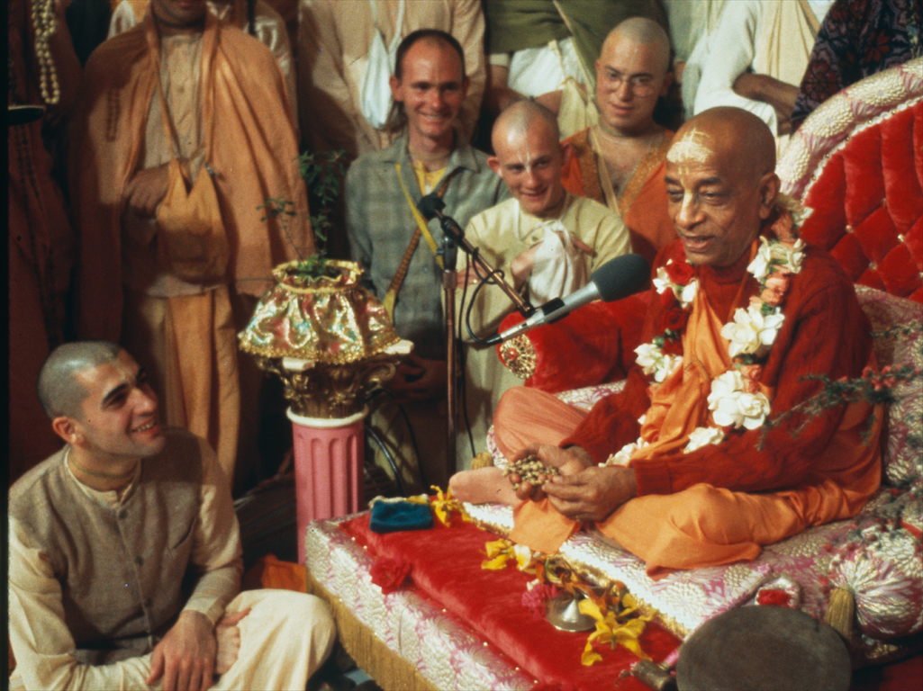
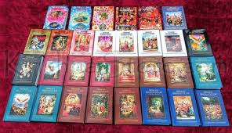
(4) Fruits for the hearers of Srimad Bhagavatam, SB 1.7.6

Slide 11
SB 1.7.8-11: Vyäsadeva Teaches Çrémad-Bhägvatam
to His son, Çréla Sukadeva Goswami
Saunaka: “Why Sukdeva Goswami, a liberated soul indifferent to everything took interest in SB?”
Suta: – Ätmäräma verse (Even liberated souls are attracted to qualities of Lord)
ätmärämäç ca munayo
nirgranthä apy urukrame
kurvanty ahaitukéà bhaktim
ittham-bhüta-guëo hariù

Slide 12
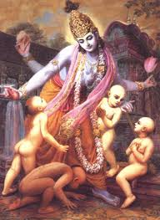
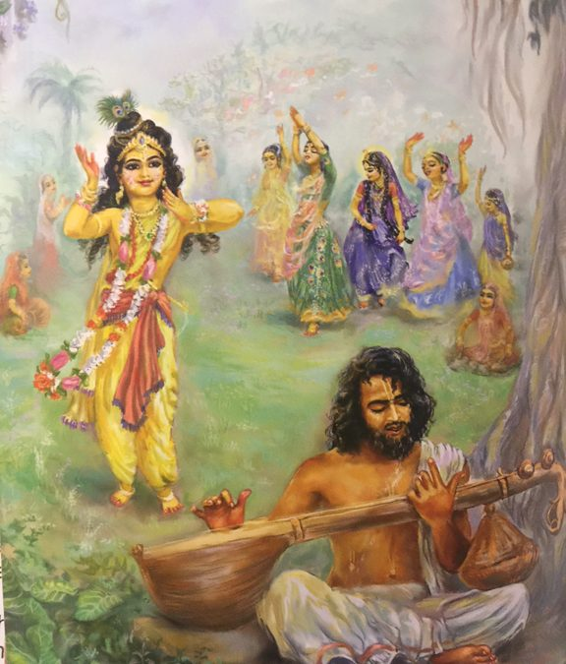
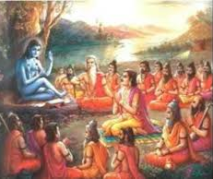
(5) Atmarama’s Ahaituki Bhakti, SB 1.7.10

Slide 13
Suta starts answering questions about Parikshit
[Asked by Saunaka in SB 1.4.9-12]
13-17: Death of sons of Pandavas & lamentation
  Asvatthama beheads 5 sleeping sons of Draupadi – Duryodhana displeased
  Draupadi cries in distress; Arjuna pacifies by offering to behead Asvatthama & moves out
18-21: Arjuna battles with Asvatthama
  Asvatthama flees in fear, Releases brahmastra w/o knowledge of withdrawal; Arjuna perceives danger
22-26: Arjuna’s prayers to Krsna
  Giver of fearlessness, Original & transcendental Lord
  Merciful to fallen souls – executes dharmadi
  Incarnates to remove earth’s burden & benefit devotes
  I don’t understand this effulgence...
27-28: Krsna responds
  Act of s/o Drona, Counteract with your weapon
29-34: Arjuna arrests Asvatthama
  Arjuna releases brahmastra; Effect of 2 Brahmastras described
  Arjuna retracts both & arrests Asvatthama

Slide 14
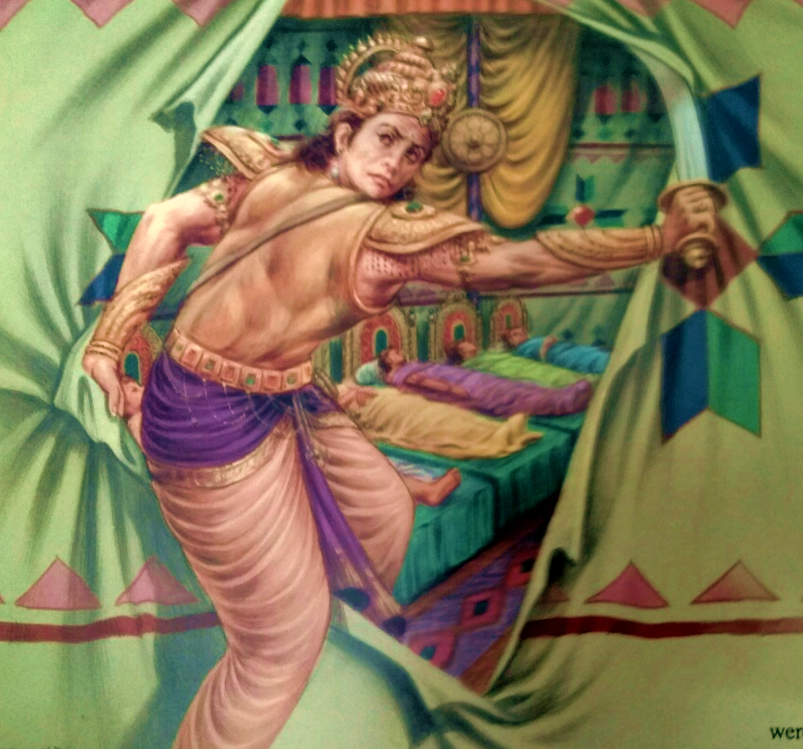
Ashwathama
Son of Dronacharya.
Ashwathama, at the end of the war promised Duryodhana to kill the
Pandavas. He attacked the Pandava camp in the middle of the night.

Slide 15
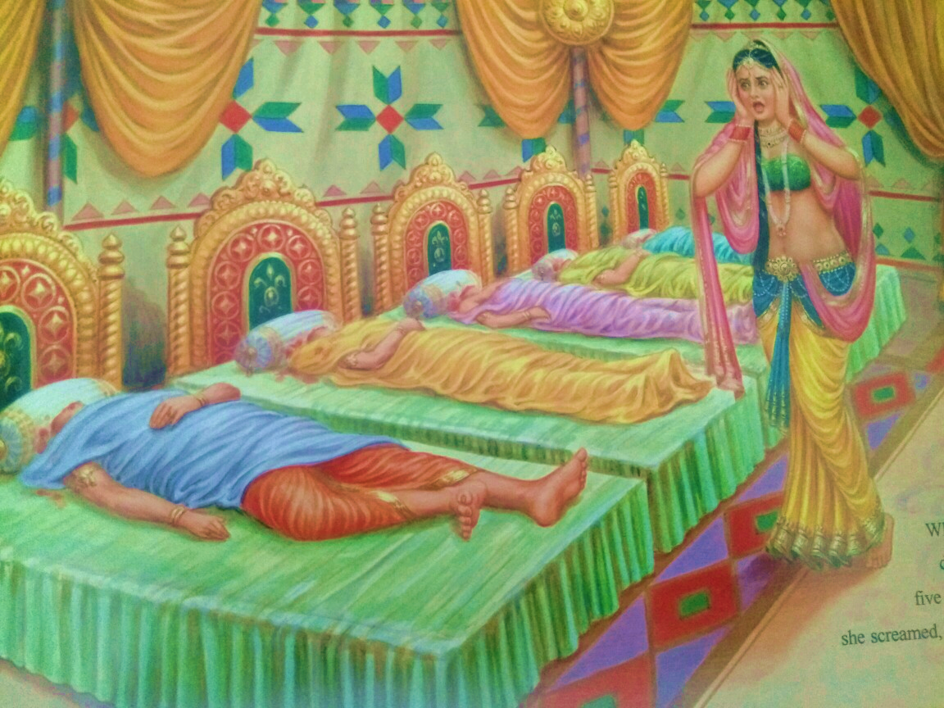
Ashwathama ended up murdering the 5 sons of the Pandavas by Draupadi.

Slide 16
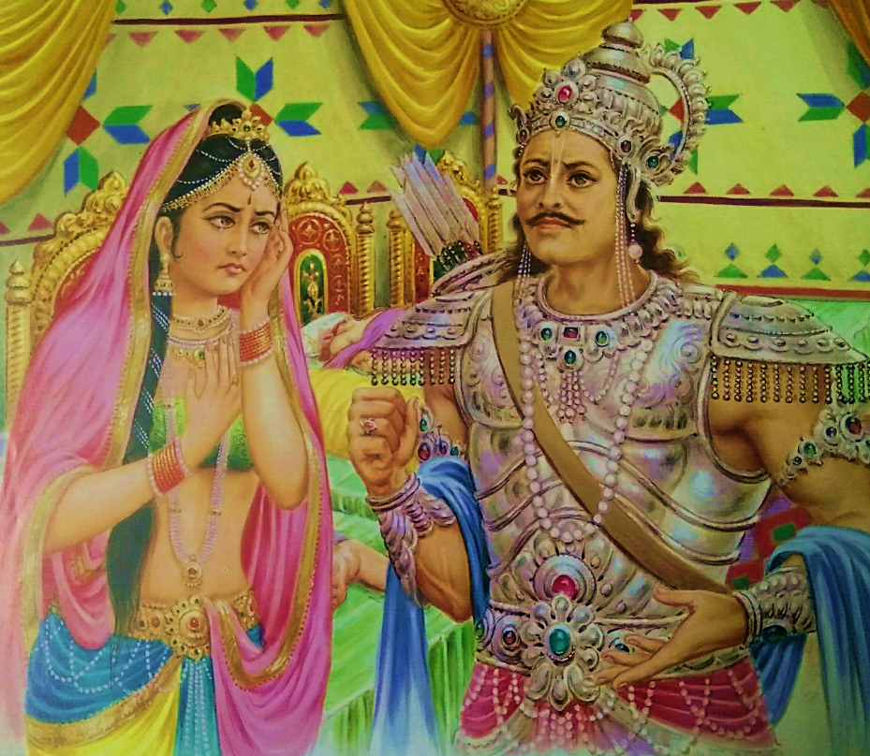
Arjuna spoke to grief stricken Draupadi, “O gentle lady, when I present you with the head of that brāhmaṇa, after beheading him with arrows from my Gāṇḍīva bow, I shall then wipe the tears from your eyes and pacify you. Then, after burning your sons’ bodies, you can take your bath standing on his head.”

Slide 17
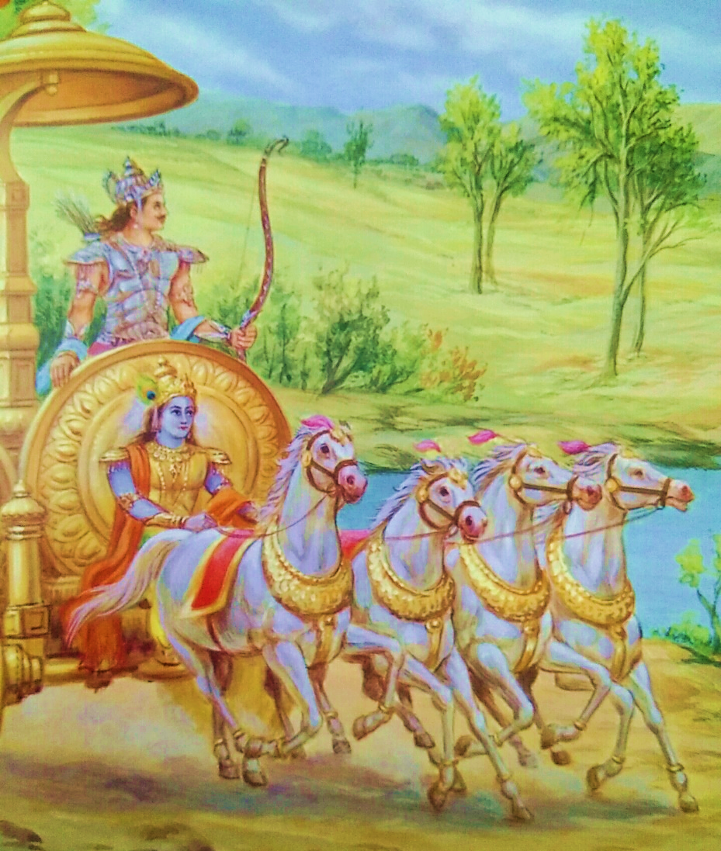
Arjuna armed himself with furious weapon, got into his chariot with infallible Lord Krishna as friend and driver, set out to follow Ashwathama.

Slide 18
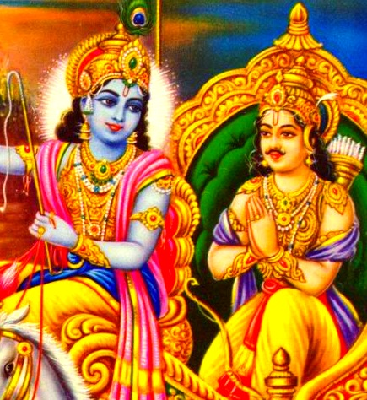
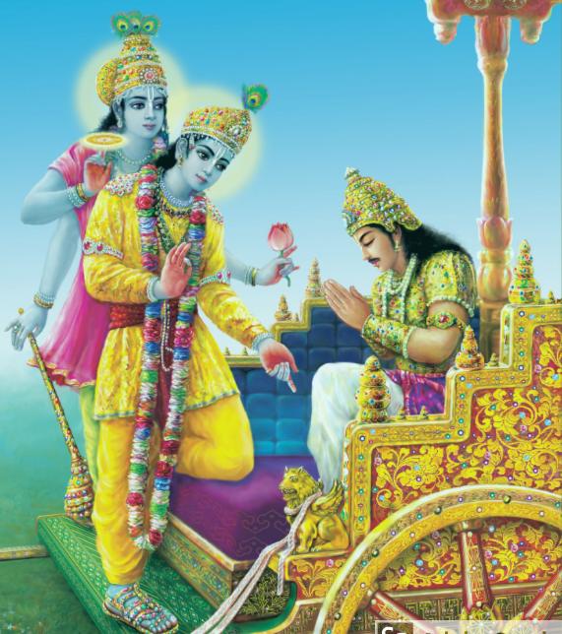
(6) Lord Krishna’s first entry into Srimad Bhagavatam as
Partha Sarathy, SB 1.7.22

Slide 19
All Contradictions are resolved in
Bhakta vatsal Krishna, SB 1.7.22
Jiva Goswami, Bhagavat Sandharba, anuccheda 47 :
Krishna must take birth in the material world to
give happiness to His devotees. He cannot avoid
coming. Does this not conflict with His independence?
One may say that His supreme independence and
His mercy contradict one another. Actually He is both
independent and merciful. Kurma Purana explains
the mutually contradictory qualities of the Lord
by simply stating that the SPOG possesses such
mutually contradictory qualities. (means all
contradictions are resolved only in Him!)

Slide 20
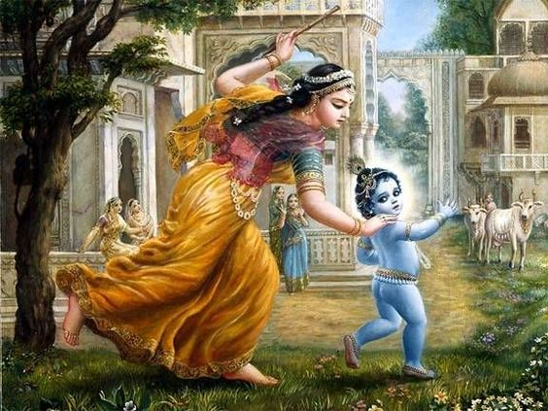
Eg. All Contradictions
are resolved in Krishna
Damodar Lila
Atmaram X hungry
Prashaant X Angry
Aptakaam X hankering
for Yasoda’s love
Laxmi’s husband X steals butter like beggar
Instills fear in X flees in fear of Yasoda’s stick
Time & death
Travels at speed of Mind X easily caught by Yasoda
Sandrananda, Condensed Bliss X Cries tears
Anantam X bound by Rope of Yasoda

Slide 21
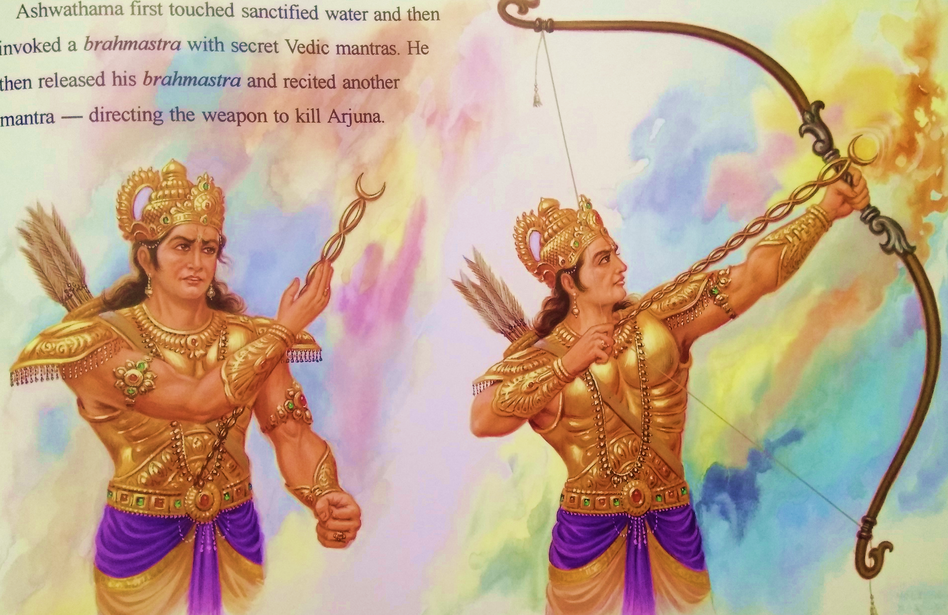

Slide 22
Since Ashwathama’s life was in danger, he touched water in sanctity and concentrated upon the chanting of the hymns for throwing brahmashtra (nuclear weapon), although he did not know how to withdraw such weapons.
Thereupon a glaring light spread in all directions. It was so fierce that Arjuna thought his own life in danger, and so he began to address Lord Śrī Kṛṣṇa.

Slide 23
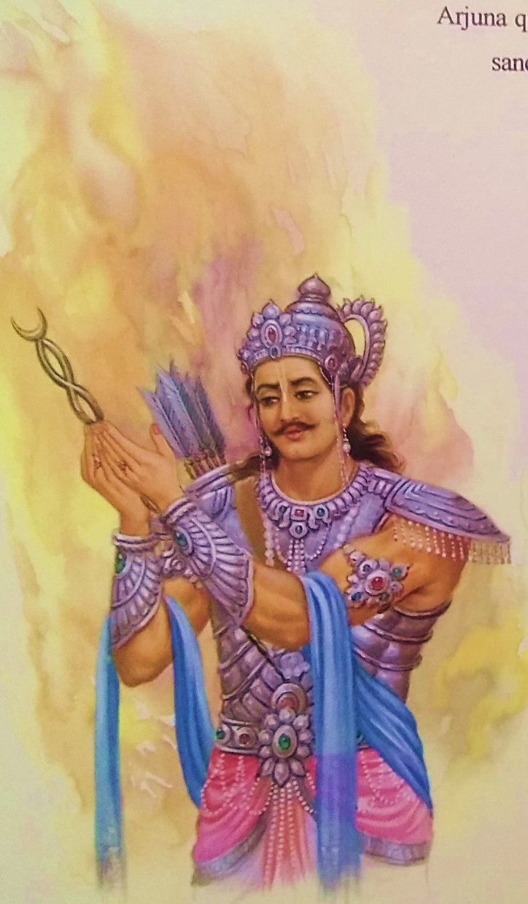
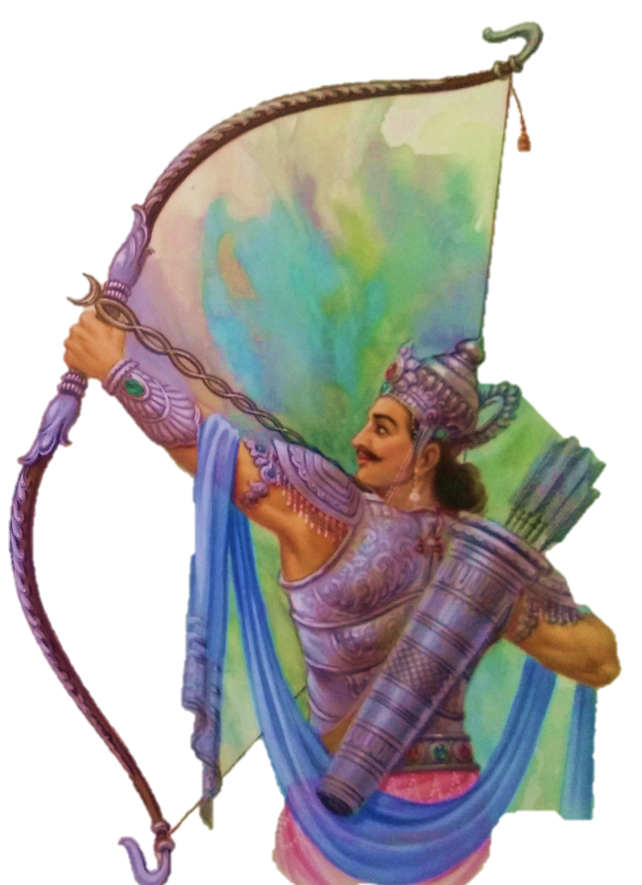
(7) Respect before a Request, SB 1.7.26
Arjuna touched water for purification, and after circumambulating Lord Śrī Kṛṣṇa, he cast his brahmāstra weapon to counteract the other one.

Slide 24
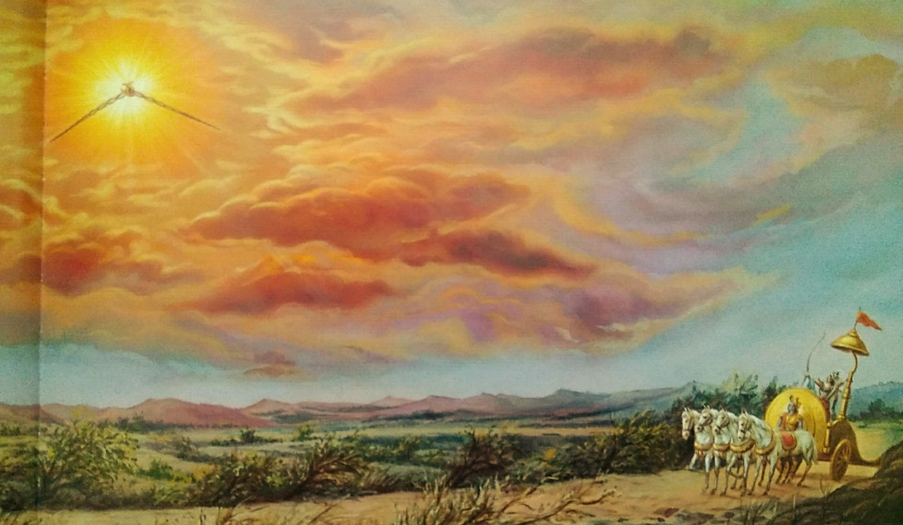
When the rays of the two brahmāstras combined, a great circle of fire, like the disc of the sun, covered all outer space and the whole firmament of planets.

Slide 25
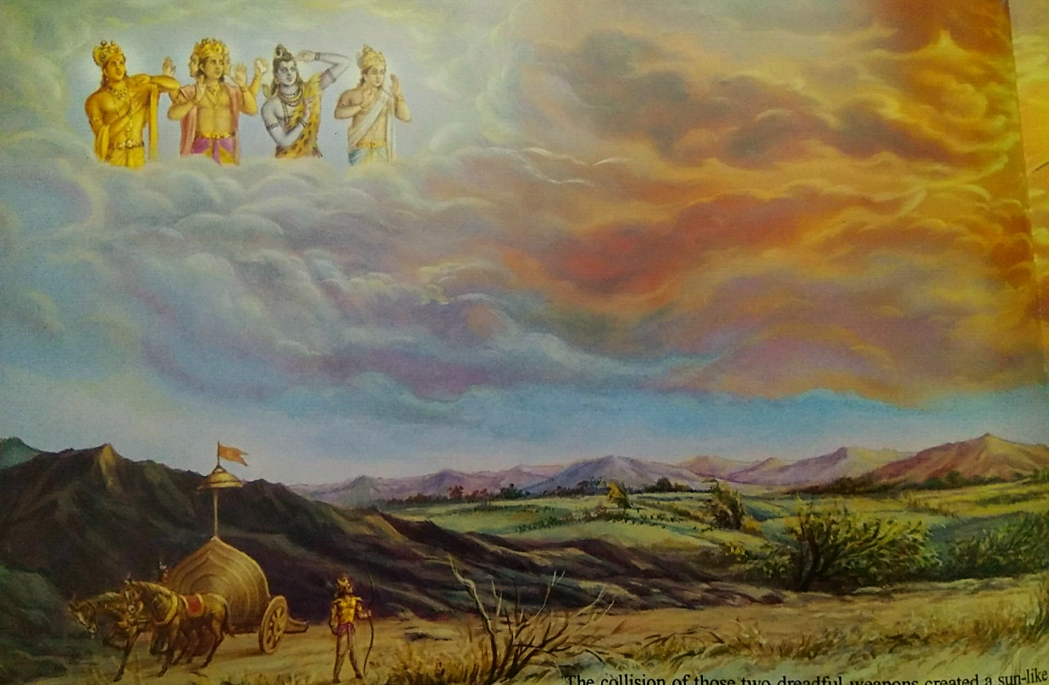
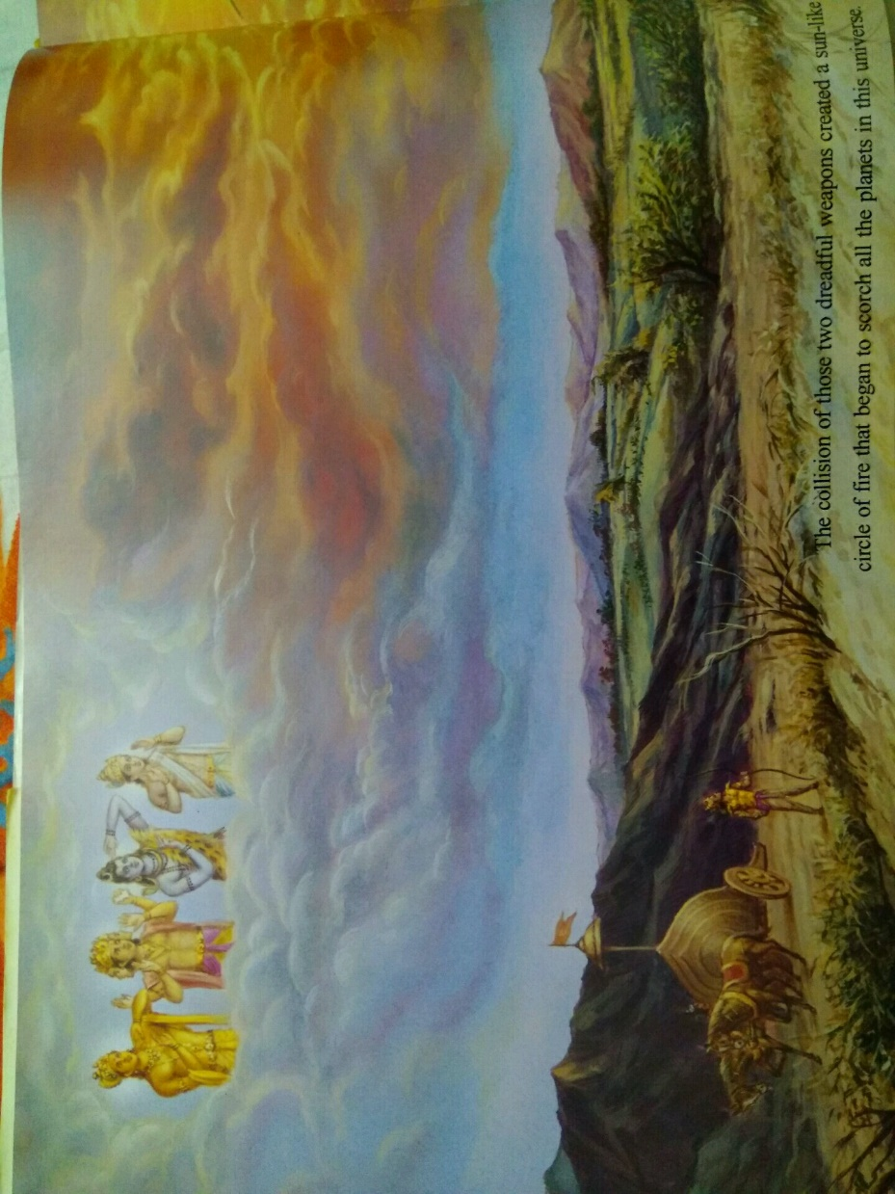
All the population of the three worlds was scorched by the combined heat of the weapons. Everyone was reminded of the sāṁvartaka fire which takes place at the time of annihilation.

Slide 26
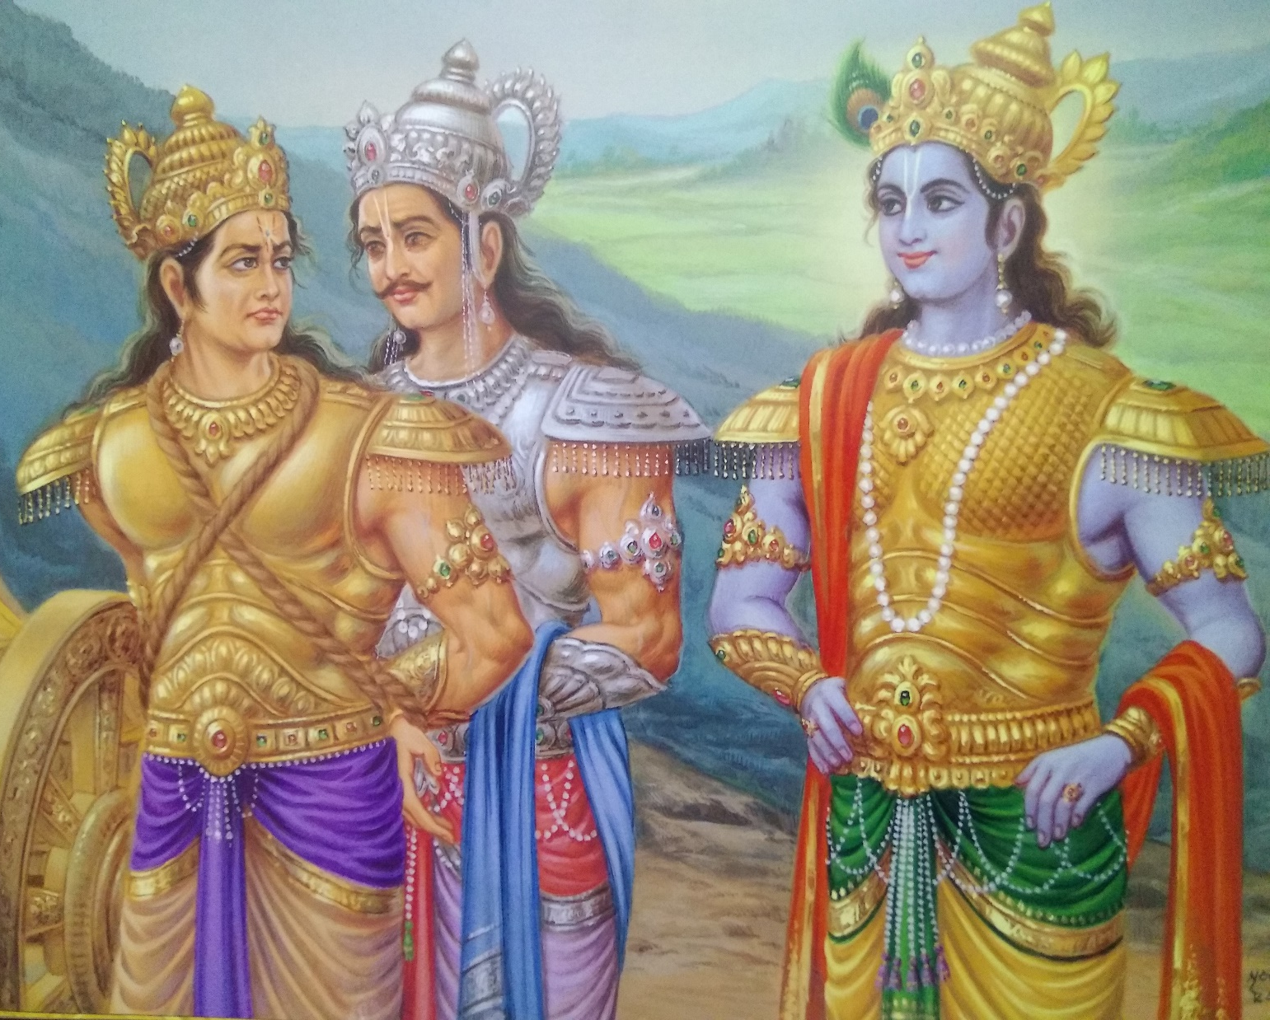
Thus seeing the disturbance of the general populace and the imminent destruction of the planets, Arjuna at once retracted both brahmāstra weapons, as Lord Śrī Kṛṣṇa desired. After binding Aśvatthāmā, Arjuna wanted to take him to the military camp.

Slide 27

(8) Nonsense Nonviolence, SB 1.7.36
The Personality of Godhead Śrī Kṛṣṇa, looking on with His lotus eyes, spoke to Arjuna in an angry mood.
Lord Śrī Kṛṣṇa said: O Arjuna, you should not show mercy by releasing this relative of a brāhmaṇa [brahma-bandhu], for he has killed innocent boys in their sleep. A person who knows the principles of religion does not kill an enemy who is careless, intoxicated, insane, asleep, afraid or devoid of his chariot. Nor does he kill a boy, a woman, a foolish creature or a surrendered soul.
A cruel and wretched person who maintains his existence at the cost of others’ lives deserves to be killed for his own well-being, otherwise he will go down by his own actions.
Furthermore, I have personally heard you promise Draupadī that you would bring forth the head of the killer of her sons. This man is an assassin and murderer of your own family members. Not only that, but he has also dissatisfied his master. Kill him immediately.

Slide 28
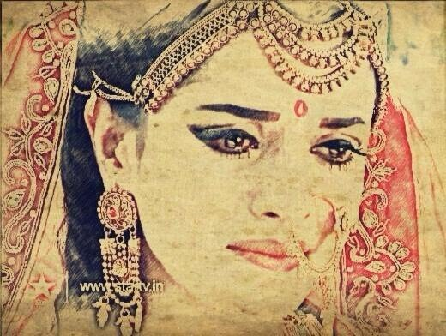
(9) Knowing mind of Lord and acting, SB 1.7.40,56
Although Kṛṣṇa, who was examining Arjuna in religion, encouraged Arjuna to kill the son of Droṇācārya, Arjuna, a great soul, did not like the idea of killing him, although Aśvatthāmā was a heinous murderer of Arjuna’s family members.
After reaching his own camp, Arjuna, along with his dear friend and charioteer [Śrī Kṛṣṇa], entrusted the murderer unto his dear wife, who was lamenting for her murdered sons.

Slide 29
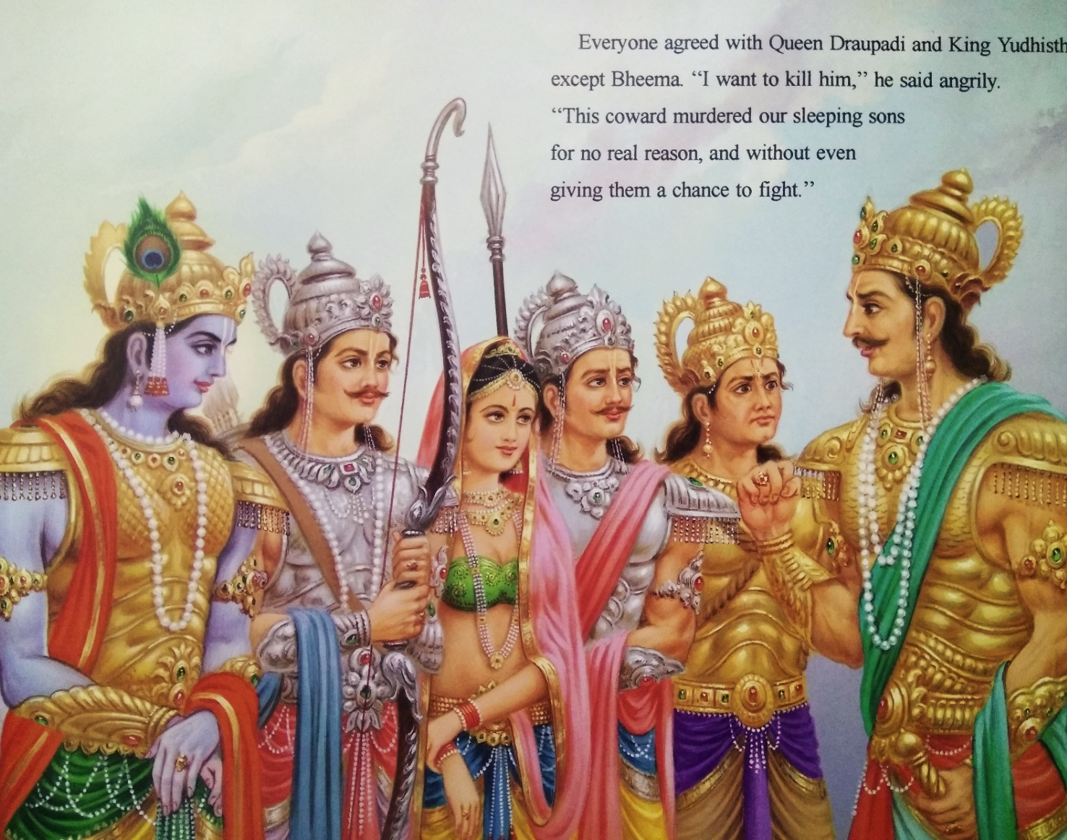
Draupadi said, “If the kingly administrative order, being unrestricted in sense control, offends the brāhmaṇa order and enrages them, then the fire of that rage burns up the whole body of the royal family and brings grief upon them all.”

Slide 30
The Personality of Godhead, Śrī Kṛṣṇa said: “A friend of a brāhmaṇa is not to be killed, but if he is an aggressor he must be killed. All these rulings are in the scriptures, and you should act accordingly. You have to fulfill your promise to your wife, and you must also act to the satisfaction of Bhīmasena and Me.

Slide 31
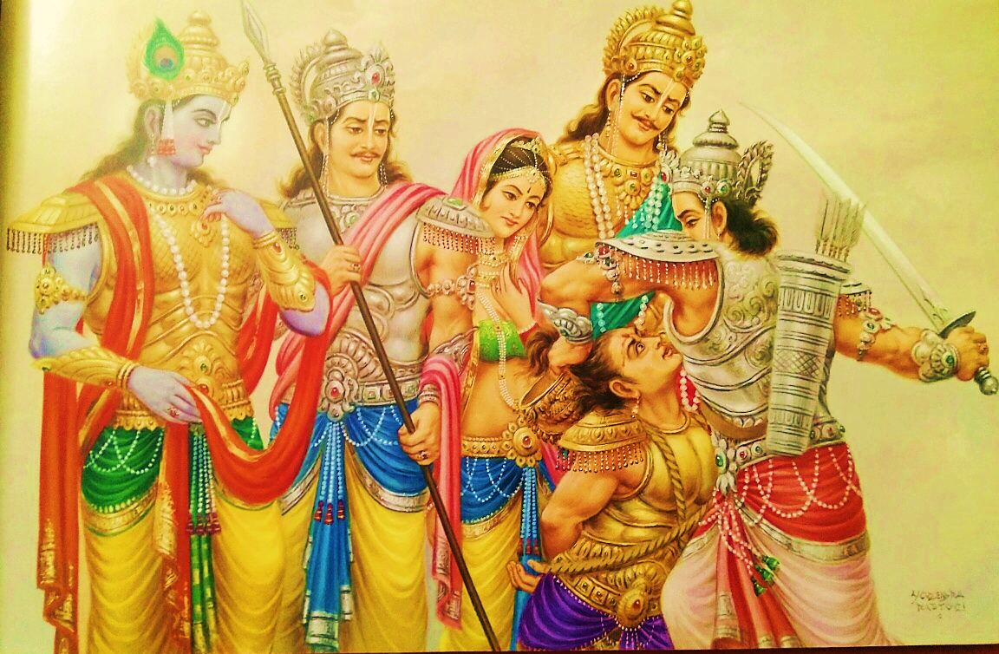

Slide 32
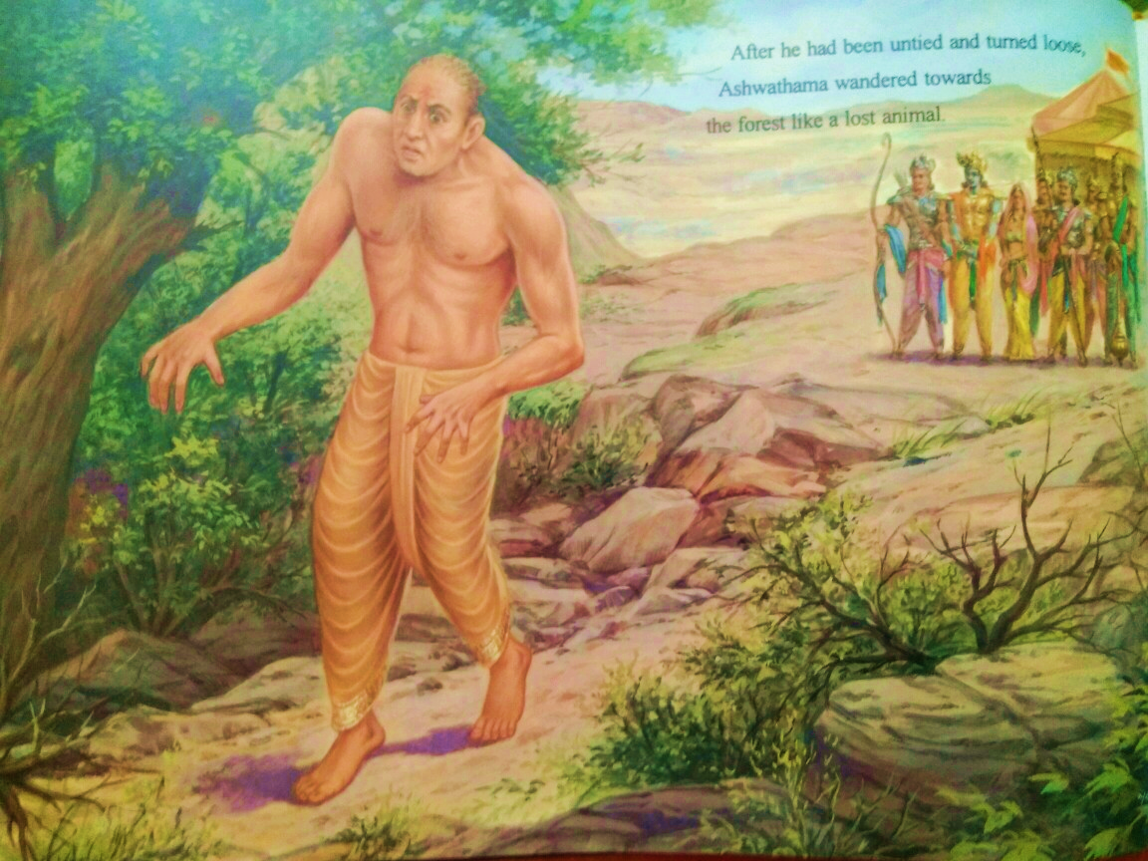

Slide 33
Arjuna could understand the motive of the Lord by His equivocal orders, and thus with his sword he severed both hair and jewel from the head of Aśvatthāmā.
Aśvatthāmā had already lost his bodily luster due to infanticide, and now, moreover, having lost the jewel from his head, he lost even more strength. Thus he was unbound and driven out of the camp.
Cutting the hair from his head, depriving him of his wealth and driving him from his residence are the prescribed punishments for the relative of a brāhmaṇa. There is no injunction for killing the body.

Slide 34
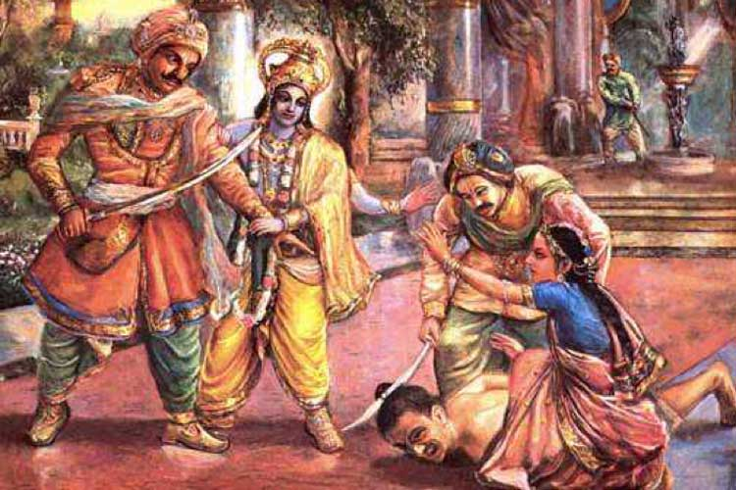
(10) Conflict Resolution among devotees, SB 1.7.32-52

Slide 35

Arguments for killing Aswatthama
Arguments for killing Asvatthama
Krsna supports killing (35-39)
Never show mercy on brahma-bandhu – killed inncocent boys in sleep
Codes of religious war
Maintenance at cost of others
Kill for his well-being
Your promise to Draupadi
Assassin, dissatisfied his master
Arjuna passed test (40-41)
Great soul, didn’t like the idea to kill him
Entrusted him to lamenting Draupadi
Mild & gentle nature of Draupadi (42-48)
Showed respects & Requested for release of brahmana
Obligation to guru, Drona
Killing son means killing father
Never cause grief to respectable & worshipable family
Kripi shouldn’t lament like me
Offense to brahmanas burns us
Yudhistira supports Draupadi
In accordance with dharma, justified, glorious, full of mercy & equity, w/o duplicity
Nakula, Sahadeva, Arjuna, Satyaki, Krsna – all agreed
Agreement & disagreement with Draupadi (49-51)
Bhima disagreed (Asvatthama killed sleeping sons for nobody’s interest)
Lord’s intervention & Arjuna’s action (52-58)
Brahma-bandhu not to be killed & if agressor, to be killed – Satisfy everyone
Arjuna severs hair & jewel of Asvatthama – unbound & driven out
Final rites of Pandavas’ sons

Slide 36
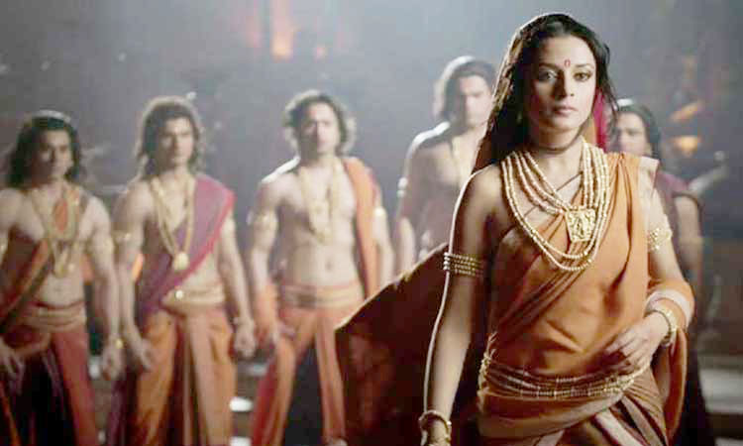
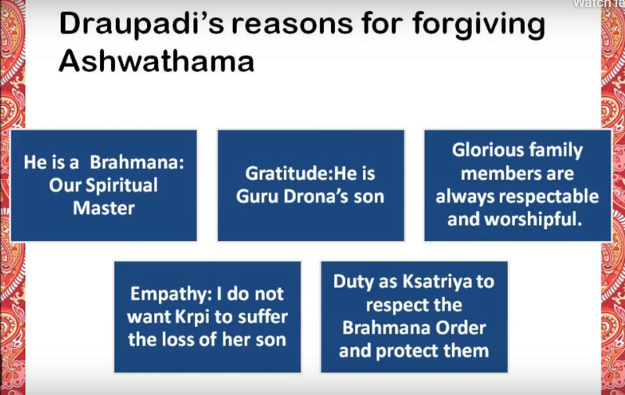
(10) Conflict Resolution among devotees, SB 1.7.32-52
dharmam
nyayam
nirvyalikam
Karunam & samam
mahat

Slide 37
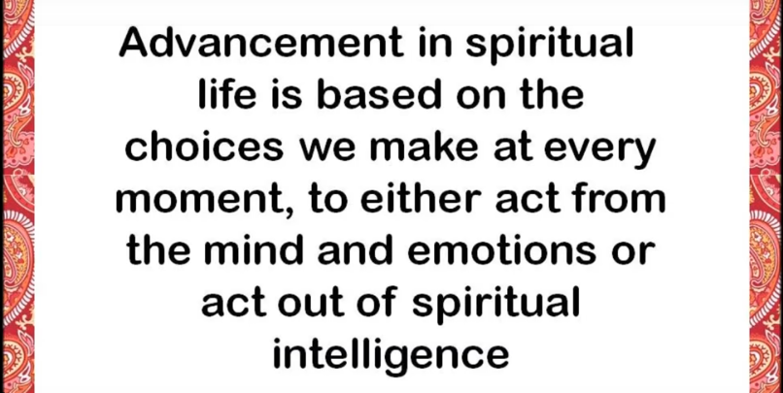

Slide 38
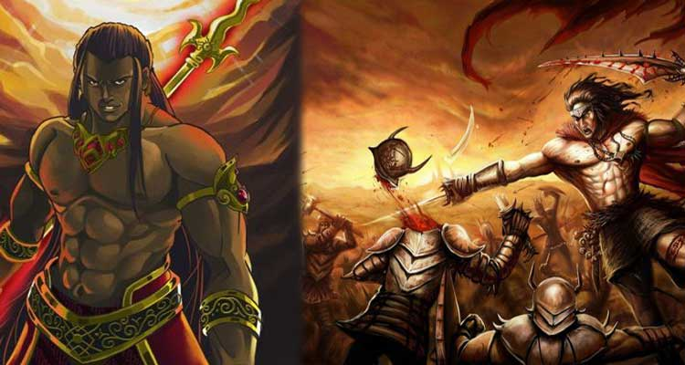
(11) Woman’s soft-heartedness, SB 1.7.42

Slide 39
Chapter 7 Overview
1.7. Son of Drona Punished
1-7: Vyasa’s meditation & teaching SB to Suka
Vyasa saw
PoG & his external energy & Jiva misidentifies & suffersMiseries mitigated by DS – compiled SB (6)
Aural reception extinguishes fire of soka, moha, bhaya (7)
8-11: Vyasa teaches SB to Suka
Why Suka, already on path of SR, studied SB? (9)
Even atmaramas desire to do DS (10)
Suta begins to answer questions of sages in 1.4 – about Parikshit
13-34: Arresting of Aswatthama
13-17: Death of sons of Pandavas & lamentation
18-21: Arjuna battles with Asvatthama, who releases Brahmastra
22-26: Arjuna’s prayers to Krsna
27-28: Krsna responds [Act of s/o Drona, Counteract with your weapon]
29-34: Arjuna arrests Asvatthama
Arguments for killing Asvatthama
Krsna supports killing (35-39)
Arjuna passed test (40-41)
Mild & gentle nature of Draupadi (42-48)
Agreement & disagreement with Draupadi (49-51)
Lord’s intervention & Arjuna’s action (52-58)
Arjuna severs hair & jewel of Asvatthama – unbound & driven out
Final rites of Pandavas’ sons

Slide 40
Entering Chapter 8
Continuing with events after Kurukshetra battle…

Slide 41
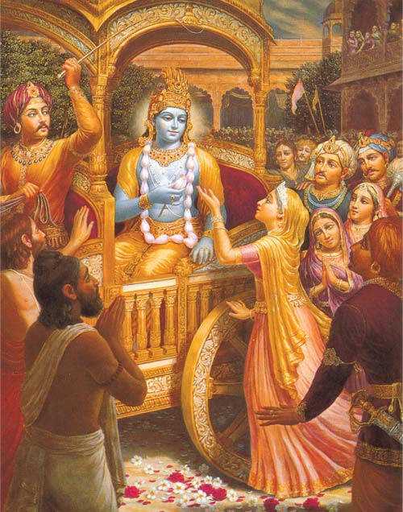
1.8 Prayers by Queen Kunté and Parékñit Saved
Contents
Pacification of aggrieved pandavas
Parikshit saved in the womb
Prayers of Kuntidevi
Lamentation of Yudhistira

Slide 42
SRIMAD BHAGAVATAM, the Crest Jewel of All Puranas
You are welcome Tomorrow for
First Canto Chapter 8
Prayers by Queen Kunti & Parikshit saved
By His Divine Grace A.C.Bhaktivedanta Swami Prabhupada, Founder Acarya of ISKCON

