Slide 1
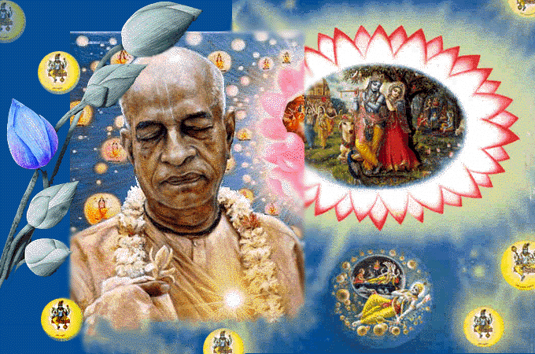
SRIMAD BHAGAVATAM, the Crest Jewel of All Puranas
By His Divine Grace A.C.Bhaktivedanta Swami Prabhupada, Founder Acarya of ISKCON
Bhagavata
Rasamaalayam
A 19-Session Presentation of First Canto of SB
by Radheshyam das, ISKCON, NVCC, Pune
www.live.radheshyamdas.com

Slide 2
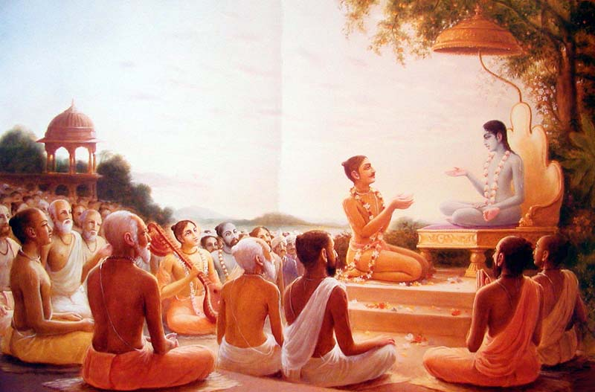
Bhagavata Rasamaalayam
A 19-Session Presentation of First Canto of SB
by Radheshyam das, ISKCON, NVCC, Pune
SB Canto 1 Chapter 10
Departure of Lord Krishna for Dwaraka

Slide 3
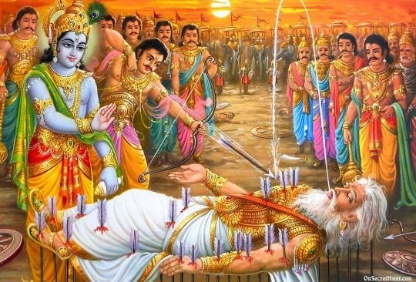

Slide 4
|| 1.9.32 ||
çré-bhéñma uväca—
iti matir upakalpitä vitåñëä
bhagavati sätvata-puìgave vibhümni |
sva-sukham upagate kvacid vihartuà
prakåtim upeyuñi yad bhava-pravähaù ||
Bhéñma said: At the end of my life I offer my thoughts (iti matir upakalpitä vitåñëä) to you, bhagavän full of six qualities (bhagavati), best of the Yadus (sätvata-puìgave), superior to all other forms of the Lord (vibhümni), absorbed in bliss with your associates (sva-sukham upagate), and who, as a pastime (vihartuà), in the form of the puruñävatara, sometimes accepts mäyä by your glance (kvacid prakåtim upeyuñi), which produces the material world (yad bhava-pravähaù).

Slide 5
At the end of my life (iti), my thoughts are offered to the Lord.
Since my master has come to me at the time of my passing away under the influence of his mercy, I must give him a gift.
There is nothing suitable in this abode of possessiveness and ego. Therefore I make a gift of my thoughts alone.
“But in this world we see people who give also desire to take.”
“My thoughts are without desire (vitåñëä). I offer them to bhagavän, who is full of six wondrous qualities.”

Slide 6
“But the Lord is famous as Näräyaëa.”
“No, he is famous as the best of the Yadu dynasty.”
“But Näräyaëa is greatly famous as bhagavän for all time.”
“There is no greatness superior to his (vibhümni). He is the source of Näräyaëa.”
He attained (gate) profusely (upa) the highest bliss (sukham) with his own Yädavas and Päëòavas (sva).
The main qualities of the Lord have thus been described.

Slide 7
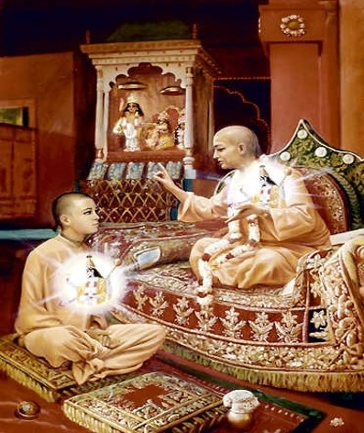
SP Purport 1.9.32
Pure devotees of the Lord have no desire other than the service of the Lord, and therefore they are called sätvatas. The Lord is the chief amongst such sätvatas. Bhéñmadeva, therefore, had no other desires—he was completely free of all material desires. Unless one is purified from all sorts of material desires, the Lord does not become one's leader. Desires cannot be wiped out, but they have only to be purified.
It is confirmed in the Bhagavad-gétä by the Lord Himself that He gives His instruction from within the heart of a pure devotee who is constantly engaged in the service of the Lord. Such instruction is given not for any material purpose but only for going back home, back to Godhead (Bg. 10.10).
Lord gives instructions from within the heart of a pure devotee

Slide 8
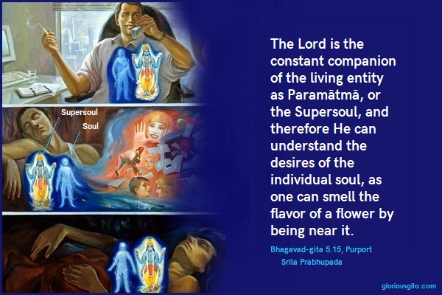
For the ordinary man who wants to lord it over material nature, the Lord only sanctions and becomes a witness of activities, but He never gives the nondevotee instructions for going back to Godhead. That is the difference in dealings by the Lord with different living beings, both the devotee and the nondevotee. [SP Purport 1.9.32]

Slide 9
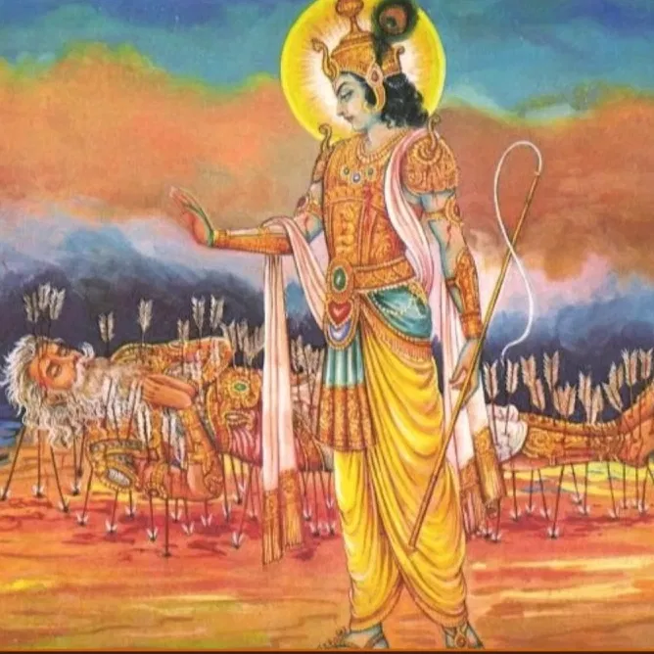
|| 1.9.33 ||
tri-bhuvana-kamanaà tamäla-varëaà
ravi-kara-gaura-varämbaraà dadhäne |
vapur alaka-kulävåtänanäbjaà
vijaya-sakhe ratir astu me ’navadyä ||
Let me have pure prema (anavadyä ratir astu me) for Kåñëa, the friend of Arjuna (vijaya-sakhe), who possesses a body desired by all the inhabitants of the three worlds (tri-bhuvana-kamanaà vapuh), which is clothed with intense yellow garments shining in the sun (ravi-kara-gaura-vara-ambaraà dadhäne), whose complexion is dark like the tamäla tree (tamäla-varëaà), and whose lotus face is surrounded by locks of hair (alaka-kula-ävåta-änana-abjaà).

Slide 10
“What is the nature of your thoughts?”
Let me have pure prema (ratiù) without desire for results, for the friend of Arjuna (vijaya-sakhe), who accepts a body which is desired by all persons in the upper, middle and lower planets, which is clothed in garments golden in the sun’s rays.
My thoughts take the form of a prayer to have this prema for the most beautiful Kåñëa as the charioteer of Arjuna.
In the prayers of following verses also there is no use of the second person, though Kåñëa was present before him This indicates his attraction for the sweetness of the Lord absorbed in véra-rasa during the battle, and his absorption in relishing it.

Slide 11
|| 1.9.34 |
yudhi turaga-rajo-vidhümra-viñvak-
kaca-lulita-çramaväry-alaìkåtäsye |
mama niçita-çarair vibhidyamäna-
tvaci vilasat-kavace ’stu kåñëa ätmä ||
May my mind concentrate on Kåñëa (kåñëa astu ätmä), whose face was decorated (alaìkåta äsye) with wavy hair (viñvak-kaca) covered with the dust raised by horses (yudhi turaga-rajo-vidhümra), tossed all about because of the speed of his driving (lulita), and with perspiration because of his great effort in protecting Arjuna (çramaväry), whose armor shone brightly (tvaci vilasat-kavace), pierced slightly by my sharp arrows (mama niçita-çarair vibhidyamäna).

Slide 12
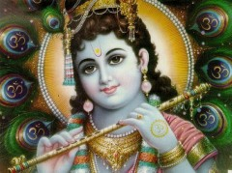
Having spoken of Kåñëa’s face
surrounded by locks of hair,
Bhéñma cannot give up that sweetness.
Again he describes more details.
The face is decorated with hair thrown all about because of the speed of the chariot, and colored with the dust raised by the horses.
The face is decorated with perspiration arising from effort.
This indicates Kåñëa’s efforts because of his affection for Arjuna.

Slide 13
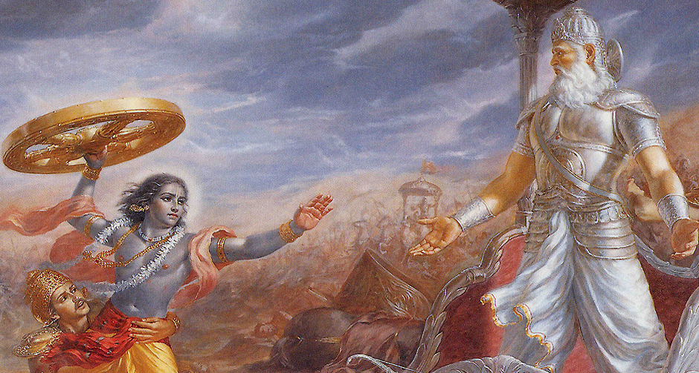
SP Purport 1.9.34
Sharp arrows are soft roses when thrown with love for the Lord.
The Lord is the absolute form of eternity, bliss and knowledge. As such, transcendental loving service to the Lord in one of the five principal relations, namely çänta, däsya, sakhya, vätsalya and mädhurya, i.e., neutrality, servitorship, fraternity, parental affection and conjugal love, is graciously accepted by the Lord when offered to the Lord in genuine love and affection.
Çré Bhéñmadeva is a great devotee of the Lord in the relation of servitorship. Thus his throwing of sharp arrows at the transcendental body of the Lord is as good as the worship of another devotee who throws soft roses upon Him.

Slide 14
SP Purport 1.9.34
Sharp arrows are soft roses when thrown with love for the Lord.
It appears that Bhéñmadeva is repenting the actions he committed against the person of the Lord. But factually the Lord's body was not at all pained, due to His transcendental existence. His body is not matter. Both He Himself and His body are complete spiritual identity. Spirit is never pierced, burnt, dried, moistened, etc. This is vividly explained in the Bhagavad-gétä.

Slide 15
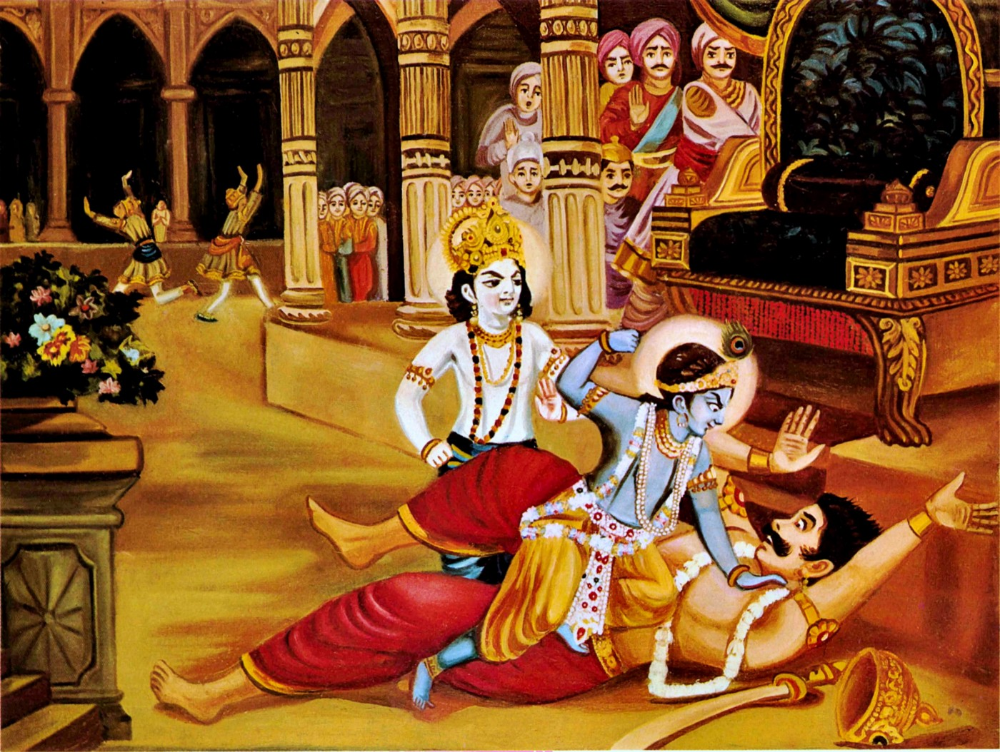
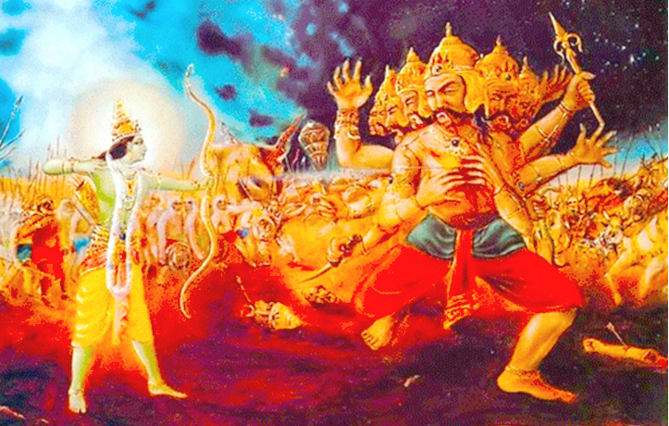
SP Purport 1.9.34
Kaàsa wanted to kill Kåñëa, and Rävaëa wanted to kill Räma, because foolishly they were unaware of the fact that the Lord is never killed, for the spirit is never annihilated.
Therefore Bhéñmadeva's piercing of the body of Lord Kåñëa is a sort of bewildering problem for the nondevotee atheist, but those who are devotees, or liberated souls, are not bewildered.

Slide 16
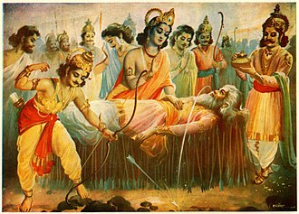
SP Purport 1.9.34
Bhishma’s
Repentance
&
Lord Krishna’s
merciful attitude
are both unique.
Bhéñmadeva appreciated the all-merciful attitude of the Lord: although He had been disturbed by Bhéñmadeva's sharp arrows, He had not left Arjuna alone, nor was He reluctant to come before Bhéñma's deathbed even though He had been ill-treated by him on the battlefield. Bhéñma's repentance and the Lord's merciful attitude are both unique in this picture.

Slide 17
|| 1.9.35 ||
sapadi sakhi-vaco niçamya madhye
nija-parayor balayo rathaà niveçya |
sthitavati para-sainikäyur akñëä
håtavati pärtha-sakhe ratir mamästu ||
May I have prema for the chariot driver of Arjuna (pärtha-sakhe ratir mama astu), who placed the chariot between the two opposing armies (nija-parayor balayo madhye rathaà niveçya) immediately on hearing Arjuna’s request (sakhi-vaco niçamya), and, situated there (sthitavati), by his glance (akñëä), took away (håtavati) the prärabdha-karmas of the opposing party (para-sainik äyuh).

Slide 18
And he immediately followed Arjuna’s order.
senayor ubhayor madhye rathaà sthäpaya me ’cyuta |
yävad etän nirékñye ’haà yoddhukämän avasthitän ||
O Acyuta please station my chariot between the two armies, so I can view at the commencement of the war those situated with a desire to fight, and can see my companions in battle. BG.1.21
Just by his glance (akñëä), showing to Arjuna “This is Bhéñma, this is Droëa, this is Karëa,” he took away their lives.
This actually indicates he took away their prärabdha-karma, since it will be said later yam iha nirékñya hatä gatäù sva-rüpam: those who saw him on the battlefield of Kurukñetra attained their original forms after death. (SB 1.9.39)

Slide 19
|| 1.9.36 ||
vyavahita-påtanä-mukhaà nirékñya
sva-jana-vadhäd vimukhasya doña-buddhyä|
kumatim aharad ätma-vidyayä yaç
caraëa-ratiù paramasya tasya me ’stu ||
May I have prema for the feet of the Supreme Lord (tasya paramasya caraëa-ratiù me astu) who, by giving knowledge of Himself (ätma-vidyayä yah), destroyed the ignorance (kumatim aharad) of Arjuna who, on seeing the heads of the opposing army at a distance (vyavahita-påtanä-mukhaà nirékñya), refused to fight (vimukhasya) because he thought it was a sin to kill his relatives (sva-jana-vadhäd doña-buddhyä).

Slide 20
Vyavahita-påtanä-mukhaà nirékñya means “seeing Bhéñma and others standing in front of the army at a distance.” Arjuna became disinclined to kill his relatives.
evam uktvärjunaù saìkhye rathopastha upäviçat |
visåjya saçaraà cäpaà çoka-saàvigna-mänasaù ||
Speaking in this manner, Arjuna, giving up his bow and arrows, mind disturbed with lamentation, sat down on his chariot amidst the warriors assembled for battle. BG 1.46
This is described by the word kumatim.
Arjuna’s loss of intelligence was caused by the Lord himself, like Yudhiñöhira’s present loss of intelligence, because loss of intelligence is impossible for the eternal associate of the Lord, who is also the avatära, Nara.
Kåñëa did this in order to reveal Bhagavad-gétä, which delivers the whole world by showing the truth about Kåñëa. Ätma-vidyayä means by knowledge fixed in Kåñëa.

Slide 21
|| 1.9.37 ||
sva-nigamam apahäya mat-pratijïäm
åtam adhikartum avapluto rathasthaù |
dhåta-ratha-caraëo ’bhyayäc caladgur
harir iva hantum ibhaà gatottaréyaù ||
Giving up his own promise not to fight (sva-nigamam apahäya), and making my vow to make him fight come true (mat-pratijïäm åtam adhikartum), Kåñëa, situated on the chariot (ratha sthaù), quickly got down (avaplutah) and holding the wheel of a chariot (dhåta-ratha-caraëo), ran towards me (abhyayät), like a lion coming to kill an elephant (harir iva hantum ibhaà), while the earth shook (caladguh) and his top cloth fell to the ground (gata uttaréyaù).

Slide 22
“It is said that Kåñëa elevates his devotee to a higher position than his own. I saw that directly.” This is explained in two verses.
Kåñëa made a promise (sva-nigamam) that he would not take up weapons, but would only assist Arjuna. I made a promise that I would make him give up that promise and take up weapons.
To make sure that this would become true, Kåñëa, situated on the chariot, quickly got down from the chariot in such a manner that no one could see his separation from the chariot.

Slide 23
He took the wheel of the chariot and ran towards me. His cloth fell down. He was not even aware.
The earth trembled because of his great strength exerted through running in excitement.
Because Kåñëa cannot give up his quality of affection for his devotee, when Arjuna would be unable to fight, Kåñëa would give up his promise and use weapons to protect Arjuna.
Bhéñma made this promise that Kåñëa should take up weapons in order to fulfill this desire.
Having seen Kåñëa’s prema for Arjuna when he broke his own promise, and satisfying Bhéñma, Kåñëa’s excellence became famous in the world.

Slide 24
|| 1.9.38 ||
çita-viçikha-hato viçérëa-daàçaù
kñataja-paripluta ätatäyino me |
prasabham abhisasära mad-vadhärthaà
sa bhavatu me bhagavän gatir mukundaù ||
O Kåñëa (bhagavän)! Let my only goal be Mukunda (sah mukundaù bhavatu me gatih), who, afflicted by my sharp arrows (çita-viçikha-hatah), armor broken (viçérëa-daàçaù), covered in blood (kñataja-paripluta), rushed towards me (me abhisasära), his enemy (ätatäyinah), with great force (prasabham), in order to kill me (mad-vadha arthaà).

Slide 25
With force (prasabham) he protected Arjuna and came towards me with the intention “Today I will kill Bhéñma with my own hands.”
The word abhisasära is used to indicate a hero desiring to meet his lover.
In a similar manner I became extraordinarily happy when Kåñëa approached me in anger.
May my goal be no one else, only Mukunda, giver of liberation, who acted in this way.
O Kåñëa! I have offered only this prayer to you.

Slide 26
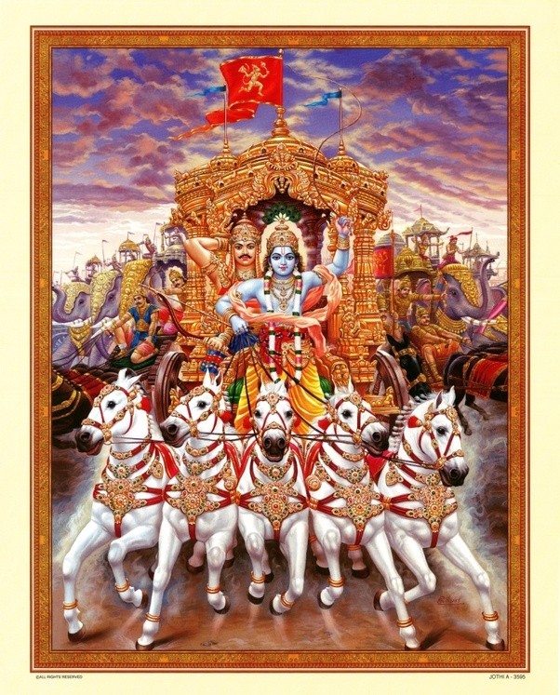
|| 1.9.39 ||
vijaya-ratha-kuöumba ätta-totre
dhåta-haya-raçmini tac-chriyekñaëéye |
bhagavati ratir astu me mumürñor
yam iha nirékñya hatä gatäù sva-rüpam ||
Desiring to die (mumürñoh), may I have prema for the Lord (bhagavati ratir astu me) who protected Arjuna’s chariot (vijaya-ratha-kuöumba) while holding a whip in his right hand (ätta-totre), the reins in his left hand (dhåta-haya-raçmini), whose beauty must be seen (tad-çriyekñaëéye), and who bestowed liberation to those who died on the battle field after seeing him (yam iha nirékñya hatä gatäù sva-rüpam).

Slide 27
Bhéñma has a desire that even the unrighteous should develop prema for Kåñëa, who is eager to protect his devotees.
Kåñëa protected (kuöumbe) Arjuna (vijaya) from the sinful.
He held a whip (totre). He held the reins of the horses.
I, and not Arjuna, saw with my eyes, his beauty as he held the reins in his left hand, the whip in his right hand, while saying “Hum, hum” to speed the horses.
May I have prema for that Kåñëa.
I desire to die now (mumürñoù), for having died, I will constantly see that sweetness. If I am revived how will I see that, because the Lord has brought about an end to his pastimes on this earth?

Slide 28
|| 1.9.40 ||
lalita-gati-viläsa-valgu-häsa-
praëaya-nirékñaëa-kalpitoru-mänäù |
kåtam anukåta-vatya unmadändhäù
prakåtim agan kila yasya gopa-vadhvaù ||
The gopés (gopa-vadhvaù) were worshipped (kalpita uru-mänäù) by Kåñëa’s expert actions (lalita-gati-viläsa), emotional displays, words and glances (valgu-häsa-praëaya-nirékñaëa). Attaining those qualities (kåtam), they responded in harmony to his most extraordinary displays of love (anukåta-vatya), blinded by the madness of love (unmada andhäù). How amazing (kila) that these gopés attained the nature of Kåñëa himself (yasya prakåtim agan).

Slide 29
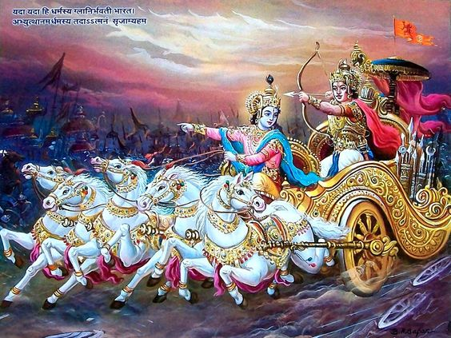
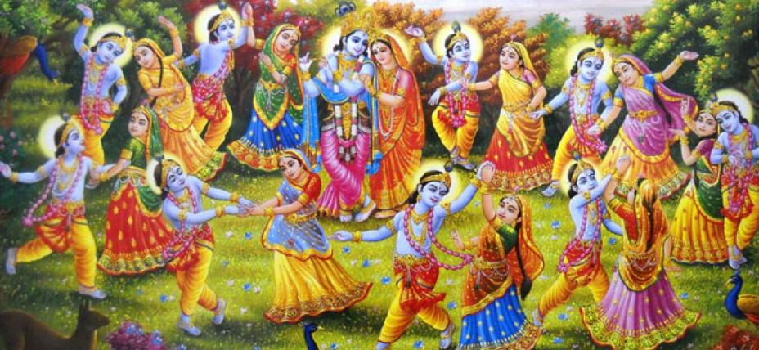
“Though you are omniscient, the prema that you desire in my charioteer pastime is in Arjuna alone. It is understood that among all the associates with prema, he is the chief.”
That is not so. Your dear gopés have the most exalted prema among all devotees. They are superior to Arjuna.
No one can dare to pray for their position. Let that be!
I will be successful at my death just by indicating their nature.

Slide 30
In harmony with him, they offered him dancing, songs and speech in the räsa-lélä.
There was no need to teach them anything. They did not need practice. How astonishing (kila)!
They were blinded by the increase of great prema (unmadändhäù).
Kåñëa did not give his unique, extraordinary power to Arjuna.

Slide 31
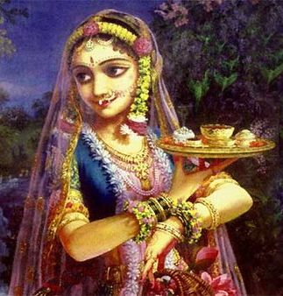
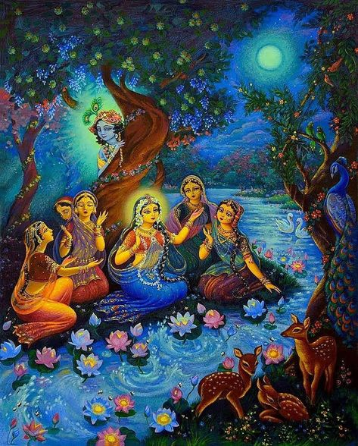
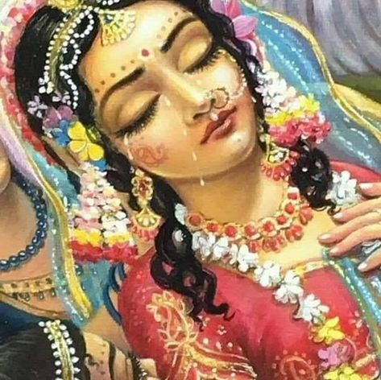
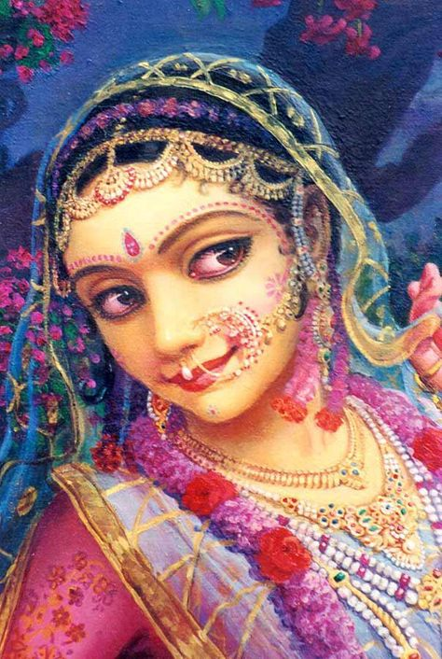
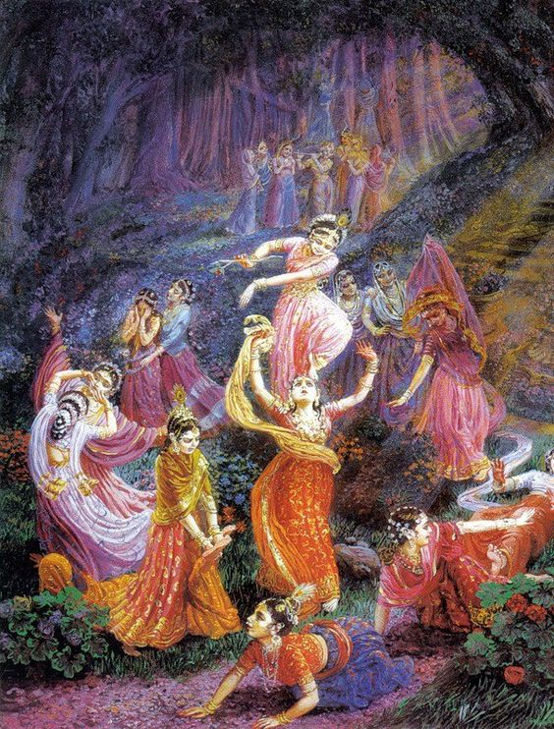
Kåtam can also refer to Kåñëa’s actions such as lifting Govardhana.
They imitated those actions.
unmäda - This indicates madness in separation.
This is the highest level of exalted prema.

Slide 32
|| 1.9.41 ||
muni-gaëa-nåpa-varya-saìkule ’ntaù-
sadasi yudhiñöhira-räjasüya eñäm |
arhaëam upapeda ékñaëéyo
mama dåçi-gocara eña ävir ätmä ||
The lord of my life (mama ätmä), worthy of being seen (ékñaëéyah), who received the worship (arhaëam upapeda) of all the greatest sages and kings (muni-gaëa-nåpa-varya-saìkule) in the assembly (antaù sadasi) during the räjasüya sacrifice of Yudhiñöhira (yudhiñöhira-räjasüya eñäm), has become visible to my eyes (mama dåçi-gocara eña ävih).

Slide 33
Bhéñma relates his great fortune which is directly visible now, to the necessity of attaining the Lord.
Kåñëa was seen with amazement by the sages exclaiming “O what beauty! What greatness!”
In the midst of the gathering composed of the best sages and kings, during the räjasüya sacrifice of Yudhiñöhira, he received (upapede) worship.
He, my soul, the lord of my life (mama ätmä), is now visible to my eyes.
He has fulfilled my request.

Slide 34
|| 1.9.42 ||
tam imam aham ajaà çaréra-bhäjäà
hådi hådi dhiñöhitam ätma-kalpitänäm |
pratidåçam iva naikadhärkam ekaà
samadhigato ’smi vidhüta-bheda-mohaù ||
Freed of the illusion of difference in the Lord’s various forms (vidhüta-bheda-mohaù), I have attained the Lord (tam samadhigato asmi) who is one (ekaà) though appearing to be many (na ekadhä pratidåçam) like the sun seen by many people (arkam iva), who is the charioteer, but who is also in my heart (imam), the unborn (ajaà) and is situated in the hearts of all the jévas (çaréra-bhäjäà hådi hådi dhiñöhitam), who create their own bodies (ätma-kalpitänäm).

Slide 35
Why do you not address the Lord directly but instead address him indirectly with word like vijaya-sakhe vijaya-ratha-kuöumba me ratir astu and caraëa-ratiù paramasya tasya me ’stu and sa bhavatu me bhagavän gatir.”
This verse answers, indicating that Bhéñma desires the Lord as a charioteer.
I have attained that Lord (tam) who is the charioteer of Arjuna, holding the whip and bridle in his hands, who is now appearing in my heart (imam).

Slide 36
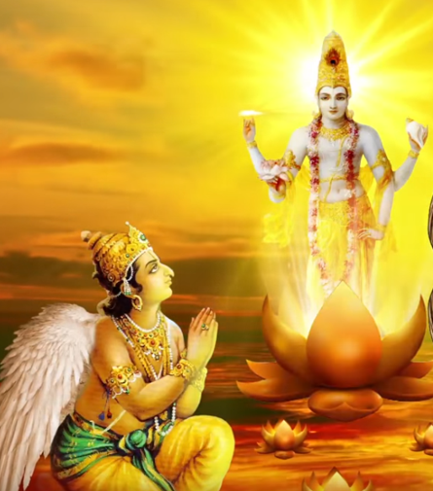
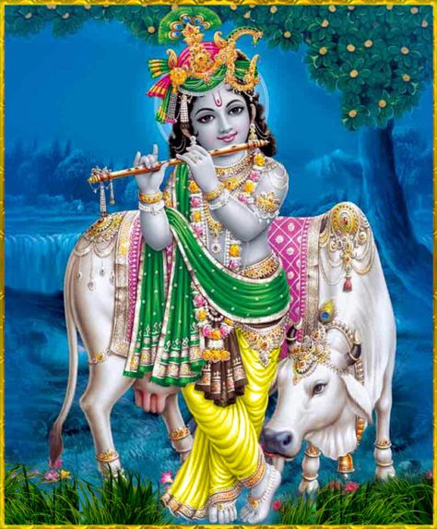
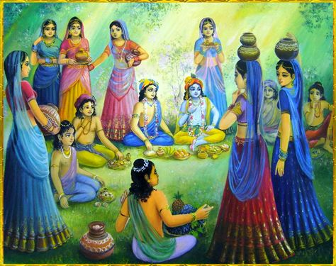
The worshipable object of Bhéñmadeva is Lord Çré Kåñëa as Pärtha-särathi, and that of the gopés is the same Kåñëa in Våndävana as the most attractive Çyämasundara…..In His personal feature Kåñëa is both Pärtha-särathi and Çyämasundara of Våndävana, but only in His impersonal feature is He the brahma-jyoti and the Paramätmä. Great mahätmäs like Bhéñmadeva realize all these different features of Lord Çré Kåñëa, and therefore they worship Lord Kåñëa with one-pointed attention, knowing Him as the origin of all features. [SB 1.9.42]

Slide 37
|| 1.9.43 ||
süta uväca—
kåñëa evaà bhagavati
mano-väg-dåñöi-våttibhiù |
ätmany ätmänam äveçya
so ’ntaùçväsa upäramat ||
Suta said: Thus Bhéñma (sah), absorbing himself in Kåñëa (ätmänam kåñëa evaà äveçya), bhagavän, the charioteer situated in his heart (bhagavati ätmany), using his mind, words and sight (mano-väg-dåñöi-våttibhiù), stopped his breathing (antaù çväsa) and ceased external functions (upäramat).

Slide 38
|| 1.9.44 ||
sampadyamänam äjïäya
bhéñmaà brahmaëi niñkale |
sarve babhüvus te tüñëéà
vayäàséva dinätyaye ||
The ignorant, who were like birds (vayäàsi iva) who think that day has been destroyed at the approach of evening (dina atyaye), thought that Bhéñma had attained the brahman (äjïäya bhéñmaà niñkale brahmaëi sampadyamänam), and became silent (sarve te tüñëéà babhüvuh).

Slide 39
Bhéñma had attained his cherished form of Kåñëa as the charioteer, but the common people, not knowing this though that he had entered into brahman.
That is expressed in this verse.
An example of ignorance is given.
Birds, thinking that the day has been destroyed at the end of day because they cannot see it, become silent.
The day has not actually be destroyed, because one understands that after some time, that day still exists, since after twelve hours daylight appears again.
The ignorant think that when Bhéñma passed away he attained liberation.

Slide 40
|| 1.9.45 ||
tatra dundubhayo nedur
deva-mänava-väditäù |
çaçaàsuù sädhavo räjïäà
khät petuù puñpa-våñöayaù ||
Drums played by devatäs and men sounded (tatra dundubhayo neduh deva-mänava-väditäù), the kings (räjïäà) without hatred praised him (sädhavo çaçaàsuù), and flowers fell from the sky (khät petuù puñpa-våñöayaù).

Slide 41
|| 1.9.46 ||
tasya nirharaëädéni
samparetasya bhärgava |
yudhiñöhiraù kärayitvä
muhürtaà duùkhito ’bhavat ||
O Çaunaka of the Bhågu dynasty (bhärgava)! Yudhiñöhira (yudhiñöhiraù) had last rites (nirharaëädéni) of the departed Bhéñma (samparetasya) performed (kärayitvä) and became sad for a moment (muhürtaà duùkhito abhavat).

Slide 42
Though Bhéñma is an eternal associate of the Lord, his aàça had entered into Vasu (who then descended from the heavenly planets to earth.)
Thus Bhéñma is shown by the Lord to give up his body.
His aàça was situated in Vasu, and he himself attained the spiritual world.
yävad adhikäram avasthitir ädhikärikäëäm: those designated by the Lord remain in their posts on earth as long as that Lord chooses. (Vedänta-sütra 3.3.33)

Slide 43
|| 1.9.47 ||
tuñöuvur munayo håñöäù
kåñëaà tad-guhya-nämabhiù |
tatas te kåñëa-hådayäù
sväçramän prayayuù punaù ||
The sages in joy (munayah håñöäù) praised Kåñëa (tuñöuvuh kåñëaà) with his confidential names (tad-guhya-nämabhiù) and then with Kåñëa in their hearts (tatas te kåñëa-hådayäù) departed again for their hermitages (sväçramän prayayuù punaù).
Tad-guhya-nämabhiù indicates that they said, “O Kåñëa, affectionate to the devotees, controlled by prema! We offer respects to your affection nature.”

Slide 44
|| 1.9.48 ||
tato yudhiñöhiro gatvä
saha-kåñëo gajähvayam |
pitaraà säntvayäm äsa
gändhäréà ca tapasviném ||
Then Yudhiñöhira (tatah yudhiñöhirah) went to Hastinäpura (gajähvayam gatvä) with Kåñëa (saha-kåñëah) and consoled Dhåtaräñtåa and Gändhäré (pitaraà tapasviném gändhäréà ca säntvayäm äsa), who was overcome with grief (implied).

Slide 45
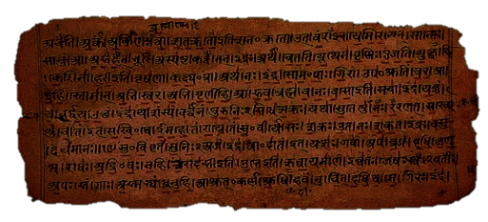
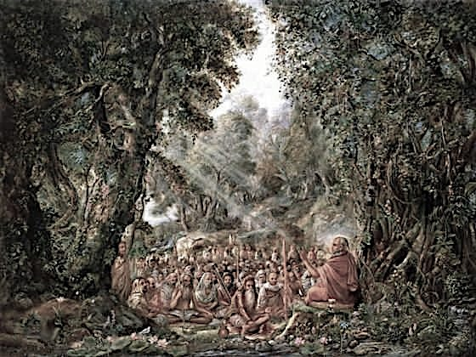
1.10. Departure of Lord Kåñëa for Dvärakä
Contents
Kingdom of Yudhiñöhira Mahäräja
Kåñëa gets ready to depart
Ladies of Hastinapura – Glorify Lord
Lord departs and proceeds towards Dwarka

Slide 46
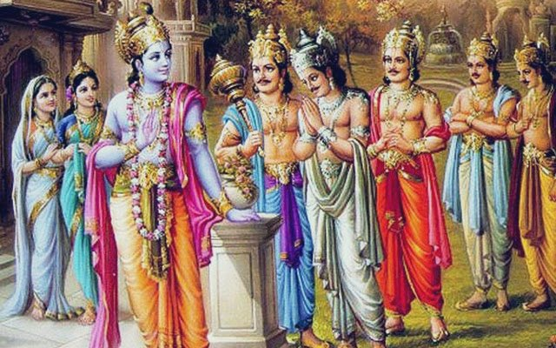
Theme : 1 : SB 1.10.1-6: Kingdom Yudhiñöhira Mahäräja

Slide 47
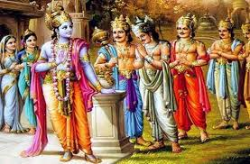

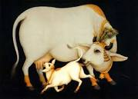

SB 1.10.1-6: Kingdom of Yudhiñöhira Mahäräja
1-6: Rule of Maharaja Yudhisthira
  Kuru dynasty was exhausted (2)
    Krsna was pleased by
    establishing Yudhisthira Maharaj
  Enlightened by Bhisma, he
  ruled over the earth and seas (3)
  Prosperous kingdom (4-5)
    Rain is more than needed
    Earth produced in profusion
    Milk from fatty cow bags moistened earth
    The rivers, oceans, hills, mountains, forests, creepers and active drugs, in every season – paid tax to the King
  Happy subjects (6)
    No mental agonies
    No diseases
    No excessive heat or cold

Slide 48
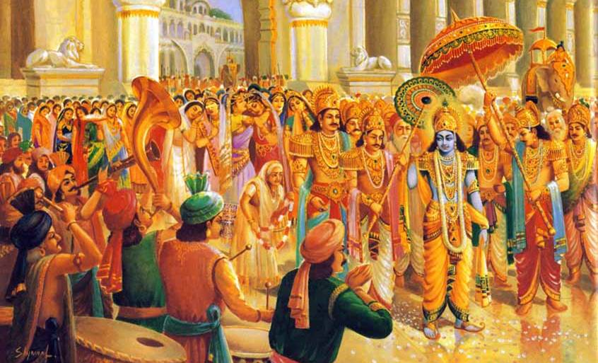
Theme : 2 : SB 1.10.7-19:
Kåñëa gets ready to depart for Dwaraka

Slide 49
7-19: Kåñëa gets ready to depart
7-8: Family assembled to see-off Krsna
  Lord took permission of Yudhisthir and alight the chariot (7-8)
    embraced others
    received obeisance from others
9-14: Intensity of Lord’s attractive influence seen
  All the devotees, unable to tolerate separation, nearly fainted (9)
  Hearts were melting on the pot of attraction (11-12)
  They looked at Lord with unblinking eyes (13)
  Uncontrollable tears (14)
15-19: Lord was appropriately honored
  Instruments were sounded to honor the Lord (15)
  Ladies showered flowers (16)
  Arjuna took umbrella, Uddhava & Satyaki fanned (17-18)
  Benedictions were being offered to the Lord (19)

Slide 50

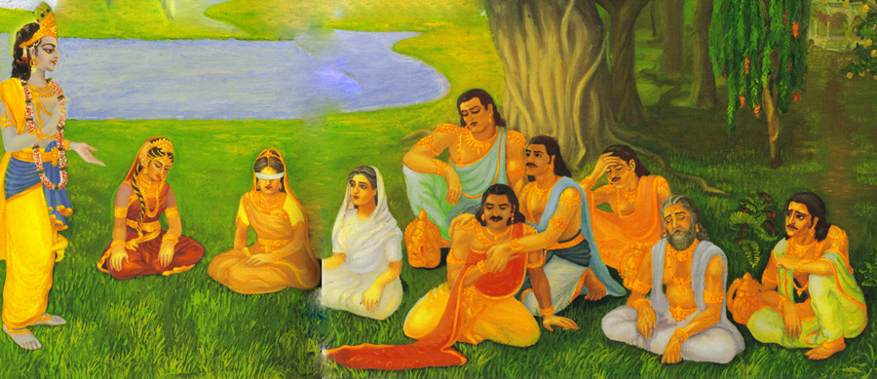
(SB 1.10.7) “After the battle of Kurukshetra, Sri Hari, Lord Sri Krishna, resided at Hastinapura for a few months to pacify His relatives and please His own sister [Subhadra].”

Slide 51
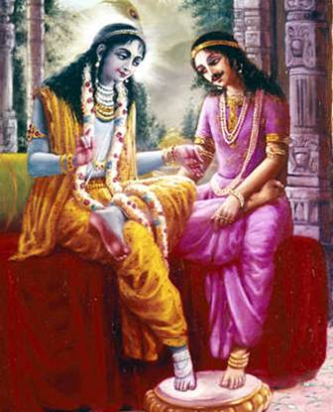
Vedic culture is a deeply personal culture – being centered around God, the Supreme Person.
Krishna reciprocates with the feelings of His devotees.

Slide 52
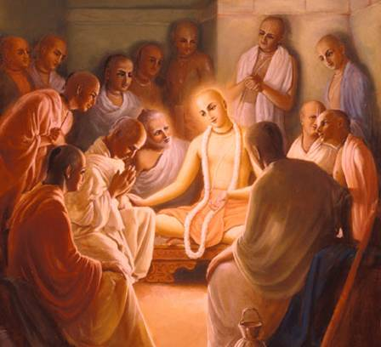
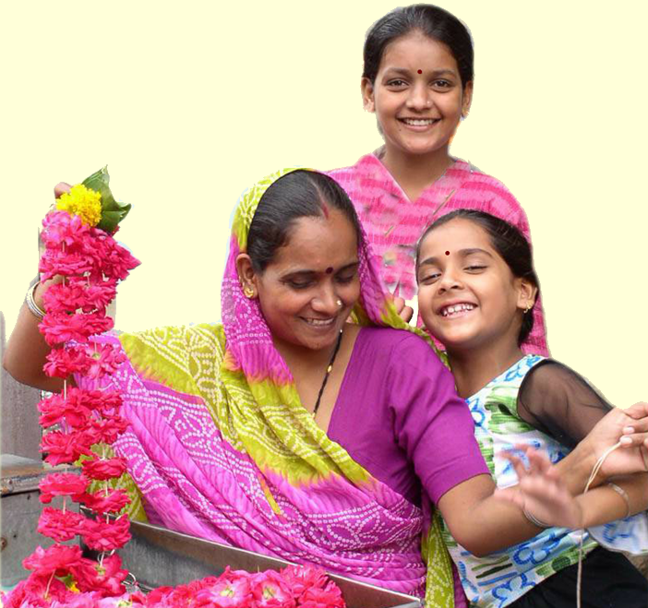
In a God-centered civilization,
all exchanges are based on a
mood of service with full
consideration of other’s
feelings …
Relationships and welfare of others is given more importance than economic or material advancement …

Slide 53
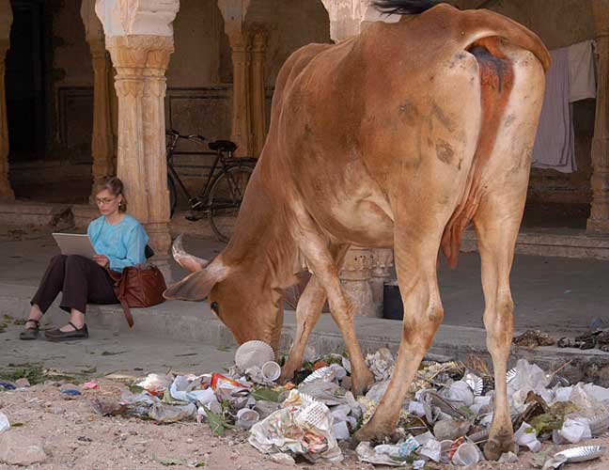
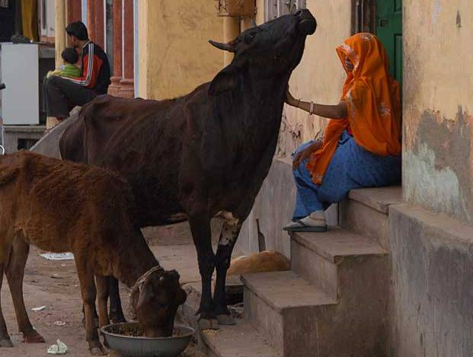
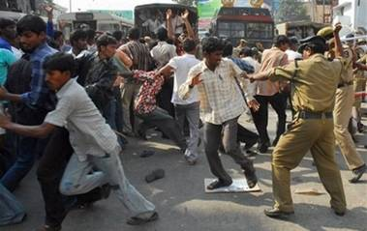
In a God-centered civilization,
Exploitation or neglect of one group for satisfying another is considered reprehensible
Interests of one individual/ group
do not clash with another’s …
because everything is done
for the pleasure of God.

Slide 54

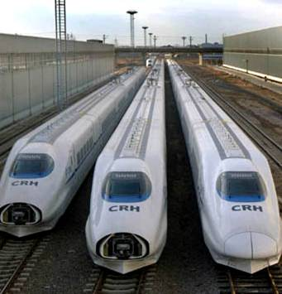
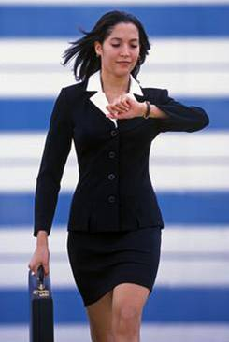
Conversely, when Sense-gratification is the main objective in life, with no higher purpose ---
the result is industrial culture and rapid mechanization – we want everything faster and quicker.
No time for loving Exchanges.

Slide 55

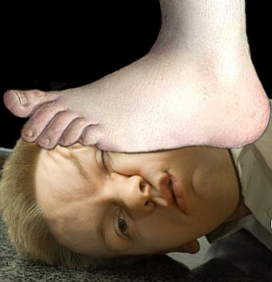
Competition & Exploitation become the norm, killing finer human instincts.
Key to
good
career
Got to get better
grades
I’ll prove myself

Slide 56
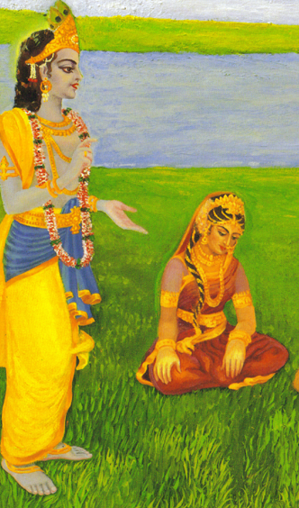
Krishna stays back to pacify His sister, Subhadra ---
Another aspect of relationships in Vedic culture -
the older brother in the family feels great responsibility for other siblings.
The younger sister is treated as good as one’s daughter.
So many others could have pacified Subhadra and Yudhishtira, but Krishna personally stayed back out
of affection.

Slide 57
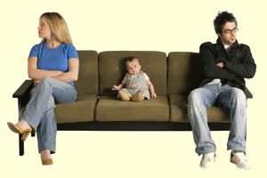
Modern societies often lack such deep feelings of commitment and responsibility between
family members or within community.

Slide 58
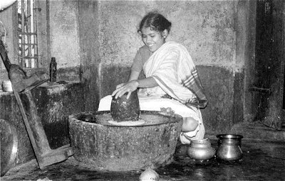
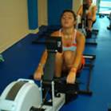
When individuals are only interested in gratifying the senses, everything becomes machine-like.
“A labor of love in cooking for my family.”
“No patience to cook, and
no time. Have to go to the gym.”

Slide 59
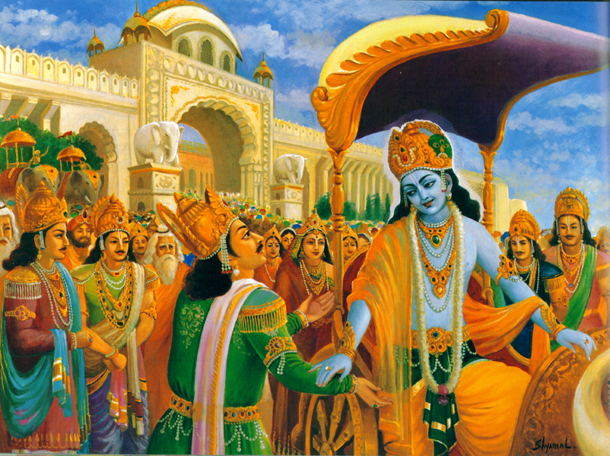
(Text 8) “Afterwards, when the Lord asked permission to depart and the King gave it, the Lord offered His respects to Maharaja Yudhisthira
by bowing down at his feet, and the King
embraced Him.

Slide 60
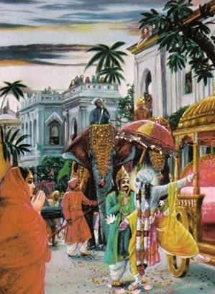
(Text 8)
“After this the Lord, being embraced by others and receiving their obeisances, got into His chariot.”

Slide 61
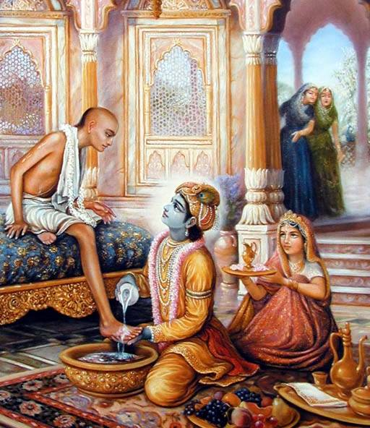
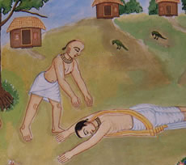
Customs and rituals were so designed as to touch the heart, to create an atmosphere saturated with heartfelt exchanges.

Slide 62
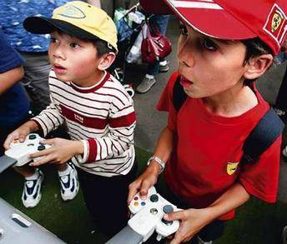
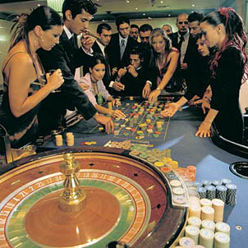

In today’s society, for lack of meaningful relationships and engagements, people feel unfulfilled and seek lesser engagements – often mindless or even harmful.

Slide 63
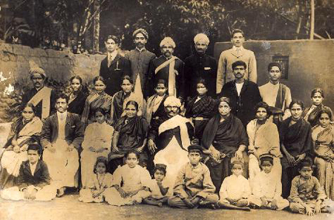

Tension, strife, mental disturbances – in Vedic culture, these were mostly
dissipated
by the fabric of
loving relationships.
There was hardly any need for extraneous family counselors, psychiatrists etc.

Slide 64
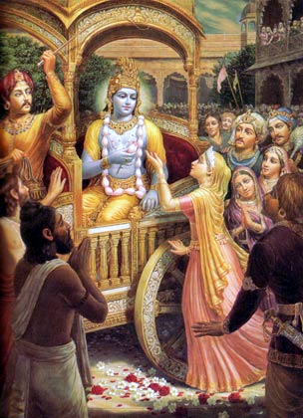
(Text 9)
“At that time Subhadra, Draupadi, Kunti, Uttara, Gandhari, Dhrtarashtra, Yuyutsu, Krpacarya, Nakula, Sahadeva, Bhimasena, Dhaumya and Satyavati all nearly fainted because it was impossible for them to bear separation from Lord Krishna.”

Slide 65

“The intelligent, who have understood the Supreme Lord in association with pure devotees
and have become freed
from bad materialistic association, can never
avoid hearing
the glories of the Lord,
even though they have heard them only once. “
(Text 10)

Slide 66






Pandavas moments with Krishna

Slide 67
“How, then, could the Pandavas tolerate His separation, for they had been intimately associated with His person, seeing Him face to face, touching Him, conversing with Him, and sleeping, sitting and dining with Him?” (Text 10)

Slide 68

Nature of hearing topics about Krishna – from undisturbed authorities--pacifies the mind of all incongruities
& helps one transcend all kinds of problems.
Vedic culture emphasized regularly hearing transcendental topics.
Unnecessary negative vibrations and needless propoganda of disturbing news was avoided.

Slide 69


In contrast, modern society is bombarded from all sides by disturbing vibrations; newspapers and other media agitate and aggravate the disturbances in the mind – high-speed, from across the globe -- without giving any positive shelter.

Slide 70

(Text 13)
All their hearts were melting for Him on the pot of attraction. They looked at Him without blinking their eyes, and they moved hither and thither in perplexity.

Slide 71

(text 14)
The female relatives, whose eyes were flooded with tears out of anxiety for Krsna, came out of the palace. They could stop their tears only with great difficulty. They feared that tears would cause misfortune at the time of departure.

Slide 72

The ladies feared that their tears might bring
misfortune for Krishna.
Such sentiments were
not superstitious.
Our mental state
influences how things unfold.
We can project positive or
negative vibrations into our surroundings.
Therefore they stopped their tears
with difficulty and smiled affectionately.

Slide 73

(text 16)
“Out of a loving desire to see the Lord, the royal ladies of the Kurus got up on top of the palace, and smiling with affection and shyness, they showered flowers upon the Lord.”

Slide 74



Women in Vedic Culture

Slide 75
Some people say that restricted male-female association is a Mohammedan introduction (parda)
Here we see this custom was observed even during the days of the Mahabharata, 5000 years ago.
Instead of coming down in the open air, the ladies went up on the top of the palace and from there paid their respects to Lord Krishna by showers of flowers.

Slide 76

Shyness is a gift of nature to the fair sex.
It commands respect from the opposite sex.
It enhances the women’s beauty and prestige, even if they are of a less important family or even if they are less attractive.

Slide 77



Woman is considered to be fire, and man is considered to be like butter.
The butter must melt in association with fire.

Slide 78


Therefore they may be brought together only when it is necessary …

Slide 79

Even great and powerful men like Julius Ceaser or Visvamitra fell victim to feminine attraction.

Slide 80

Human civilization as conceived by the sages of India was meant to promote simple living and high thinking.
When the mind is always pre-occupied with impressing the opposite party, there is very little chance for being sober and contemplating higher values of life.

Slide 81


Shyness in women is a great protection to check unrestricted mixing and maintains chastity in society.
It is nature’s gift, and it must be utilized.

Slide 82


Contrary to popularized belief that Vedic culture is restrictive and exploitative towards women,
it offers them
great protection.

Slide 83


Queen Archi goes to Vaikuntha with Maharaj Prithu
Devahuti seeks transcendental knowledge

Slide 84



Vedic culture is not restrictive, rather it is meant to
lead one to higher freedom.

Slide 85

A simple housewife –
is that all?
Are they not being confined to stereotyped roles ?
Don’t they need gainful employment?

Slide 86


In a proper Vedic society, women are gainfully and meaningfully engaged – in fact much more than an average woman of today –
she works for her own
self-realization and
facilitates her family to
achieve a similar goal …
responsibilities that she alone can do properly.

Slide 87


She also serves the community in meaningful, fulfilling ways for a wholesome life of progressive satisfaction.

Slide 88


Artificial attempts at equality actually leaves women more prone to exploitation …

Slide 89



and subject to
needless anxieties…

Slide 90

In Vedic society, women were not equal, but in fact enjoyed a more respectable position than men – they were addressed as “Mother”– a position of greatest respect !
Boys were trained right from childhood
to respect and cherish
all women as mothers.

Slide 91



Vedic education was meant NOT for acquiring degrees or earning one’s livelihood;
Rather it stressed on formation of Character.

Slide 92

Canakya Pandita
on Education
One who sees all women other than one’s wife as mother,
others' possessions as insignificant as a lump of clay,
Treats all living beings as equal to himself
-- such a person is considered a learned man.

Slide 93


Natural Opulence
and Social Organization

Slide 94


(text 15) “While the Lord was departing from the palace of Hastinapura, different types of drums -like the mrdanga, dhola, nagra, dhundhuri and dundubhi-and flutes of different types, the vina, gomukha and bheri, all sounded together to show Him honor.”

Slide 95

(text 17)
“At that time Arjuna, the great warrior and conqueror of sleep, who is the intimate friend of the most beloved Supreme Lord, took up an umbrella which had a handle of jewels and was embroidered with lace and pearls.”

Slide 96


Gold, jewels, pearls and valuable stones – all gifts of nature -- were profusely used in
worship and decoration even
until recent times–
Even the elephants and cows
were ornamented in gold!

Slide 97


Nature provides bountifully by the order of the Lord, when man does not waste his valuable time in producing unwanted things in the name of necessities.

Slide 98


By so-called development of
industrial enterprises, we are
now using rubber and plastic
instead of metals like
gold, silver, brass and copper.

Slide 99




We are using margarine instead of purified butter, and one fourth of the city population has no shelter.

Slide 100

(Text 18)
“Uddhava and Satyaki began to fan the Lord with decorated fans, and the Lord, as the master of Madhu, seated on scattered flowers, commanded them along the road.”

Slide 101


By the painstaking efforts of great acharyas,
remembrance of this culture is
preserved to this day.
Even to this day, the Deity of Lord Krishna in the temples
is regularly brought out in
grand procession.

Slide 102



Ladies cleanse the streets and decorate them with elaboratefloral designs; brahmins chant Vedic hymns;
Children pull carts or light fire crackers;

Slide 103


Others bring offerings to the Deities
and distribute
sanctified food to public.

Slide 104

Simply by observing the Lord’s beauty, they feel no necessity for movies, televisions and clubs for artificial entertainment – whatever personal problems and interpersonal tensions there may be are set aside and forgotten and the entire community is brought together in the sublime celebrations.

Slide 105




Signs of decoration in special festivals were also collected from the gifts of nature, such as the plantain trees,
the mango trees,
fruits and flowers.

Slide 106


These rapidly vanishing natural arts involve deep expressions of devotion and effort.

Slide 107




In contrast to the highly commercialized modern culture, the Vedic mode of reception created an atmosphere of auspiciousness and is full of sincerity on the part of both the receiver and received.

Slide 108


Everybody is engaged in meaningful and fulfilling services – unemployment is not an issue.
Duty of the king was to ensure that everyone is engaged – meaningfully, and according to their specific natures.

Slide 109

Exchanging services with one another – the herdsmen, farmer, cobbler, artisans , businessmen --- all live in a close-knit community, centered on God .
Thus every member’s contribution is valued.

Slide 110

The modern society also has doctors, engineers, economists, teachers… The exchange of service is still there, but measured on a different yardstick
– the money scale!

Slide 111




Unlike the Vedic artisan, the modern worker labors hard in factories to produce nuts and bolts – for money
while the rich get richer…
and the poor
get poorer …

Slide 112



The artificial way of living depending on factories and tools can render so-called happiness only to a limited number at the cost of millions.

Slide 113

If the human civilization has sufficient grains, minerals, jewels, water, milk, etc., then why should it hanker after terrible industrial enterprises at the cost of the labor of some unfortunate men?

Slide 114

A peaceful & progressive community with God in center :
For some, it is only a mirage -- they blindly reject it as not rational. But for genuinely thirsty people, it is an oasis.

Slide 115

Such a community is not a product of chance.
It flourishes under the guidance & organization
of sober and enlightened leaders

Slide 116






And by systematic education and training of its members.

Slide 117
Theme : 3 : SB 1.10.20-30: Ladies of Hastinäpura glorify Lord

Slide 118
20-30: Ladies of Hastinäpura – Glorify Lord
20-30: Glorification of Lord:
  Very pleasing talks: (20)
anyonyam äsét saïjalpa uttama-çloka-cetasäm
kauravendra-pura-stréëäà sarva-çruti-mano-haraù
  Spoke in santa rasa (reverence) (21)
  Lord transcendental even in creation (22)
  But Lord is perceivable now! (23-24)
    Devotional service is the best process
  Appreciates Krsna’s form as most confidential (25-26)
  Remembered Lord’s pastimes and association with
  Yadu’s and Pandavas (26)
  Dvaraka more glorious than heavens (27)
  Fortune of wives of Krsna and favor to gopis (28-29)
  Mercy of Lord Krishna on His queens (30)
    Lord never left them

Slide 119
Theme : 4 : SB 1.10.31-36:
Lord departs and proceeds towards Dwarka

Slide 120
31-36: Lord departs and proceeds
towards Dwarka
31-36: Lord’s reciprocation:
  With the ladies of Hastinapura (31)
  Maharaja Yudhisthira arranged four divisions of defence to accompany the Lord (32)
  Pandavas overwhelmed with thought of separation (33)
  Lord passed through various provinces to reach Dvaraka (34-35)
  Lord was welcomed at various provinces (36)
    Lord performed His evening rites

Slide 121
Chapter 10 Overview
1.10 Krsna’s departure for Dwaraka
1-6: Yudhistira’s kingdom
Rules with perfect knowledge (from Krsna & Bhisma) – misgivings eradicated (3)
7-19: Krsna gets ready to depart
Resided for few months to pacify relatives & then started (7)
Intensity of Krsna’s attractive influence & separation (9-14)
Krsna appropriately honored (15-19)
20-30: Talks of ladies of Hastinapura
Pleasing talks more attractive than Vedic hymns (20)
Krsna is original PoG – existed before creation (21)
DS – best for experience Lord’s form (23)
Lord descends in MW to punish miscreants (25)
Yadu dynasty & Mathura & Dwaraka queens & gopis are glorious (26)
31-36: Lord’s proceeds to Dwaraka
Lord smiled & accepted their greetings (31)
Yudhistira arranges defense for protection, followed Krsna & returned

Slide 122
Entering Chapter 11
After describing Krsna leaving Hastinapur, Suta Goswami describes
Krsna entering Dwaraka

Slide 123

1.11 Lord Kåñëa's Entrance into Dvärakä
Contents
Dwarakavasis receive Krsna
Dwaraka city described
Welcome by various people & Lord’s reciprocation
Lord enters city, Krsna’s beauty described
Lord’s dealings
Transcendental character of Lord

Slide 124
SRIMAD BHAGAVATAM, the Crest Jewel of All Puranas
You are welcome Tomorrow for
First Canto Chapter 10
Lord Krishna’s Entrance into Dwaraka
By His Divine Grace A.C.Bhaktivedanta Swami Prabhupada, Founder Acarya of ISKCON

