Slide 1
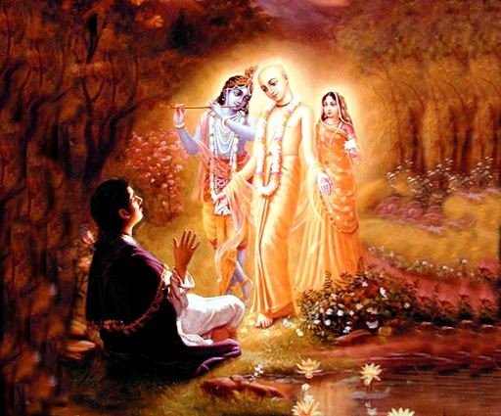

Mantra Jam
Shlokas from Vedic Scriptures
By Mother Prachi, evolve pune

Slide 2
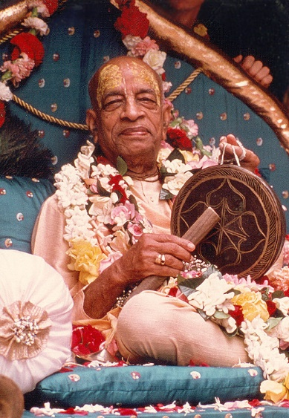
With the inspiration of
His Divine Grace
A.C. Bhaktivedanta Swami Srila Prabhupada
Founder Acarya of the International Society for Krishna Consciousness

Slide 3
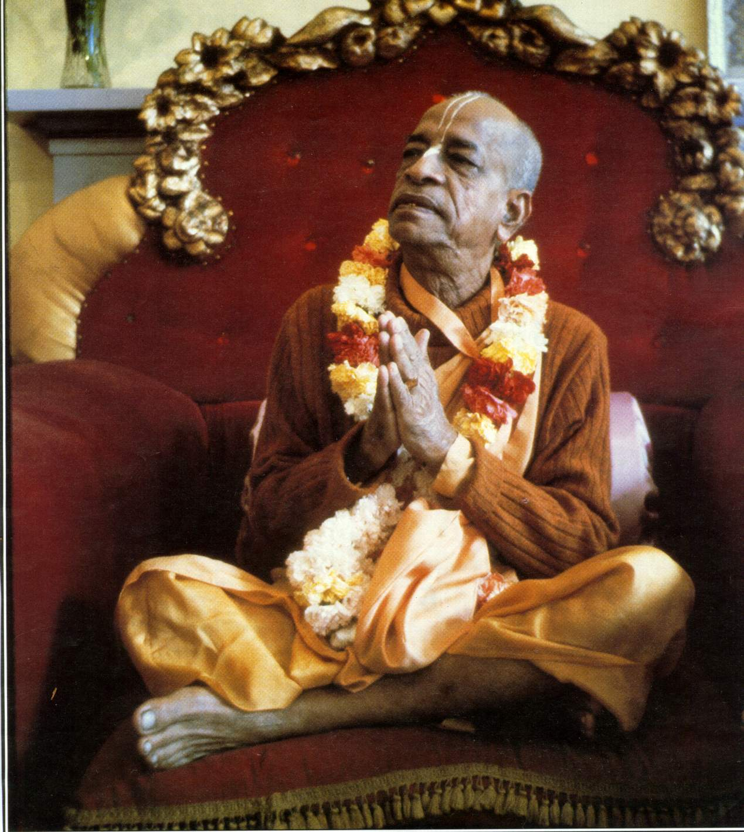
oà ajïäna-timirändhasya jïänäïjana-çaläkayä
cakñur unmélitaà yena tasmai çré-gurave namaù
I was born in the darkest ignorance, and my spiritual master opened my eyes with the torch of knowledge. I offer my respectful obeisances unto him.

Slide 4
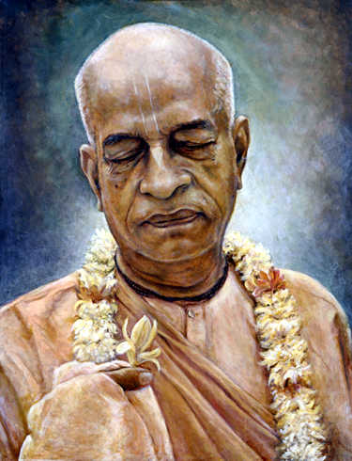
namah om vishnu-padaya krishna-preshthaya bhutale
srimati bhaktivedanta-svamin iti namine
I offer my respectful obeisances unto His Divine Grace A.C. Bhaktivedanta Swami Prabhupada, who is very dear to Lord Krishna, having taken shelter at His lotus feet.

Slide 5
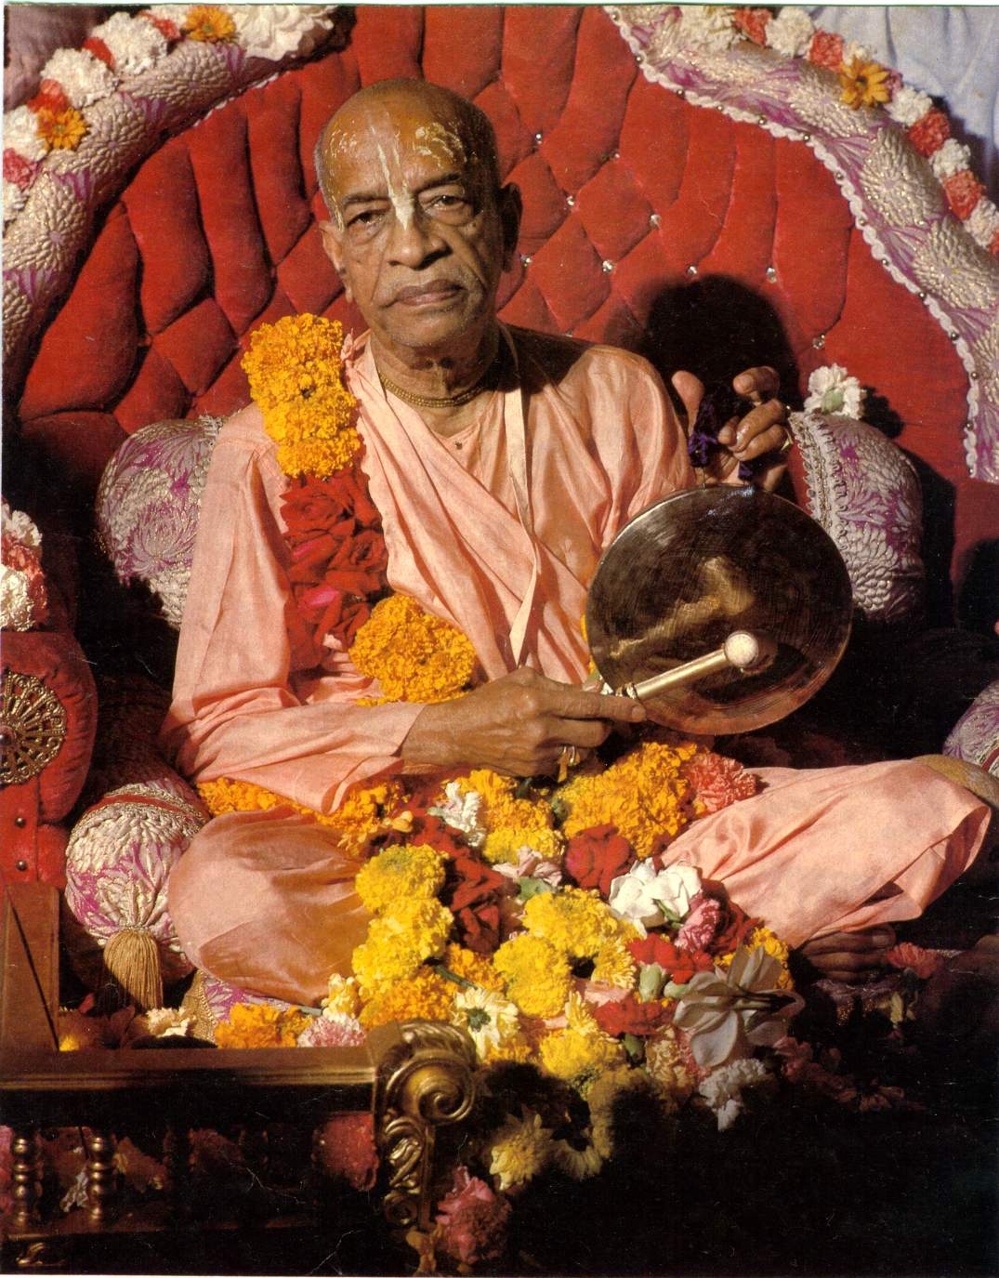
namas te sarasvate deve gaura-vani-pracharine
nirvishesha-shunyavadi-paschatya-desha-tarine
Our respectful obeisances are unto you, O spiritual master, servant of Sarasvati Goswami. You are kindly preaching the message of Lord Chaitanyadeva and delivering the Western countries, which are filled with impersonalism and voidism.

Slide 6
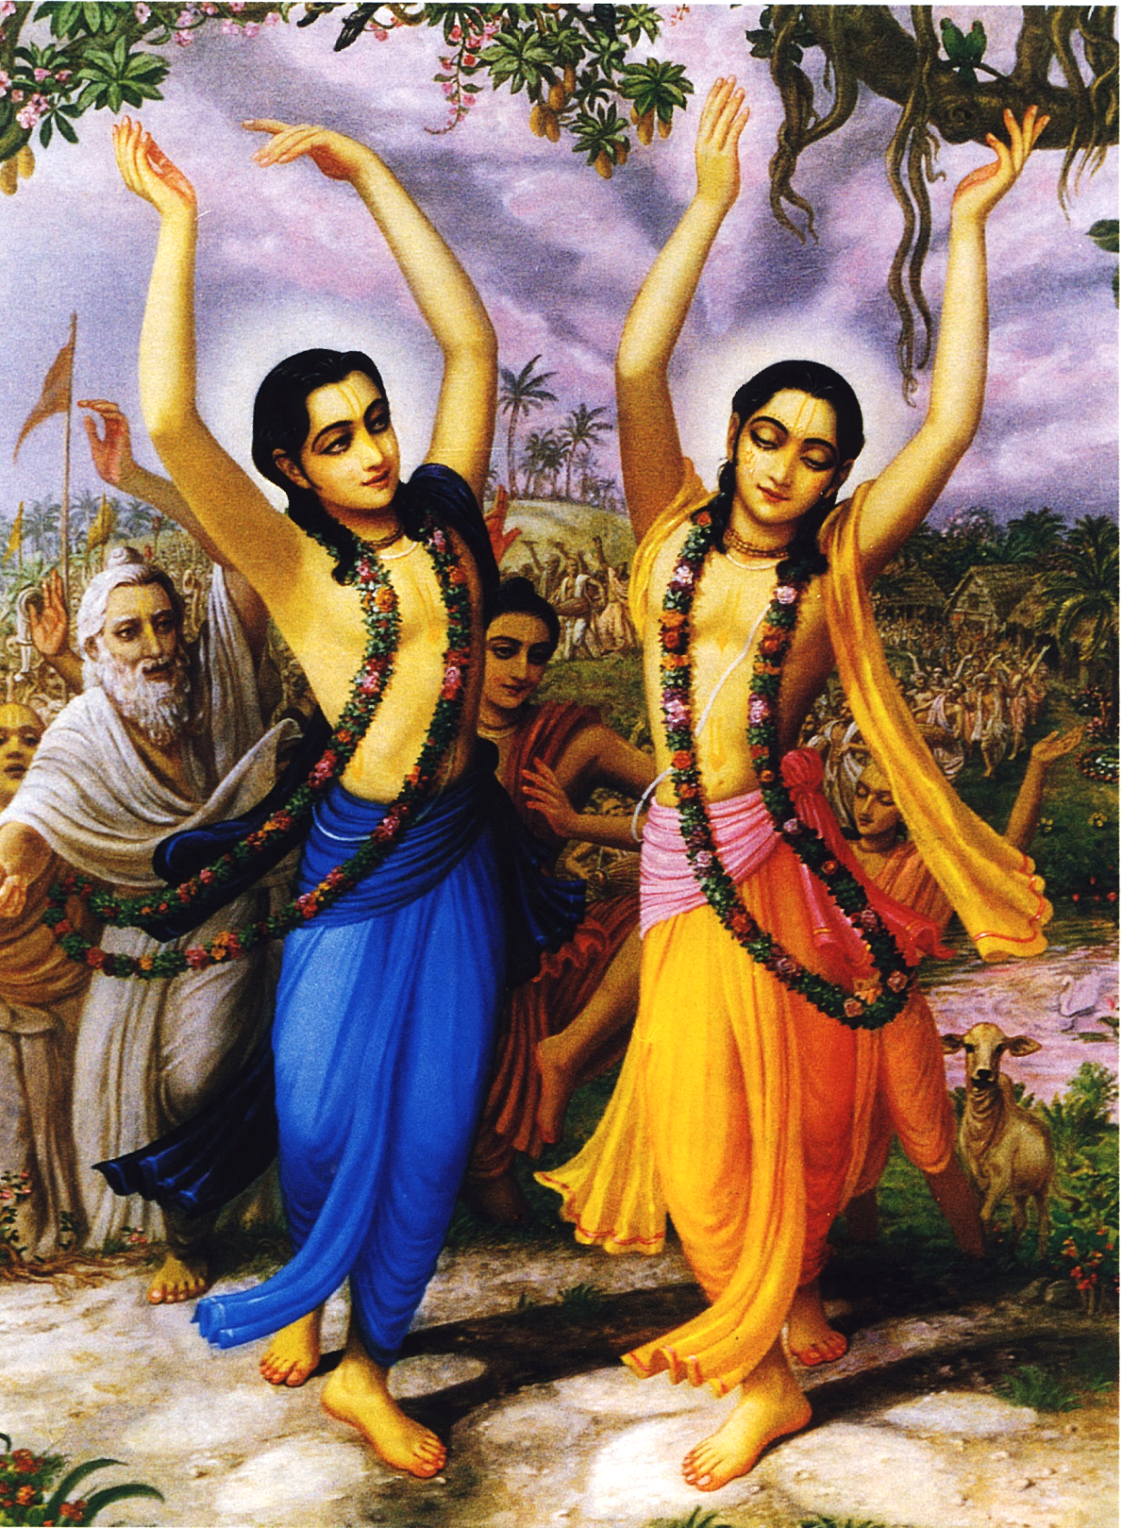
çré-kåñëa-caitanya
prabhu-nityänanda
çré-advaita gadädhara
çréväsädi-gaura-bhakta-vånda
I offer my obeisances to Çré Kåñëa Caitanya, Prabhu Nityänanda, Çré Advaita, Gadädhara, Çréväsa and all others in the line of devotion.

Slide 7
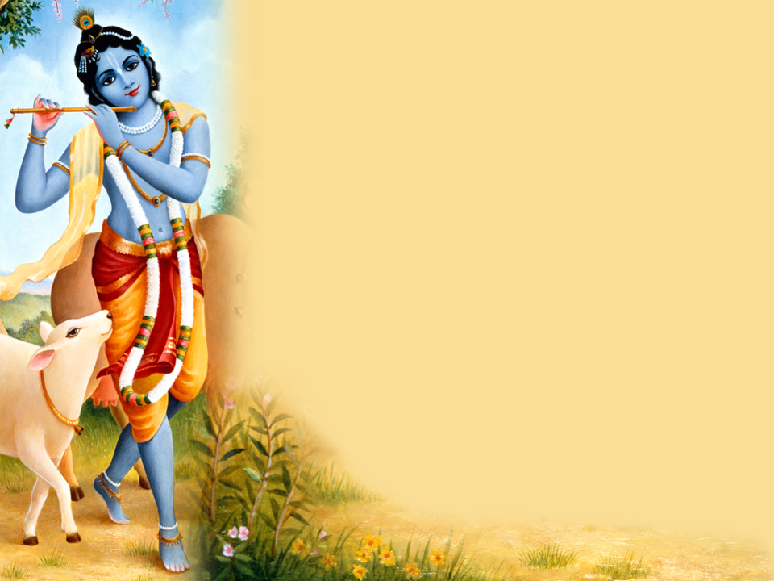
HARE KRISHNA HARE KRISHNA
KRISHNA KRISHNA HARE HARE
HARE RAMA HARE RAMA
RAMA RAMA HARE HARE

Slide 8
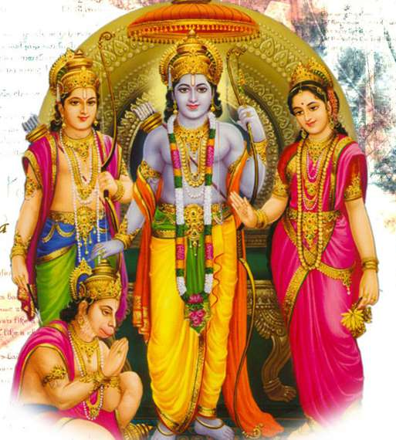
Lord Chaitanya Mahaprabhu’s Pastimes:
Murari Gupta’s devotion

Slide 9
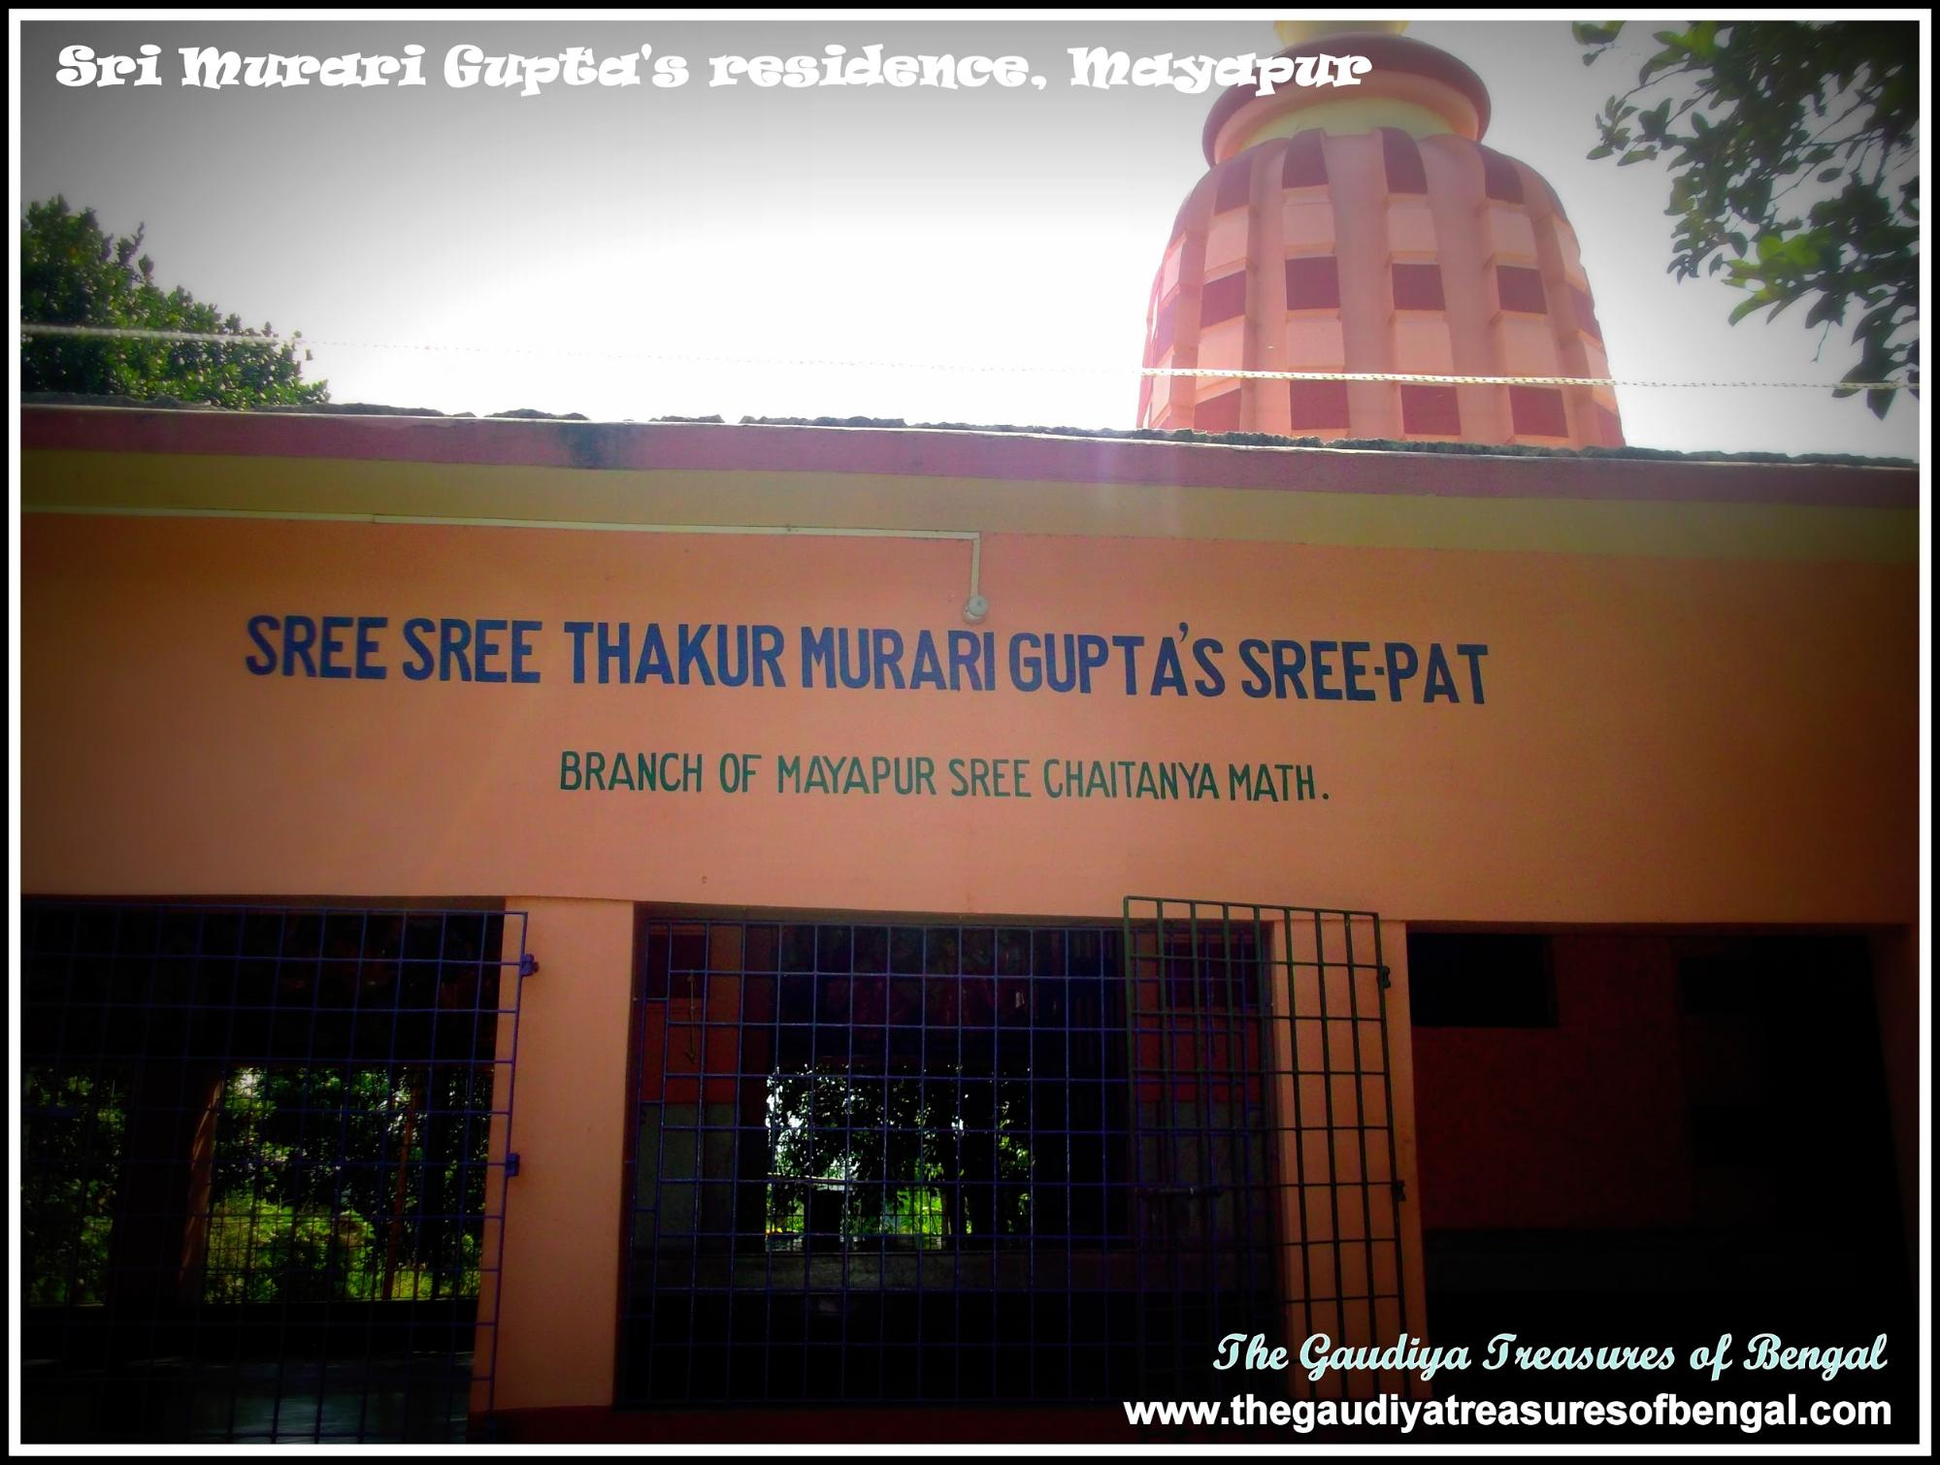

Slide 10
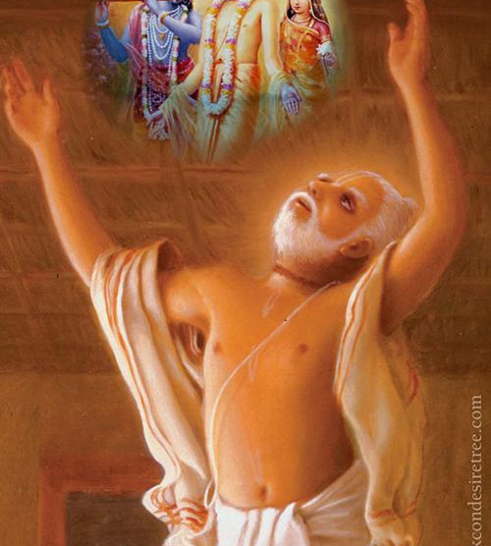
Maha Prakash pastime ( Advait acarya and Haridas Thakur)

Slide 11
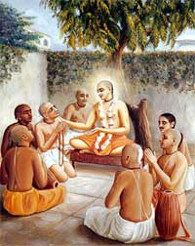

Slide 12
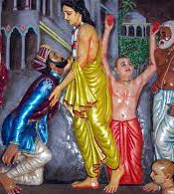
Chand Kazi receives mercy of lord

Slide 13
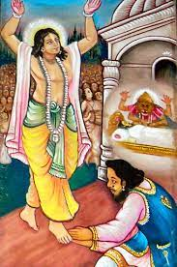

Slide 14
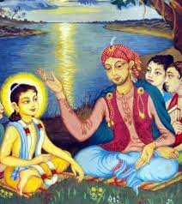
Keshav Kashmiri surrenders to lord

Slide 15



Thank you
Sublime Living
EVOLVE
High Thinking

