Slide 1
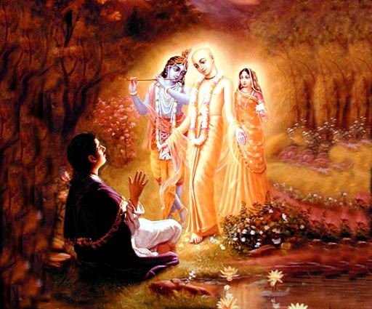

Mantra Jam
Shlokas from Vedic Scriptures
By Padma Radhika Devi Dasi, evolve pune

Slide 2
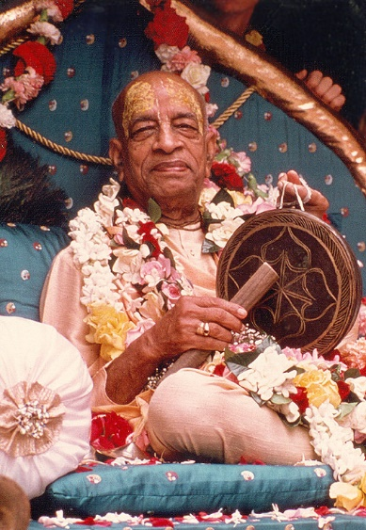
With the inspiration of
His Divine Grace
A.C. Bhaktivedanta Swami Srila Prabhupada
Founder Acarya of the International Society for Krishna Consciousness

Slide 3
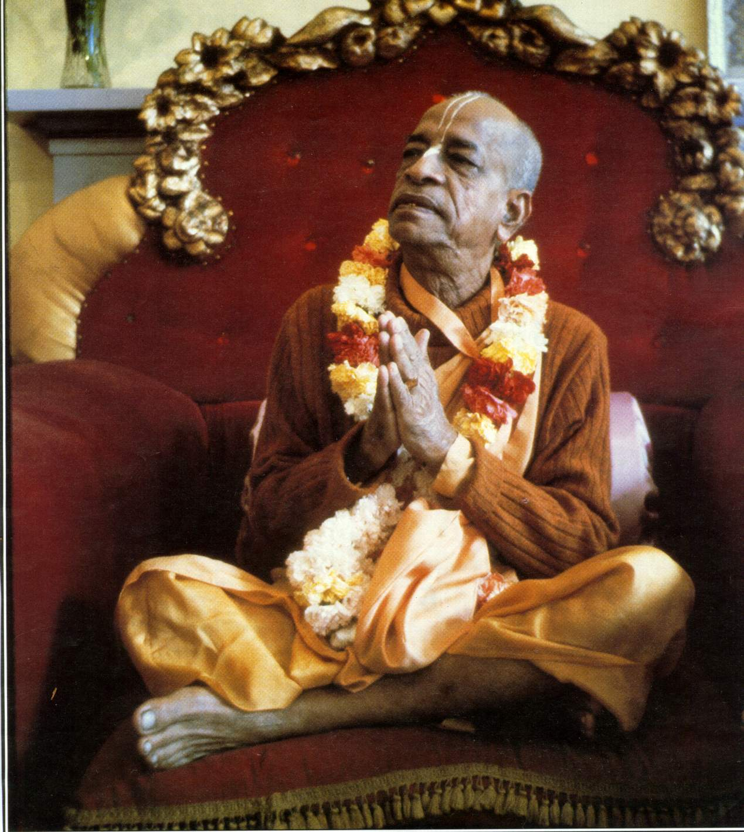
oà ajïäna-timirändhasya jïänäïjana-çaläkayä
cakñur unmélitaà yena tasmai çré-gurave namaù
I was born in the darkest ignorance, and my spiritual master opened my eyes with the torch of knowledge. I offer my respectful obeisances unto him.

Slide 4
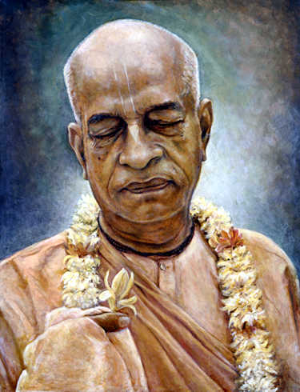
namah om vishnu-padaya krishna-preshthaya bhutale
srimati bhaktivedanta-svamin iti namine
I offer my respectful obeisances unto His Divine Grace A.C. Bhaktivedanta Swami Prabhupada, who is very dear to Lord Krishna, having taken shelter at His lotus feet.

Slide 5
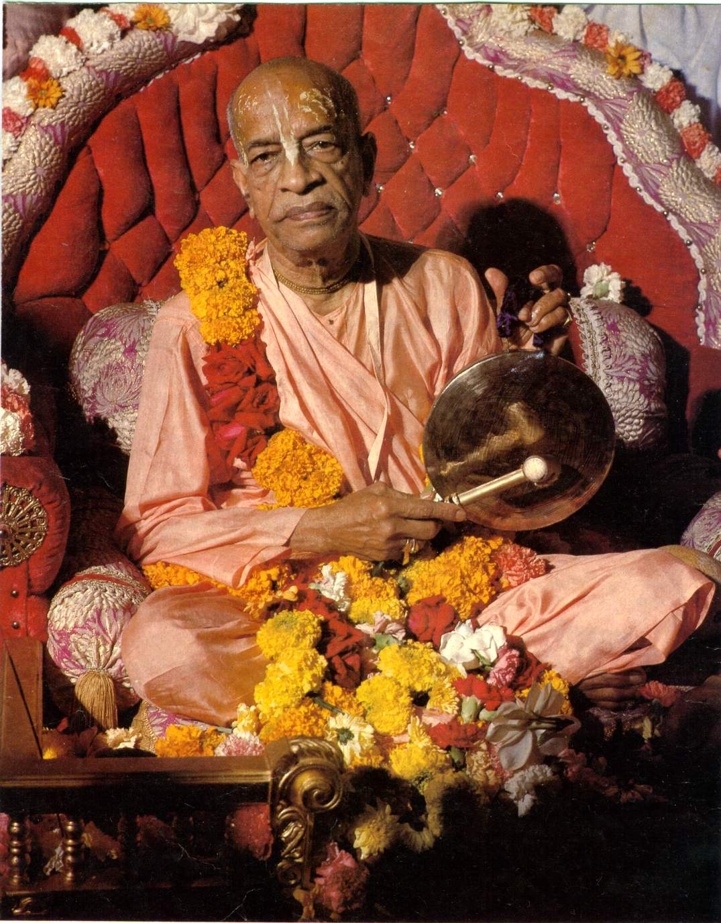
namas te sarasvate deve gaura-vani-pracharine
nirvishesha-shunyavadi-paschatya-desha-tarine
Our respectful obeisances are unto you, O spiritual master, servant of Sarasvati Goswami. You are kindly preaching the message of Lord Chaitanyadeva and delivering the Western countries, which are filled with impersonalism and voidism.

Slide 6
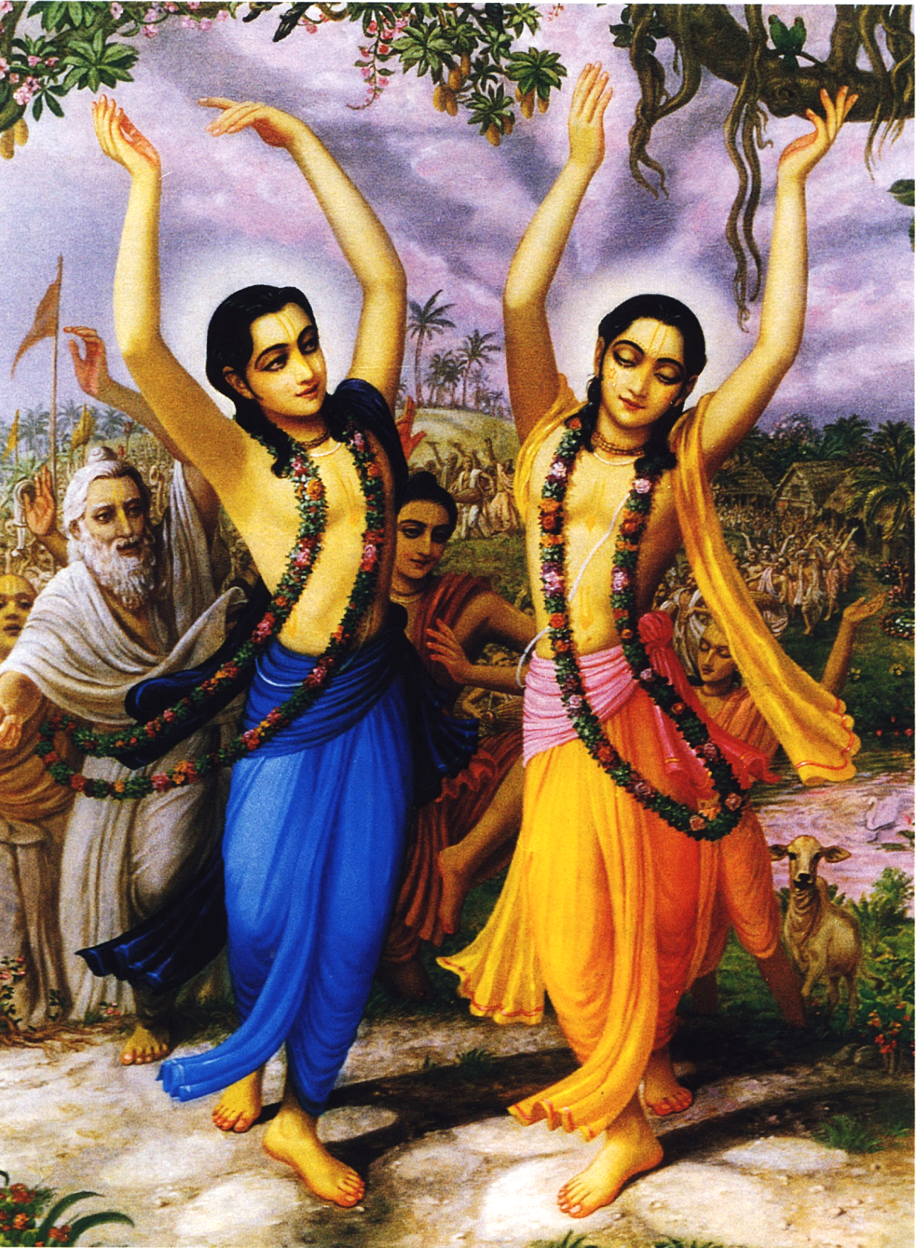
çré-kåñëa-caitanya
prabhu-nityänanda
çré-advaita gadädhara
çréväsädi-gaura-bhakta-vånda
I offer my obeisances to Çré Kåñëa Caitanya, Prabhu Nityänanda, Çré Advaita, Gadädhara, Çréväsa and all others in the line of devotion.

Slide 7
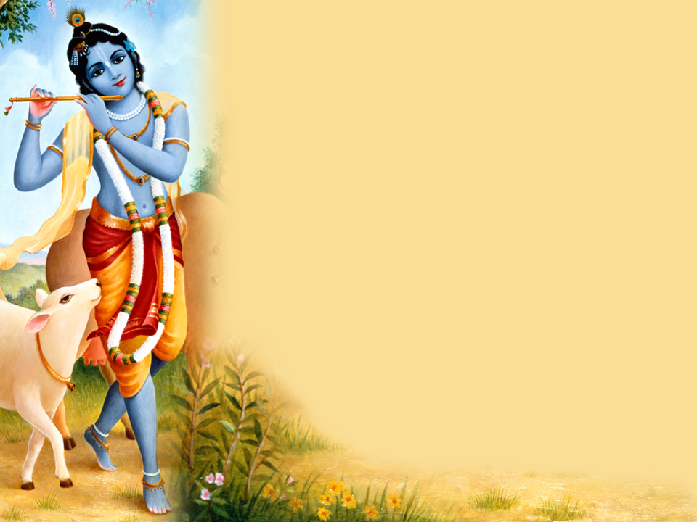
HARE KRISHNA HARE KRISHNA
KRISHNA KRISHNA HARE HARE
HARE RAMA HARE RAMA
RAMA RAMA HARE HARE

Slide 8
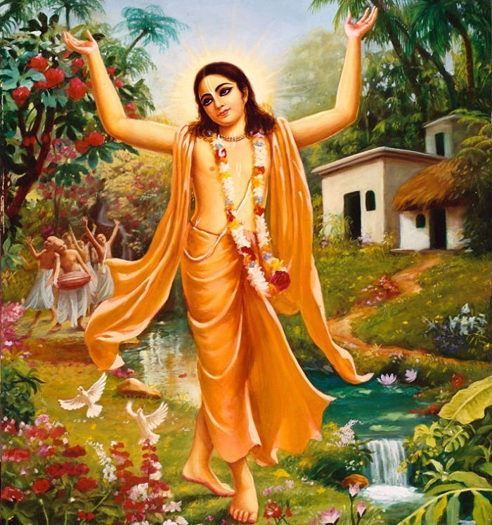
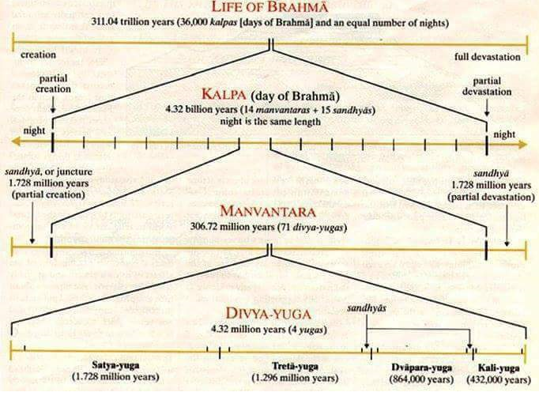

Slide 9
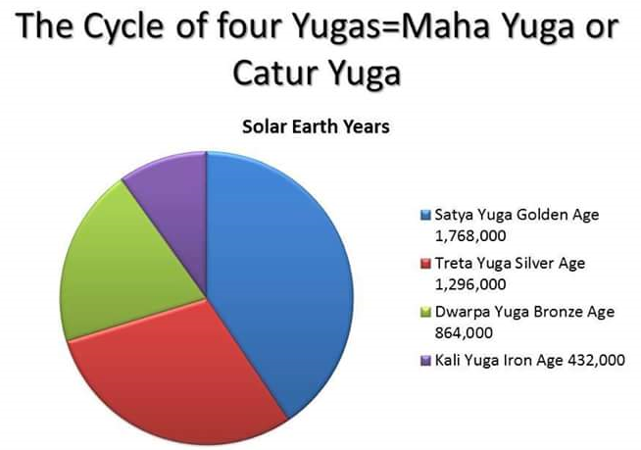

Slide 10
Lord Krishna and Lord Caitanya Mahaprabhu come "once" every 1000 Divya-yugas (Maha-yugas) or every day of Brahma.
A ''day-time of Brahma's 12 hours'' equals 1000 Maha yugas, Catur-yuga or Divya-yuga which are -.
Satya Yuga is 1,728,000 human years,
Treta Yuga is 1,296,000 human years long,
Dwapara Yuga 864,000 human years
Kali Yuga 432,000 human years.
And only the ''night-time of 12 hours'' from sunset to sunrise is when a partial annihilation takes place while Brahma sleeps where there are no Maha yugas
So a ''day and night 24 hour period'' of Brahma's time equals 8 billion 640 million human years

Slide 11
Lord Caitanya and Krishna's appearance is very rare as they comes just ''once'' over that enormous period of time.
Srila Prabhupada – ‘’ Lord Kṛṣṇa and Lord Caitanya appear once in each day of Brahmā’’ (CC Adi 3.10 Text 10 Purport)
Krishna in His original Form comes at the end of every "one thousand" Dvarpara-yuga
Lord Caitanya ''only once'' in every "one thousand" Kali-yuga
CC Adi 3.10 Text 10
At the end of the Dvāpara-yuga of the twenty-eighth divya-yuga, Lord Kṛṣṇa appears on earth with the full paraphernalia of His eternal Vraja-dhāma.
PURPORT by Srila Prabhupada.
"Now is the term of Vaivasvata Manu, during which Lord Caitanya appears. First Lord Kṛṣṇa appears at the close of the Dvāpara-yuga of the twenty-eighth divya-yuga, and then Lord Caitanya appears in the Kali-yuga of the same divya-yuga.
Lord Kṛṣṇa and Lord Caitanya appear once in each day of Brahmā, or once in fourteen manv-antaras, each of seventy-one divya-yugas in duration.

Slide 12
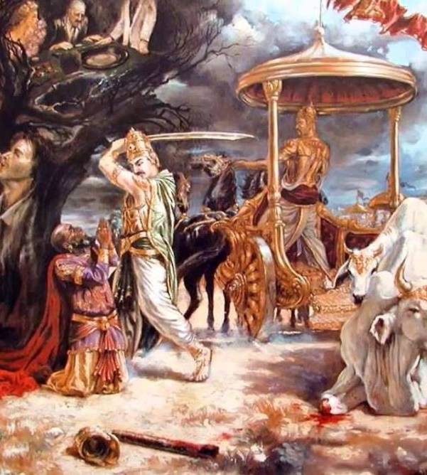

CC Adi 13.62 asaṅkhya bhaktera karāilā avatāra śeṣe avatīrṇa hailā vrajendra-kumāra
Translation
Lord Kṛṣṇa, Vrajendra-kumāra, first caused countless devotees to appear, and at last He appeared Himself.

Slide 13
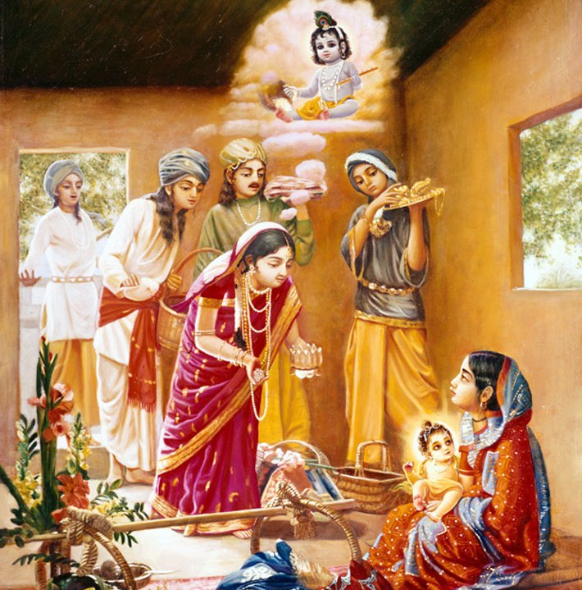

CC Adi 13.65
sarva-śāstre kahe kṛṣṇa-bhaktira vyākhyāna
jñāna, yoga, tapo-dharma nāhi māne āna
Translation
In all the revealed scriptures of Vedic culture, devotional service to Lord Kṛṣṇa is explained throughout. Therefore devotees of Lord Kṛṣṇa do not recognize the processes of philosophical speculation, mystic yoga, unnecessary austerity and so-called religious rituals. They do not accept any process but devotional service.

Slide 14
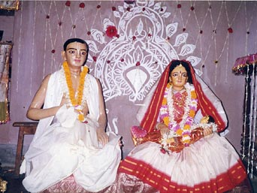
CC Adi 13.76
tāṅhā ba-i viśve kichu nāhi dekhi āra
ataeva ‘viśvarūpa’ nāma ye tāṅhāra
Translation
The gigantic universal form is called the Viśvarūpa incarnation of Mahā-saṅkarṣaṇa. Thus we do not find anything within this cosmic manifestation except the Lord Himself.

Slide 15
CC Adi 13.77 naitac citraṁ bhagavati hy anante jagad-īśvare otaṁ protam idaṁ yasmin tantuṣv aṅga yathā paṭaḥ
Translation
“As the threads in a cloth spread both lengthwise and breadthwise, so the Supreme Personality of Godhead exists directly and indirectly within everything we see in this cosmic manifestation. This is not very wonderful for Him.”
Purport
This is a verse from Śrīmad-Bhāgavatam (10.15.35).

Slide 16
CC Adi 13. 78 ataeva prabhu tāṅre bale, ‘baḍa bhāi’ kṛṣṇa, balarāma dui — caitanya, nitāi
Translation
Because Mahā-saṅkarṣaṇa is the ingredient and efficient cause of the cosmic manifestation, He is present in every detail of it. Lord Caitanya therefore called Him His elder brother. The two brothers are known as Kṛṣṇa and Balarāma in the spiritual world, but at the present moment they are Caitanya and Nitāi. Therefore the conclusion is that Nityānanda Prabhu is the original Saṅkarṣaṇa, Baladeva.

Slide 17
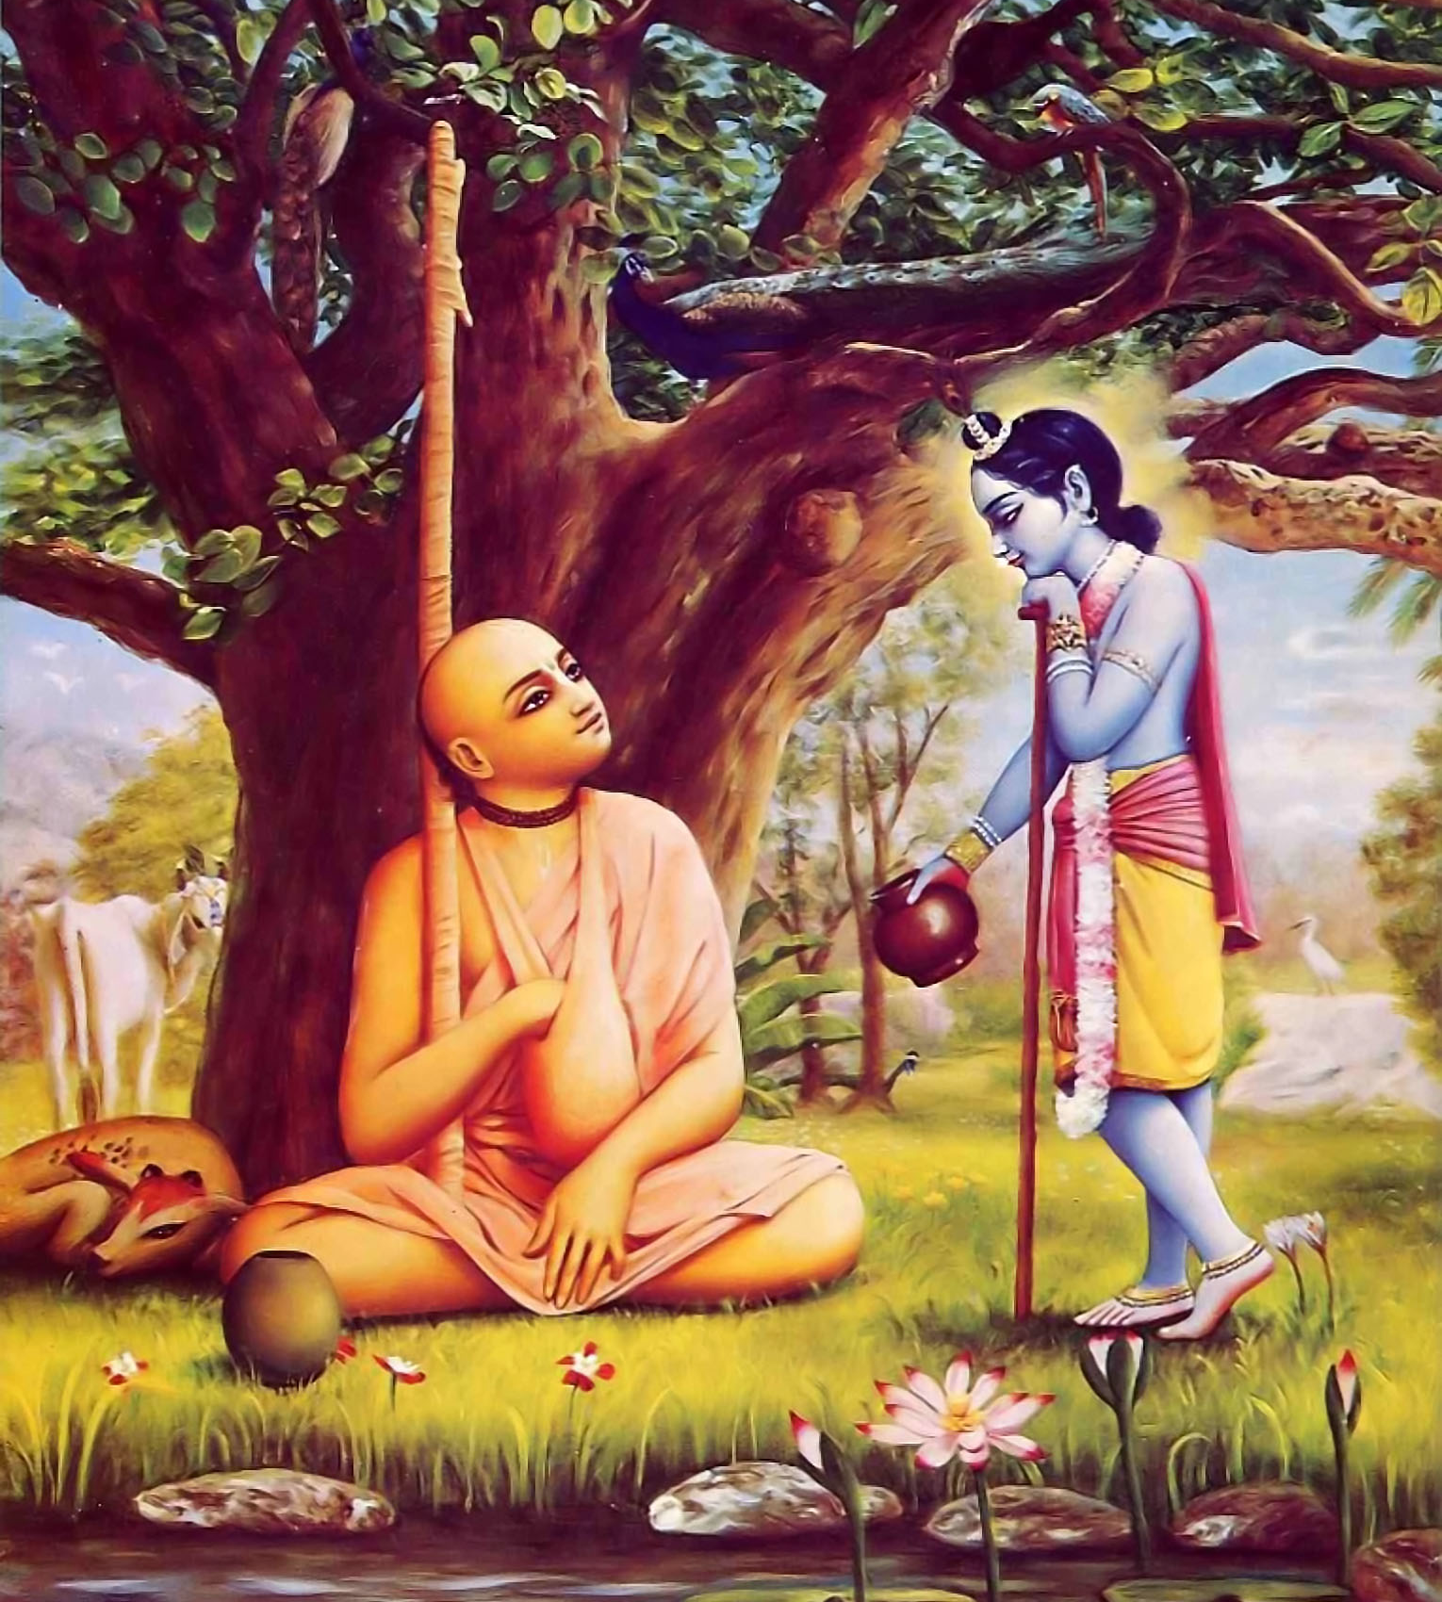

CC Adi 13.94 jagat bhariyā loka bale — ‘hari’ ‘hari’ sei-kṣaṇe gaurakṛṣṇa bhūme avatari
Translation
When the whole world was thus chanting the holy name of the Supreme Personality of Godhead, Kṛṣṇa in the form of Gaurahari advented Himself on the earth.

Slide 18
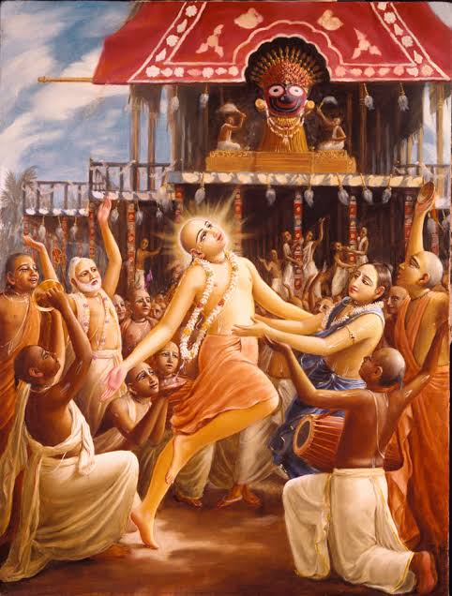
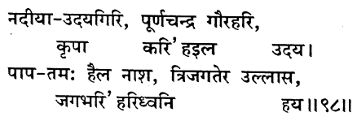
CC Adi 13.98 nadīyā-udayagiri, pūrṇacandra gaurahari, kṛpā kari’ ha-ila udaya pāpa-tamaḥ haila nāśa, tri-jagatera ullāsa, jagabhari’ hari-dhvani haya
Translation
Thus by His causeless mercy the full moon, Gaurahari, rose in the district of Nadia, which is compared to Udayagiri, where the sun first becomes visible. His rising in the sky dissipated the darkness of sinful life, and thus the three worlds became joyful and chanted the holy name of the Lord.

Slide 19

CC Adi 4.1 śrī-caitanya-prasādena tad-rūpasya vinirṇayam bālo ’pi kurute śāstraṁ dṛṣṭvā vraja-vilāsinaḥ
Translation
By the mercy of Lord Caitanya Mahāprabhu, even a foolish child can fully describe the real nature of Lord Kṛṣṇa, the enjoyer of the pastimes of Vraja, according to the vision of the revealed scriptures.

Slide 20
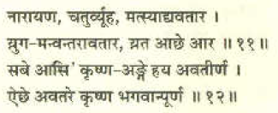
CC Adi 4.11-12 nārāyaṇa, catur-vyūha, matsyādy-avatāra yuga-manvantarāvatāra, yata āche āra sabe āsi’ kṛṣṇa-aṅge haya avatīrṇa aiche avatare kṛṣṇa bhagavān pūrṇa
Translation
Lord Nārāyaṇa, the four primary expansions [Vāsudeva, Saṅkarṣaṇa, Pradyumna and Aniruddha], Matsya and the other līlā incarnations, the yuga-avatāras, the manv-antara incarnations and as many other incarnations as there are — all descend in the body of Lord Kṛṣṇa. In this way the complete Supreme Godhead, Lord Kṛṣṇa Himself, appears.

Slide 21
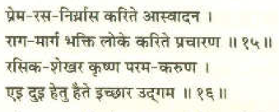
CC Adi 4.15-16 prema-rasa-niryāsa karite āsvādana rāga-mārga bhakti loke karite pracāraṇa rasika-śekhara kṛṣṇa parama-karuṇa ei dui hetu haite icchāra udgama
Translation
The Lord’s desire to appear was born from two reasons: the Lord wanted to taste the sweet essence of the mellows of love of God, and He wanted to propagate devotional service in the world on the platform of spontaneous attraction. Thus He is known as supremely jubilant and as the most merciful of all.

Slide 22



Thank you
Sublime Living
EVOLVE
High Thinking

