Slide 1
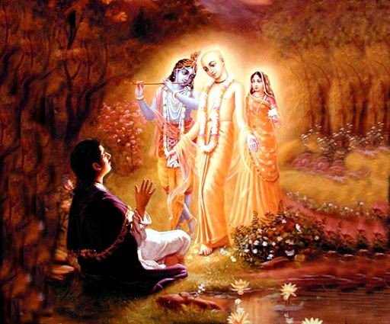

Mantra Jam
Shlokas from Vedic Scriptures
By Mother Prachi, evolve pune

Slide 2
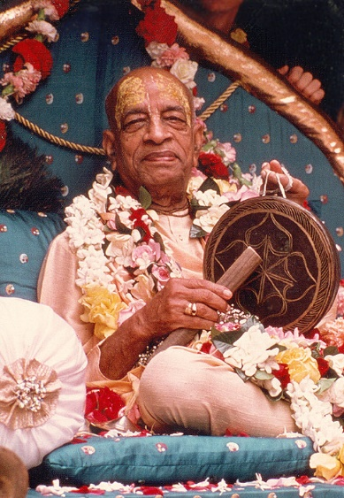
With the inspiration of
His Divine Grace
A.C. Bhaktivedanta Swami Srila Prabhupada
Founder Acarya of the International Society for Krishna Consciousness

Slide 3
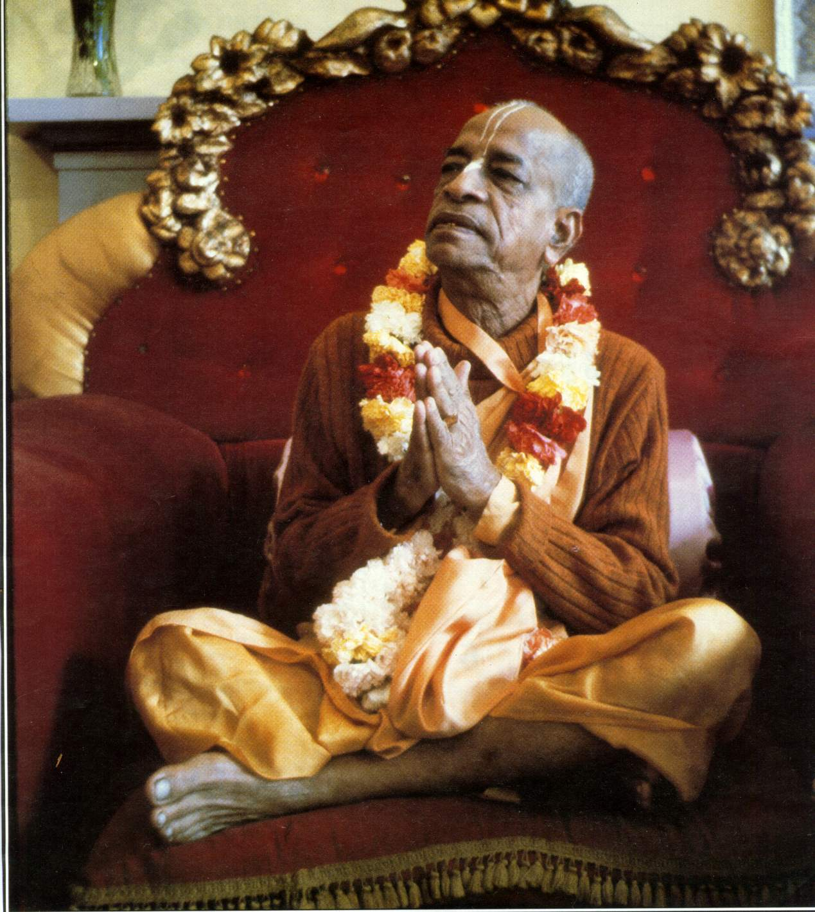
oà ajïäna-timirändhasya jïänäïjana-çaläkayä
cakñur unmélitaà yena tasmai çré-gurave namaù
I was born in the darkest ignorance, and my spiritual master opened my eyes with the torch of knowledge. I offer my respectful obeisances unto him.

Slide 4
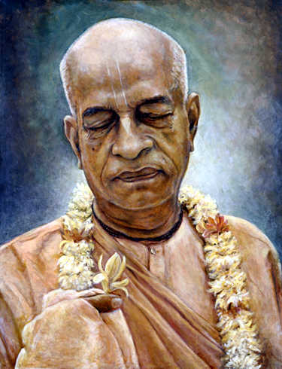
namah om vishnu-padaya krishna-preshthaya bhutale
srimati bhaktivedanta-svamin iti namine
I offer my respectful obeisances unto His Divine Grace A.C. Bhaktivedanta Swami Prabhupada, who is very dear to Lord Krishna, having taken shelter at His lotus feet.

Slide 5
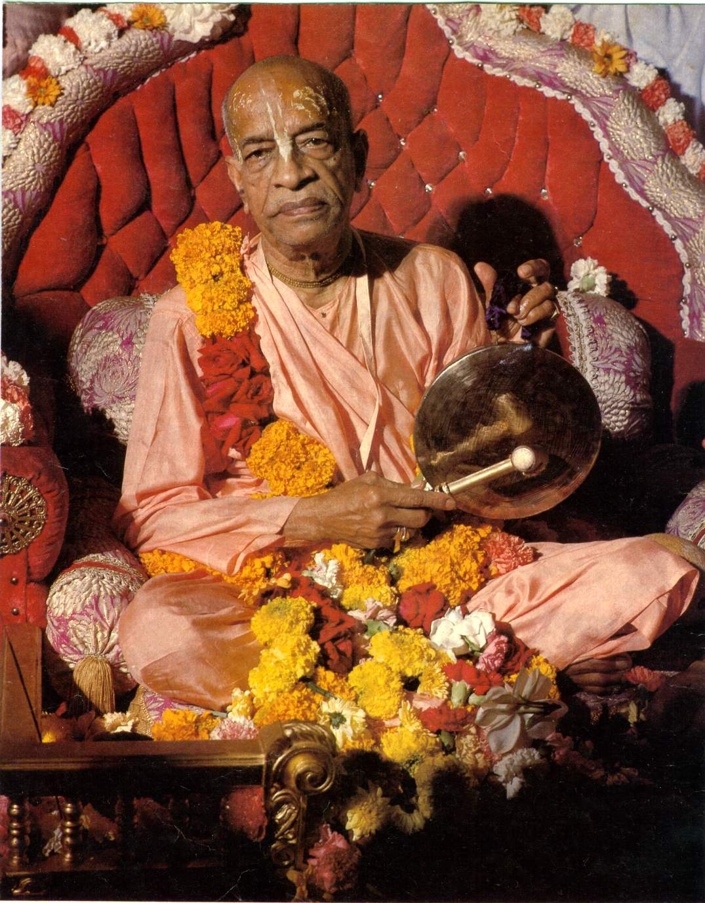
namas te sarasvate deve gaura-vani-pracharine
nirvishesha-shunyavadi-paschatya-desha-tarine
Our respectful obeisances are unto you, O spiritual master, servant of Sarasvati Goswami. You are kindly preaching the message of Lord Chaitanyadeva and delivering the Western countries, which are filled with impersonalism and voidism.

Slide 6
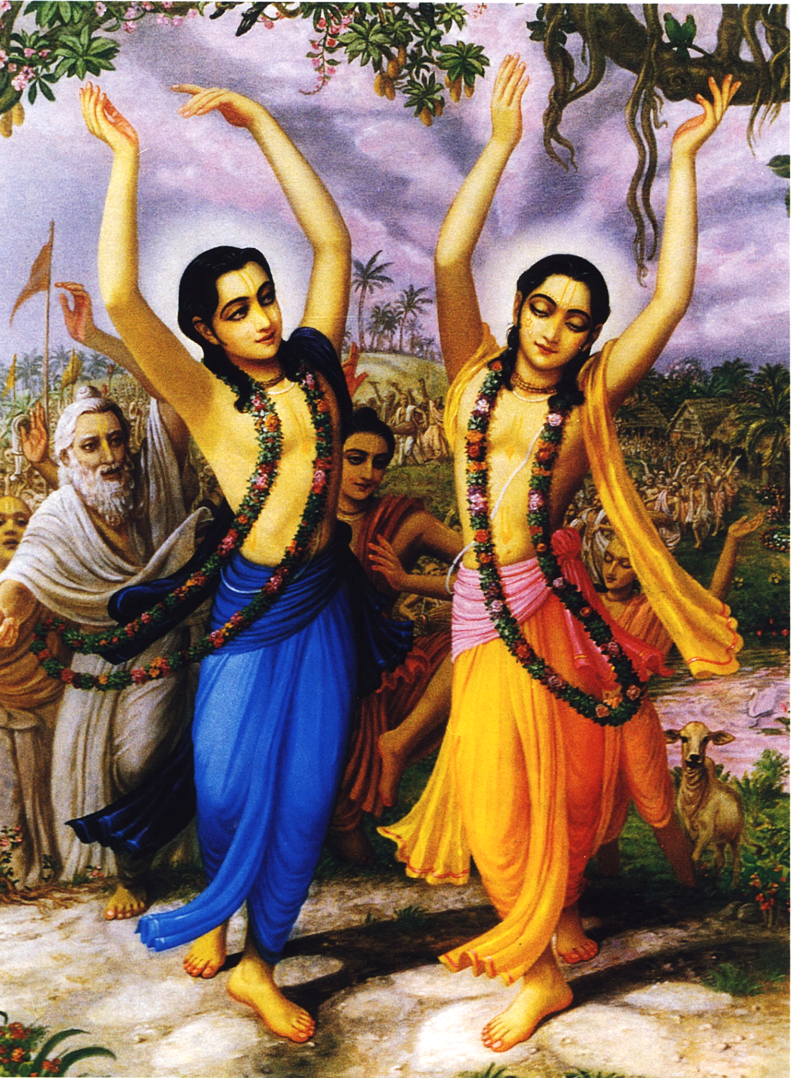
çré-kåñëa-caitanya
prabhu-nityänanda
çré-advaita gadädhara
çréväsädi-gaura-bhakta-vånda
I offer my obeisances to Çré Kåñëa Caitanya, Prabhu Nityänanda, Çré Advaita, Gadädhara, Çréväsa and all others in the line of devotion.

Slide 7
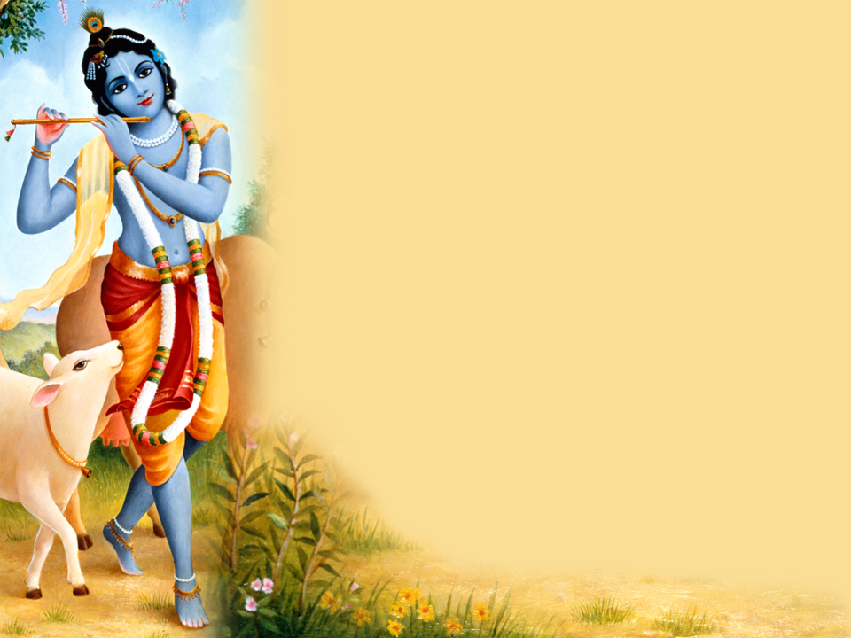
HARE KRISHNA HARE KRISHNA
KRISHNA KRISHNA HARE HARE
HARE RAMA HARE RAMA
RAMA RAMA HARE HARE

Slide 8
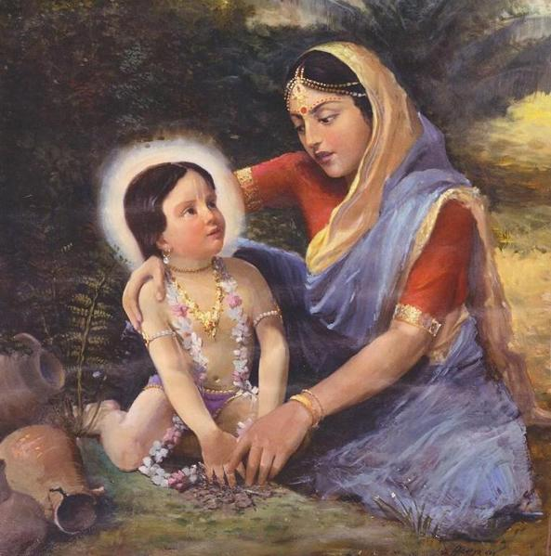
Lord Nimai’s Pastimes

Slide 9
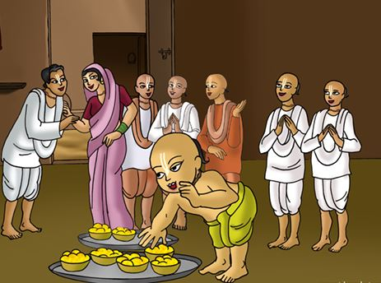
Lord Nimai accepts Brahmana’s Offering

Slide 10
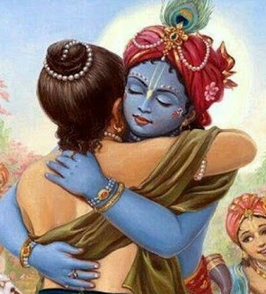
Bg. 4.11
ये यथा मां प्रपद्यन्ते तांस्तथैव भजाम्यहम् ।
मम वर्त्मानुवर्तन्ते मनुष्याः पार्थ सर्वशः ॥ ११ ॥ ye yathā māṁ prapadyante tāṁs tathaiva bhajāmy aham mama vartmānuvartante manuṣyāḥ pārtha sarvaśaḥ
Translation
As all surrender unto Me, I reward them accordingly. Everyone follows My path in all respects, O son of Pṛthā.

Slide 11
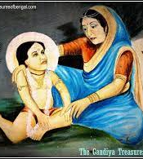
Lord Nimai’s Studies

Slide 12
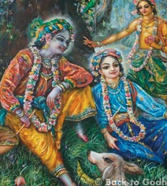
Bg. 15.15
सर्वस्य चाहं हृदि सन्निविष्टो
मत्त: स्मृतिर्ज्ञानमपोहनं च ।
वेदैश्च सर्वैरहमेव वेद्यो
वेदान्तकृद्वेदविदेव चाहम् ॥ १५ ॥ sarvasya cāhaṁ hṛdi sanniviṣṭo mattaḥ smṛtir jñānam apohanaṁ ca vedaiś ca sarvair aham eva vedyo vedānta-kṛd veda-vid eva cāham
Translation
I am seated in everyone’s heart, and from Me come remembrance, knowledge and forgetfulness. By all the Vedas, I am to be known. Indeed, I am the compiler of Vedānta, and I am the knower of the Vedas.

Slide 13



Thank you
Sublime Living
EVOLVE
High Thinking

