Slide 1
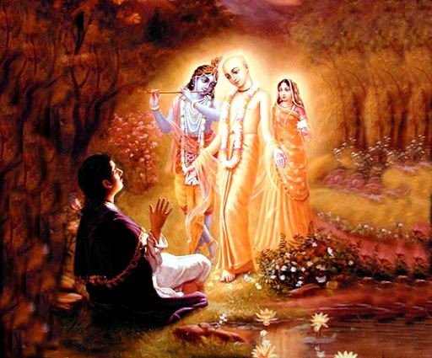

Mantra Jam
Shlokas from Vedic Scriptures
By Mother Prachi, evolve pune

Slide 2
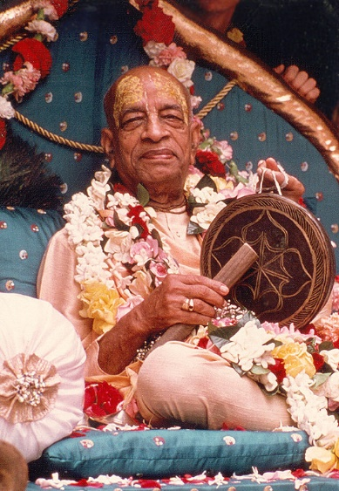
With the inspiration of
His Divine Grace
A.C. Bhaktivedanta Swami Srila Prabhupada
Founder Acarya of the International Society for Krishna Consciousness

Slide 3
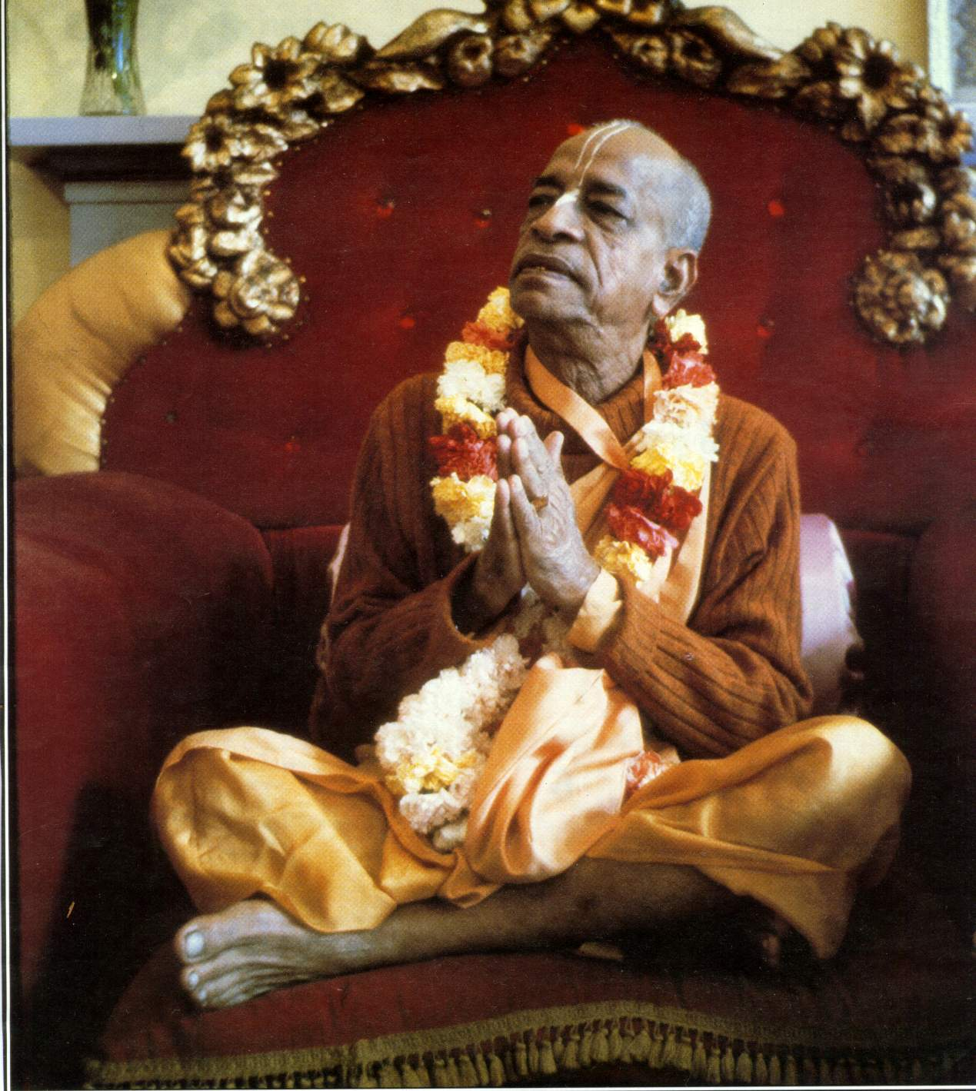
oà ajïäna-timirändhasya jïänäïjana-çaläkayä
cakñur unmélitaà yena tasmai çré-gurave namaù
I was born in the darkest ignorance, and my spiritual master opened my eyes with the torch of knowledge. I offer my respectful obeisances unto him.

Slide 4
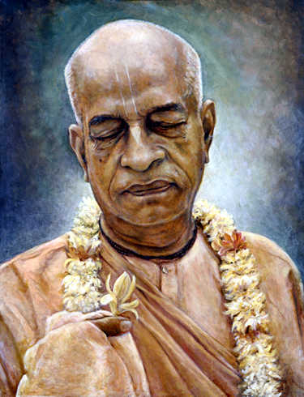
namah om vishnu-padaya krishna-preshthaya bhutale
srimati bhaktivedanta-svamin iti namine
I offer my respectful obeisances unto His Divine Grace A.C. Bhaktivedanta Swami Prabhupada, who is very dear to Lord Krishna, having taken shelter at His lotus feet.

Slide 5
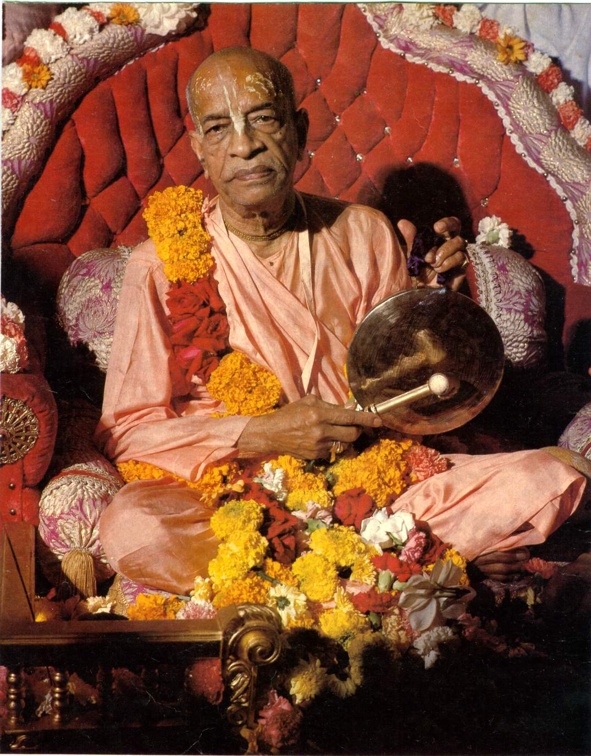
namas te sarasvate deve gaura-vani-pracharine
nirvishesha-shunyavadi-paschatya-desha-tarine
Our respectful obeisances are unto you, O spiritual master, servant of Sarasvati Goswami. You are kindly preaching the message of Lord Chaitanyadeva and delivering the Western countries, which are filled with impersonalism and voidism.

Slide 6
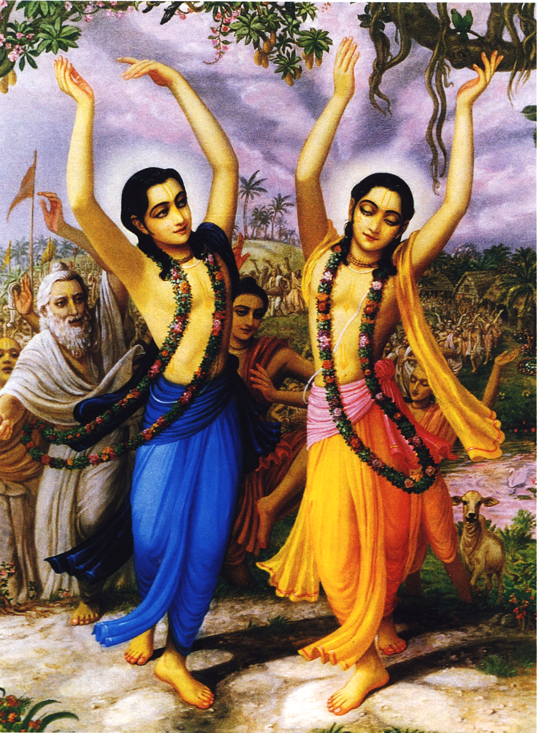
çré-kåñëa-caitanya
prabhu-nityänanda
çré-advaita gadädhara
çréväsädi-gaura-bhakta-vånda
I offer my obeisances to Çré Kåñëa Caitanya, Prabhu Nityänanda, Çré Advaita, Gadädhara, Çréväsa and all others in the line of devotion.

Slide 7
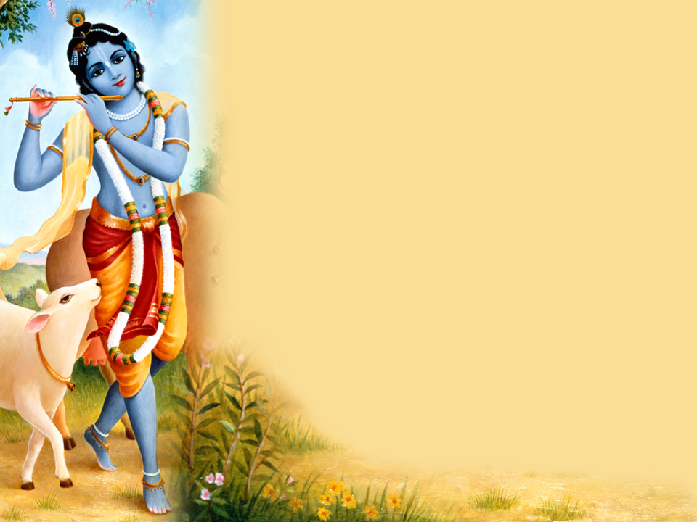
HARE KRISHNA HARE KRISHNA
KRISHNA KRISHNA HARE HARE
HARE RAMA HARE RAMA
RAMA RAMA HARE HARE

Slide 8
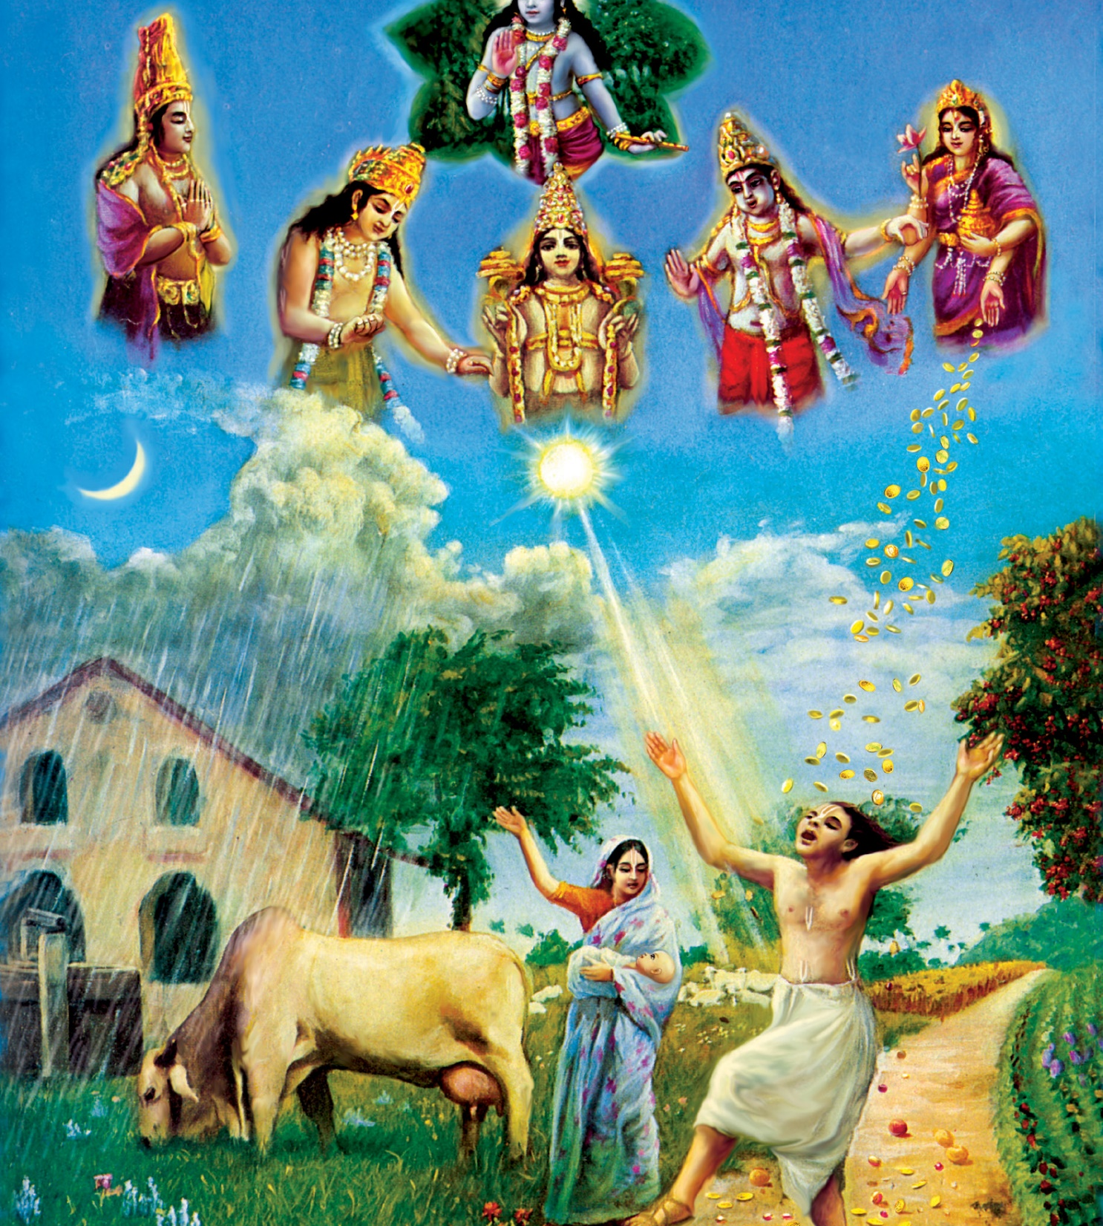
Lord Chaitanya Mahaprabhu’s Pastimes:
Worship of Krishna or Worship of Demi Gods

Slide 9
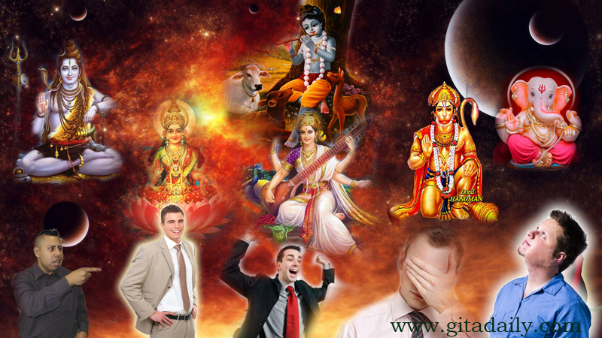

Slide 10
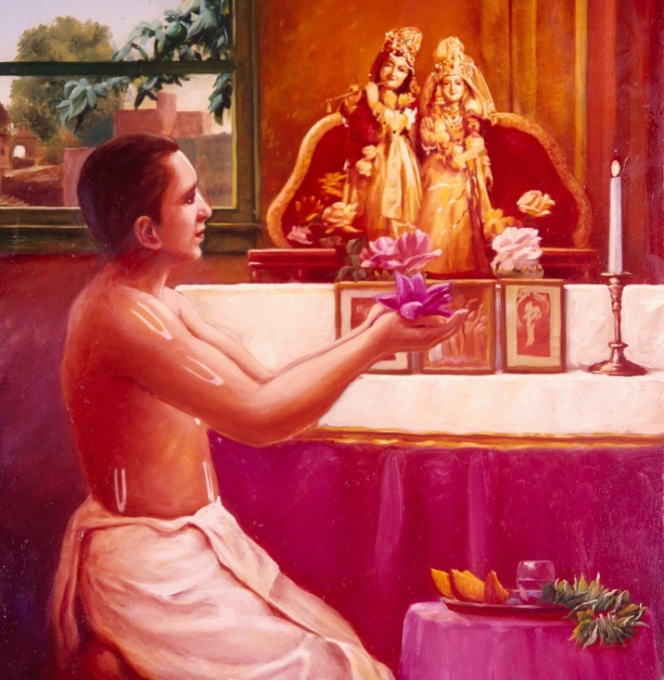
Bg. 7.23
अन्तवत्तु फलं तेषां तद्भ‍वत्यल्पमेधसाम् ।
देवान्देवयजो यान्ति मद्भ‍क्ता यान्ति मामपि ॥ २३ ॥ antavat tu phalaṁ teṣāṁ tad bhavaty alpa-medhasām devān deva-yajo yānti mad-bhaktā yānti mām api
Translation
Men of small intelligence worship the demigods, and their fruits are limited and temporary. Those who worship the demigods go to the planets of the demigods, but My devotees ultimately reach My supreme planet.

Slide 11
Bg. 9.23
येऽप्यन्यदेवताभक्ता यजन्ते श्रद्धयान्विता: ।
तेऽपि मामेव कौन्तेय यजन्त्यविधिपूर्वकम् ॥ २३ ॥ ye ’py anya-devatā-bhaktā yajante śraddhayānvitāḥ te ’pi mām eva kaunteya yajanty avidhi-pūrvakam
Translation
Those who are devotees of other gods and who worship them with faith actually worship only Me, O son of Kuntī, but they do so in a wrong way.

Slide 12
Worshipping Krishna or Worshipping Demigods
Supreme Lord Worship | Demi God Worship
Eternal & Permanent | Benedictions are temporary and perishable (Brahma, Shiva)
Worshipper is in the mode of goodness/ pure goodness | Worshipper is in the mode of passion or ignorance
Loving relationship | Give and Take relationship
Fully Independent | Dependent upon the Supreme Lord to give benediction
Like feeding stomach | Like feeding other body parts
Performed by most intelligent | Performed by less intelligent
Eg. – Parent (Loving) | Eg. Shopkeeper

Slide 13
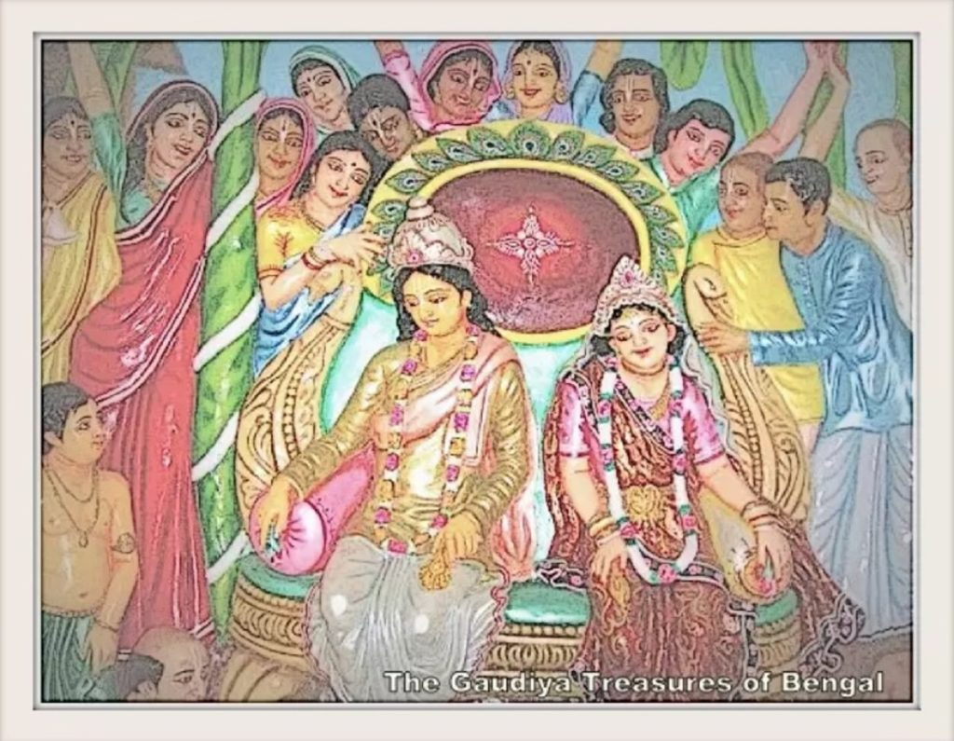
Lord Chaitanaya Mahaprabhu’s Wedding Passtimes

Slide 14
Quiz Time ☺ ☺☺

Slide 15



Thank you
Sublime Living
EVOLVE
High Thinking

