Slide 1
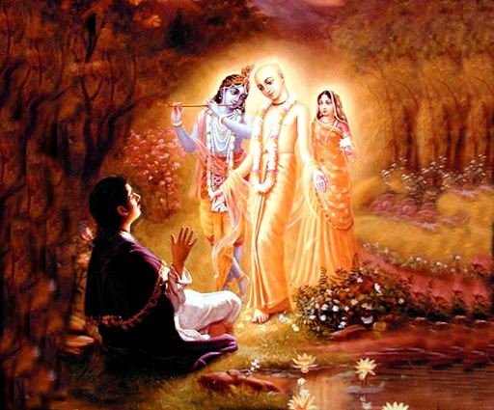

Mantra Jam
Shlokas from Vedic Scriptures
By Mother Prachi, evolve pune

Slide 2
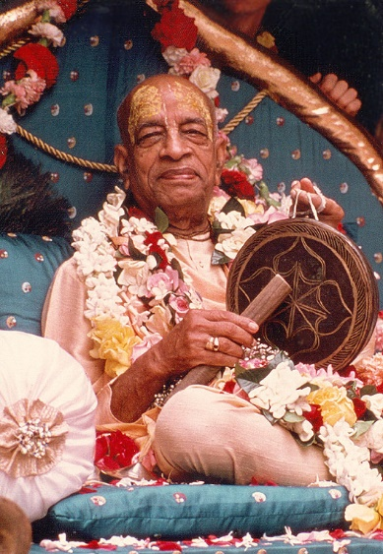
With the inspiration of
His Divine Grace
A.C. Bhaktivedanta Swami Srila Prabhupada
Founder Acarya of the International Society for Krishna Consciousness

Slide 3
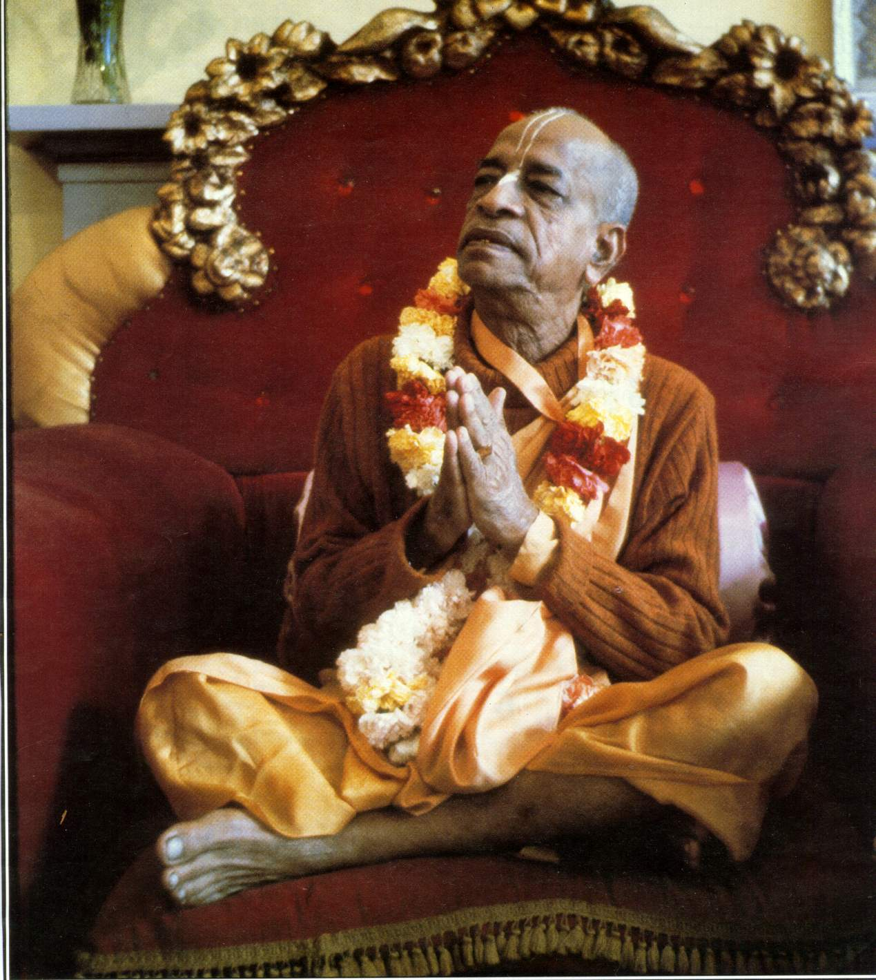
oà ajïäna-timirändhasya jïänäïjana-çaläkayä
cakñur unmélitaà yena tasmai çré-gurave namaù
I was born in the darkest ignorance, and my spiritual master opened my eyes with the torch of knowledge. I offer my respectful obeisances unto him.

Slide 4
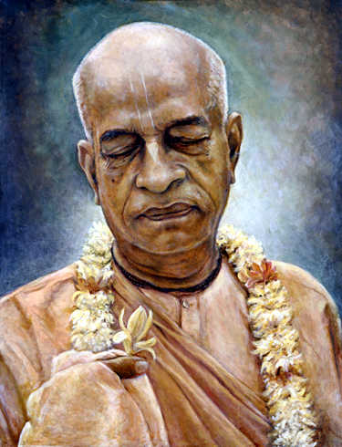
namah om vishnu-padaya krishna-preshthaya bhutale
srimati bhaktivedanta-svamin iti namine
I offer my respectful obeisances unto His Divine Grace A.C. Bhaktivedanta Swami Prabhupada, who is very dear to Lord Krishna, having taken shelter at His lotus feet.

Slide 5
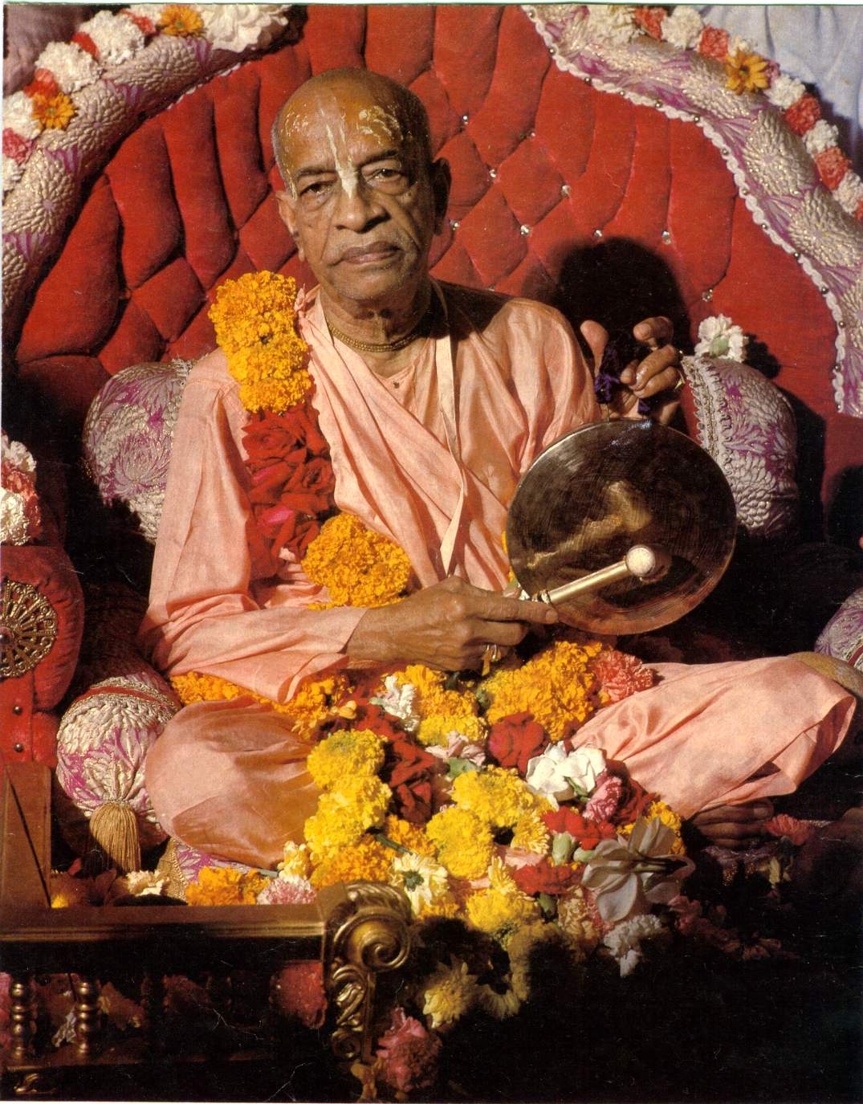
namas te sarasvate deve gaura-vani-pracharine
nirvishesha-shunyavadi-paschatya-desha-tarine
Our respectful obeisances are unto you, O spiritual master, servant of Sarasvati Goswami. You are kindly preaching the message of Lord Chaitanyadeva and delivering the Western countries, which are filled with impersonalism and voidism.

Slide 6
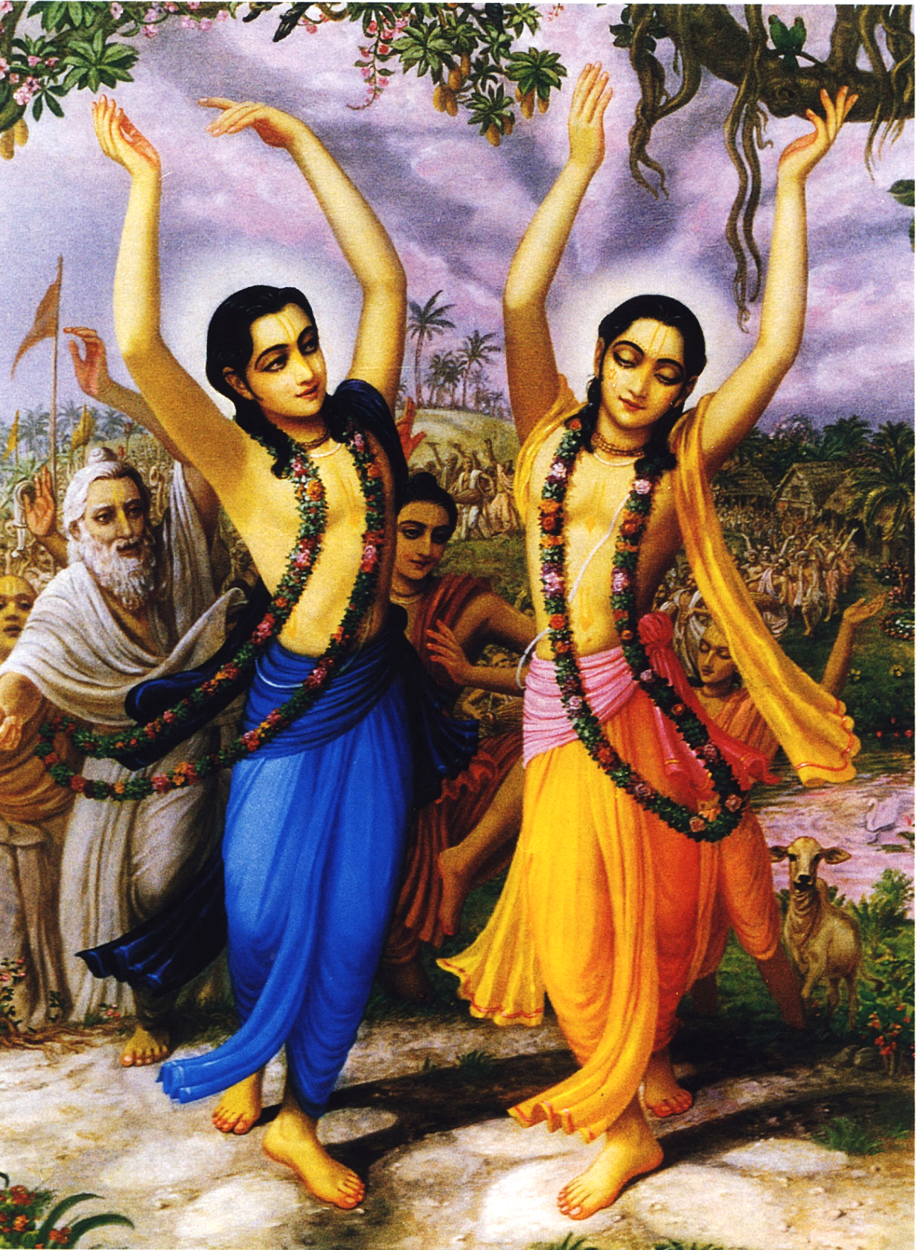
çré-kåñëa-caitanya
prabhu-nityänanda
çré-advaita gadädhara
çréväsädi-gaura-bhakta-vånda
I offer my obeisances to Çré Kåñëa Caitanya, Prabhu Nityänanda, Çré Advaita, Gadädhara, Çréväsa and all others in the line of devotion.

Slide 7
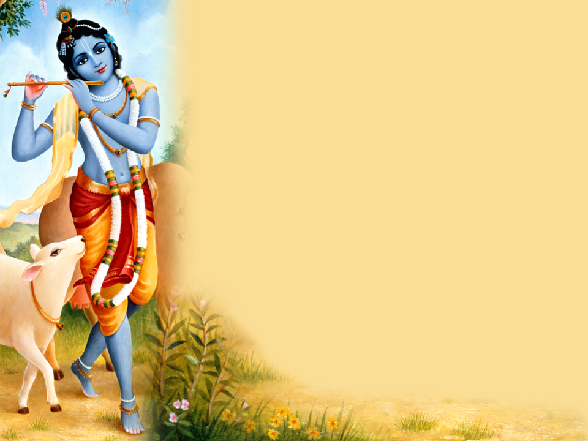
HARE KRISHNA HARE KRISHNA
KRISHNA KRISHNA HARE HARE
HARE RAMA HARE RAMA
RAMA RAMA HARE HARE

Slide 8
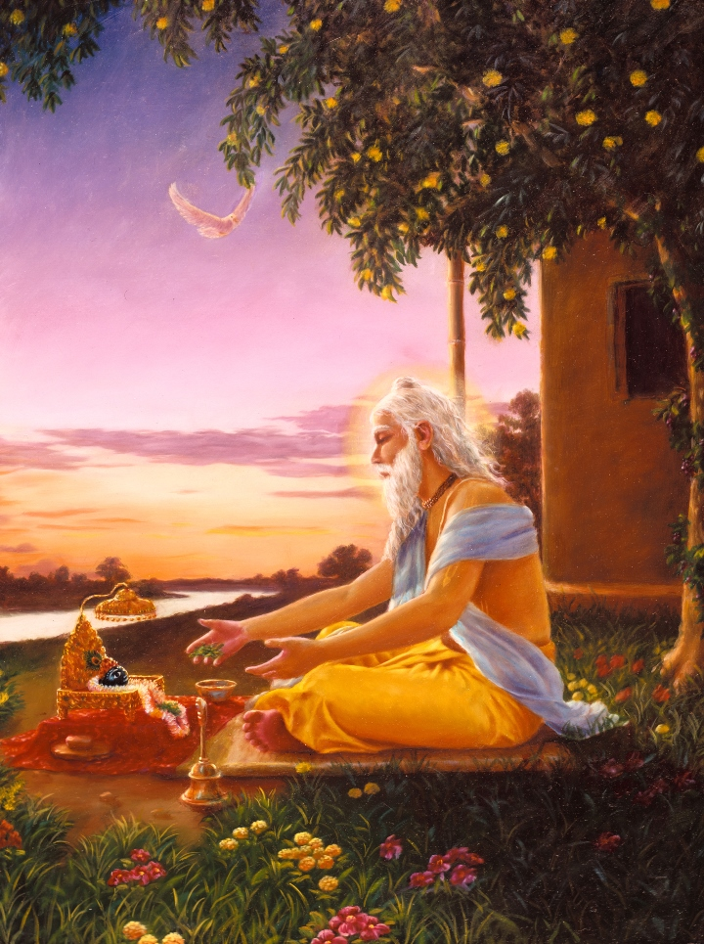
Sri Advaita Acharya Prayed to Lord for his Advent

Slide 9
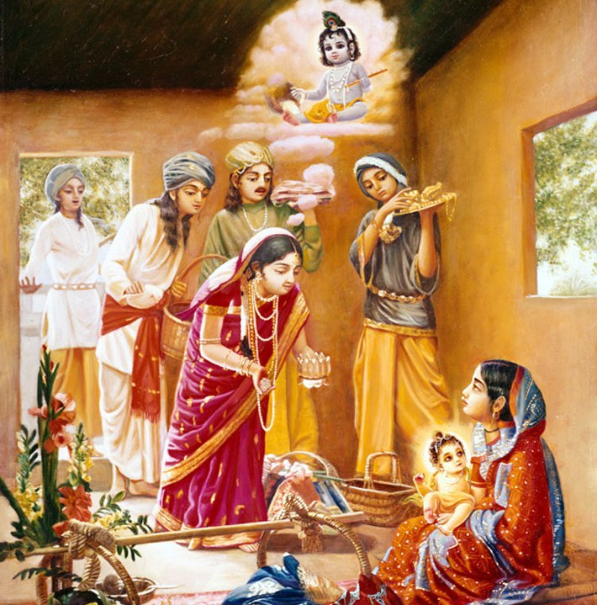
Lord Chaitanya Mahaprabhu with Sachi Mata

Slide 10
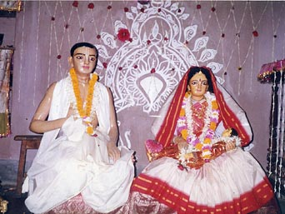
Lord Chaitanya Mahaprabhu with Sachi Mata

Slide 11
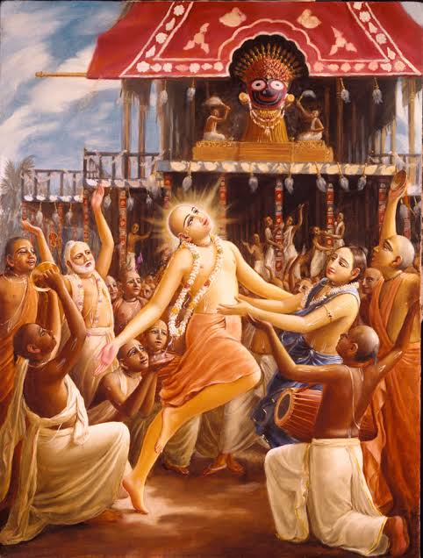
Bg. 8.5
अन्तकाले च मामेव स्मरन्मुक्त्वा कलेवरम् ।
य: प्रयाति स मद्भ‍ावं याति नास्त्यत्र संशय: ॥ ५ ॥ anta-kāle ca mām eva smaran muktvā kalevaram yaḥ prayāti sa mad-bhāvaṁ yāti nāsty atra saṁśayaḥ
Translation
And whoever, at the end of his life, quits his body remembering Me alone at once attains My nature. Of this there is no doubt.

Slide 12
Bg. 8.6
यं यं वापि स्मरन्भावं त्यजत्यन्ते कलेवरम् ।
तं तमेवैति कौन्तेय सदा तद्भ‍ावभावित: ॥ ६ ॥ yaṁ yaṁ vāpi smaran bhāvaṁ tyajaty ante kalevaram taṁ tam evaiti kaunteya sadā tad-bhāva-bhāvitaḥ
Translation
Whatever state of being one remembers when he quits his body, O son of Kuntī, that state he will attain without fail.

Slide 13
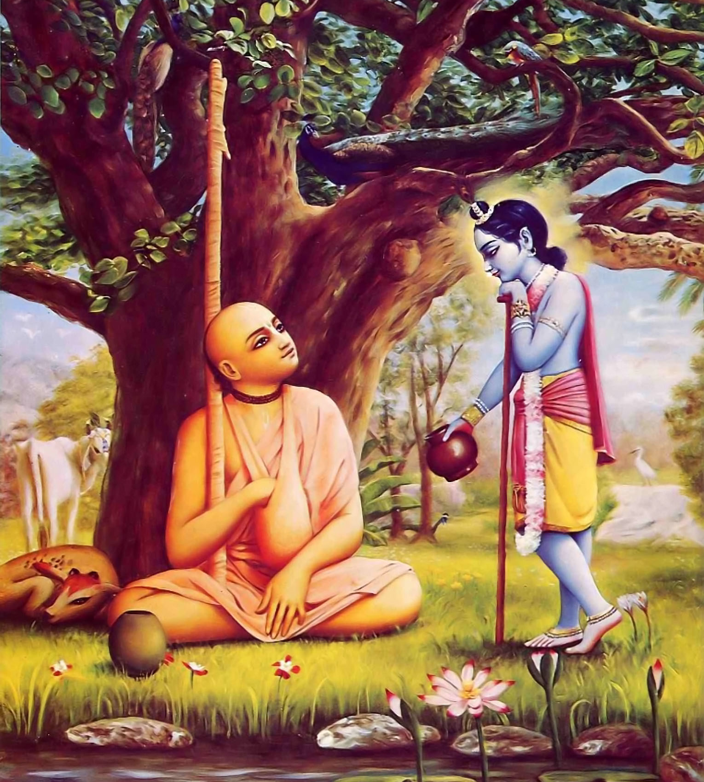
Bg. 9.34
मन्मना भव मद्भ‍क्तो मद्याजी मां नमस्कुरु ।
मामेवैष्यसि युक्त्वैवमात्मानं मत्परायण: ॥ ३४ ॥ man-manā bhava mad-bhakto mad-yājī māṁ namaskuru mām evaiṣyasi yuktvaivam ātmānaṁ mat-parāyaṇaḥ
Translation
Engage your mind always in thinking of Me, become My devotee, offer obeisances to Me and worship Me. Being completely absorbed in Me, surely you will come to Me.

Slide 14
https://kahoot.it/

Slide 15



Thank you
Sublime Living
EVOLVE
High Thinking

