Slide 1
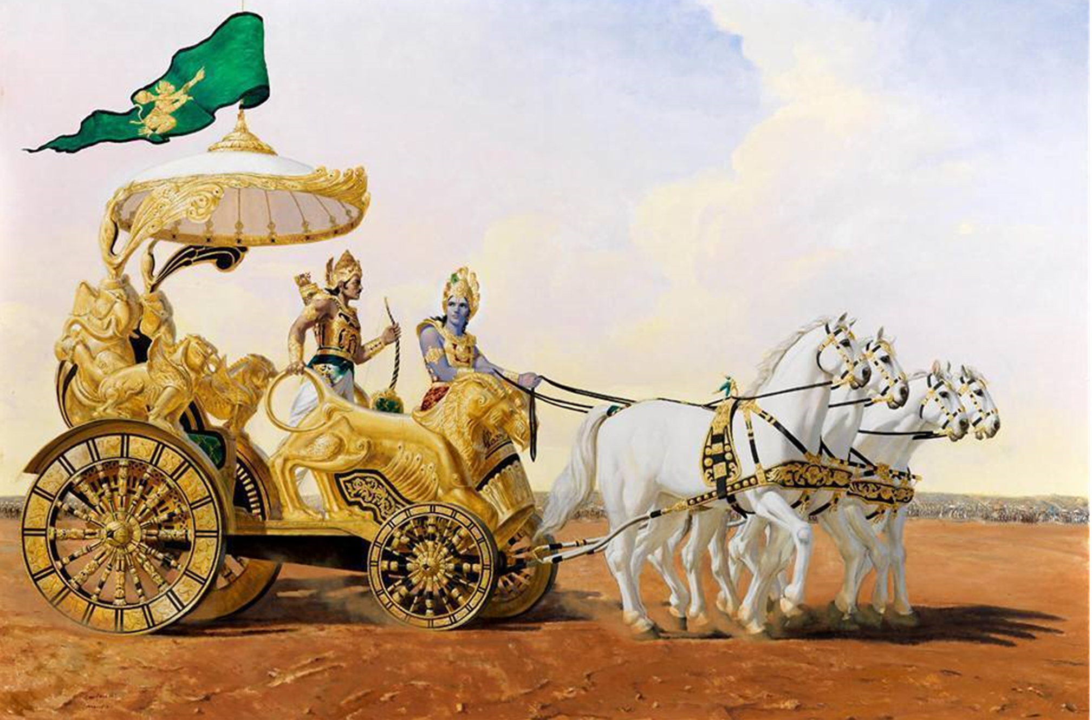
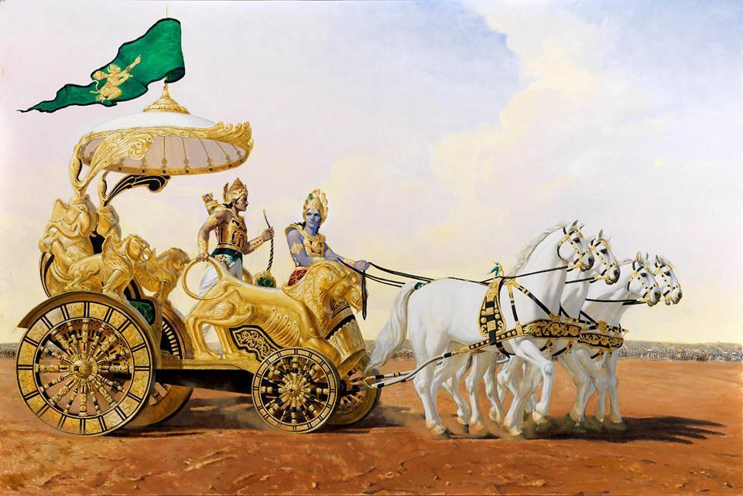

Mantra Jam
Shlokas from Bhagvad Gita
By Mother Prachi, evolve pune

Slide 2
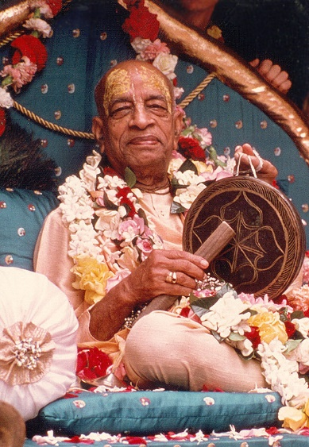
Based on the teachings of
His Divine Grace
A.C. Bhaktivedanta Swami Srila Prabhupada
Founder Acarya of the International Society for Krishna Consciousness

Slide 3
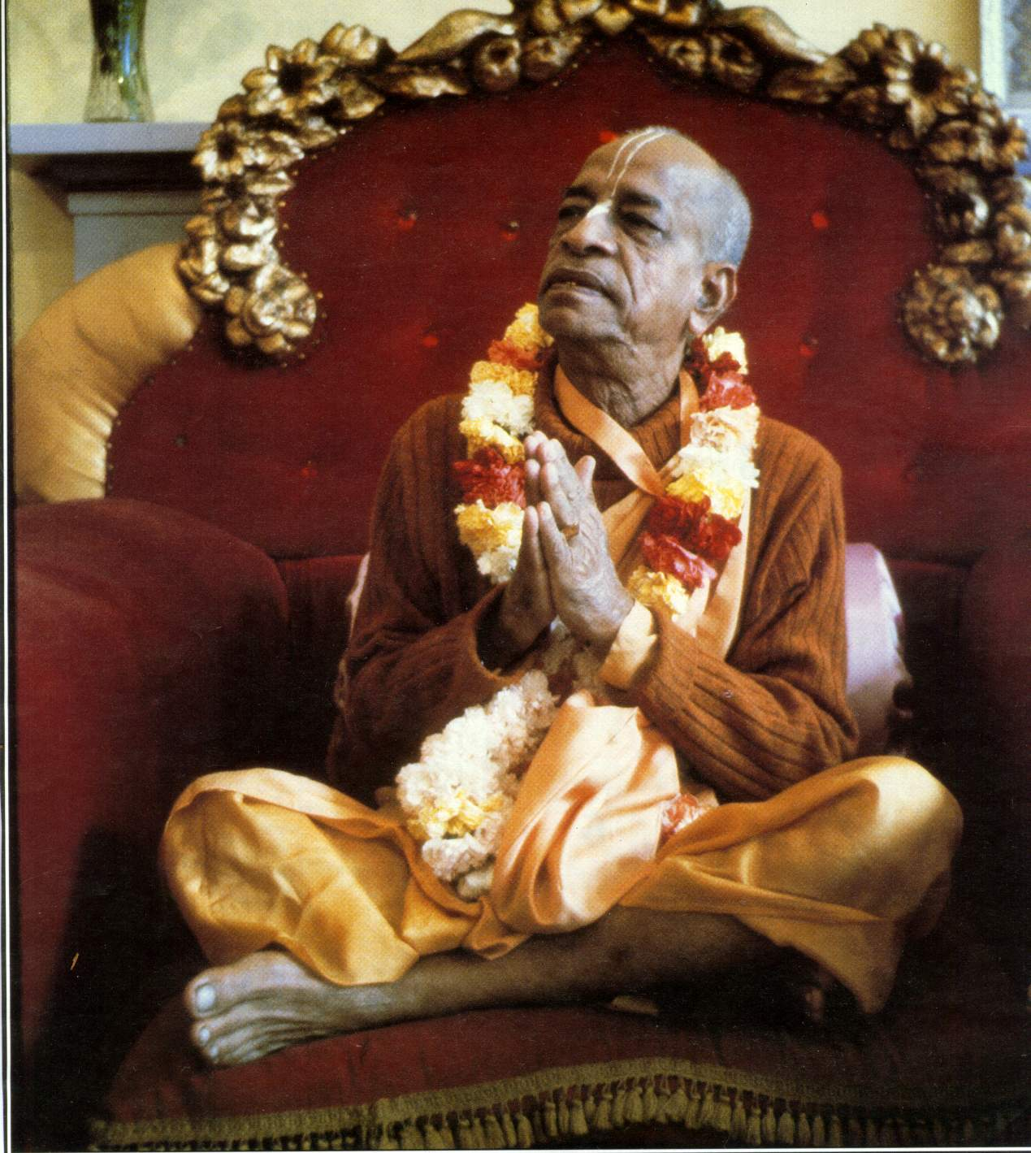
oà ajïäna-timirändhasya jïänäïjana-çaläkayä
cakñur unmélitaà yena tasmai çré-gurave namaù
I was born in the darkest ignorance, and my spiritual master opened my eyes with the torch of knowledge. I offer my respectful obeisances unto him.

Slide 4
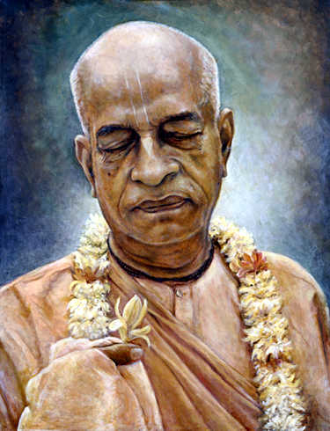
namah om vishnu-padaya krishna-preshthaya bhutale
srimati bhaktivedanta-svamin iti namine
I offer my respectful obeisances unto His Divine Grace A.C. Bhaktivedanta Swami Prabhupada, who is very dear to Lord Krishna, having taken shelter at His lotus feet.

Slide 5
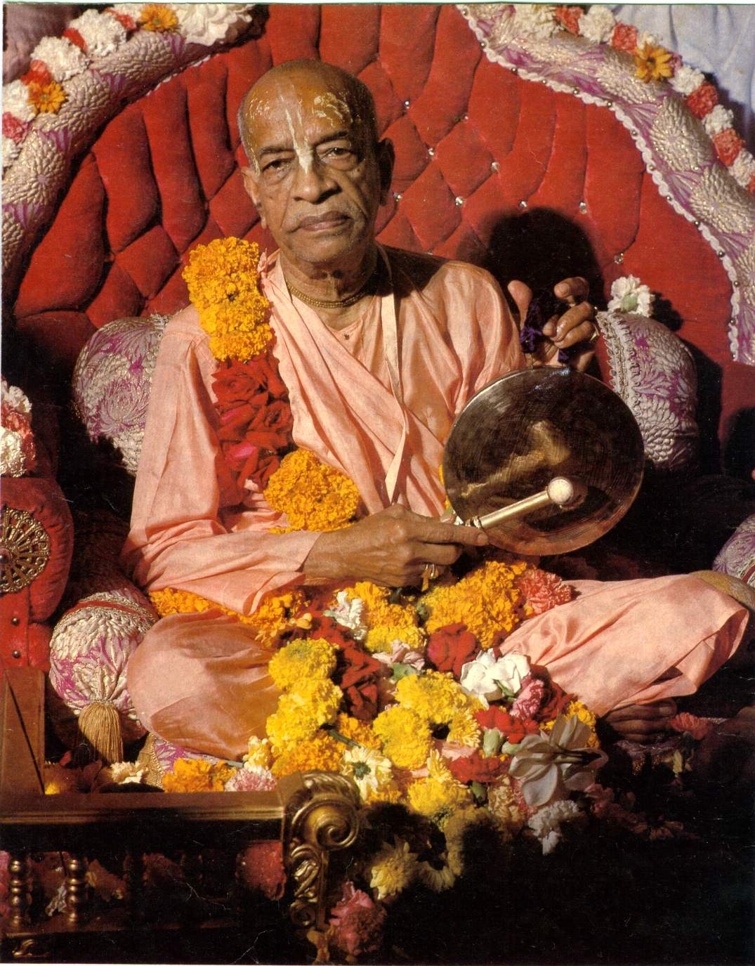
namas te sarasvate deve gaura-vani-pracharine
nirvishesha-shunyavadi-paschatya-desha-tarine
Our respectful obeisances are unto you, O spiritual master, servant of Sarasvati Goswami. You are kindly preaching the message of Lord Chaitanyadeva and delivering the Western countries, which are filled with impersonalism and voidism.

Slide 6
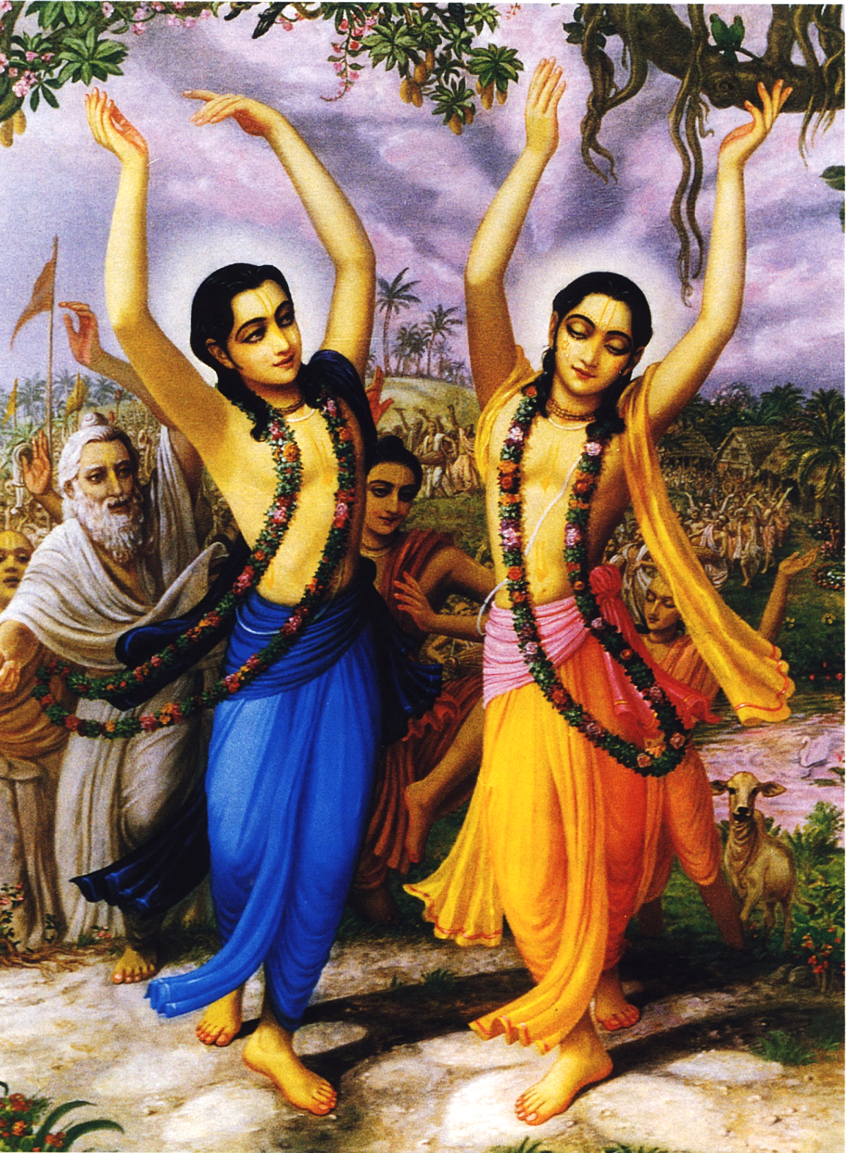
çré-kåñëa-caitanya
prabhu-nityänanda
çré-advaita gadädhara
çréväsädi-gaura-bhakta-vånda
I offer my obeisances to Çré Kåñëa Caitanya, Prabhu Nityänanda, Çré Advaita, Gadädhara, Çréväsa and all others in the line of devotion.

Slide 7
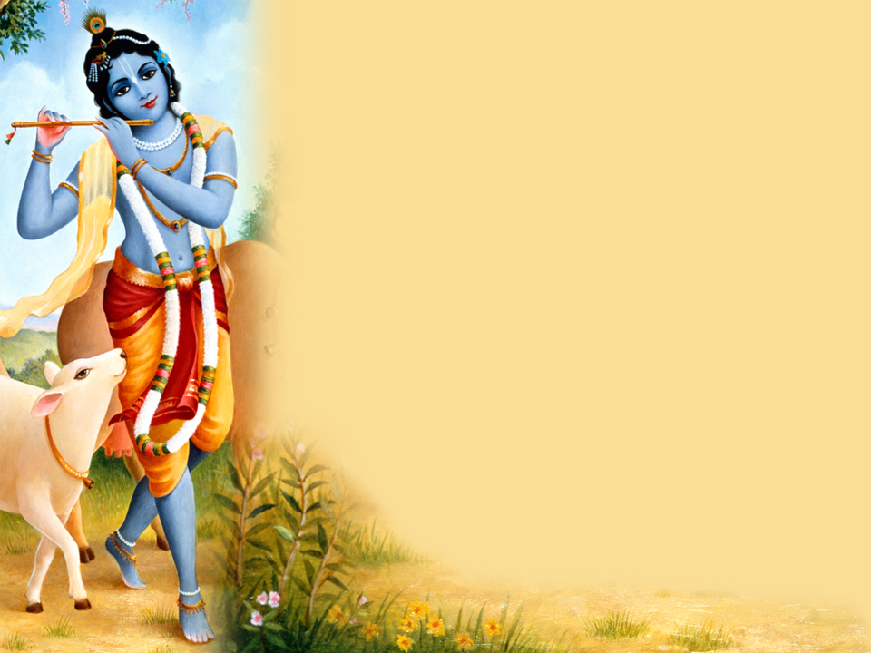
HARE KRISHNA HARE KRISHNA
KRISHNA KRISHNA HARE HARE
HARE RAMA HARE RAMA
RAMA RAMA HARE HARE

Slide 8
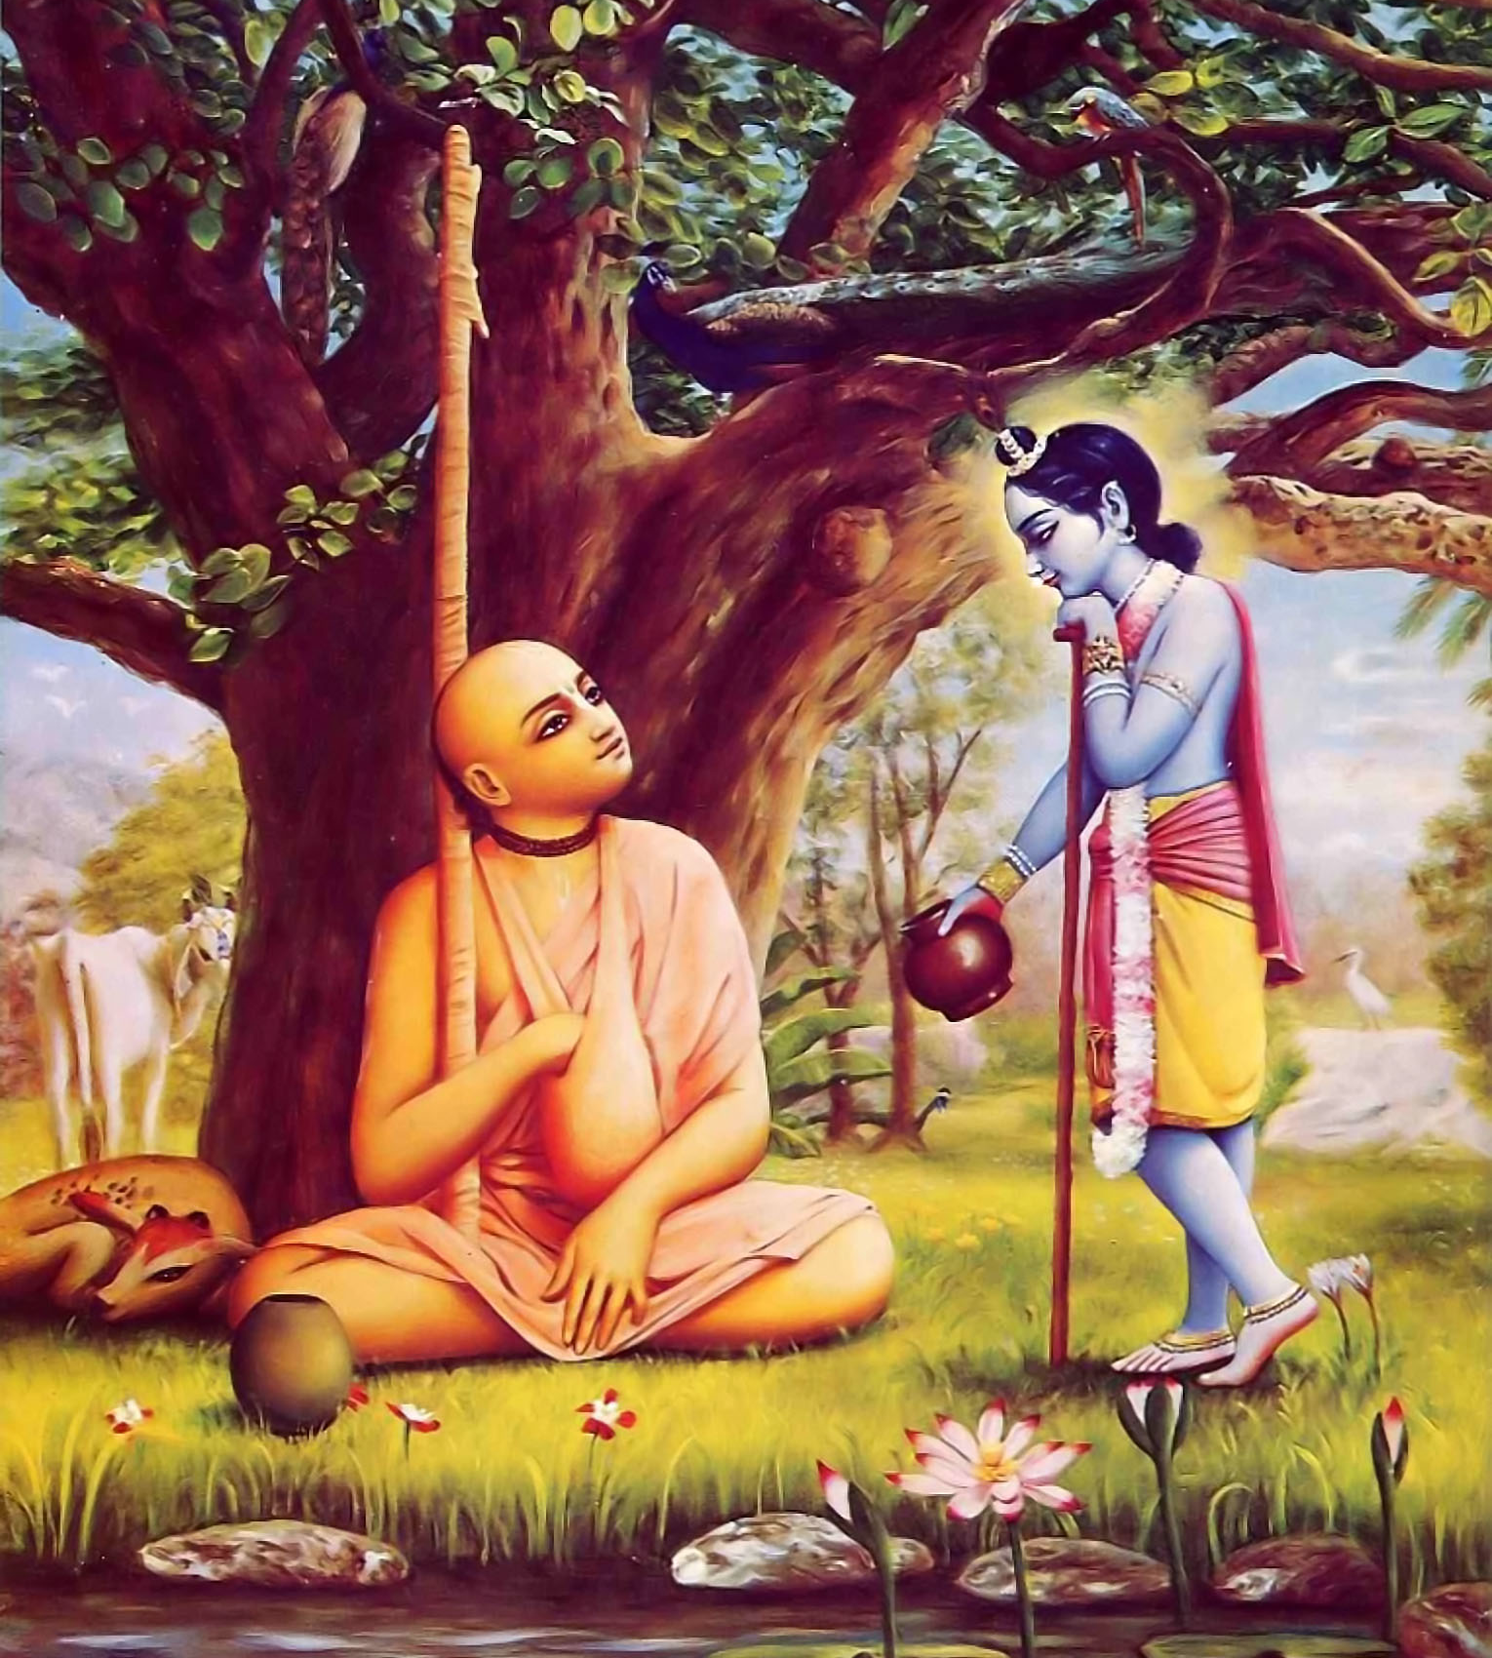
Bg. 3.9
यज्ञार्थात्कर्मणोऽन्यत्र लोकोऽयं कर्मबन्धनः ।
तदर्थं कर्म कौन्तेय मुक्तसङ्गः समाचर ॥ ९ ॥ yajñārthāt karmaṇo ’nyatra loko ’yaṁ karma-bandhanaḥ tad-arthaṁ karma kaunteya mukta-saṅgaḥ samācara
Translation
Work done as a sacrifice for Viṣṇu has to be performed; otherwise work causes bondage in this material world. Therefore, O son of Kuntī, perform your prescribed duties for His satisfaction, and in that way you will always remain free from bondage.

Slide 9
Bg. 9.22
अनन्याश्चिन्तयन्तो मां ये जना: पर्युपासते ।
तेषां नित्याभियुक्तानां योगक्षेमं वहाम्यहम् ॥ २२ ॥ ananyāś cintayanto māṁ ye janāḥ paryupāsate teṣāṁ nityābhiyuktānāṁ yoga-kṣemaṁ vahāmy aham
Translation
But those who always worship Me with exclusive devotion, meditating on My transcendental form – to them I carry what they lack, and I preserve what they have.

Slide 10
Bg. 9.22
अनन्याश्चिन्तयन्तो मां ये जना: पर्युपासते ।
तेषां नित्याभियुक्तानां योगक्षेमं वहाम्यहम् ॥ २२ ॥ ananyāś cintayanto māṁ ye janāḥ paryupāsate teṣāṁ nityābhiyuktānāṁ yoga-kṣemaṁ vahāmy aham
Translation
But those who always worship Me with exclusive devotion, meditating on My transcendental form – to them I carry what they lack, and I preserve what they have.

Slide 11
Bg. 9.26
पत्रं पुष्पं फलं तोयं यो मे भक्त्य‍ा प्रयच्छति ।
तदहं भक्त्य‍ुपहृतमश्न‍ामि प्रयतात्मन: ॥ २६ ॥ patraṁ puṣpaṁ phalaṁ toyaṁ yo me bhaktyā prayacchati tad ahaṁ bhakty-upahṛtam aśnāmi prayatātmanaḥ
Translation
If one offers Me with love and devotion a leaf, a flower, a fruit or water, I will accept it.

Slide 12
Bg. 9.27
यत्करोषि यदश्न‍ासि यज्ज‍ुहोषि ददासि यत् ।
यत्तपस्यसि कौन्तेय तत्कुरुष्व मदर्पणम् ॥ २७ ॥ yat karoṣi yad aśnāsi yaj juhoṣi dadāsi yat yat tapasyasi kaunteya tat kuruṣva mad-arpaṇam
Whatever you do, whatever you eat, whatever you offer or give away, and whatever austerities you perform – do that, O son of Kuntī, as an offering to Me.

Slide 13



Thank you
Sublime Living
EVOLVE
High Thinking

